Slide 1
Approach to toxicology

Slide 2
25 years male present after ingestion of 20 tap of paracetamol before one hour , he is fully conscious ,alert and vital signs are stable
Next step?

Slide 3
_ induce vomiting
_ gastric lavage
_ activated charcoal
_ extract blood for investigation and send for level at 4 hours

Slide 4
16 years female present with sever decrease in level of conscious after ingestion of large amount of epilepsy medication,
She is unconscious, normal BP and HR
Next step?

Slide 5
_ NG and gastric lavage
_ intubated and ventilated
_ CT brain
_ IV fluids

Slide 6
30 years K/C of depression came with tonic colonic SZ aborted with Benz , the patient intubated because of decrease level of conscious , BP 100/60 HR 160
Next step

Slide 7
_ CT brain
_ EEG
_ ECG
_ TOX screen

Slide 8
Overview
the overall mortality rate from drug overdose and poison exposure is 0.05 %.
the mortality rate for hospitalized patients is approximately 1 to 2 %.

Slide 9
poison exposures account for 5 to 10 percent of all emergency department visits and greater than 5 percent of adult intensive care unit (ICU) admissions .
The most commonly implicated poisoning exposures were due to analgesics .

Slide 10
General approach
Evaluation involves recognition that poisoning has occurred, identification of agents involved, assessment of severity, and prediction of toxicity.

Slide 11
TOXIC SYNDROMES
The term toxidrome refers to a syndrome of
Physical findings attributed to a specific class of toxins that can provide important clues to narrow the differential diagnosis

Slide 15
The general rules have many exceptions, and polydrug overdoses may result in overlapping and confusing mixed syndromes

Slide 16
Management is directed to the provision of supportive care, prevention of poison absorption, and, when appropriate, the administration of antidotes and enhancement of elimination of the poison .

Slide 17
Initial evaluation
_ airway
_breathing
_ circulation
_mental status
_ cardiac monitor
_ ECG

Slide 18
Diagnosis
History :
_ unreliable
_ should be always correlated to symptoms and signs.
_ paramedics , polices and family member are important source of history.

Slide 19
Physical examination:
Vital signs
Vital signs
Vital signs

Slide 20
ECG:
_should be performed in all patients.
_ provide diagnostic and prognostic information.

Slide 21
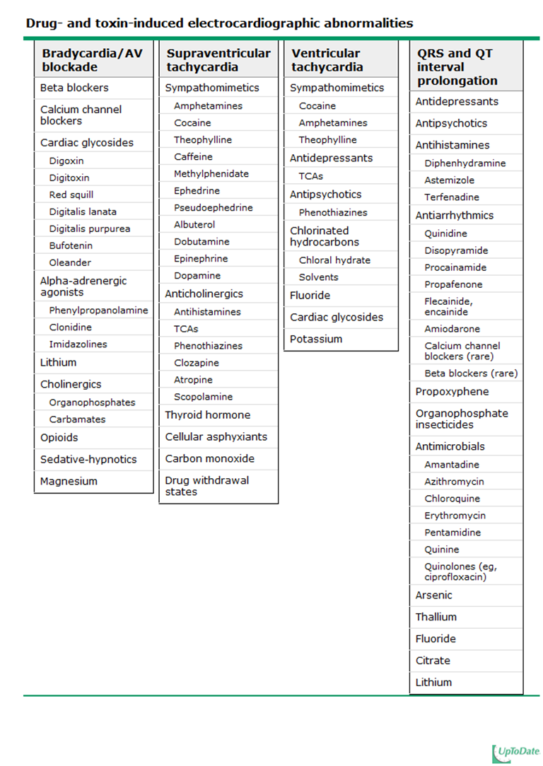

Slide 22
Radiologic studies:
_ not in all patients.
_ certain radiopaque toxins (CHIPES) may be visualized in plain films
_ ARDS

Slide 23
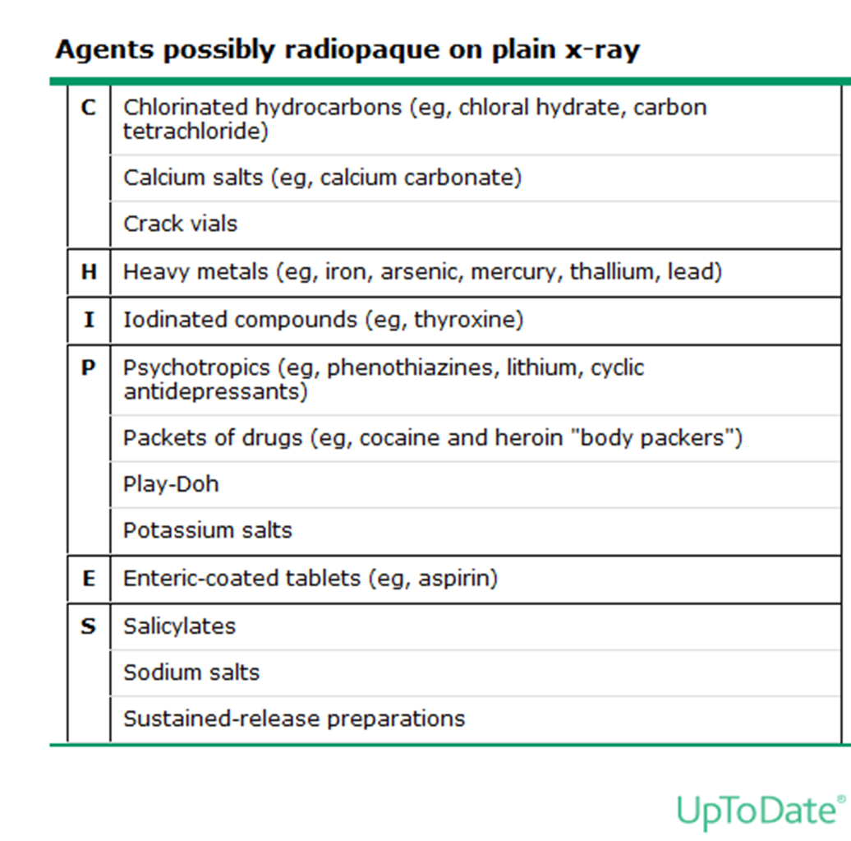

Slide 24
Toxic screen :
_ salicylates and acetaminophens .
_ drug of abuse
_ negative or positive results do not absolutely confirmed or exclude diagnosis.

Slide 25
Lab test:
_osmolar gap
_ anion gap
_ saturation gap

Slide 26
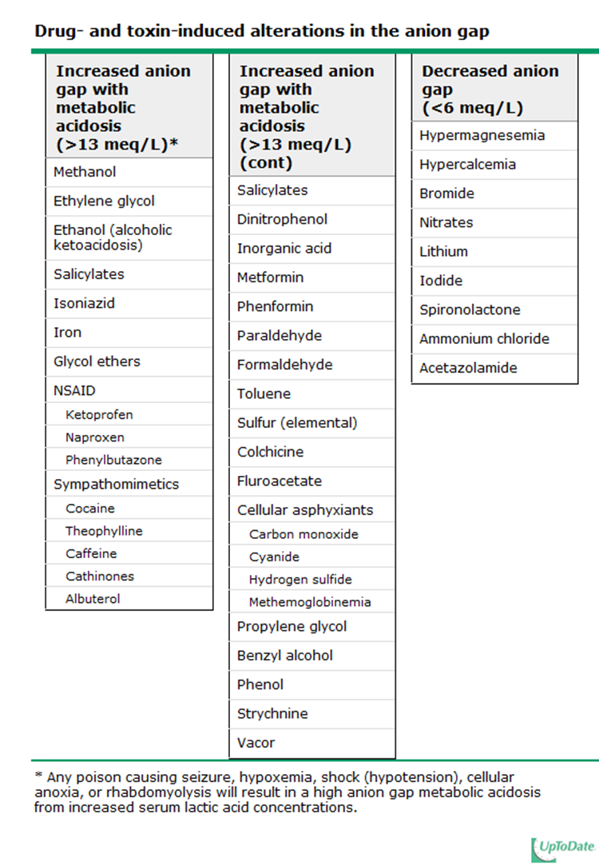

Slide 27
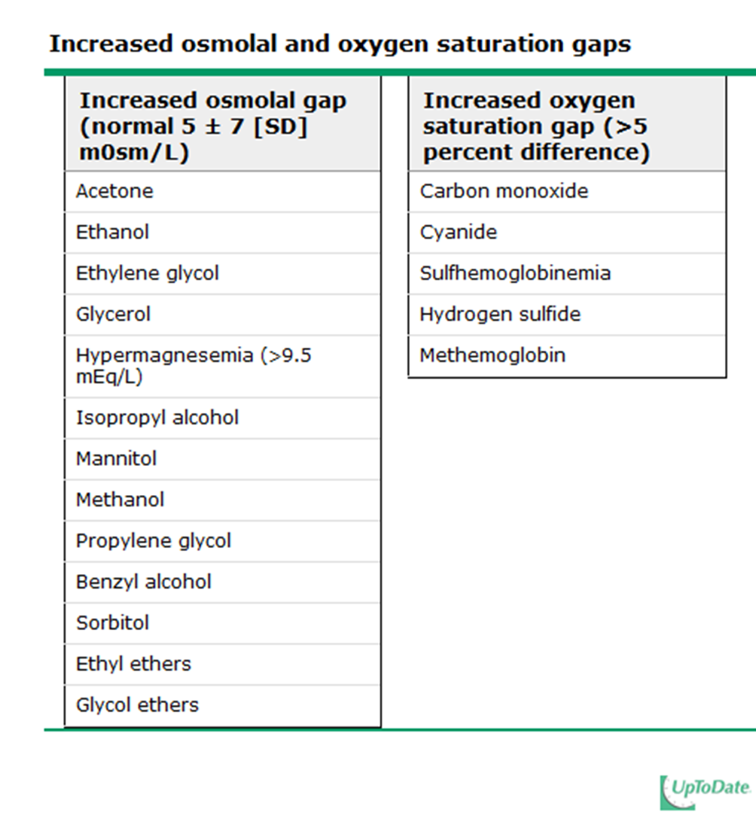

Slide 28
MANAGEMENT
Optimal management of the poisoned patient depends upon the specific poison(s) involved, the presenting and predicted severity of illness, and time between exposure and presentation.

Slide 29
Treatment variably includes supportive care, decontamination, antidotal therapy, and enhanced elimination techniques.

Slide 30
Decontamination:
The sooner decontamination is performed, the more effective it is at preventing poison absorption.

Slide 31
activated charcoal may decrease drug absorption even if it is given hours after ingestion, it has not been proved to improve outcome.

Slide 32
It might be considered in selected high-risk cases to prevent absorption when the patient is still likely to have a toxic amount of a drug or chemical in the gastrointestinal tract that is known to be absorbed by charcoal.

Slide 33
Gastric lavage should be only consider in patient present with toxic lethal dose in first one hour after exposure with protected airway

Slide 34
Whole-bowel irrigation with a polyethylene glycol solution is sometimes recommended by for overdose of metals such as iron and lead, in patients with ingestion .
for the evacuation of drug packets from body packers or body stuffers

Slide 35
Exposure of the eye to caustic chemicals and irritants requires immediate irrigation with large amounts of water or readily available fluids

Slide 36
Antidotes :
Antidotes dramatically reduce morbidity and mortality in certain intoxications, but they are unavailable for most toxic agents and therefore are used in only about 1 percent of cases .

Slide 37
They may prevent absorption, bind and neutralize poisons directly, antagonized-organ effects, or inhibit conversion to more toxic metabolites.

Slide 38
_ N-Acetylcysteine
_ naloxone
_ NAHCO3
_ deferoxamine
_ methylne blue

Slide 39
Enhanced elimination techniques :
Procedures to enhance elimination of poisons include forced diuresis, hemodialysis, hemoperfusion, hemofiltration, and exchange transfusion.

Slide 40
Supportive care :
Supportive care is the most important aspect of treatment .

Slide 41
Supportive care for the poisoned patient is generally similar to that utilized for other critically ill patients, but certain issues are managed slightly differently.

Slide 42
Intubation :
_ depress mental status.
_ risk of aspiration
_ sever acidosis
_ before gastric lavage
_ respiratory failure

Slide 43
Hypotension :
_ normal saline
_ vasopressor

Slide 44
VT:
NAHCO3
Bradyarrhythmias :
should be treated in the standard fashion with atropine or temporary pacing.
, in patients with calcium channel blocker or beta blocker intoxication, the administration of calcium and glucagon is the treatment

Slide 45
Seizures:
are best treated with benzodiazepines followed by barbiturates if necessary.

Slide 46
Drug-associated agitated behavior :
generally best treated with benzodiazepine administration, supplemented with high potency neuroleptics (eg,haloperidol) as needed.

Slide 47
Disposition
Patients who develop only mild toxicity and who have only a low predicted severity can be observed in the emergency department until they are asymptomatic.
An observation period of four to six hours is usually adequate for this purpose.

Slide 48
Patients with moderate observed toxicity or those who are at risk for such on the basis of history or initial laboratory data should be admitted to an intermediate-care floor or an appropriate observation unit for continued monitoring and treatment.

Slide 49
summary
_ common ED problem
_ look for toxidromes
_ A B C
_ all patients get ECG

Slide 50
_ ASA & acetaminophen levels
_ antidotes
_ calculate the gabs
_ supportive treatment

Slide 51
THANXS

