Slide 1


Slide 2


Slide 3
PULMONARY EMBOLISM
By
Dr Waqar
MBBS, MRCP
ASST. PROFESSOR

Slide 4
DEFINITION
Blockage of a pulmonary vessel by a clot is
called Pulmonary Embolism.
( Remember! Embolism may also be due to air, fat, amniotic fluid)
* Air embolism: eg. air in iv line
* Fat embolism: eg.release of fat from the
long bones after fracture.

Slide 5
ETIOLOGY & RISK FACTORS
Most P.Es arise from DVT of the legs, so etiology & risk factors are the same as for DVT.
DVT in the popliteal vein, thigh veins or pelvic veins is called “proximal DVT”.
DVT below the knee is called “distal DVT.”
Chance of P.E. is much higher with proximal DVT.
Rarely, thrombosis in the arms or right ventricle can also cause P.E.

Slide 6
Risk Factors For DVT/P.E.
Prolonged bed rest due to any cause
Hypercoagulable disorders:
* Protein C & S deficiency
* Nephrotic syndrome
3) Pregnancy
4) Cancers (release hypercoagulable factors)
5) CHF 6) Long air travel
7) Estrogen containing oral contraceptives
Trauma to the legs
Idiopathic
In all the above, increased risk of DVT & so, P.E.

Slide 7
What Can Happen From An Embolus?
1)P.E. causes blockage of blood flow to the lung
tissue area is ventilated but no perfusion.
The affected area can also become an infarct.
2) The amount of damaged lung tissue depends on
the size of the embolus:
* Small embolus will block a small peripheral
vessel so minimal or no symptoms
* Medium embolus S/S present
* Massive embolus blocks the main pulmonary
artery & can be fatal immediately( sudden death)

Slide 8
Signs & Symptoms
1) Very small emboli can be asymptomatic
2) Small & Medium Emboli:
* Chest pain ( sudden onset)
* Dyspnea, tachypnea
* Anxiety & restlessness
* Hemoptysis if infarction of lung
* Localized pleural rub tissue occurs
* Tachycardia/ A.Fib. ( P.E. often presents as
new onset A.Fib.

Slide 9
3) Massive P.E.: A medical emergency. A large
embolus obstructs the main pulm. Artery or its
large branches.
* Severe chest pain, tachycardia & dyspnea
* Pale & sweaty * Shock ( due to low BP)
* Sudden right heart failure raised JVP
* Cyanosis
* May even present with syncope or death
4) S/S of DVT may be present in the legs
5) Multiple small & recurrent emboli can
present as pulmonary HTN (eg. in cancer pts.)

Slide 10
What we do before Investigations?
Before doing investigations, we see how high is the chance of P.E., based on the overall scenario. This is called “pre-test clinical probability”. It helps to decide which tests to do first & then interpret the results of those tests.
Two methods are used to assess clinical probability: Geneva score & Well’s score.
Points are given according to S/S, pulse, age etc.
The final score gives an idea about the chance of P.E. ( low, intermediate or high probability)

Slide 11
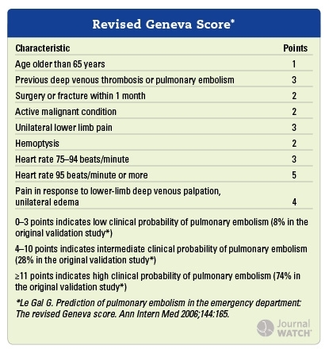
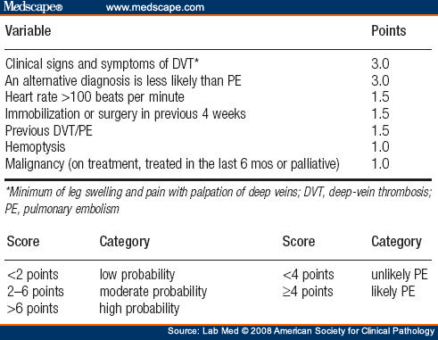
Lets see who can remember these
Geneva Score
Well’s Score

Slide 12

CAN YOU REMEMBER THE SCORES?
I CAN’T !
( No need to memorize, just have an idea)

Slide 13
INVESTIGATIONS
CXR C.T/MRI V/Q scan Plasma D dimers
of lungs
+
some other investigations
Chest X-Ray:
* Decreased vascular markings beyond the clot
(Westermark’s sign)
* Wedge shaped opacity adjacent to the pleura,
in case of infarction ( Hampton’s hump)
* CXR is normal in many cases, but helps to see
other diseases also( eg Pneumothorax)

Slide 14
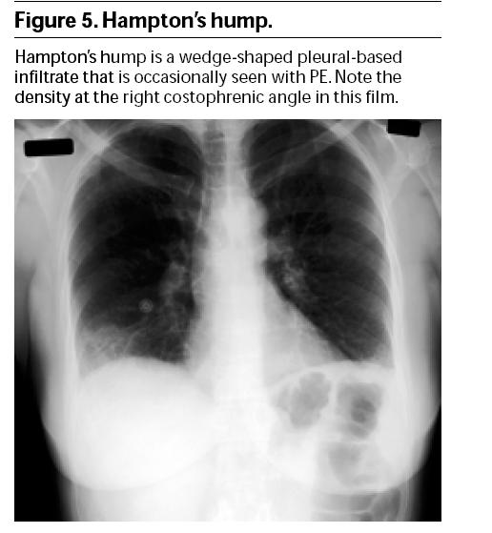
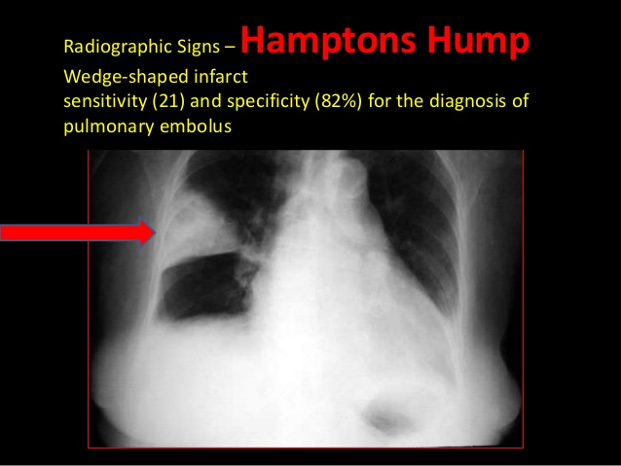
CXR IN P.E.
Hampton’s hump
Hampton’s hump

Slide 15
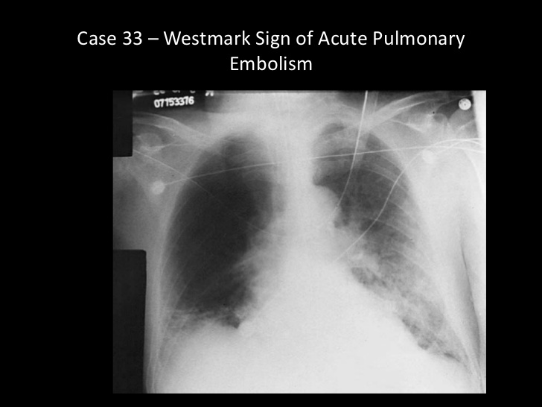
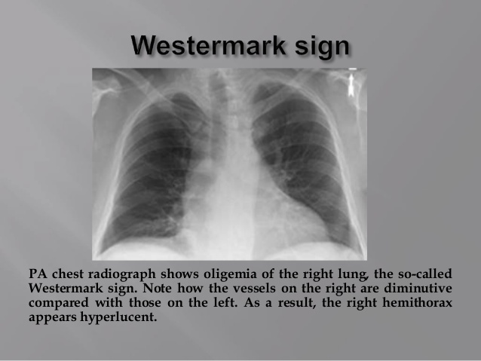
CXR IN P.E.
Westermark Sign
Westermark Sign

Slide 16
Investig. contd
2) C.T. w/ pulmonary angiogram (CTPA)
* i.v. contrast is injected & then lung mages are
taken by C.T. scan
Often the first test done in P.E. &
increasingly being used as the test of choice
* Has replaced the “old” angiogram.
* Easy to do, quick, non-invasive
* Other lung pathology can also be seen
Disadvantage: Smaller emboli can not be seen
& it cannot differentiate b/w old & new P.E.

Slide 17
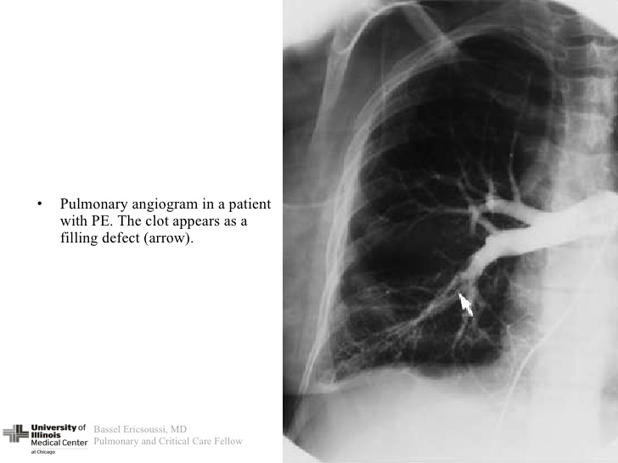
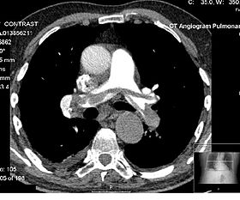
Old conventional Pulmonary angiogram
CTPA

Slide 18
INVESTIG. contd
3) V/Q Scan : (Ventilation/Perfusion scan)
* Normally, there is ventilation + perfusion in the
lungs.
In P.E., ventilation is OK, but no perfusion in
the affected area. This is called V/Q mismatch
or ventilation-perfusion defect.
In V/Q scan, we take pictures of the lung after
inhaling a radiolabelled gas, Xenon,( for the alveoli) &
giving i.v. dye, Technetium( for the pulm. vessels).
In P.E., the scan shows areas of normal
ventilation but no perfusion ( V/Q mismatch)

Slide 19
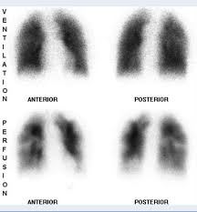
A V/Q SCAN

Slide 20
Contd.
Scan results are one of the following:
High probability for P.E.
Intermediate probability in (b) & © decision
Low probability becomes difficult
Normal : P.E. excluded

Slide 21
Investig. (contd)
4) Plasma D-dimers:
These are fibrin degradation products( FDP)
which are formed when a clot dissolves.
In P.E., D-dimer levels are raised.
Not specific for P.E., coz they are raised in other conditions also ( D.IC., old age, cancers)
OTHER INVESTIGATIONS
Lower limb doppler ultrasound to see DVT
ECG: May be normal or shows the following:
* Sinus tachycardia * New atrial fibrillation
* Right bundle branch block

Slide 22
Investig. (contd)
3) ABG: May show *hypoxia( low O2), *resp. ?
So, the diagnosis of P.E. is based on :
Assessing the signs & symptoms & deciding
about the “pre-test” clinical probability
THEN
2) Deciding about which tests to do & then inter-
-preting the results of those tests
GENERALLY SPEAKING, THE PREFERRED TEST IS
C.T. ANGIOGRAM ( CTPA)

Slide 23
MANAGEMENT
Anticoagulation with i.v. heparin or LMWH
(low molecular wt. heparin), followed by
oral anticoagulants eg warfarin or the newer agents
“riva- roxa- ban”
2) Duration of Anticoagulation: Generally, 3-6 months
2) If there is high risk of recurrent P.E. (eg. in
cancer patients), anticoagulation is given for
longer time, may be forever.
3) In massive P.E. with shock & hypotension, give
thrombolytic therapy (alteplase tpA) or
surgical removal of the clot.

Slide 24
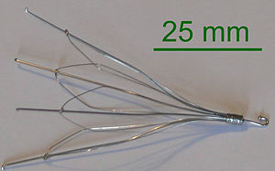
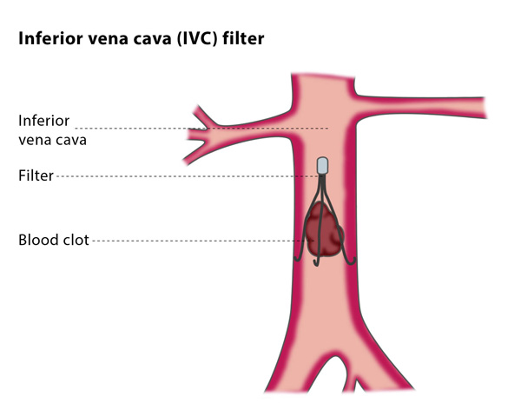
Treatment contd.
4) If anticoag. is C/I, then i.v.c. filter is placed to
prevent the clot going up into the lungs.

Slide 25
Other Supportive Treatment
a) O2
b) Morphine : To relieve pain & anxiety
Afte completing the 3-6 month warfarin course, long term low dose aspirin reduces the risk of DVT/P.E.

Slide 26
Prevention of DVT /P.E.
Avoid prolonged immobilization (if possible)
Quick Ambulation after surgery (if possible)
In immobilized patients, give s.c. heparin for prophylaxis.
During long air travel, avoid dehydration & do frequent leg movement.
Patients wth a history of DVT/P.E., may benefit from heparin prophylaxis during periods of increased DVT risk. (eg during pregnancy)

Slide 27

THANK YOU
&
KEEP SMILING

