Slide 1
Triage concept
Dr.Ahmad El-Bashir
ED Consultant KFMC
Assistant Prof. KSU
Course Director
Triage course

Slide 2
Case scenario
30 years old male known asthmatic presented to ED with history of SOB of 3 hours duration looks in severe distress , tachypnic , diaphoretic , decrease level of consciousness unable to give history

Slide 3
Important questions ?
When this patient will be seen in ED ?
In which part of ED he will be seen ?
Who will take the decision ?
Triage

Slide 4
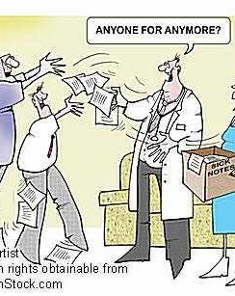
What is especial
Open doors
Broad spectrum
Who is coming
Time factors
Safety
Medico-legal issues
Infection exposure

Slide 5
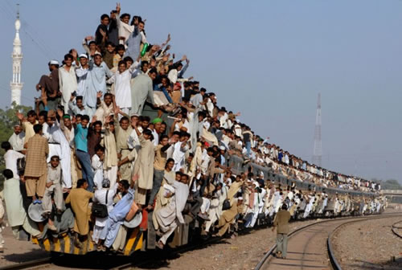
Open door
No schedule
Who is coming
How many
What is the presentation
Whom to see first

Slide 6

Broad spectrum
Seriously ill patients
Simple cases
Need emergency intervention
Need other services

Slide 7
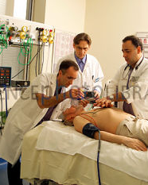
Time factor
Golden hours
Life saving intervention
Short time of management
Patients flow

Slide 8
Time Factor affect
Mortality
Morbidity

Slide 9
Pre-existing System Ensure
One language
Standard Level of service
Facilitate Auditing
Decrease triage time
Facilitate decision making
Triage course

Slide 10
Time to physician
Is an Ideal goal
First contact with the physician
Indicate actual time of management decision and intervention
Triage course

Slide 11
ED & Time Goals
Factors that determine how well ED can meet the time goals :
Bed availability
Diagnostic and therapeutic resources
Adequacy of staffing
System design
Efficiency of care processes
Ability to transfer patients
Extent of overcrowding.
Triage course

Slide 12
Appropriate place of management reflected by
Needs for immediate intervention
Needs for continuous monitoring
Nurse to patient ratio

Slide 13
Now !!!
Do we really need Triage in ED ??

Slide 14
To answer this question let us remember
What is the primary objective of ED ?
To manage life-threatening condition in a proper time and place
What is the first step in management
Identify the patient as life-threatening

Slide 15
Efficient management of the ED requires a team of providers capable of
Correctly identifying patients needs
Setting priorities and
Implementing appropriate, investigation & treatment
Proper disposition

Slide 16
Yes-Yes-Yes
Triage process is an essential station , and play a major role in management of patients in ED

