Slide 1
Severe Sepsis and Septic Shock
Abdullah Alsakka
EM.Consultant

Slide 2


Slide 3
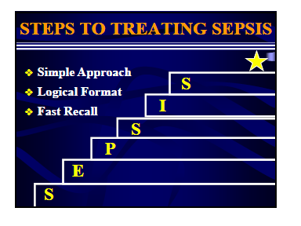

Slide 4
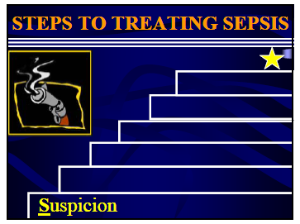

Slide 5
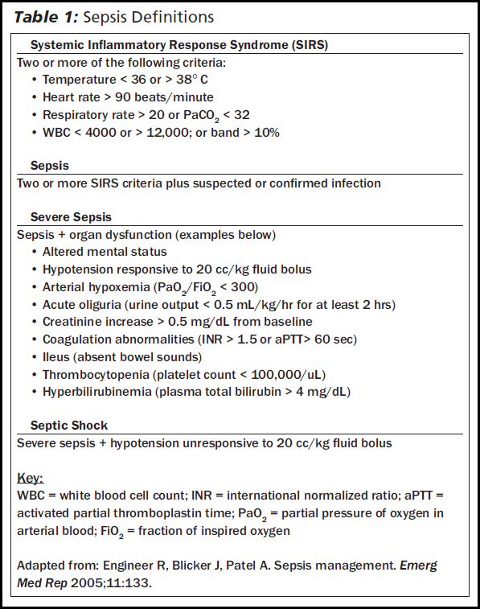

Slide 6


Slide 7
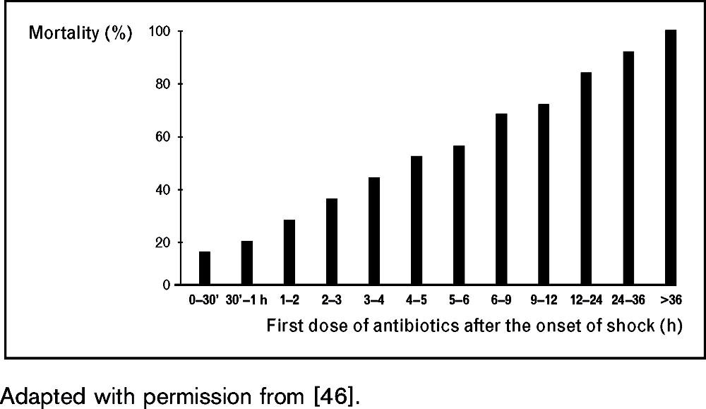
Antibiotics
Relationship between the delay of antibiotic administration after the onset of shock and mortality in patients with septic shock
From: Nobre: Curr Opin Crit Care, Volume 13(5).October 2007.586–591

Slide 8
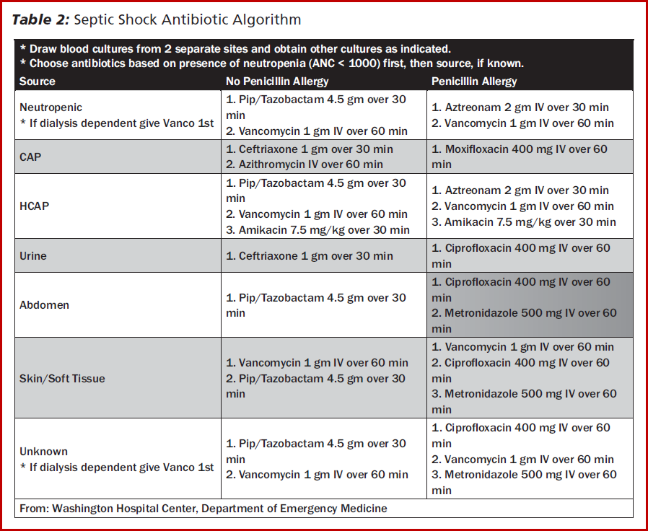

Slide 9
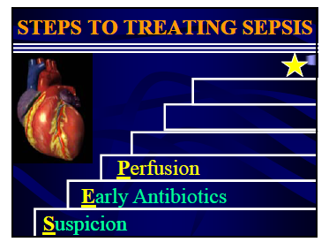

Slide 10
Preload Optimization
Fluid Resuscitation
Repeated fluid boluses as long as the patient remains hypoperfused

Slide 11
Fluid Resuscitation
(SAFE) trial randomized 6,997 critically ill patients to resuscitation with albumin or saline.
There was no difference in 28-day mortality rate (20.9% with albumin vs. 21.1% with saline)

Slide 12
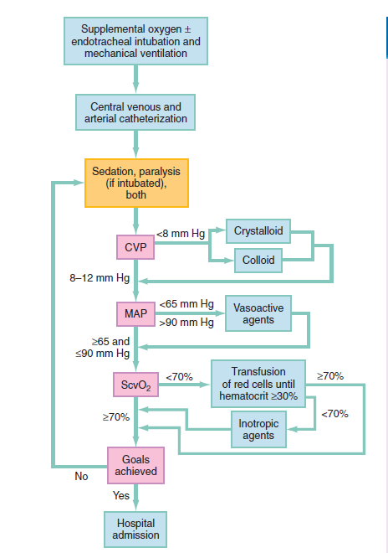

Slide 13
Afterload Optimization
Vasopressor
Following adequate intravascular volume repletion, the continued presence of hypotension warrants the use of vasopressor therapy

Slide 14
Table 1
Commonly used vasopressors, inotropes, and chronotropes
Drug
Action
Common Doses
Adverse Effects
Norepinephrine
>
0.01–0.5
g/kg/min
Tachyarrhythmias,
a
1
b
1
m
increased myocardial
oxygen consumption,
myocardial banding
necrosis with
prolonged infusions
Vasopressin
a
1
,V
,V
,V
0.04
U/min
Possible gastrointestinal
1
2
3
hypoperfusion
Dopamine
a
,
b
, dopa 1
0.5–25
g/kg/min
Tachyarrhythmias,
1
1
m
increased myocardial
oxygen consumption
Epinephrine
a
,
b
,
b
0.01–0.75
g/kg/min
Tachyarrhythmias,
1
1
2
m
leukocytosis,
increased myocardial
oxygen consumption
Phenylephrine
a
0.15–0.75
g/kg/min
Reflex bradycardia
1
m
Isoproterenol
>
b
0.01–0.02
g/kg/min
Tachyarrhythmias,
b
1
2
m
flushing, increased
myocardial oxygen
consumption
Dobutamine
b
>
b
2.0–20
g/kg/min
Tachyarrhythmias,
1
2
m
increased myocardial
oxygen consumption,
pharmacologic
tolerance in
prolonged infusions
Milrinone
Phosphodiesterase
0.3–0.8
g/kg/min
Headache, hypotension,
m
inhibition
tachycardia
Levosimendan
Increased calcium-
0.05–0.2
g/kg/min
Headache, hypotension,
m
dependent binding of
prolonged half-life of
troponin C
active metabolites

Slide 15
Vasopressor
MAP between 65 and 85 mm Hg were associated with no difference in organ perfusion variables
LeDoux D, Astiz ME, Carpati CM, et al: Effects of perfusion pressure on tissue perfusion in septic shock. Crit Care Med 2000; 28: 2729–2732

Slide 16
Norepinephrine
Norepinephrine does not usually induce or exacerbate tachycardia, due to intense venoconstriction and associated right atrial baroreceptor stimulation
Phenylephrine As a pure [alpha] agonist, should not produce tachycardia.
Dopamine and epinephrine are more likely to induce or exacerbate tachycardia than norepinephrine and phenylephrin

Slide 17
Norepinephrine
The combination of norepinephrine with dobutamine may be attractive in the setting of sepsis.
In one study, addition of norepinephrine in patients with septic shock unresponsive to dobutamine significantly improved both mean arterial pressure and cardiac output
Martin C, Viviand X, Arnaud S, et al: Effects of norepinephrine plus dobutamine or norepinephrine alone on left ventricular performance of septic shock patients. Crit Care Med 1999; 27:1708–1713

Slide 18
Norepinephrine vs. Dopamine
Trial of 1679 adults with shock (all types) who received norepinephrine or dopamine first‐line
No significant difference in overall mortality
More arrhythmias with dopamine (24 vs 12%, p<0.001)
Dopamine showed higher mortality only in cardiogenic shock patients (p=0.03)
De Backer, et al, NEJM 2010

Slide 19
Dopamine - norepinephrinin Adults with Septic Shock Norepinephrin-
The trials included a total of 995 patients randomized to norepinephrine and 1048 randomized to dopamine.
Overall, mortality was significantly lower in the norepinephrine group than in the dopamine group (48% vs. 53%).
Arrhythmias were significantly less common with norepinephrine than with dopamine (relative risk, 0.43).

Slide 20
Use of norepinephrine was associated with a 9% reduction in mortality comparedwith dopamine
Norepinephrine Outperforms Dopamine in Adults with Septic Shock
Vasu TS et al. Norepinephrine or dopamine for septic shock: A systematic review of randomized clinical trials. J Intensive Care Med 2011 Mar 24

Slide 21
Phenylephrine
A selective [alpha]-1 adrenergic agonist
Can Increase BP modestly in fluid-resuscitated septic shock patients.
Does not impair cardiac or renal function.
Good choice when tachyarrhythmias limit therapy with other vasopressors

Slide 22
Epinephrine
Because of its effects on gastric blood flow and its propensity to increase lactate concentrations, its use should be limited to patients who fail to respond to traditional therapies for increasing or maintaining blood pressure.

Slide 23
vasopressin
Low-dose vasopressin did not reduce mortality rates as compared with norepinephrine among patients with septic shock who were treated with catecholamine vasopressors
Vasopressin versus Norepinephrine Infusion in Patients with Septic Shock.
Russell, James the VASST Investigators
NEJM Volume 358(9), 28 February 2008, p

Slide 24
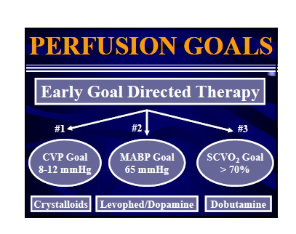

Slide 25
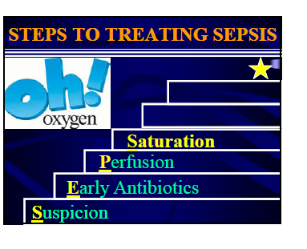

Slide 26
Intubation when :
1- O2 sat less than 90% with 100% percent oxygen with face mask with reservoir
2- Severly use of respiratory muscle

Slide 27
Ventilation
Tidal volume is 6cc/kg
“permissive hypercapnia
plateau pressures <30 cm of H2O
No bicarb

Slide 28
Etomidate
The CORTICUS group study demonstrated that patients that received etomidate as an induction agent had a 60% rate of adrenal suppression versus 43% for patients not receiving etomidate.
They further demonstrated an increased risk of death at 28 days among patients who received etomidate (40–45% mortality versus 30-32%)

Slide 29
It is not clear from the study however if those patients were compared to other patients who were also intubated but using a different induction agent or to patients that did not require intubation
To completely answer the question, there should be a trial for the purposes of comparing the use of different induction agents versus etomidate

Slide 30
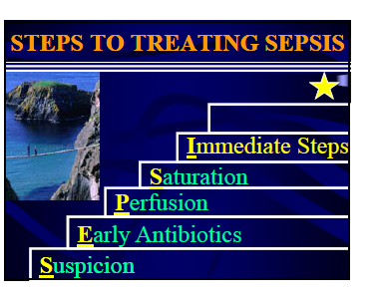

Slide 31
Corticosteroid
A recently published controlled trial of 500 patients demonstrated no difference in mortality when steroids were used in all sepsis patients receiving vasopressors for any length of time
Sprung C, Hydrocortisone Therapy for Patients with Septic Shock. N Engl J Med.
(Prospective randomized controlled trial 499 patients)

Slide 32
Corticosteroids
Septic patients with hypotension despite vasopressors should receive a dose of 4 mg of dexamethasone or 100 mg of hydrocortisone in the ED to provide a physiologic level of glucocorticoid in the setting of adrenal failure
It is not indicated in patients without shock or organ failure or in patients who have responded to vasopressors.

Slide 33
Stress dose steroids should be given to patients on chronic steroid therapy as they have been shown to accelerate improvements in hemodynamic stability and reduce mortality without any significant increase in infectious complication

Slide 34
insulin
study showed no improvement in patients receiving an intensive insulin regimen with a resultant mean blood glucose of 112 mg/dL versus standard therapy in which patients had a mean blood glucose of 151 mg/dL
Brunkhorst F, et al. Intensive Insulin Therapy and Pentastarch Resuscitation in Severe Sepsis. N Engl J Med. 2008;
(Prospective randomized trial, 537 patients)

Slide 35
Insulin
intensive control of glucose
insulin should be administered in a systematic way while monitoring blood glucose regularly to maintain normal or near normal levels without hypoglycemic episodes.
An intensive regimen cannot be strongly recommended based on the available evidence.

Slide 36
Blood product
transfusion of packed red blood cells (pRBCs) up to a hematocrit of 30% in patients with an ScvO2 less than 70%.
Fresh frozen plasma should be transfused for patients with a prolonged prothrombin time (International Normalized Ratio, INR > 1.5)
Platelets should also be transfused for planned invasive procedures in patients with thrombocytopenia and platelets less than 50,000/ mm3

Slide 37
Renal Replacement Therapy
Acute intermittent dialysis is indicated for patients with renal failure and stable hemodynamics.
Continuous venovenous hemofiltration (CVVH) with its smaller volume shifts can be used in place of intermittent hemodialysis (HD) in unstable patients with renal failure
There is no difference in efficacy and safety between intermittent HD and CVVH in stable patients.

Slide 38
Recombinant Human Activated Protein C (rh-APC)
More than likely, the heterogeneity of sepsis is responsible for some of the variability in trial results regarding this therapy.
While the physiology supporting its use in sepsis patients certainly seems sound, the clinical trial results are not robust enough to claim the highest level of evidence to recommend its use in all patients.

Slide 39
Among those identified as “high risk of death,” there is likely to be a subset (“protein C responder”) that do have large benefit.
Identifying an individual patient’s pathophysiology may be the next step in tailoring therapy there is not a globally agreed upon methodology for determining “high risk of death” while the patient is in the first few hours of illness

Slide 40
Antithrombin III (AT III)
The ensuing KyberSept trial large multi-center Phase III trial with 2314 patients; it showed no overall benefit in mortality
Eisele B , et al. Antithrombin III in patients with severe sepsis.
A randomized, placebo- controlled, double-blind trial plus a metaanalysis on all randomized, placebo-controlled, double-blind trials with antithrombin III in severe sepsis. Intensive Care Med. 1998

Slide 41
Antithrombin III cannot currently be recommended strongly for inclusion in a standard protocol for the treatment of sepsis, but as more information is gathered it may yet prove to be a useful treatment in certain subsets of patients.

Slide 42
Intravenous Immunoglobulin (IV-IG)
After some years of investigation, IV-IG in sepsis had been widely concluded to be of no benefit
Pildal J. Gotzsche PC. Polyclonal immunoglobulin for treatment of bacterial sepsis: a systematic review. Clin Infect Dis. 2004

Slide 43
Anti-TNF Fragment Antigen Binding (FAB)
Fragments
controlled trial of 81 patients with severe sepsis (2 or more organ dysfunctions) or shock were treated with either polyclonal ovine anti-TNF fragment antigen binding fragment (CytoFab) or placebo.
Study treated patients showed significant reductions in circulating TNF and IL-6. CytoFab was well tolerated with no significant adverse effects..

Slide 44
There was a statistically significan reduction in ventilator-free days and ICU length of stay.
There was a reduction in mortality in the treated group (26% [11/43 patients]) versus the placebo group (37% [14/38]), but the study was not powered to detect significant differences.
A large phase III trial may answer questions of efficacy and safety of this newer formulation of anti-TNF treatments

Slide 45
((Antioxidants Selenium
There were no serious adverse events from selenium observed in the study.
Selenium and other antioxidants are promising but, as yet, unproven therapies
Cho S, Kanna B. Selenium in intensive care: an interesting yet not fully proven concept. Crit Care Med. 2007

Slide 46
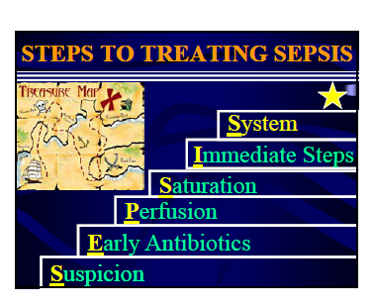

Slide 47
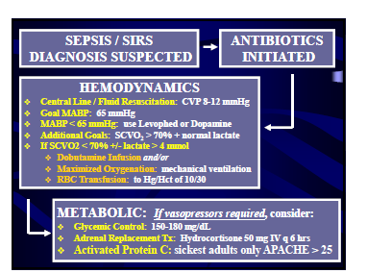

Slide 48
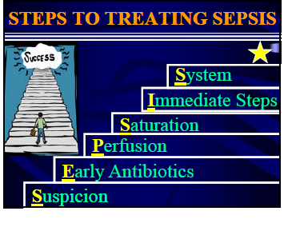

Slide 49
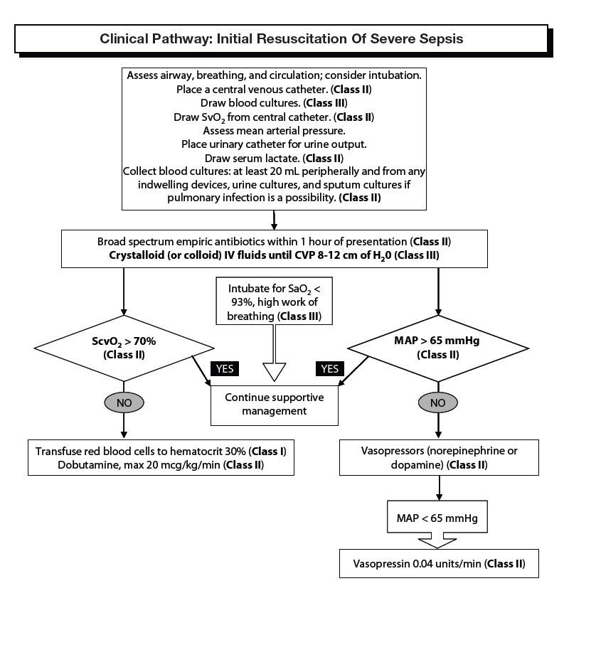

Slide 50
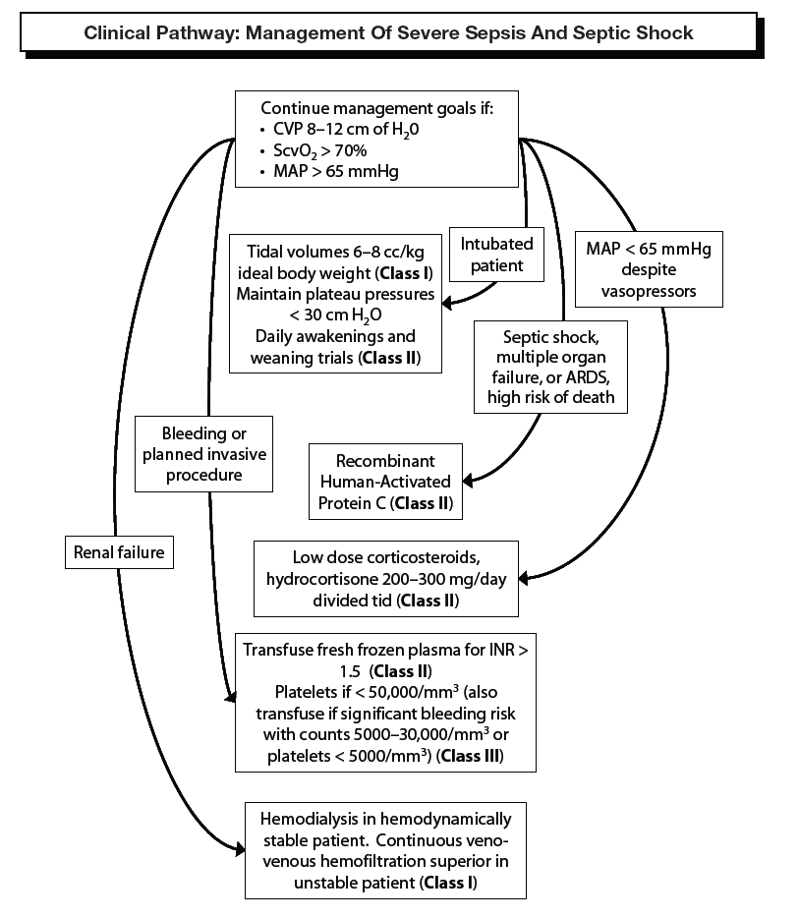

Slide 51
Thank you

