Slide 1
Case Presentation
Done by : Aisha Alhazmi
Supervised By: DR.Mansour AlQurashi

Slide 2
History taking
Malaz is a 3 month Yamani female living in Riyadh, known case of Holt-Oram syndrome presented to the ER on Friday December 20th 2013 , complaining of difficulty in breathing and cyanosis for the last 4 days.
History was taken from a 33 year old illiterate mother.

Slide 3
History of presenting illness
The patient was in her usual state of health until 4 days prior to the hospital admission when the mother reported difficulty in breathing and cyanosis .
The difficulty in breathing was associated with lips and tongue blue discoloration , exacerbated during sleeping and awaken the infant from sleeping.
Cyanosis was noticed also during feeding and passing stool.
The mother noticed also sweating during feeding , interrupted feeding ( the infant is getting tired easily during feeding) .

Slide 4
Hospital course
Malaz admitted through ER , she was diagnosed as acute bronchitis.
she received oxygen and Ventolin but she didn’t improve.
patient stayed in the PICU for 4 days, Then she was transferred to the ward for further observations and laboratory investigation.
Notes:
0.45% NaCl “1450 ml/24 h

Slide 5
Systematic review
General:
No history of weight loss, fever, pallor or lethargy , no history of contact with sick people .
Gastrointestinal:
No history of Colic , jaundice and vomiting.
No history of changes in bowel habits.
Genitourinary:
normal
CNS:
No history of convulsions or abnormal movements.

Slide 6
Rheumatology:
Deformity in the hands and arms since birth.
Haematology:
No history of easy bruising or ecchymosis.
Dermatology:
No history of lump, skin rash, itching or pigmentation.
No hair or nail changes.

Slide 7
Past History
She is a known case of Holt-Oram syndrome since birth diagnosed at Al.Yamama hospital .
No history of previous surgical procedure.
No history of blood transfusion.

Slide 8
Drug and Allergies
She’s only on Ventolin .
Not known to have any allergy to food or drugs.

Slide 9
Perinatal history
Antenatal:
No history of any diseases during pregnancy, drugs , exposure to radiation and smoking .
normal fetal movement .
Natal:
Malaz is a product of caesarean section due to fetal distress .She was full term , cried immediately after delivery and birth weight was 2.5 kg.
Post natal :
The Doctors diagnosed her condition as Holt- Oram syndrome , and discharged with her mother.

Slide 10
Nutritional history
Patient is fed through a NGT since one week after birth Because she get tired of sucking.
Immunization history .
She took the birth vaccines only (BCG, hepatitis B)
No allergy or side effects from vaccines.

Slide 11
Developmental history
Primitive reflexes were disappeared .
Gross Motor : Head rise to 90 degree in ventral suspension.
Fine motor : she can’t Hold object.
vision : normal .
Hearing & language :Turns to sound at ear level, no cooing.
Social : social smile .

Slide 12
Family and social history
37 y/o
33 y/o
2 y/o
Pt.
The father is 37 year old and he’s a Company employee.
The mother is 33 year old housewife.
No consanguinity between parents.
The patient is having one sister.
No history of metabolic diseases or neonatal death.

Slide 13
No history of chronic illness in the family.
No history of similar syndrome .
No history of passive smoking.
No history of bronchial asthma, allergic rhinitis, allergic conjunctivitis or dermatitis in the family.
No pets at home.
They are living in apartment of 5 rooms in Al.Naseem neighborhood with poor socioeconomic status.

Slide 14
Examination
The patient is alert, ill looking , lying on bed, average size, There are deformity in her both hands and arms.
She is connected to IV line . She had oxygen mask and NGT.
She was not cyanosed . Not pale or jaundiced.
Vital signs:
BP 98/58 PR 150 b/min RR 36
Oral temperature 37.4 ⁰C O2 saturation 92% RA.
Growth parameters
Weight 2.9 kg (less than 3rd percentile),53% of median weight for age. Weight for Height less than 3rd percentile.
Height 55 cm (5th percentile).
Occipital frontal circumference 42 cm (90 percentile).

Slide 15
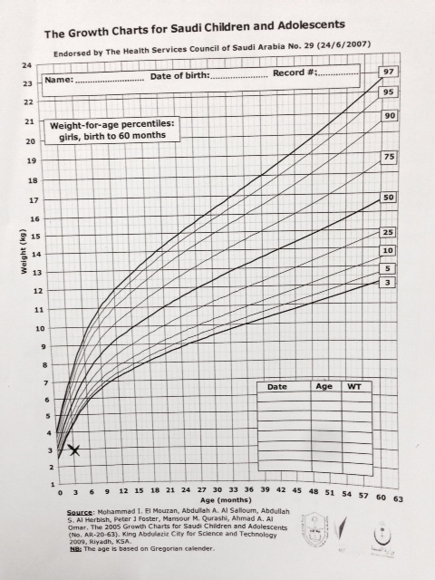
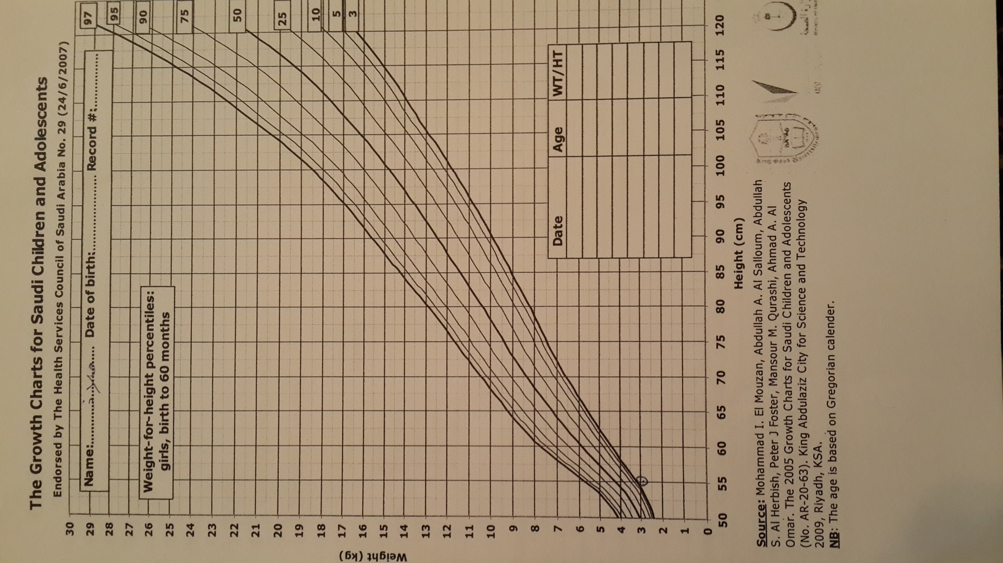

Slide 16
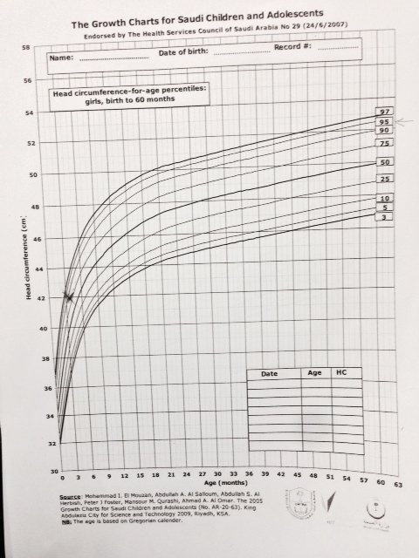
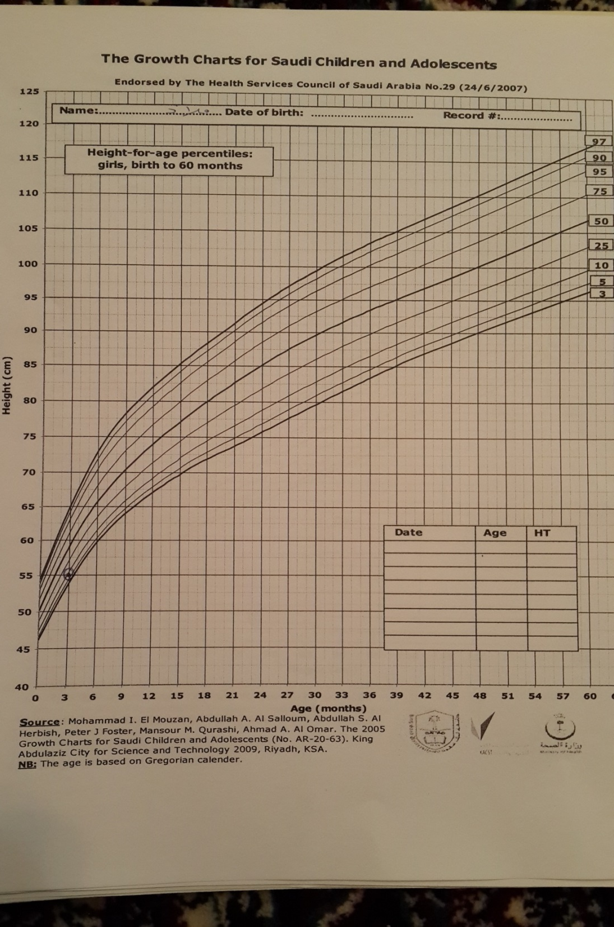

Slide 17
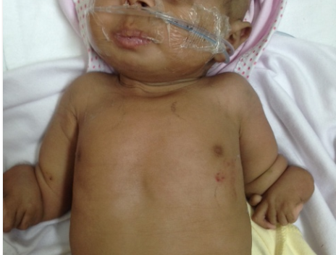

Slide 18
Hands and arms:
The patient has absent ulna on both sides.
She has only four fingers on her right hand.
No finger clubbing, peripheral cyanosis and pallor.
Face:
No pallor and no dysmorphic features.
Eyes:
Normal eyes .
Ears:
There is no malformation or preauricular tag.
There is no dicharge .
Nose:
No active ala nasi .
There is no dicharge .

Slide 19
Mouth:
No cyanosis in the tongue and lips and no angular stomatitis also there is no oral ulcers or gingival hypertrophy. tonsils are not enlarged.
Fair oral hygiene.
Neck:
No neck swelling, no skin changes.
No palpable lymph nodes.

Slide 20
Respiratory examination
Inspection: chest moves symmetrically, no obvious deformities or scars. She using her accessory muscles while breathing.
Palpation: trachea is central, equal bilateraly, chest expansion is normal and equal in both sides.
Auscultation: normal vesicular breathing, there is bilateral chest wheezing .

Slide 21
Cardiovascular examination
Inspection: no obvious deformities, or scars . But visible pulsation.
Palpation: apex beat is in the left 5th intercostal space at the midclavicular line .
Thrill at left lower sternal border(LLSB).
Auscultation: normal heart sounds , pansystolic murmur 4/6 at LLSB, no gallop .
All peripheral pulses are palpable and equal.
Notes:
6-12 the normal pulse rate from 70 – 110 beats/min

Slide 22
Abdomenal examination
Inspection: the abdomen is not distended and moves symmetrically with respiration. Her flanks were normal. There is no cautery marks, scars, dilated veins, visible peristalsis, local bulging or any skin changes.
Palpation: the abdomen is soft and lax, there is no tenderness, the liver was palpable 2cm BRCM.MCL . No splenomegaly.
Kidneys are not enlarged
Percussion: No ascites by doing shifting dullness.
Auscultation: normal bowel sounds. No aortic or renal bruit.
Genitalia: normal.

Slide 23
Neurological examination:
Upper and lower limb examination:
General inspection:
Normal skin, no scars .
Motor system:
Inspection: no wasting, fasciculation or tremor.
Tone: normal .
Reflexes: normal.

Slide 24
Investigation:
Chemistry.
CBC.
Chest and abdominal X-ray.
Echocardiogram.

Slide 25
Chemistry
22.18 (4.40-6.40(µmol/L | GLU
8.4 (2.9-9.3) mmol/L | UPEA
34.2 (39.0-114.0) µmol/L | CR-S
132 (135-145) mmol/L | Na
4.1(3.5-5.1) mmol/L | K
2.24 (2.23-2.58 )mmol/L | CALC
132 (.32-91 ) U/L | ALP

Slide 26
CBC
12.48(6.0 – 17.5) | WBC
8.41 | NEUT
3.49 | LYMPH
.2 | EOS
.09 | BASO
3.52 | RBC
11.0 | HGB
92.9 | MCV
31.3 | MCH
261 | PLT

Slide 27
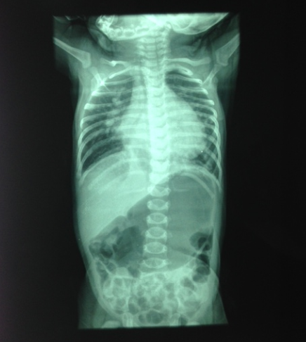
Chest and abdominal X-ray

Slide 28
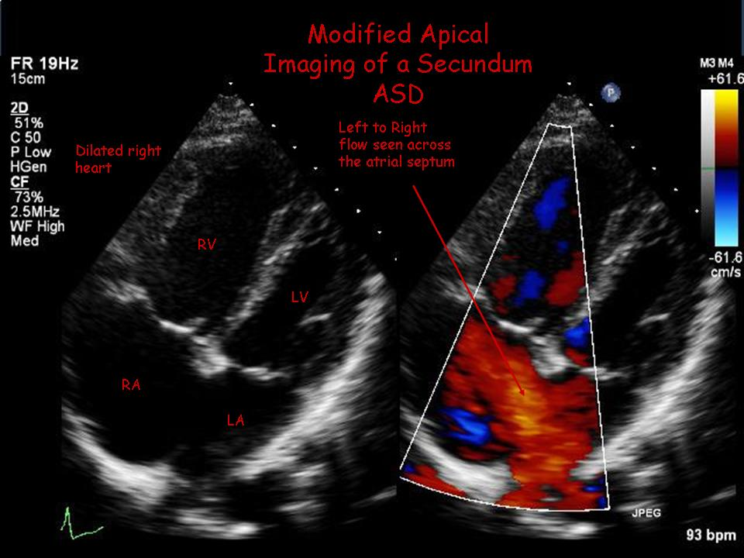
Echocardiogram
VSD
ASD

Slide 29
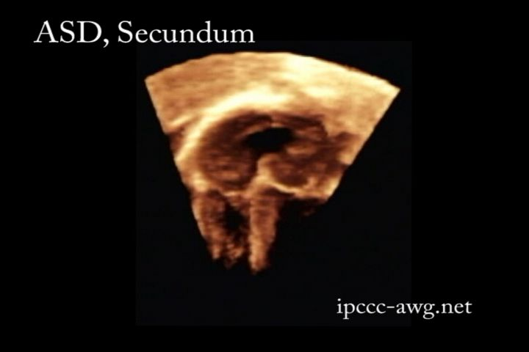
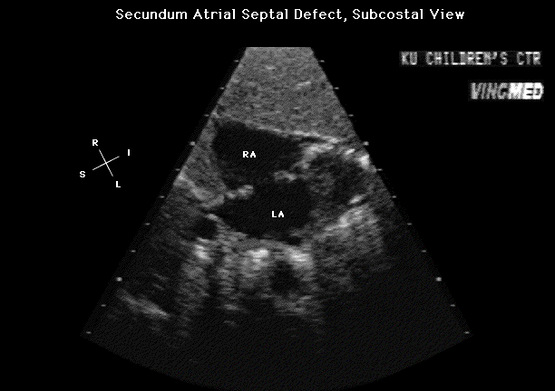

Slide 30
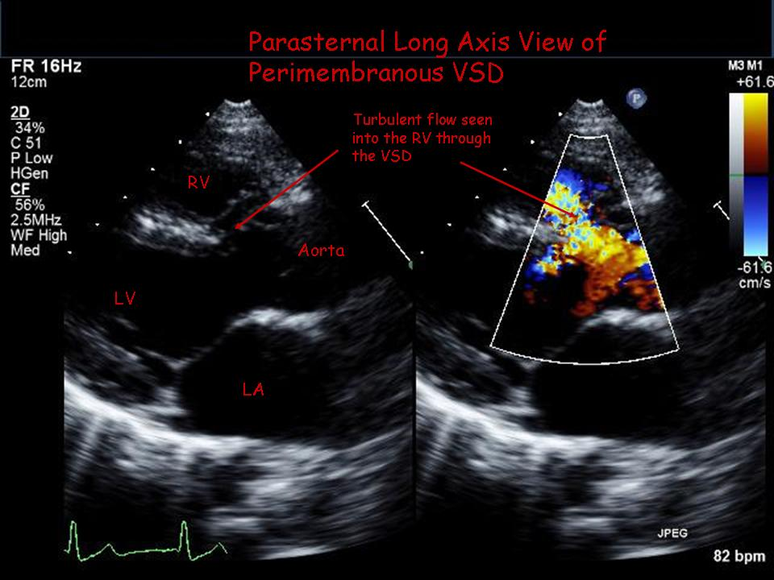

Slide 31
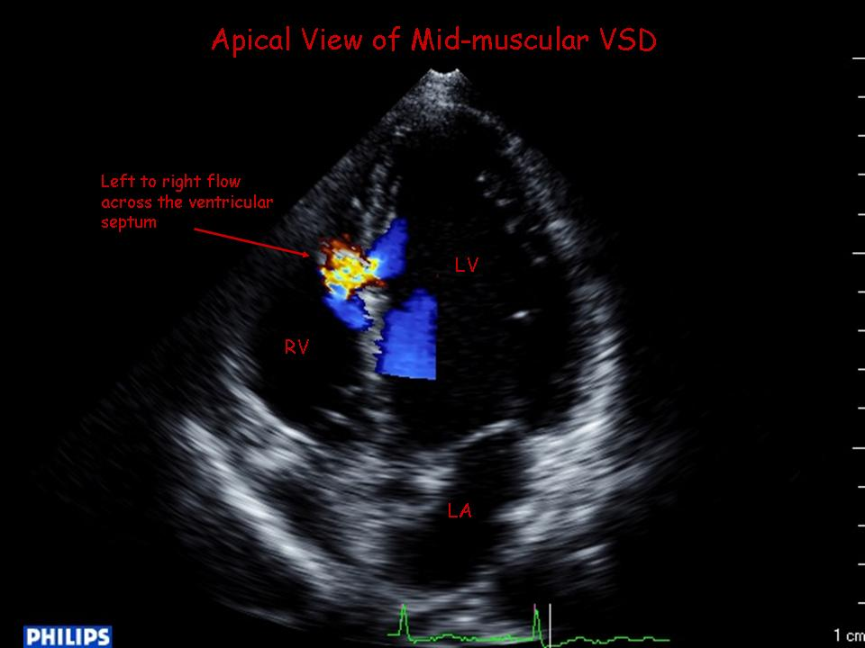

Slide 32
PROBLEM LIST
Holt Oram syndrome.
Congenital heart disease (ASD,VSD).
Failure to thrive.
Heart failure.
Chest infection.

Slide 33
Ventricular Septal Defect Treatment & Management
In children with moderate or large VSDs, a trial of medical therapy is indicated to manage symptomatic congestive heart failure (CHF) because many VSDs may become smaller with time.
Uncontrolled CHF with growth failure and recurrent respiratory infection is an indication for surgical repair. Neither the age nor the size of the patient is prohibitive in considering surgery.
Large defects associated with elevated pulmonary artery (PA) pressure are often repaired when infants are younger than 1 year.

Slide 34
Management of Medium or large Asymptomatic VSD
corrective closure:
VSDs should be closed to prevent progression to severe pulmonary hypertension, heart failure, and Eisenmenger's syndrome.
Indicated when Qp to Qs shunt ratio is >1.5, PA systolic pressure >50 mmHg, increased LV and left atrial size, or deteriorating LV systolic function. Once the ratio of pulmonary to systemic vascular resistance >0.7, the risks of surgical closure become prohibitive.

Slide 35
Management of Medium or large Asymptomatic VSD
The usual procedure is open surgery in which a patch (bovine pericardium or synthetic material) is used to close the VSD.
Percutaneous device closure is an option for type 4 (muscular) and some forms of type 2 (peri-membranous) defects, especially if the defect is away from the tricuspid valve and the aorta.

Slide 36
Prophylactic antibiotics
Endocarditis is a complication of VSDs, and a high index of suspicion must be maintained.
Infective endocarditis often presents non-specifically, and most commonly involves fever with possible physical signs of peripheral emboli (Osler nodes, Roth spots, or Janeway lesions).

Slide 37
Prophylactic antibiotics….cont
Prophylactic antibiotics are now only indicated in patients at particularly high risk of developing endocarditis :
patients with a previous history of infective endocarditis.
patients within 6 months following patch repair or percutaneous device closure.
patients with a residual defect following closure.
Prophylaxis is no longer recommended for routine GI procedures.
Primary Options:
amoxicillin : children: 50 mg/kg orally one hour before procedure.
OR:
clindamycin : children: 20 mg/ kg orally one hour before procedure.

Slide 38
Management of symptomatic VSD with left to right shunt
preoperative medical therapy
The most commonly encountered situation in which preoperative medical therapy is required is with congestive heart failure in infants and children; these therapies are almost never required in adults.
Medical therapy is not curative and is used to control heart failure symptoms prior to surgery.
Medicines include diuretics, and in some cases angiotensin-converting enzyme (ACE) inhibitors and digoxin.
Anaemia, if present, should be corrected by red blood cell transfusion, or by iron therapy in case of iron-deficiency anaemia

Slide 39
Primary Options:
furosemide : children and adults: consult specialist for guidance on dose
Secondary Options
furosemide : children and adults: consult specialist for guidance on dose
-- AND --
captopril : children and adults: consult specialist for guidance on dose
Or:
enalapril : children and adults: consult specialist for guidance on dose
-- AND --
digoxin : children and adults: consult specialist for guidance on dose
corrective closure
The development of heart failure symptoms is an indication for surgery. Surgery can be performed once heart failure symptoms have been controlled with therapy.

Slide 40
Holt Oram syndrome
Holt-Oram syndrome (HOS) is an autosomal dominant syndrome that results in :
congenital heart defects:
  atrial septal defect (ASD) (commonest cardiac defect)
  ventricular septal defect (VSD)
upper limb abnormalities:
  radial ray anomalies, e.g. radial aplasia, radial hypoplasia
  thumb anomalies, e.g thumb aplasia
  Dr Jeremy Jones and Dr Yuranga Weerakkody et al.

Slide 41
Radiographic features;
Antenatal ultrasound
The diagnosis can be suspected amongst the differential if upper limb abnormalities are noted along with heart defects on fetal ultrasound. The limb defects can be asymmetrical.
Differential diagnosis:
TAR syndrome: thrombocytopaenia - absent radius syndrome.
VACTERL association
Aase Syndrome

Slide 42
VACTERL association
The abbreviation VACTERL derives from:
V - vertebral anomalies:
  hemivertebrae
  congenital scoliosis
  caudal regression
  spina bifida
A - anorectal anomalies:
  anal atresia
C - cardiac anomalies / cleft lip
T - tracheo-
E - oesophageal fisula +/- oesophageal atresia
R - radial ray anomalies / renal anomalies
L - limb anomalies
  polydactyly
  Oligodactyly
At least three of the above features (in each category) is considered necessary for the diagnosis of this condition .

Slide 43
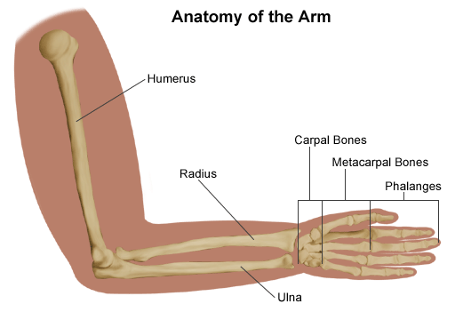

Slide 44
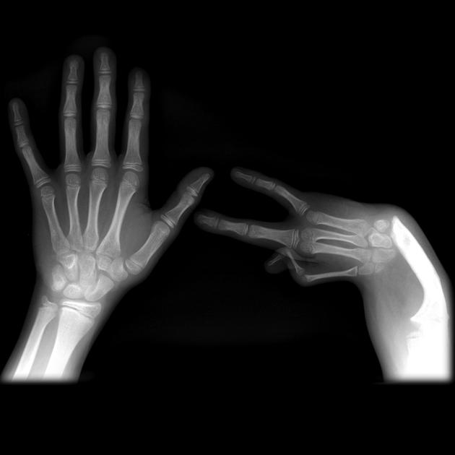
Case 1

Slide 45
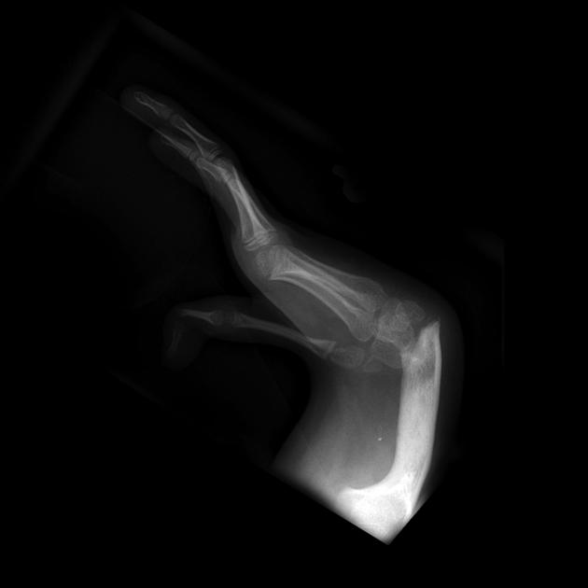
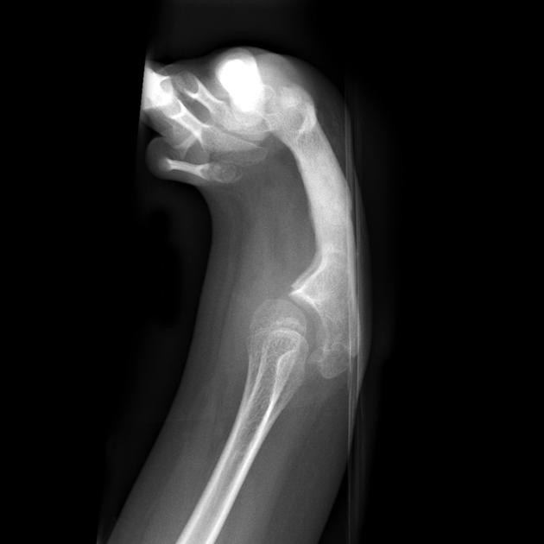

Slide 46
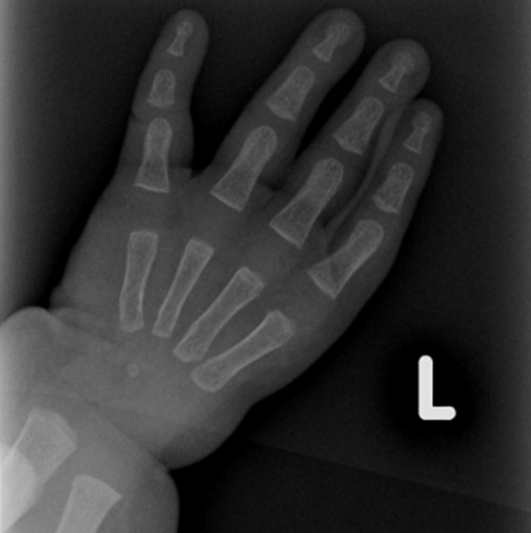
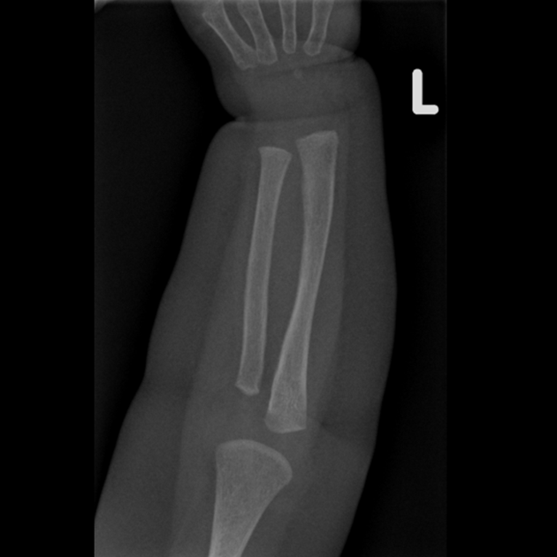
Case 2

Slide 47
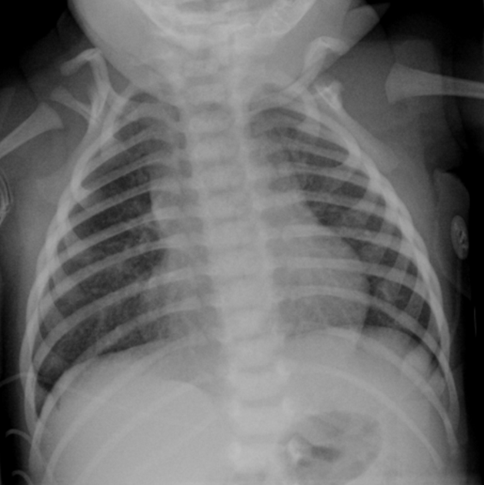

Slide 48
Case 3

Slide 49
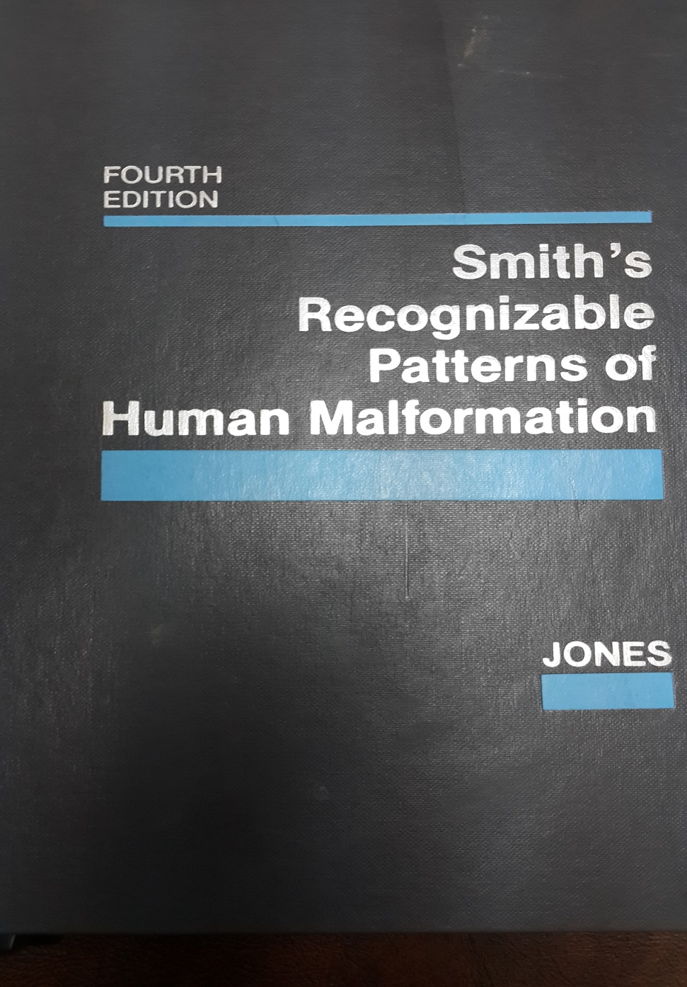
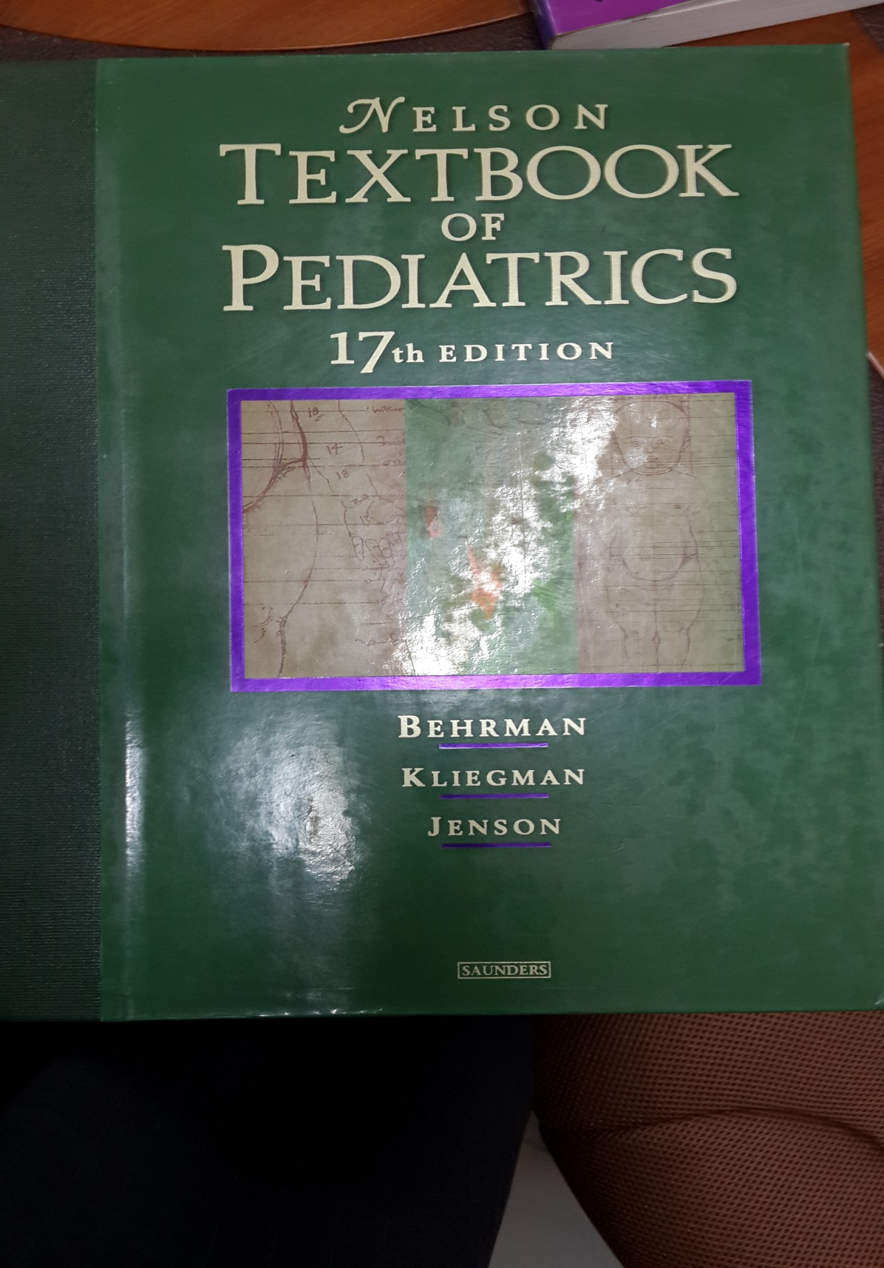
References

Slide 50
Thank YOU !

