Slide 1
HYPOTHYROIDISM
Dr.Badi AlEnazi
Pediatric endocrinology consultant and diabetologist
Alyammamah hospital
2016

Slide 2
Objectives:
To know thyroid development
To know thyroid physiology
Classification of hypothyroidism
Thyroid dysgenesis
Thyroid dyshormonogensis
Symptom and sign of hypothyroidism
Complication
Treatment of hypothyroidism

Slide 3
Thyroid development
This happen in three stages :
1- embryogenesis :
Which began on the floor of the primitive oral cavity .
Then descend to its definitive position in the anterior lower neck by the end of the first trimester .
2- the hypothalamic- pituitary – thyroid axis becomes functional in 2nd trimester
3- peripheral metabolism of thyroid hormones mature in 3rd trimester

Slide 4
Cont
T3 ,T4 , TSH all don’t cross the placenta
That is why their constrations in fetal blood reflect primary fetal secretions and metabolism .

Slide 5
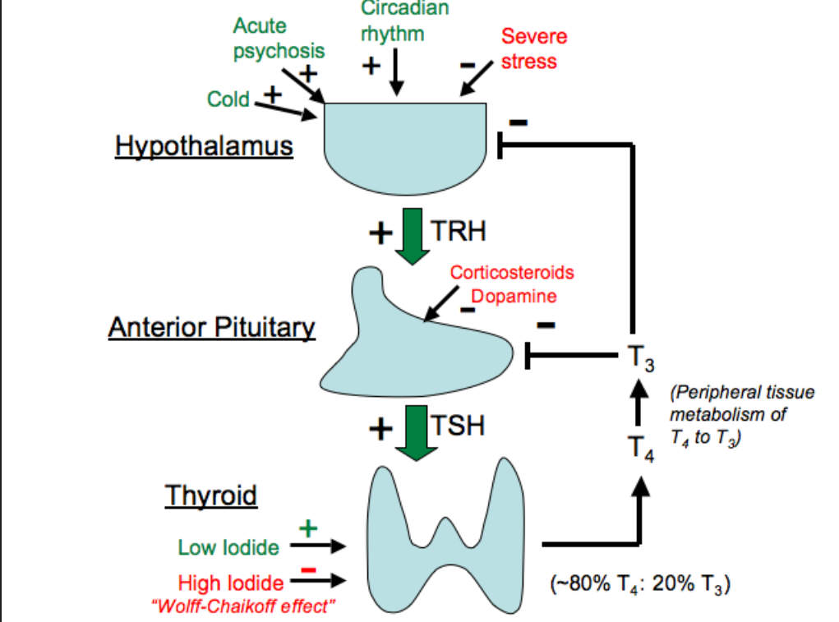
Physiology of thyroid

Slide 6
Important clue
1- Iodine is important for producing thyroid hormones
2-FT4 , FT3 are the thyroid hormones
3- TBG : thyroid binding protein
4- the most effective form is : FT3 , which is responsible for the feedback effect on TSH release
5- measurment of FT4 , TSH in serum are the test of choice
6- FT4 , FT3 forming less than 0.02% of the total
7- TG : thyroglobulin which consist of tyrosine polymerase ( 120 )
T4 : consist of coupl of diiodotyrosine

Slide 7
HYPOTHYROIDISM
CLASSIFICATIONS :
CONGENITAL
ACQUIRED
OR
PRIMARY : disease of thyroid gland
SECONDARY : disease in pituitary
TERTIARY : Disease in hypothalamus

Slide 8
CONGENITAL HYPOTHYROIDISM
Insedence : 1/4000 live birth
It is due to :
1 -Dysgenesis :
2- dyshormogenesis disorder :
3- others .

Slide 9
Thyroid dysgenesis
disorder of embryogenesis
Is the most common cause of congenital hypothyroidism
Acounting around 85%
Mainly sporadic
Due to :
1- apalsia : 1/3 of cases
no remonant of thyroid tissue can be detected by radionuclide scan
2- hypoplasia : 1/3
some thyroid tissue can be detected in the normal position of neck
3- ECTOPIA ( lingual thyroid )
detedted any where from the base of the tongue till the nomal position

Slide 10
dysHormogenesis
A variety of defect in biosynthesis of thyroid hormon
Goiter is almost always present
1- defect of iodide transport
2- thyroid pyroxidase defects of organification and coupling :
- the most common cause in this group
- defect involve one or more of the enzymes which required for thyroid hormone after trapping of iodide .

Slide 11
Cont’d
3- defect of thyroglobulin synthesis :
characterized by : goiter , high TSH , low T4 , low or absent of TG
4- defect in deiodination :
this enzyme defect leading to loss of nondeiodinated tyrosine in the urine , which cause iodide deficiency and goiter
This defect may be happen in peripheral tissue or in the thyroid gland or both .

Slide 12
Others
- thyrotropin receptor-blocking antibody :
TRBAB
Cause transient congenital hypothyroidism
Due to transplacental passage of maternal AB which inhibit the TSH of binding to its receptor in the newborn
When suspected :
- Hx maternal autoimmune thyroid disease ( Hashimoto , graves ,
- hypothyroidism while the patient receiving replacement therapy
- Hx of similar conditions with the siblings .

Slide 13
Cont’d
RADIOIODINE ADMINSTRATION :
which may be used for Rx of Graves disease or thyroid cancer during pregnancy .
It affect the fetus if taken at any time
It is also contraindicated in breast feed mother

Slide 14
Clincal manifestations
- Normal at birth
Some may have increased head size due to myxedema of the brain, gestation more than 42 wks , BW more than 4 KG
Prolonged physiological jaundice
- defficulty in feeding
- somnolence
Chocking spells during nursing
- large togue
- decrease general activity

Slide 15
Cont’d
- Large abdomen
- constipation
- hypothermia
Mottled and cold skin
Umbilical hernia
Slow pulse , cardiomegaly , and pericardial effusion

Slide 16
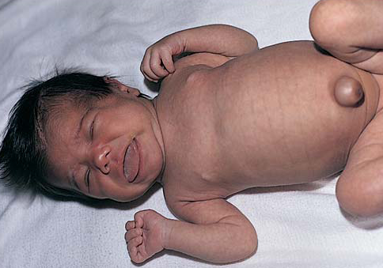

Slide 17
If not treated
- Short infant
- short arms
- widly open anteriore and post fontanele
- Depressed , broad nose
- late dentition
- Mental retardation
- Lethrgy
- Carotenemia causing yellowish skin color but sclera is kept white .

Slide 18
LABORATORY
FT4 : low
TSH : high in primary , and low in secondary
Bone age : delayed ( even at birth )

Slide 19
Treatment
Thyroxin replacement
In newborn : 10-15 ug /kg
In childhood : 3 ug/kg

