Slide 1
ADRENAL GLAND DISORDER
Dr.Badi AlEnazi
Pediatric endocrinology consultant and diabetologist
Alyammamah hospital
2016

Slide 2
Adrenal Cortex
Zona Glomerulosa: Mineralocorticoids
Zona Fasiculata: Glucocorticoids
Zona Reticularis: Androgens
Medulla

Slide 3
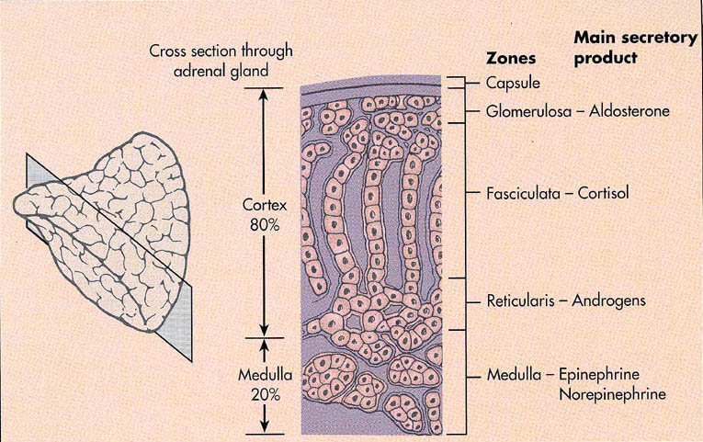

Slide 4
ADRENAL GLAND
Adrenal Cortex, Function :
MINERALOCORTICOIDS – regulate sodium retention and potassium loss and body fluid
GLUCOCORTICOIDS – act as anti-inflammatory agents; affect metabolism.
ANDROGENS – regulates growth and development of genetalia and puberty
Adrenal Medulla, Function :
ADRENALINE (EPINEPHRINE) – increases heart rate and blood pressure.
NORADRENALINE (NOREPINEPHRINE) – constricts arterioles.

Slide 5
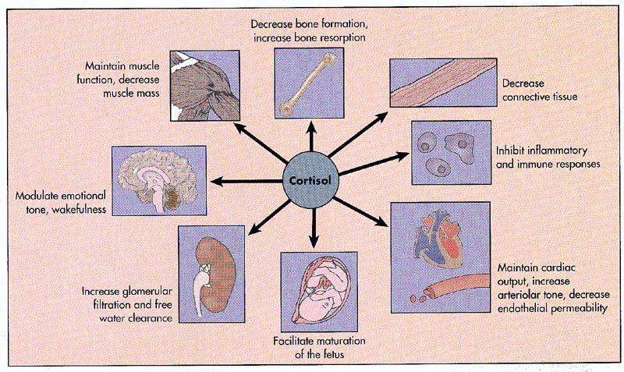

Slide 6
Aldosterone
Mineralocorticoid
Regulates concentration of Na+ and K+.
  Kidney conserves Na+.
  Kidney excretes K+.
Responds to changes in composition of plasma.
Regulated by renin-angiotensin system of kidney

Slide 7
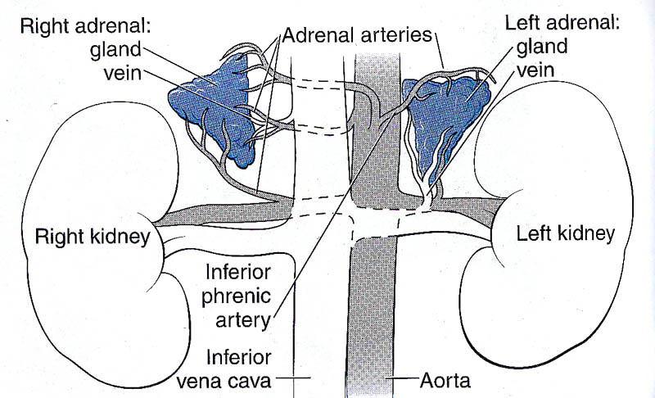

Slide 8
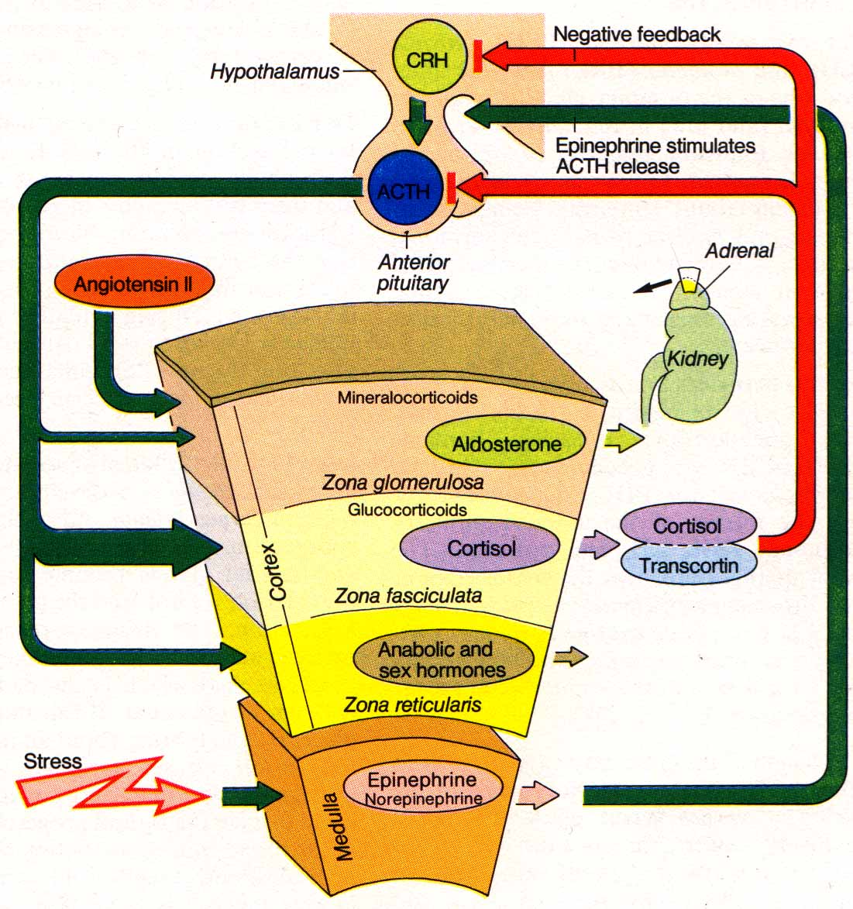
Regulation of adrenal gland secretion
ACTH
Cortisol
Cortisol

Slide 9
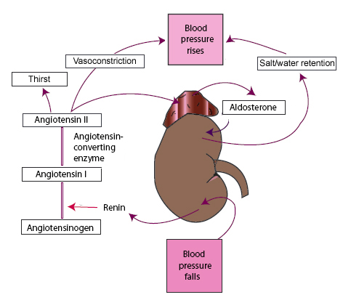
Adrenal physiology 2:
Renin-angiotensin system

Slide 10
Steroid Biosynthesis
ACTH
Cholesterol
StAR, 20,22-desmolase
17α-hydroxylase
17,20-lyase
Pregnenolone
17-OH-Pregnenolone
DHEA
3βHSD
3βHSD
3βHSD
17α-hydroxylase
17,20-lyase
Progesterone
17-OH-Progesterone
Androstenedione
aromatase
21-hydroxylase
21-hydroxylase
DOC
11-deoxycortisol
17βHSD
11β-hydroxylase
Estrone
11β-hydroxylase
Cortisol
Testosterone
Corticosterone
17βHSD
aromatase
18-hydroxylase
18-OH-Corticosterone
Estradiol
18-oxidase
Aldosterone

Slide 11
Adrenal Dysfunction
Decrease function
Increase function
Adrenal insufficiency
Low cortisol, aldestrone
Eg Addison disease
Cushing syndrome
High Cortisol
Hyperaldosteronism
High aldestrone
Pheochromocytoma
High catecholamine

Slide 12
Causes of Adrenal insufficiency
Congenital adrenal hyperplasia
Addison disease
Infection (TB, sepsis)
Adrenoleukodystrophy

Slide 13
Primary adrenal insufficiency:
Etiologies
Acquired
Autoimmune
AIDS
Tuberculosis
Bilateral injury
  Hemorrhage
  Necrosis
  Metastasis
Idiopathic
Congenital
Congenital adrenal hyperplasia
Wolman disease
Adrenal hypoplasia congenita
Allgrove syndrome (AAA)
Syndromes
Adrenoleukodystrophy
Kearns-Sayre
Autoimmune polyglandular syndrome 1 (APS1)
APS2

Slide 14
Primary adrenal insufficiency:
Etiologies
Acquired
Autoimmune
AIDS
Tuberculosis
Bilateral injury
  Hemorrhage
  Necrosis
  Metastasis
Idiopathic

Slide 15
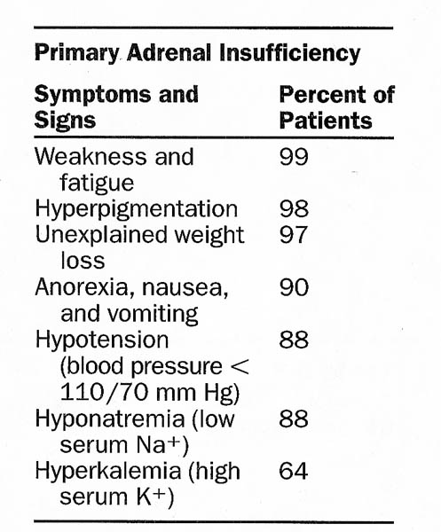

Slide 16
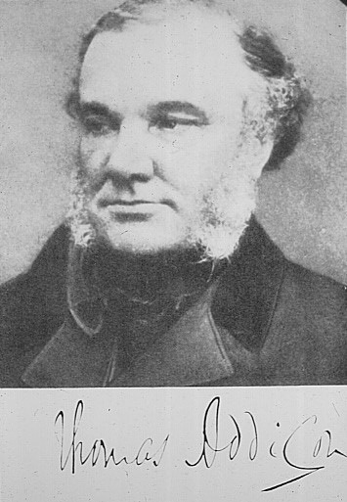
Addison’s Disease
1st described in 1855 by Dr. Thomas Addison
Refers to acquired primary adrenal insufficiency
Does not confer specific etiology
  Usually autoimmune (~80%)

Slide 17
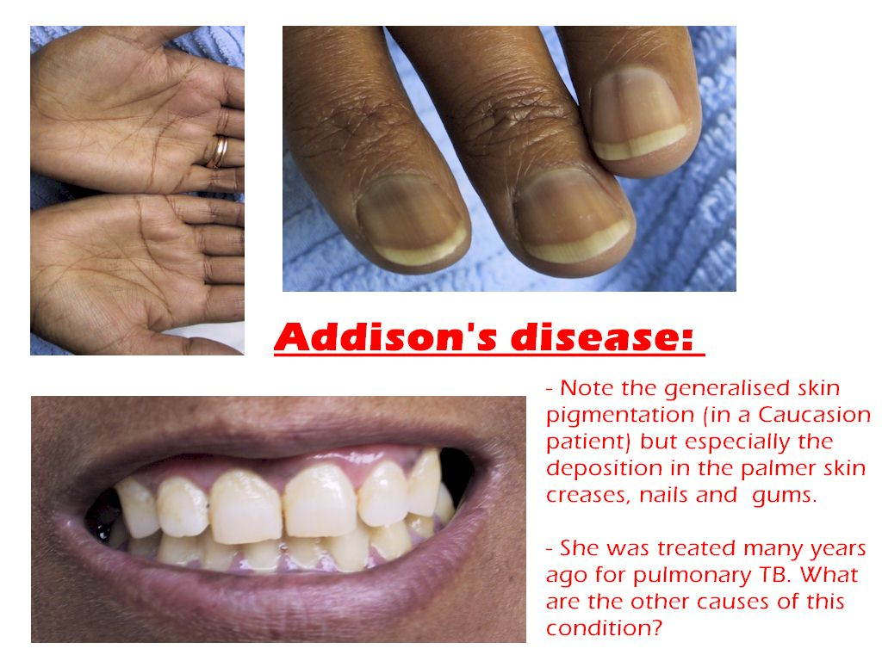

Slide 18
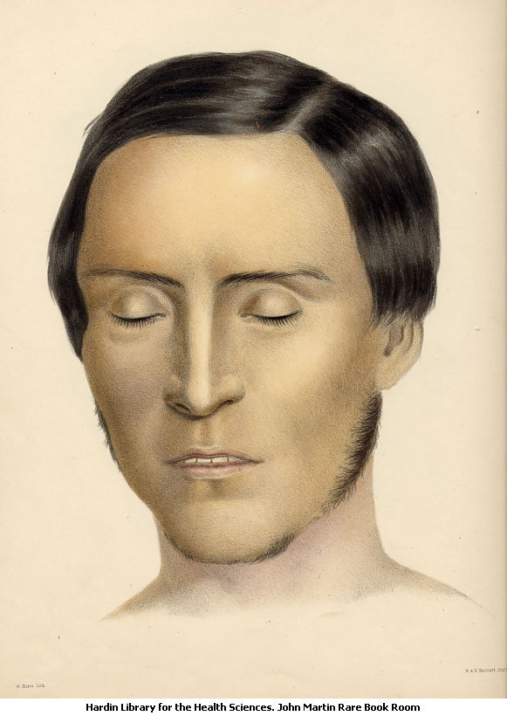
Primary adrenal insufficiency:
Symptoms
Fatigue
Weakness
Orthostatsis
Weight loss
Poor appetite
Neuropsychiatric
  Apathy
  Confusion
Nausea, vomiting
Abdominal pain
Salt craving

Slide 19
Primary Adrenal Insufficiency
Hyperpigmentation
Dehydration
Hypotension
Hyperkalemia
Hyponatremia
Hypoglycemia

Slide 20
Addisonian crisis
Life threatening complication
Severe vomiting and diarrhoea followed by dehydration
Low blood pressure and shock
Hypoglycemia
Loss of consciousness
Treatment: IV fliuds+IV hydrocortisone

Slide 21
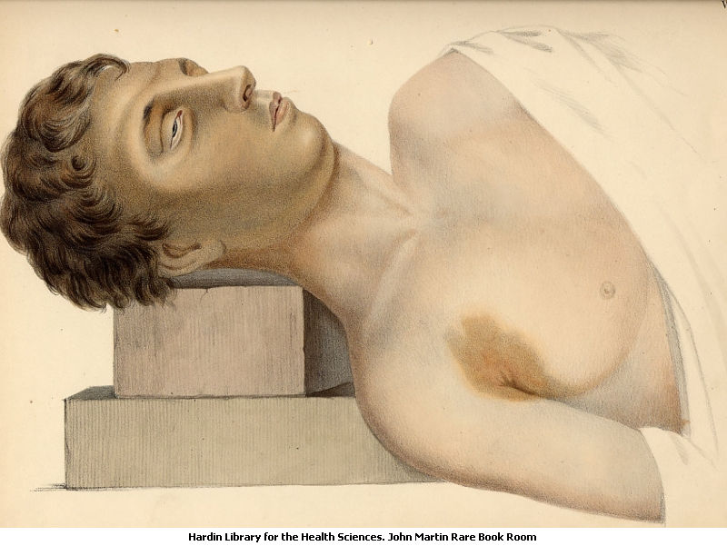
Primary adrenal insufficiency:
Physical findings
Hyperpigmentation
Hypotension
Orthostatic changes
Weak pulses
Shock
Loss of axillary/pubic hair (women)

Slide 22
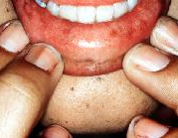
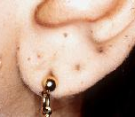
Primary adrenal insufficiency:
Physical findings

Slide 23
Primary adrenal insufficiency:
Laboratory findings
Hyponatremia
Hyperkalemia
Hypoglycemia
Narrow cardiac silhouette on CXR
Low voltage EKG

Slide 24
Primary adrenal insufficiency:
Etiologies
Congenital
Congenital adrenal hyperplasia
Wolman disease
Adrenal hypoplasia congenita
Allgrove syndrome (AAA)

Slide 25
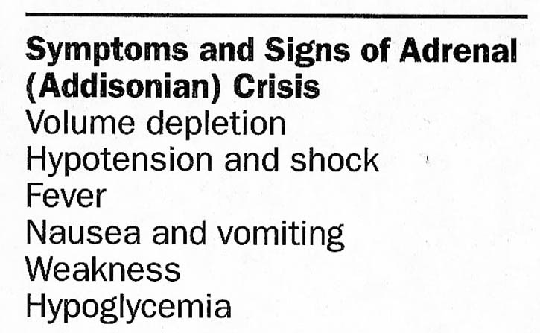

Slide 26
Congenital Adrenal Hyperplasia
The first case was described in 1865
Family of inherited disorders of adrenal steroidogenesis
Each disorder results from a deficiency of one of several enzymes necessary for steroid synthesis
Autosomal Recessive (M=F)
21-hydroxylase  is the commonest form

Slide 27
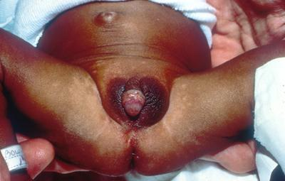
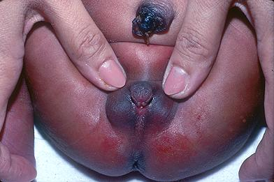

Slide 28
Phenotypic Spectrum of the
Congenital Adrenal Hyperplasias
Salt-losing
Simple virilizing
Non-classical
SPECTRUM
Adolescent/adult
Female
Hirsutism
Irregular menses
Infertility
Newborn Ambiguous genitalia
Salt loss
Failure to thrive
Young child
Premature pubarche
Advanced bone age
Notes:
28

Slide 29
Clinical features
Aldosterone and Cortisol Deficiency:
approx. at 2 weeks of life :
Wt loss
hyponatremia
hyperkalemia
hypoglycemia
hypotension
others:
- vomiting, dehydration , poor feeding & weakness
- if no treatment → Shock ,cardiac arrhythmias & death

Slide 30
21-OH deficiency
More than 90% of CAH is due to 21-OH deficiency
2 main forms
Classic Non-classic
( early presentation ) ( late presentation )
75% salt losing 25% simple virilizing (non-salt losing)
Severity

Slide 31
Treatment
Glucocorticoid replacement
10-20 mg /m2 /day hydrocortisone
monitor:
Growth velocity & percentiles
Skeletal maturation
17-OH- prog (early morning befor medication)
Mineralocorticoid Replacement
Fludrocortison 0.1-0.3 (+/- Nacl 0.9 %)
Monitor:
V/S, BP, plasma renin activity
Surgical managment

Slide 32
Steroid biosynthetic enzymes
1) Cholesterol side chain cleavage=scc (20,22 desmolase)
2) 3β-Hydoxysteroid dehydrogenase
3) 17 α hydroxylase and 17,20 –lyase
4) 21β-Hydroxylase
5) 11β-Hydroxylase
6) Aldosterone synthetase (11β,18 hydroxylase & 18 oxidase

Slide 33
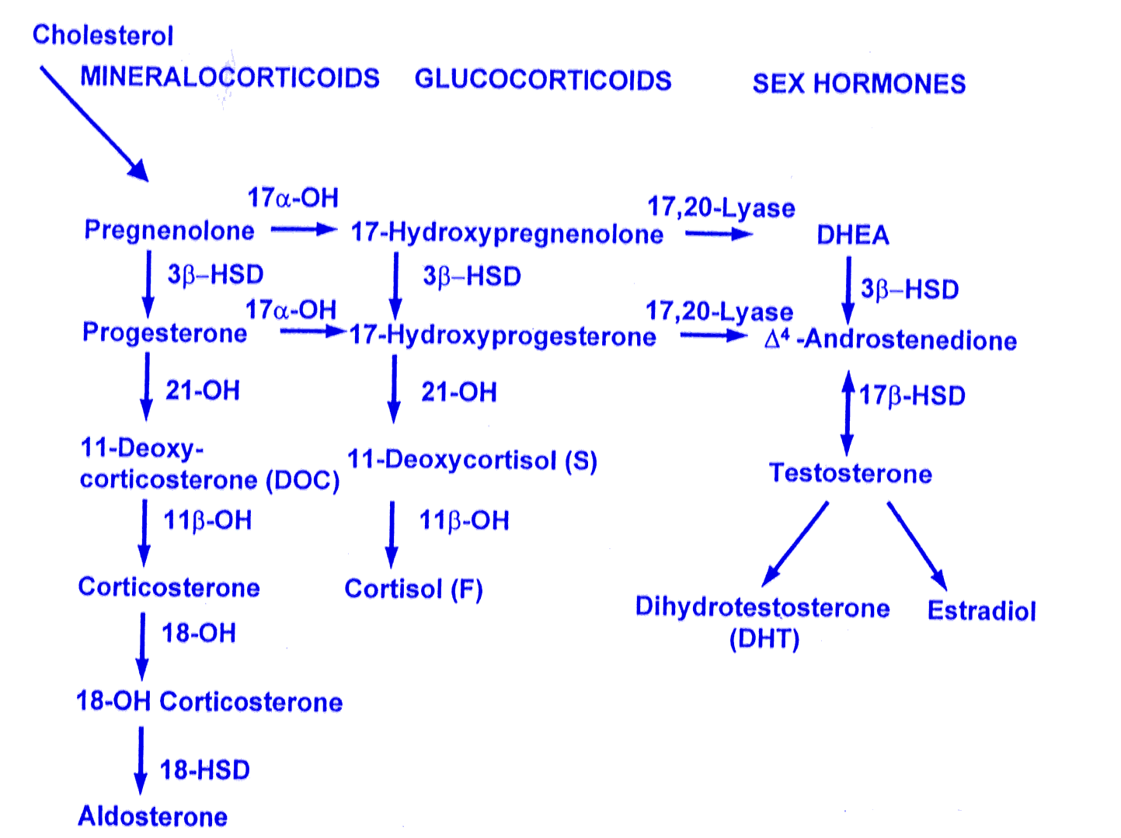

Slide 34
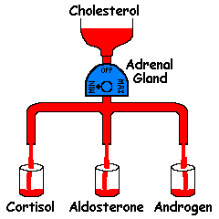
Congenital Adrenal Hyperplasia

Slide 35
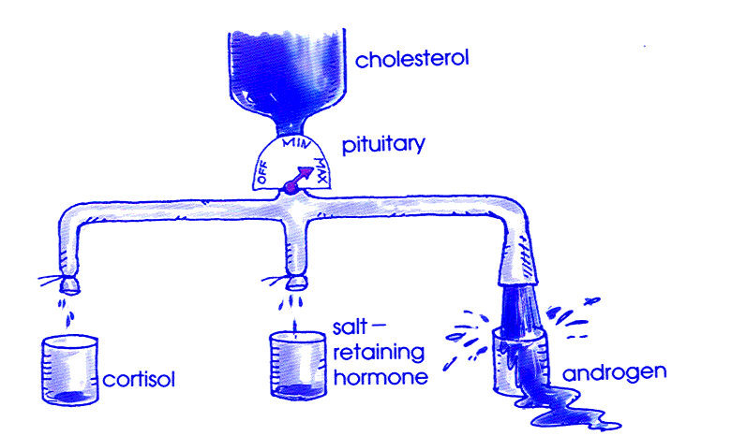
Congenital Adrenal Hyperplasia

Slide 36
Presentations of 21 HCAH
Ambiguous genitalia in girls
Dehydration
Shock
Salt-loss presentations with electrolytes imbalance
  Hyponatremia
  Hyperkalaemia
Hypoglycemia
Hyperpigementations

Slide 37
BOYS WITH CAH
Are unrecognized at birth because their genitalia are normal.
Present early with salt wasting
crisis resulting in dehydration, hypotension, hyponatremia and hyperkalemia
Or present later in childhood with early pubic hair, precocious puberty and accelerated growth

Slide 38
Nonclassical CAH
Residual enzyme activity.
Non salt losing CAH
present late in childhood with precocious pubic hair and/or clitoromegaly and accelerated growth.
Present in adolescence or adulthood with varying virilizing symptoms ranging from oligomenorrhea to hirsutism and infertility.

Slide 39
Diagnosis
Serum electrolytes & glucose
  Low Na & high K
  Fasting hypoglycemia
  Elevated serum urea due to associated dehydration
Elevated plasma Renin & ACTH levels
Low Cortisol
High 17 – OHP
High androgens especially testosterone level
Low Aldosterone
Urinary steroid profile
Chromosomes
Pelvic US

Slide 40
Management
Hydrocortisone
Fludrocortisone 0.05 - 0.2 mg/day
Triple hydrocortisone duiring stress.
During adrenal crisis intravenous hydrocortisone and IV fliud
Surgey for female external genetalia

Slide 41
Primary adrenal insufficiency:
Acute treatment
NS volume resusitation
  Reverse shock
Look for/treat hypoglycemia
  25% dextrose
New problem, suspected AI
  Labs→steroids
Established patient with AI
  Steroids

Slide 42
Stress dose steroids
Loading dose
  50-100 mg/M2 hydrocortisone IV/IM
  Small/medium/large approach
    Infants: Hydrocortisone 25 mg
    Small children: Hydrocortisone 50 mg
    Larger children/teens: Hydrocortisone 100 mg
Continue hydrocortisone with 50-100 mg/M2/day
  Divide q6-8 hours
  May be 2-3x home dose

Slide 43
Relative Steroid Potencies
 | Glucocorticoid | Mineralocorticoid
Hydrocortisone | 1 | ++
Prednisone/ Prednisolone | 3-5 | +
Methylprednisone | 5-6 | 0
Dexamethasone | 25-50 | 0
Fludrocortisone | 15-20 | +++++

Slide 44
Cushing’s syndrome
Cushing’s Syndrome
  Results from increased adrenocortical secretion of cortisol
  Causes include:
    ACTH-secreting tumor of the pituitary (Cushing’s disease)
    excess secretion of cortisol by a neoplasm within the adrenal cortex
    ectopic secretion of ACTH by a malignant growth outside the adrenal gland
    excessive or prolonged administration of steroids

Slide 45
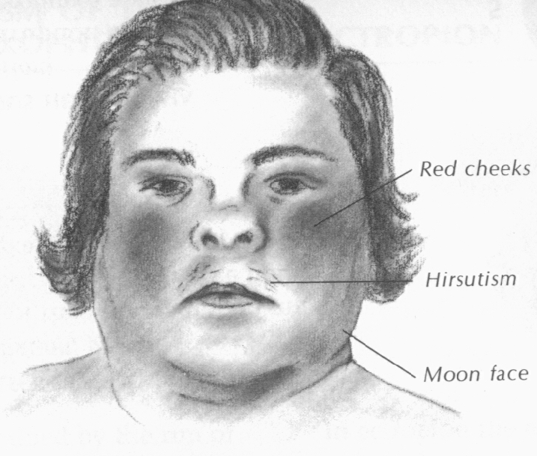
Cushing’s syndrome
Cushing’s Syndrome
  Characterized by:
    truncal obesity
    moon face
    buffalo hump
    acne, hirsutism
    abdominal striae
    hypertension
    psychiatric disturbances
    osteoporosis
    Amenorrhea
    Diabetes

Slide 46
Frequency of signs and symptoms in Cushing’s syndrome
Sign or symptom | Occurrence % | Sign or symptom | Occurrence %
Central obesity | 94 | Easy bruisability | 60
Hypertension | 82 | Osteoporosis | 60
Glucose intolerance | 80 | Personality changes | 55
Hirsutism | 75 | Acne | 50
Amenorrhea or impotency | 75 | Edema | 50
Purple striae | 65 | Headache | 40
Plethoric faces | 60 | Poor wound healing | 40

Slide 47
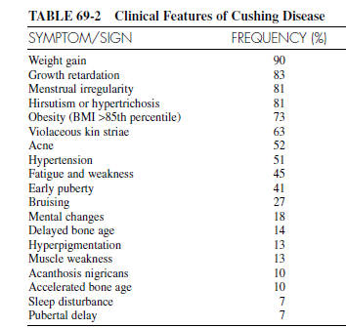

Slide 48
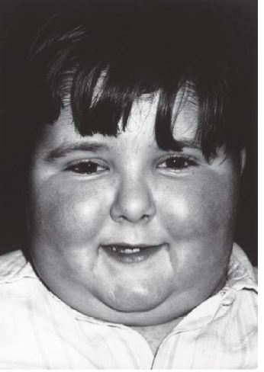

Slide 49
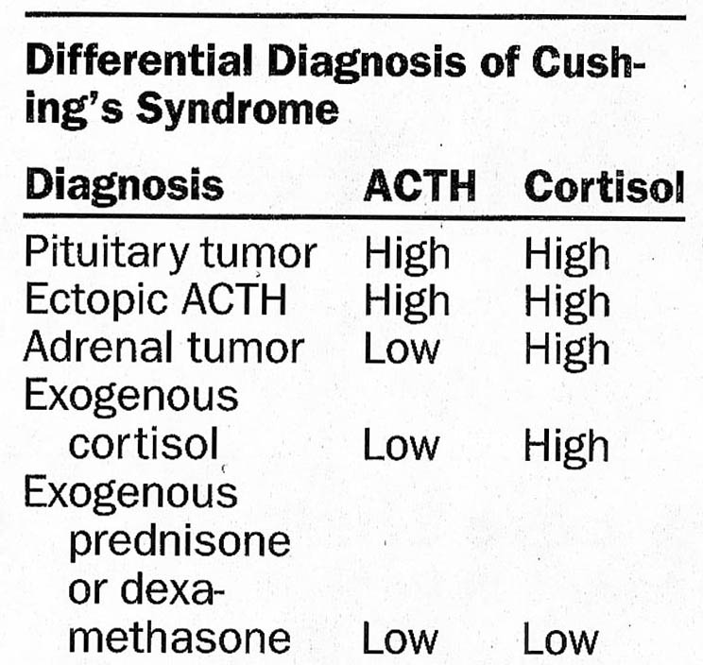

Slide 50
Treatment of Cushing’s syndrome
Treatment of underline cause
Surgery for neoplasia

Slide 51
THANK YOU

