Slide 1
BIRTH INJURIES
Prepared by: Dr. Salma Elgazzar

Slide 2
Learning objectives
Recognize causes and pathogenesis of birth injuries.
Recognize clinical presentation and differential diagnosis of birth injuries.
Recognize management of birth injuries.

Slide 3
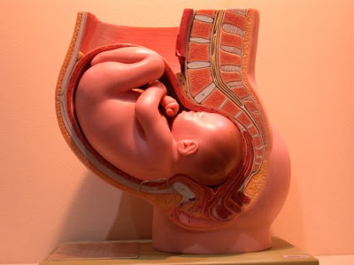
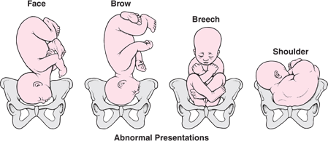

Slide 4
DEFINITION:
These are the injuries that occur during delivery.
It is defined as an impairment of the neonate's body function or structure due to an adverse event that occurred at birth.
INCIDENCE:
The overall incidence of birth injuries has declined with improvement in obstetrical and prenatal diagnosis.
The reported incidence of birth injuries is :
2% in vaginal deliveries (cephalic position).
1.1% in cesarean deliveries.

Slide 5
RISK FACTORS
Large babies:
When fetal weight exceeds 4 kg, in one study the incidence of fetal injury was 7.7% in infant with birth weight greater than 4.5 kg.
Maternal obesity.
Abnormal fetal presentation(fetal presentation other than a vertix position) particularly breech presentation.
Instrumental delivery.
Other factors:
Very small premature babies.
Small maternal stature.
Cephalopelvic disproportion.
Prolonged labor.
Primiparous.
Maternal pelvic anomalies.

Slide 6
CLASSIFICATION
Soft tissue injuries.
Cranial injuries.
Nerve injuries.
Facial injuries.
Visceral injuries.
Fractures.
Dislocation.

Slide 7
A.SOFT TISSUE INJURIES
The most common form of traumatic birth injuries are soft-tissue injuries including bruising, petechiae, subcutaneous fat necrosis, and lacerations.
Bruising and petechiae
Usually self-limiting and are often seen on the presenting portion of the newborn's body.
Bruising and edema of the genitals are common findings in infants delivered from the breech position.
Petechiae of the head and face are often seen in infants delivered from the vertex position, especially with a face presentation.
Most often, petechiae are present at birth, do not progress, and are not associated with other bleeding.
Significant bruising has been recognized as a major risk factor for the development of severe hyperbilirubinemia.
Follow-up within two days of the newborn hospital discharge is recommended for infants with significant bruising in order to assess them for progressive jaundice.

Slide 8
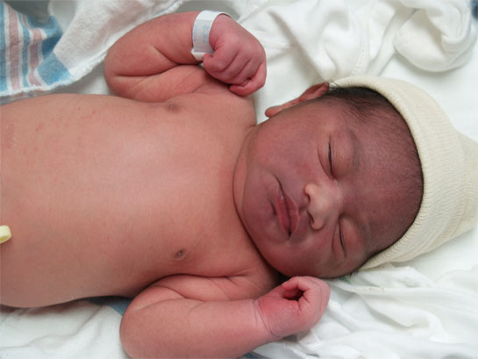
FACIAL BRUISING

Slide 9
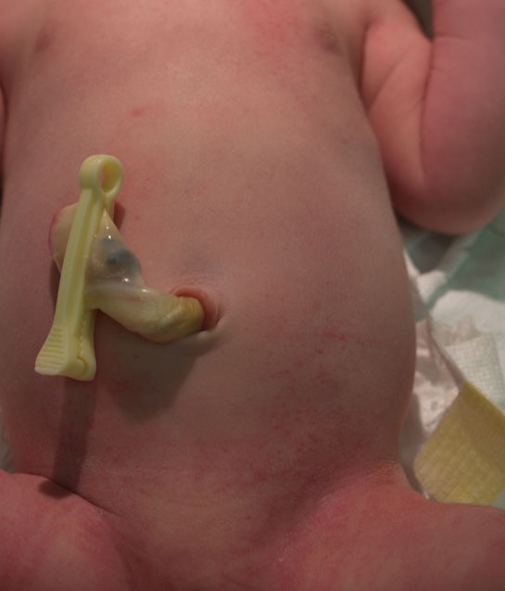
Petechiae of new born
While petechiae may be due to pressure during birth, widespread petechiae deserve some evaluation.

Slide 10
2.Subcutaneous fat necrosis
Subcutaneous fat necrosis (SFN) is uncommon
Usually occurs in the first few weeks of life as a result of ischemia to the adipose tissue following a traumatic delivery.
SFN is characterized by firm, indurated nodules and plaques on the back, buttocks, thighs, forearms, and cheeks.
Typically, this condition is self-limiting.
3.Lacerations
Fetal laceration has been reported as the most common birth injury associated with cesarean delivery .
The lacerations occurred most often on the presenting part of the fetus, typically the scalp and face.
The majority of fetal lacerations were mild, requiring repair with sterile strips only.

Slide 11
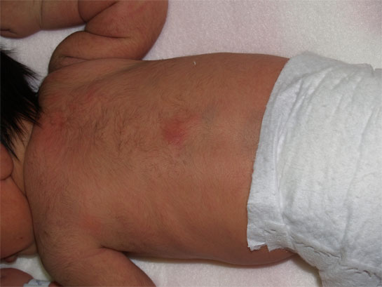
Subcutaneous fat necrosis
This red lesion is subcutaneous fat necrosis. On palpation, there is a firm nodule in the subcutaneous tissue under the area of redness that is freely mobile with respect to the bony structures underneath it. Subcutaneous fat necrosis is more common in infants who have had difficult deliveries, cold stress, or perinatal asphyxia. Lesions are typically asymptomatic and resolve spontaneously within several weeks, usually without scarring or atropy. Infants with extensive lesions or with renal disease should have calcium levels followed once or twice weekly. Hypercalcemia associated with subcutaneous fat necrosis is rare, but is a potentially lethal complication.

Slide 12
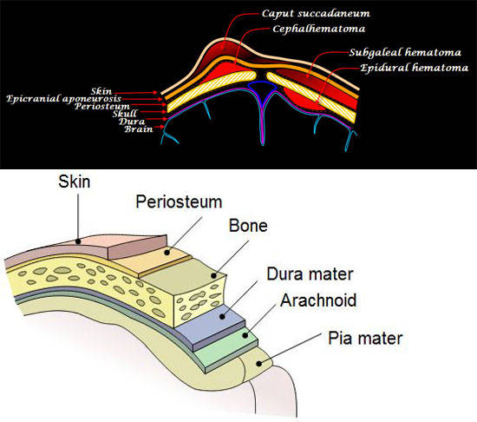
B. Cranial injuries
I. Extracranial injuries.
II. Intracranial hemorrhage.

Slide 13
I.Extracranial injuries
1- cephalhematoma
It is a sub- periosteal hemorrhage, thus it is limited to the borders of a cranial bone (usually parietal).
There is no discoloration of the overlying scalp.
It begins to appear after several hours because sub-periosteal bleeding is a slow process.
In some cases, there is an underlying linear fracture (detected by X-ray).
It resolves gradually and usually leaves an elevated edge.

Slide 14
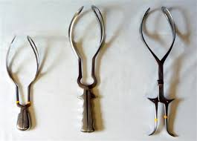
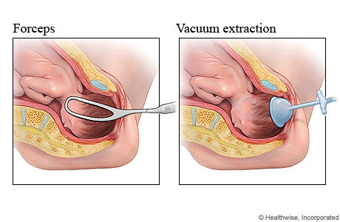

Slide 15
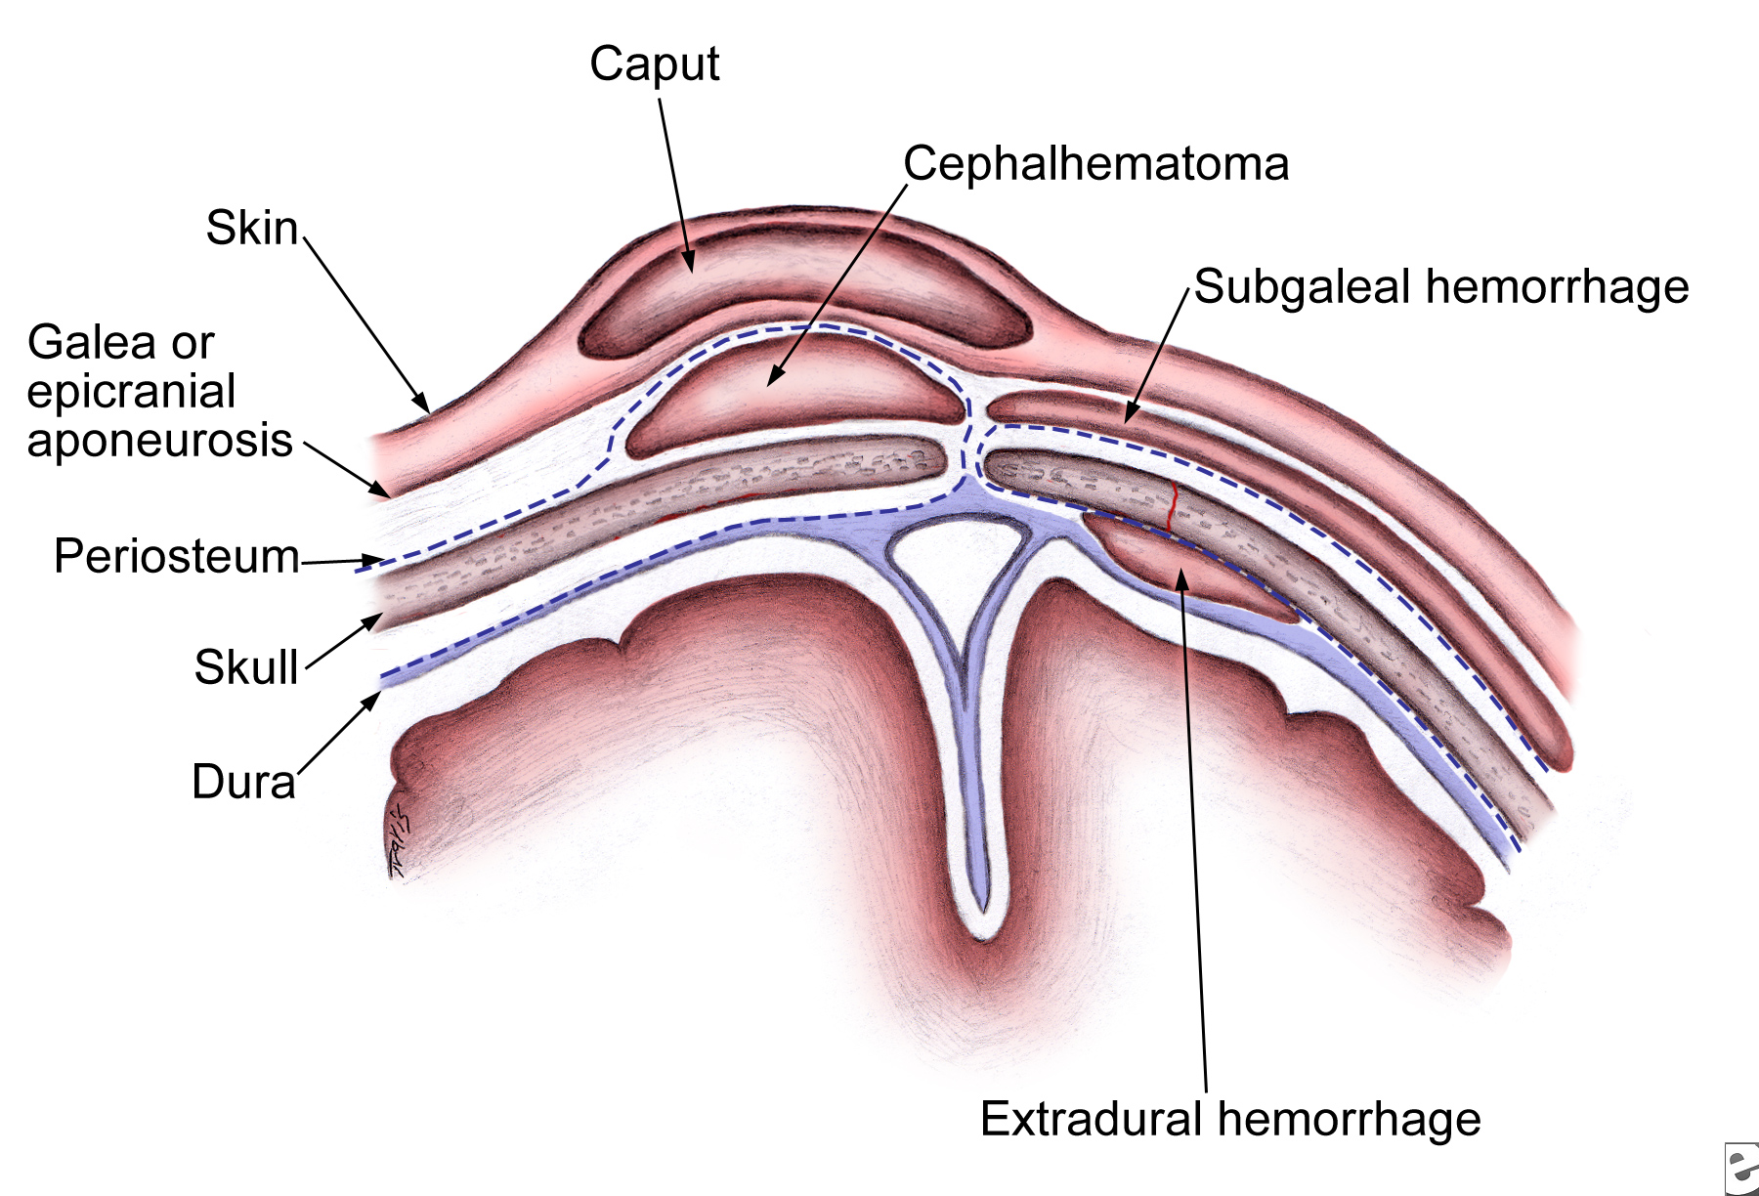

Slide 16
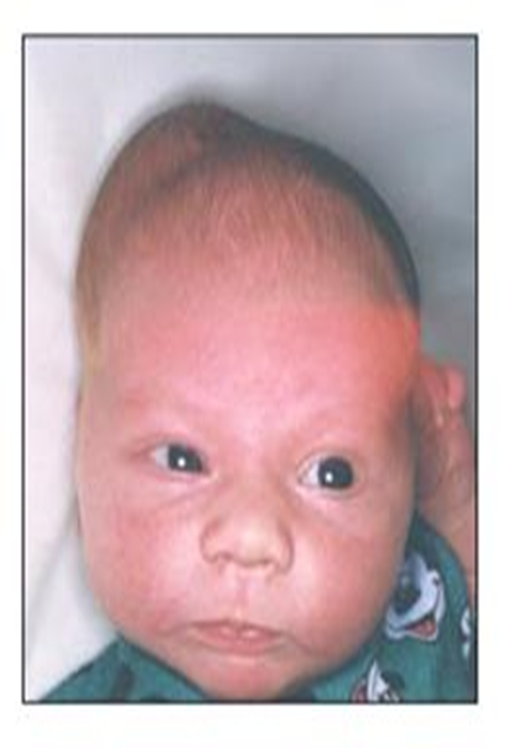
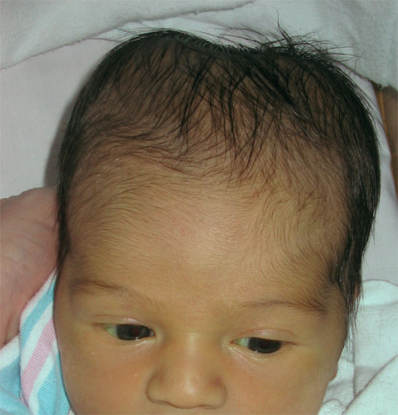
cephalhematoma

Slide 17
Complications:
Anemia (blood loss).
Hyperbilirubinemia (resorption of the hematoma) may occur with large cephalhematomas.
Infection may occur if aspiration is done
Management:
Usual management is mainly observation.(Do not aspirate)
Phototherapy may be necessary if blood accumulation is significant leading to jaundice.
Rarely anaemia can develop needing blood transfusion.
The presence of a bleeding disorder should be considered but is rare.
Skull radiography or CT scanning is also used if concomitant depressed skull fracture is a possibility.

Slide 18
Differential diagnosis:
It should be differentiated from:
Caput succedaneum.
Menigeocele (pulsating, increases with crying,x-ray shows a bone defect.
Subaponeurotic hemmorhage.

Slide 19
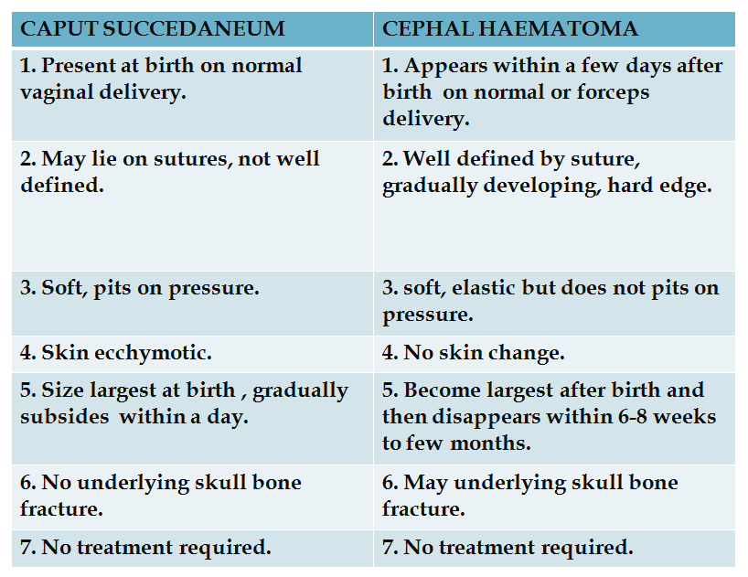
2- Caput Succedaneum
This a diffuse edematous swelling of the scalp, presents at birth, not limited to a bone which resolves in few days.

Slide 20
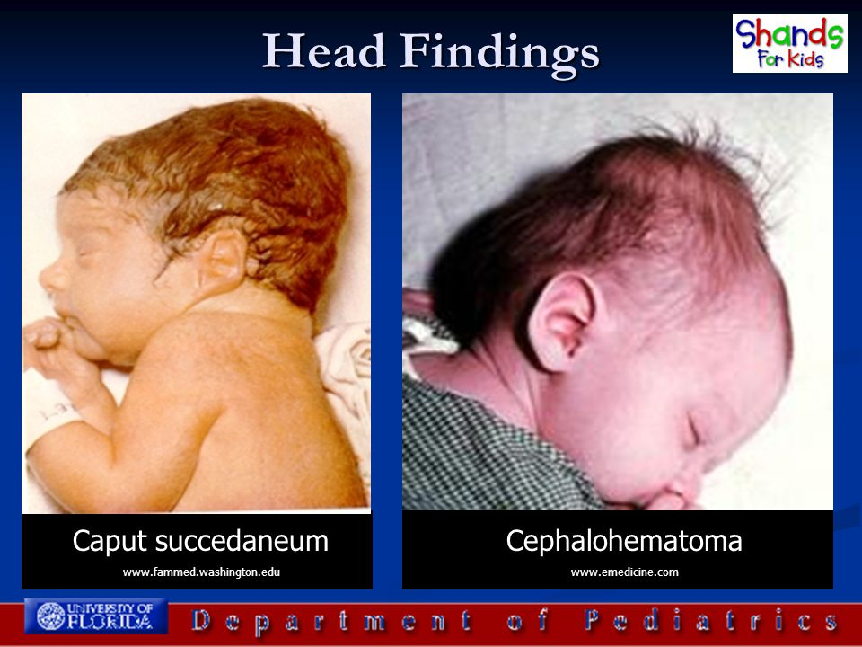

Slide 21
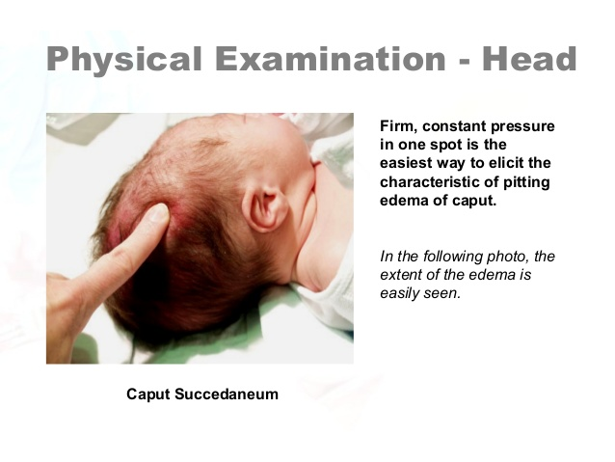

Slide 22
3- Subaponeurotic hemorrhage
-The whole scalp is swollen and boggy with bluish discoloration.
-Hemorrhage is in the loose areolar area (under the aponeurosis) i.e. not limited to bone.
-Clinical picture of shock may be present.

Slide 23
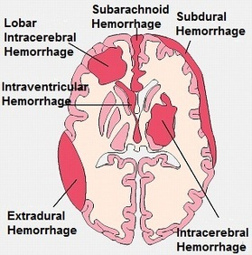
II. Intracranial hemorrhage
Definition:
Hemorrhage inside the cranial cavity.
Types:
-Outside the brain (epidural, subdural, subarachnoid).
-In the brain ventricles (interventricular).
-In the brain parenchyma (e.g. intracerebral)

Slide 24
II. INTRACRANIAL HEMORRHAGE
The most common:
In preterm →interventricular.
In full-term→ subarachnoid and intracerebral.
Important causes:
Instrumental delivery.
Hypoxia (perinatal, hyaline membrane disease)
Spontaneous in extreme prematurity.
Bleeding tendency is a rare cause.

Slide 25
II. INTRACRANIAL HEMORRHAGE
Clinical manifestations:
Pallor , cyanosis with irregular breathing, later on jaundice (resorption of concealed blood).
Lethargy , poor Moro reflex ,weak suckling.
High pitched cry.
Convulsions, usually tonic.
Tense bulging anterior fontanel.
Localizing neurological deficits may occur like occular palsies, unequal pupils.
N.B .Triad of pallor, high pitched cry, tense bulging ant. fontanel you should suspect intracranial hemorrhage.
Diagnosis:
Beside the history and clinical picture:
Cranial ultrasonography is very useful and as sensitive as the CT scan.
A hemorrhagic CSF occurs in subarachnoid hemorrhage.

Slide 26
II. INTRACRANIAL HEMORRHAGE
Complications:
Death from respiratory failure.
Obstructive hydrocephalus.
Cerebral palsy.
Prevention:
Good maternal and obstetric care.
Treatment:
The treatment is a symptomatic one:
Vitamin K to help coagulation.
Ventilatory support (if there is respiratory difficulty).
Phenobarbitone (if there is convulsions).
Blood transfusion (if there is anemia).
Treatment of complications like hydrocephalus.

Slide 27
C. Nerve injuries
1-Phrenic nerve injury:
-It causes diaphragmatic paralysis with paradoxical movement.
-Clinical manifestations include respiratory distress with diminished breath sounds on the affected side.
2-Facial verve injury:
- Occurs with forceps delivery or as a result of compression of the facial nerve against the mother’s ischial spine.
- It is of lower motor neuron type thus it affects upper and lower parts of face.

Slide 28
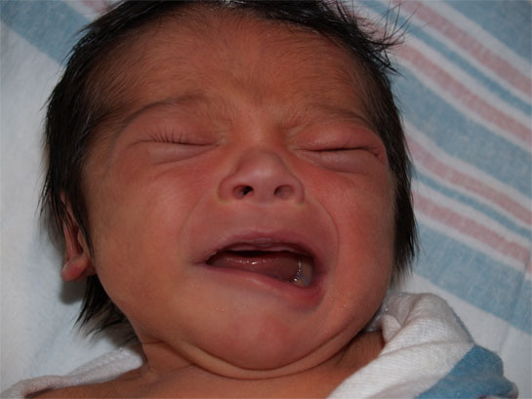
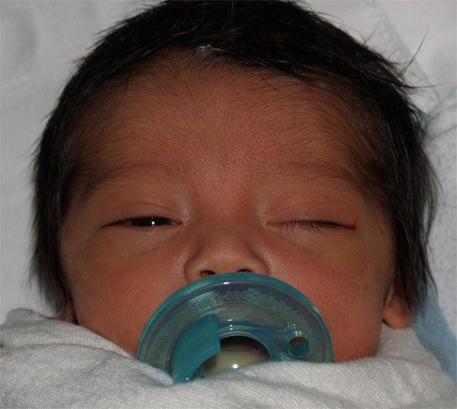
. Facial Nerve Injury

Slide 29
3- Brachial plexus injury:
Cause: It occurs when traction is exerted on the head and neck during delivery.
Types:
 | Erb’s paralysis (common) | Klumpke’s paralysis (rare)
Site of injury | Upper trunk ( C5,6) | Lower trunk (C8,T1)
Muscles affected | Deltoid (abduction). Biceps,supinator (supination) | Intrinsic muscles of the hand.
position | Adduction ,internal rotation of the arm with pronation of the forearm. (policeman’s tip) | Partial claw hand
association | Phrenic nerve palsy (fibers fom C5) | Horner’s syndrome (sympathetic fibers in T1)

Slide 30
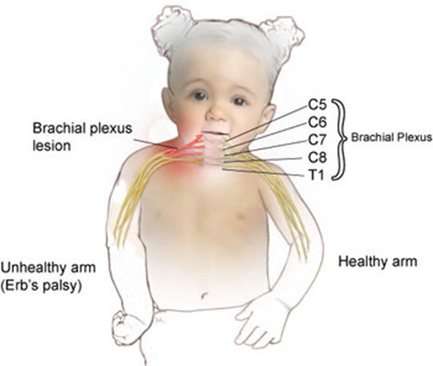
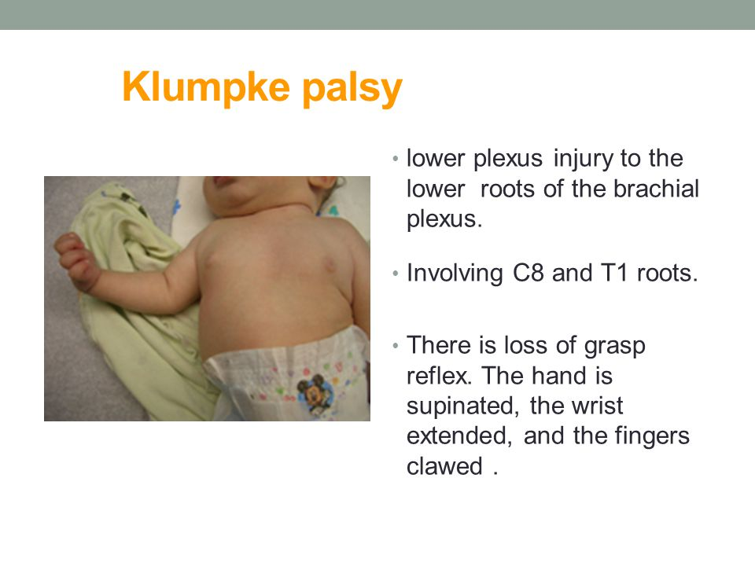

Slide 31
Prognosis:
If paralysis is due to edema ,and the nerve fibers are intact , the function will return within a few months.
If paralysis is due to laceration, permanent damage will occur.
Treatment:
Maintain the neutral position.
Physiotherapy ( nerve stimulation)
Exploration and neuroplasty is not recommended except months later

Slide 32
D. FACIAL INJURIES
1-NASAL SEPTAL DISLOCATION:
-It occurs due compression of the nose from the maternal symphysis pubis or sacral promontory during labor and delivery.
-The examination reveals deviation of the nose to one side with asymmetric nares and flattening of the dislocated side.
-The pressure of the tip of the nose causes the nares to collapse, resulting in a more apparent deviated septum, which does not resume a normal position when pressure is released.
-The diagnosis is made by rhinoscopy.
-Manual reduction by an otolaryngologist using a nasal elevator should be performed by three days of age.
- No treatment or a delay in treatment may result in nasal septal deformity .

Slide 33
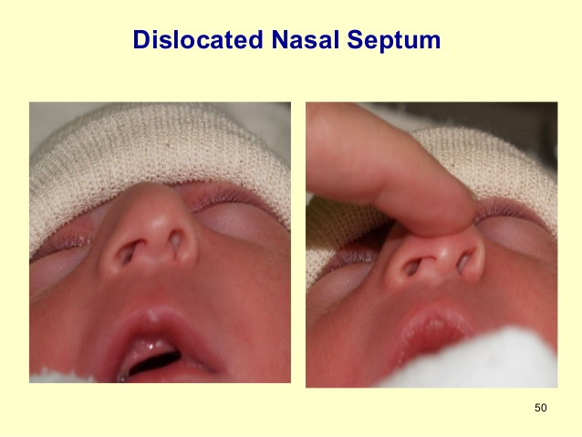

Slide 34
2- OCULAR INJURIES :
Minor ocular trauma, such as retinal and subconjunctival hemorrhages, and lid edema, are common and resolve spontaneously without affecting the infant
-Resolution of a retinal hemorrhage occurs within one to five days and a subconjunctival hemorrhage within one to two weeks.
-Significant ocular injuries ( hyphema, vitreous hemorrhage, orbital fracture, lacrimal duct or gland injury, and disruption of Descemet's membrane of the cornea)occur with a higher incidence associated with forceps-assisted delivery.
-Prompt ophthalmologic consultation should be obtained for patients with, or suspected to have, these injuries.

Slide 35
E. Visceral and muscle injuries
The important visceral and muscle injuries include:
Subcapsular hematoma of the livre.
Suprarenal hemorrhage.
Sternomastoid tumor:
-It is a painless firm swelling, around 2 cm in diameter over the middle or lower third of the sternomastoid muscle.
-Stretching of the muscle during delivery→ small hematoma which heals by fibrosis.
- In the majority of cases, it resolves spontaneously and needs nothing more than physiotherapy.
-If it persists ,torticollis occurs and may need surgical resection of the fibrous band.

Slide 36
F. FRACTURES
Most common bones that can be fractured during birth are:
Skull:
- Linear fractures → observe only.
Depressed fracture → has to be evaluated even if there are no neurological deficits.
2. clavicle:
- Most common ,causes unilateral absence of Moro reflex.
- Management: nothing as it heals spontaneously.
3. Long bones:
Splint with wooden tongue depressor. (e.g. fractural femur)

Slide 37
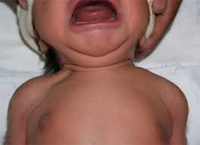
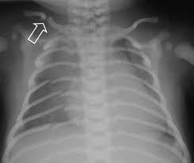
Clavicular fracture

Slide 38
G. Dislocations
Dislocations caused by birth trauma are rare. In many cases, the dislocations, especially of the hip and knee, are due to intrauterine positional deformities or congenital malformations.
- The lack of ossification in neonates limits the utility of plain radiographs in diagnosing dislocations, and other modalities, such as ultrasound, magnetic resonance imaging, and arthrography, may be needed.

Slide 39
Summary
The overall incidence of birth injuries is about 2 and 1.1 percent in vaginal and cesarean deliveries, respectively.
Factors that increase the risk of birth injuries include macrosomia (fetal weight greater than 4000 g), maternal obesity, breech presentation, operative vaginal delivery (ie, the use of forceps or vacuum during delivery), small maternal size, and the presence of maternal pelvic anomalies.
The most common form of traumatic birth injuries are soft-tissue injuries including bruising, petechiae, subcutaneous fat necrosis, and lacerations. Lacerations are the most common injury associated with cesarean delivery and are generally mild, requiring repair only with sterile strips. The other three conditions are generally self-limited and resolve without any intervention.
The extracranial injuries of caput succedaneum (edema of the scalp) and cephalohematoma (subperiosteal collection of blood) usually resolve spontaneously without any intervention.

Slide 40
Summary
Neurologic injury includes injury to peripheral nerves including the brachial plexus and facial, phrenic.
Facial injuries include nasal septal dislocation, which requires reduction by three days of life to avoid nasal septal deformity, and ocular injuries, which are usually mild and resolve without any intervention.
Intra-abdominal injuries due to birth trauma are rare and primarily are due to rupture and subcapsular hemorrhage into the liver, spleen, and adrenal gland.
Fractures due to birth trauma include clavicular, humeral, femoral, and skull fractures. Since most clavicular and skull fractures resolve spontaneously, they are managed conservatively with observation alone.

Slide 41
THANK YOU

