Slide 1
ABG INTERPRETATION

Slide 2
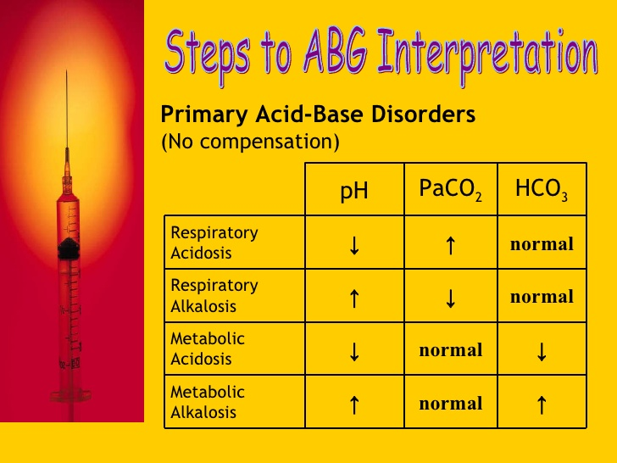

Slide 3
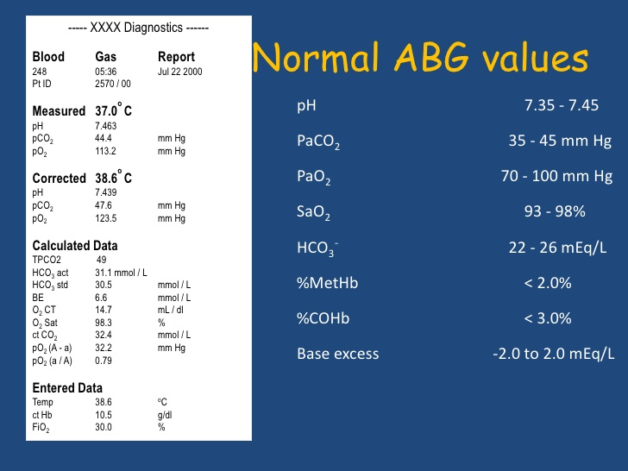

Slide 4
BE = from – 2.5 to + 2.5 mmol/L
BE (base excess) is defined as the amount of acid that would be added to blood to titrate it to pH 7.4 at pCO₂ = 40 mmHg.
positive value = base excess
negative value = base deficit (BD)

Slide 5
The Delta Ratio (∆/∆)
The delta ratio is sometimes used in the assessment of elevated anion gap metabolic acidosis to determine if a mixed acid base disorder is present.
Delta ratio = ∆ Anion gap/∆ [HCO3-] or ↑anion gap/ ↓ [HCO3-]
Delta Delta = Measured AG– Normal AG
Normal [HCO3-] – Measured [HCO3-]
= (AG – 12)
(24 - [HCO3-])

Slide 6
Delta ratio | Assessment Guidelines
< 0.4 | Hyperchloremic normal anion gap acidosis
<1 | High AG & normal AG acidosis
1 to 2 | Pure Anion Gap Acidosis Lactic acidosis: average value 1.6 DKA more likely to have a ratio closer to 1 due to urine ketone loss
>2 | High AG acidosis and a concurrent metabolic alkalosis or a pre-existing compensated respiratory acidosis

Slide 7
E.G1
pH: 7.56 (7.35-7.45)
pO2: 10.7 (10–14)
pCO2: 5.0 (4.5–6.0)
HCO3: 31 (22-26)
BE: +5 (-2 to +2)
Other values within normal range
What does the ABG demonstrate?
What’ s the differential diagnosis of this ABG picture?

Slide 8
1-This is metabolic alkalosis
2-Differential diagnosis of a metabolic alkalosis:
Persistent vomiting
  E.g. gastric outlet obstruction (the classic example is pyloric stenosis in a baby)
Hyperaldosteronaemia
Diuretic use
Milk alkali syndrome
Massive transfusion

Slide 9
E.G2
pH: 7.25 (7.35-7.45)
pO2: 11.1 (10–14)
pCO2: 3.2 (4.5–6.0)
HCO3: 11 (22-26)
BE: -15 (-2 to +2)
Potassium: 4.5
Sodium: 135
Chloride: 100
Other values within normal range
What is the acid base disorder?
What is the anion gap in this case?

Slide 10
1-It is a case of metabolic acidosis
2-Anion gap = [Na⁺] − ([Cl–] + [HCO₃⁻])
Here anion gap is:135-(100+11)=24

Slide 11
What is the differential diagnosis for a metabolic acidosis with raised anion gap?
What is the differential diagnosis for a metabolic acidosis with normal or decreased anion gap?

Slide 12
High anion gap metabolic acidosis:
MUDPILES
Methanol
Uraemia
Diabetic ketoacidosis (and alcoholic/starvation ketoacidosis)
Propylene glycol
Isoniazid
Lactate
Ethylene glycol
Salicylates

Slide 13
another way is to think about the mechanism of acidosis:
Excess production of acids
  DKA, lactic acidosis (produced by poorly perfused tissues)
Ingestion of acids
  Methanol, ethanol, ethylene glycol
Inability to clear acids
  Renal failure

Slide 14
metabolic acidosis with normal or decreased anion gap
Loss of bicarbonate:
From the GI tract (diarrhoea or high-output stoma)
From the kidneys (renal tubular acidosis)

Slide 15
E.G3:
pH: 7.12 (7.35-7.45)
pO2: 11.5 (10–14)
pCO2: 3.2 (4.5–6.0)
HCO3: 9 (22-26)
BE: -17 (-2 to +2)
Lactate: 4.0
Potassium: 5.5
Glucose: 22
DIAGNOSIS?

Slide 16
Dka with metabolic acidosis

Slide 17
Respiratory compensation for metabolic disorders
In metabolic acidosis
Expected pCO2 = 1.5 x [HCO3] + 8 (range: +/- 2)
In metabolic alkalosis
Expected pCO2 = 0.7 [HCO3] + 20 (range: +/- 5)
“If the actual pCO2 or [HCO3-] is different from the predicted values,
You must suspect a 2nd acid-base disorder”

Slide 18
metabolic compensation for respiratory acid base disorders
Acute Respiratory ACIDOSIS:
The [HCO3] will increase by 1 mmol/l for every 10 mmHg elevation in pCO2 above 40 mmHg
Chronic Respiratory acidosis:
The [HCO3] will increase by 4 mmol/l for every 10 mmHg elevation in pCO2 above 40mmHg

Slide 19
Acute Respiratory alkalosis:
The [HCO3] will decrease by 2 mmol/l for every 10 mmHg decrease in pCO2 below 40 mmHg.
•Chronic Respiratory alkalosis:
The [HCO3] will decrease by 5 mmol/l for every 10 mmHg decrease in pCO2 below 40 mmHg.

Slide 20
E.G4:
a hypertensive lady on thiazide therapy , develops pneumonia which results in hyperventilation
PH=7.64
PCO2=32
PO2=75
HCO3=33
K=2.1
DIAGNOSIS?

Slide 21
A mixed alkalosis: A metabolic alkalosis due to the thiazide diuretic therapy and a respiratory alkalosis.
A respiratory alkalosis is present. This is probably secondary to the dyspnoea from decreased pulmonary compliance due to the pneumonia.
The metabolic alkalosis is probably chronic as the patient has been on these drugs for some time. The hypokalaemia is assumed to be related to this diuretic use and the alkalosis.

Slide 22
Case report 1
A young man was injured in the chest from a car accident. Instrument ventilation was started.
plasma measured values
HCO₃⁻ 25 mmol/L
pH 7.24
pCO₂ 60 mmHg = 8 kPa
pO₂ 60 mmHg = 8 kPa
Type of ABB disorder??

Slide 23
Solution of case report 1
Respiratory acidosis without compensation. Hypoventilation is a cause of ↑ pCO₂ in arterial blood.

Slide 24
Case report 2
A 45 year old man was admitted with a history of persistent vomiting. He had a long history of dyspepsia. Examination revealed dehydration and shallow respiration.
plasma measured values
K⁺ 2.8 mmol/L
HCO₃⁻ 45 mmol/L
urea 34 mmol/L
ABG
pH 7.56
pCO₂ 54 mmHg = 7.2 kPa
Type of AB disorder??

Slide 25
Solution of case report 2
Metabolic alkalosis is a result of persistent vomiting loss of H⁺ and dehydration.
Small amount of urine (lower diuresis) is a cause of higher concentration of urea in blood.
Respiratory compensation was started (hypoventilation) → ↑ pCO₂.
Lower K⁺ concentration indicates alkaleamia.

Slide 26
Case report 3
A 23 year old mechanic was admitted to hospital 12 hours after drinking antifreeze.
He was given 400 mmol of HCO₃⁻ with a little effect. Dialysis was started but he went to shock and died 12 hours after admission.
plasma admission dialysis 4 hours
Na⁺ 137 mmol/L 145 mmol/L
K⁺ 5.4 mmol/L 4.9 mmol/L
Cl⁻ 95 mmol/L 87 mmol/L
HCO₃⁻ 4 mmol/L 5 mmol/L
Glc 2.5 mmol/L
ABG
pH 6.95 7.05 7.29
pCO₂ 15 mmHg 16 mmHg 25 mmHg = 3.33 kPa
Type of ABB disorder??

Slide 27
Solution of case report 3
Metabolic acidosis is due to antifreeze poisoning. Antifreeze contains ethylene glycol which is oxidized to oxalic acid in body.
After 12 hours, the respiratory compensation was started → hyperventilation → ↓ pCO_{2.}
Cause of his death is a renal failure due to oxalates in kidneys.

Slide 28
Case report 4
A young woman was admitted 8 hours after taking an overdose of aspirin.
plasma measured values
HCO₃⁻ 12 mmol/L
ABG
pH 7.53
pCO₂ 15 mmHg = 2 kPa
Type of ABB disorder??

Slide 29
Solution of case report 4
Respiratory alkalosis is due to overdose of aspirin.
pCO₂ is decreased because patient has a hyperventilation.
Renal compensation was started → excretion of HCO₃⁻.

