Slide 1
MED – I TUTORIAL
25/09/2016
Dr. M. Sofi MD; FRCP (London); FRCPEdin; FRCSEdin

Slide 2
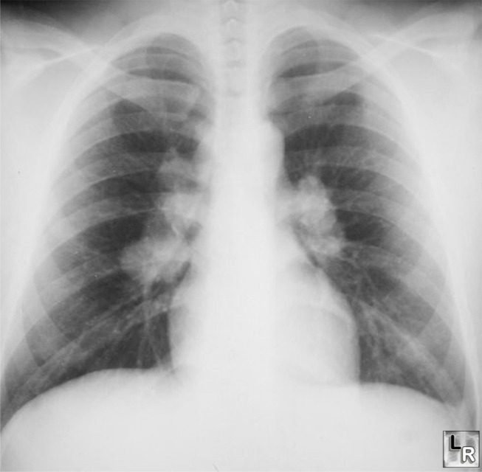
40 year old man presented with cough and shortness of breath for six months.
Six weeks ago he noticed painful lumps on the skin of his legs which had resolved in two weeks
Investigation:
FBC: normal
Sodium 145 mmol/l
Potassium 2.8 mmol/l
Chloride 100 mmol/l
Urea 2.4 mmol/l
Serum creatinine 83 µmol/l
Calcium 3.4 mmol/l
What is the abnormality in CXR?
What is the most likely diagnosis?

Slide 3
Bilateral hilar lymphadenopathy: Causes
Sarcoidosis
Infection
  Tuberculosis
  Fungal infection
  Mycoplasma
  Intestinal Lipodystrophy (Whipple's disease)
Malignancy
  Lymphoma
  Carcinoma
  Mediastinal tumors
In-organic dust disease
  Silicosis
  Berylliosis
Extrinsic allergic alveolitis
  Such as bird fancier's lung
Less common causes also exist:
  Churg-Strauss syndrome
  Human immunodeficiency virus
  Extrinsic allergic alveolitis
  Adult-onset Still's disease

Slide 4
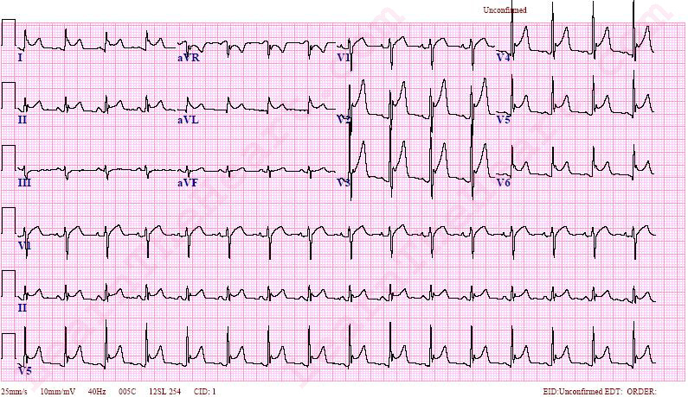
28 year old lady presented with sharp chest pain which radiated to trapezius ridge and was worse in supine position lasted for hours
What are conspicuous changes in ECG?
What is the likely diagnosis?

Slide 5
Pericarditis: Causes:
Idiopathic causes
Infectious conditions:
  Viral
  Bacterial
  TB
Inflammatory disorders:
  RA
  SLE
  Scleroderma
  Rheumatic fever
Metabolic disorders:
  Renal failure
  Hypothyroidism
  Hypercholesterolemia
Cardiovascular disorders:
  Acute MI
  Dressler syndrome
  Aortic dissection
Miscellaneous causes:
  Iatrogenic,
  Neoplasms,
  Drugs,
  Irradiation,
  Cardiovascular procedures
  Trauma

Slide 6
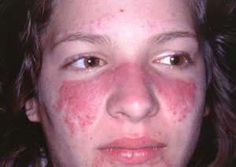
Describe 2 characteristics of the rash?
  -----------
  ------------
Name 2 conditions in which this type of rash is present?
  --------------
  --------------

Slide 7
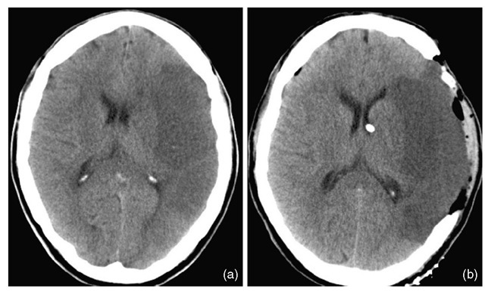
Describe 2 abnormal findings of the CT?
  -------------------
  ------------------
Name vascular territory involved?
  ----------------------

Slide 8
A 24 year old student was admitted with SOB and tingling in her hands. . An ABG was taken on 35% oxygen.
pH 7.52 (NR 7.35-7.45)
PaO₂ 28 kPa (NR 10.0-14.0 kPa)
Paco₂ 2.0 kPa (NR 4.4-5.9 kPa)
HCO3⁻ 18.4mmol/l (NR 18-22 mmol/L)
Base excess + 6 mmol/l (-3)-(+3)
What is the functional abnormality?
Respiratory acidosis
Metabolic acidosis
Mixed metabolic acidosis and alkalosis
Respiratory alkalosis
Circulating auto-antibodies are found in?
Hairy cell leukemia
Multiple myeloma
SLE
Dermatomyositis

Slide 9
The management of patient with slurred speech resolved in 15 minutes includes?
Discharge with follow up appointment in the clinic after 1 week
Start intravenous heparin.
Start aspirin immediately.
Urgent CT brain to exclude cerebral bleed.
Splenectomy is curative in?
G6PD deficiency
Sickle cell anemia
Thalassemia
Hereditary spherocytosis
In which type of epilepsy, the level of consciousness is spared?
  Complex partial.
  Simple motor.
  Absence.
  Generalized tonic clonic.

Slide 10
Cushing’s disease is?
Tumor of adrenal cortex
Primary bilateral adrenal hyperplasia
ACTH secreting tumor of pituitary
Ectopic tumor manifestation of Ca lung
Commonest histological variety of nephrotic syndrome is?
Minimal lesion
Focal glomerulosclerosis
Mesngioproliferative
Membranous
Macrocytic anemia with peripheral neuropathy the likely to have deficiency of?
Folic acid
Vitamin B12
Iron
Vitamin C

Slide 11
A man with painful goitre
A 40 year old man presented with fatigue, fever and painful goitre. The results of investigations were as follows:
Hb 14.3 g/dl
WBC 11.2 x 10^{9/l}
ESR 100 mm in the first hour
T4 32.4pmol/l (NR 9.4 – 24.5)
TSH ˂ 0.1mU/l (NR 0.5 – 5.5 )
Radio-iodine 131 thyroid scan: uptake at 4 hours ˂ 5% (normal range 6 -18%)
What are the lab result abnormalities?
What is the most likely diagnosis?
What treatment is required?

Slide 12
A 48 year old female is concerned about her several episodes of fainting. Brief clinical examination reveals pallor of her skin. Her blood is:
Hb 8.7 g/dl
MCV 64.5 fl
Plt 556 x 10⁹/l
WBC 7.7 x 109/l
Serum iron 6 µmol/l (NR: 65-180 µg/dL )
Ferritin 10 µmol/l (NR: 12-300 ng/mL)
TIBC 90 µmol/l (NR: 45-85 µmol/L)
Vitamin B12 221 ng/l (NR: 130-700 ng/L)
Folate 9.2 µgl/l (NR: 7-36 nmol/L
How would you interpret these results?
---------------------------------
How would you proceed with investigations?
--------------------------------
--------------------------------

Slide 13
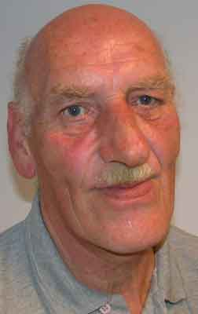
65 year old man presents with worsening hoarseness of voice and noticed progressive coarsening of his skin
What is the clinical diagnosis? ______
What investigation should be requested?_______

Slide 14
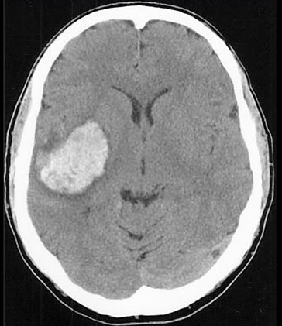
Axial CT scan obtained in a 57-year-old man who presented with left hemiplegia and obtundation.
Name the site of the lesion?
--------------------
What is commonest cause of this lesion?
------------------

Slide 15
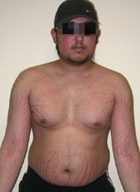
This young man was found to have hypertension on routine examination and referred to dermatology for purple striae on his body.
What is the clinical diagnosis? __________
Name 2 relevant investigation of choice?
  ----------
  ----------
Q2

Slide 16
Treatment options of Cushing’s syndrome include?
Untreated patients have normal life span
Bilateral adrenalectomy should have pituitary irradiation
Medical treatment alone is efficacious
Cushing’s disease is synonymous with Cushing’s syndrome
Cushing disease (secondary hypercortisolism) presents with?
Bilateral adrenal cortical atrophy
Prominent hypo-pigmentation
Spontaneous remission
Anterior pituitary adenoma
Cushing’s syndrome?
Obesity is late manifestation
Hyper-pigmentation favors ectopic ACTH source
Hyper-prolactnemia is prominent feature
Distal muscles wasting is typical

