Slide 1
Photographic Quiz In Medicine
By Dr. Zahoor

Slide 2
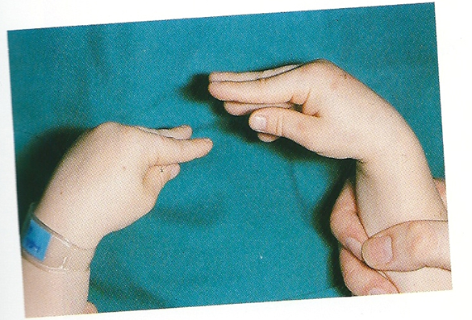
Question 1:
What is shown in the picture?
What is most likely cause?

Slide 3
Answers 1
Carpopedal spasm
2. Hypocalcaemia

Slide 4
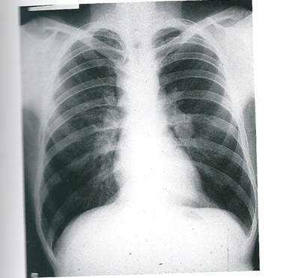
Question 2:
What abnormality does this chest X-ray show?
What is the likely diagnosis?

Slide 5
Answers 2
Bilateral hilar lymphadenopathy
Lymphoma
Sarcoidosis
Leukemia

Slide 6
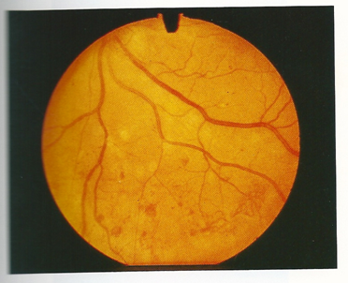
Question 3
What abnormality is shown?
What is the most likely cause?

Slide 7
Answers 3
Haemorrhages
- Exudates
2. Diabetic retinopathy

Slide 8
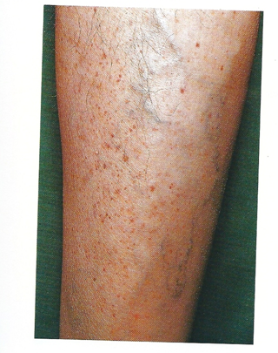
Question 4
What is seen in the picture?
What could be the cause?

Slide 9
Answers 4
Petichel Hemorrhages (purpura)
Thrombocytopenia
- Drugs e.g. Thiazide diuretic, heparin , Quinine, NSAID drugs, Ranitidine

Slide 10
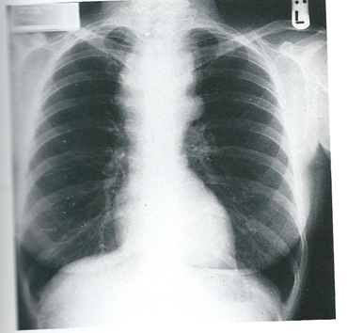
Question 5
What abnormality is shown?
What could be the cause?

Slide 11
Answers 5
Mediastinal mass
Lymphoma
Thymoma
Metastatic carcinoma
Leukemia

Slide 12
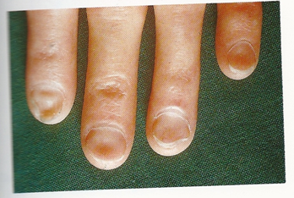
Question 6
What abnormality is shown?
What is the most likely cause?

Slide 13
Answers 6
Koilonychia
Iron deficiency anaemia

Slide 14
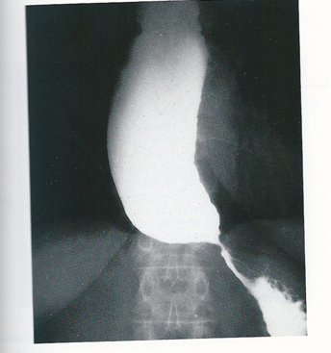
This patient had progressive dysphagia. Barium swallow was done.
Question 7
What does the X-ray show?
What is the diagnosis?

Slide 15
Answers 7
Narrowing of lower end of Esophagus
Achalasia

Slide 16
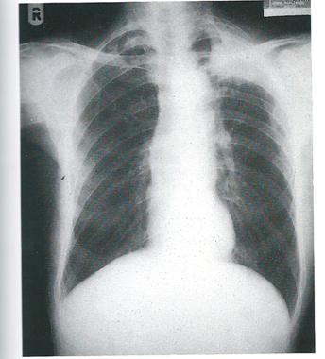
Chest X-ray of middle aged man
Question 8
What does this X-ray show?
What is likely diagnosis?

Slide 17
Answers 8
White shadow left apex
Most likely left apical carcinoma, Pancoast tumor

Slide 18
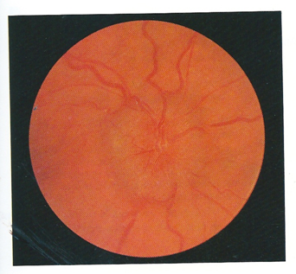
This patient was presented with headache.
Question 9
What is shown in the picture?
What could be the cause?

Slide 19
Answers 9
Papilloedema
Raised intracranial pressure e.g. brain tumor, meningitis

Slide 20
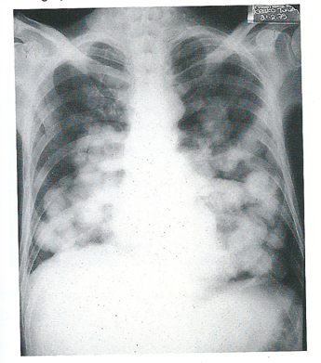
This patient is presented with weight loss.
Question 10
What this X-ray chest is showing?
What is the diagnosis?

Slide 21
Answers 10
Chest X-ray shows multiple rounded shadows in the lung fields
Multiple secondaries - cannonball secondaries (primary carcinoma site in kidney or testes)

Slide 22
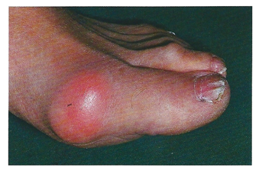
Question 11
What is the diagnosis?
What is the treatment that you would give?

Slide 23
Answers 11
Acute gout
Anti-inflammatory drugs e.g. Voltaren, Brufen

Slide 24
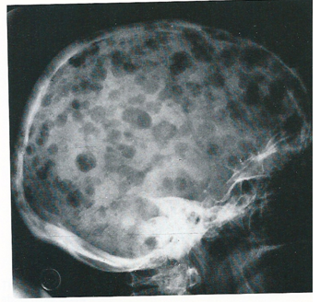
Question 12
What does the skull X-ray show?
Give two causes.

Slide 25
Answers 12
Multiple lytic lesions in the skull
Multiple myeloma
Multiple secondaries

Slide 26
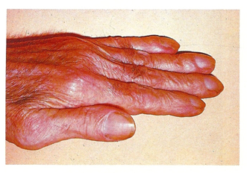
Question 13
What is shown in the picture?
Give two pulmonary conditions which may cause this appearance.

Slide 27
Answers 13
Finger clubbing
Bronchial carcinoma
Bronchiectasis
Fibrosing alveolitis
Empyema

Slide 28
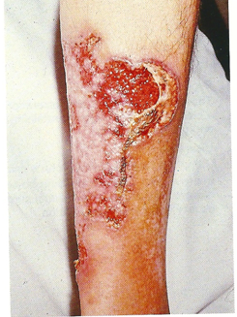
Question 14
What is this skin condition?
What disease are associated with it?

Slide 29
Answers 14
Pyoderma gangrenosum (skin ulceration with clear cut margin)
Ulcerative colitis
Crohn’s diasease

Slide 30
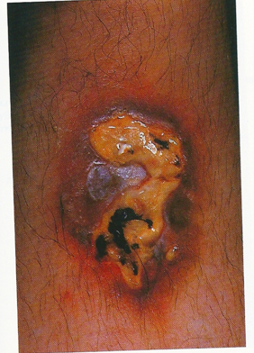
This patient aged 35 years had diabetes mellitus.
Question 15
What is this lesion?

Slide 31
Answers 15
Necrobiosis lipoidica
It is closely associated with diabetes mellitus. Ulcerated Plaques look yellow because of high lipid content.

Slide 32
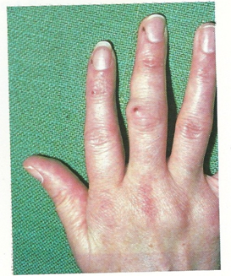
Question 16
Give two abnormal physical sign.
What is the most likely diagnosis?

Slide 33
Answers 16
Arthritis of proximal interphalangeal and metacarpophalangeal joints
Vasculitis
2. Rheumatoid arthritis

Slide 34
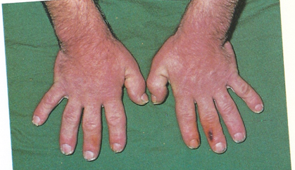
Question 17
What this picture is showing?
What is likely diagnosis?

Slide 35
Answers 17
Hands are thick
Acromegly

Slide 36
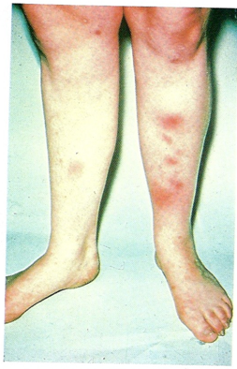
Question 18
What physical sign is shown?
Give two likely causes.

Slide 37
Answers 18
Erythema nodosum (hypersensitivity vasculites)
Sarcoidosis
Streptococcal infection
Tuberculosis
Drugs e.g. oral contraceptives
Chronic inflammatory bowel disease

Slide 38
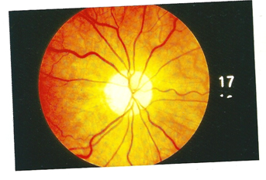
Question 19
What is the abnormality?
What could be the cause?

Slide 39
Answers 19
Optic atrophy
Glaucoma
Multiple sclerosis
Methyl alcohol

Slide 40
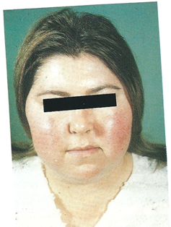
Question 20
What this picture is showing?
What is the differential diagnosis?

Slide 41
Answers 20
Cushingoid appearance with moon face and plethora
Cushing syndrome
Exogenous Glucocorticoids

Slide 42
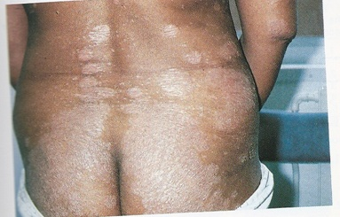
Question 21
1. What is the diagnosis?

Slide 43
Answer 21
1. Psoriasis

Slide 44
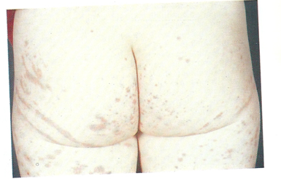
This boy presented with abdominal pain following upper respiratory tract illness.
Question 22
What this picture is showing?
What is the diagnosis?

Slide 45
Answers 22
Purpuric rash
Henoch-Schonlein purpura
Aetiology is unknown, precipitating factors include streptococcal infection, drugs e.g. penicillin

Slide 46
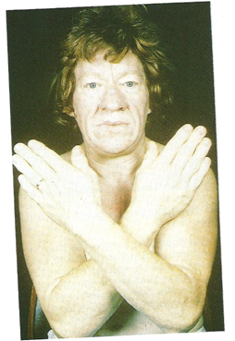
Question 23
What is the diagnosis?
How will you confirm the diagnosis?

Slide 47
Answer 23
Acromegly
Increased level of growth hormone which fails to suppress during oral glucose tolerance test
- Lateral skull X-ray
- CT

Slide 48
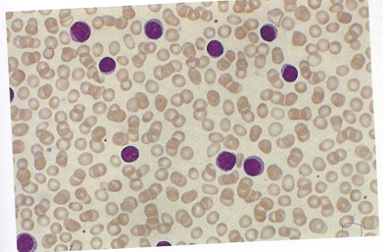
This is the peripheral blood film.
Question 24
What does it show?
What could be the possible cause?

Slide 49
Answers 24
Lymphocytosis
Viral infection
Chronic lymphatic leukemia

Slide 50
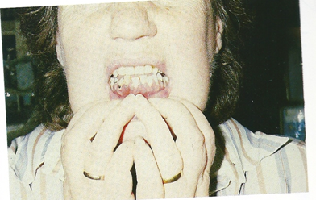
This patient had renal transplant and is on drug therapy
Question 25
What this picture is showing?
What drug causes it?

Slide 51
Answers 25
Gingival hyperplasia
Cyclosporin
Note
Other causes of gingival hyperplasia include drugs phenytoin, cyclosporin, oral contraceptives
- Pregnancy
- Scurvy
- Acute monocytic leukemia

Slide 52
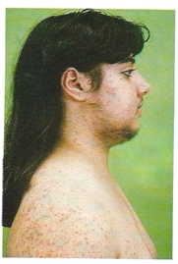
This young girl has deep voice and blood pressure 180/105
Question 26
What physical signs are present?
What is the likely diagnosis?

Slide 53
Answers 26
Cushingoid features and hirsutism
Congential adrenal hyperplasia
Androgen secreting ovarian neoplasm

Slide 54
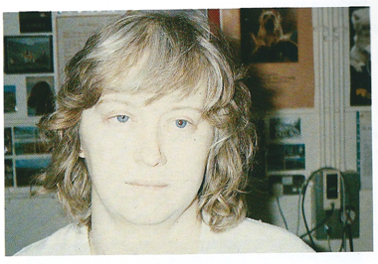
Question 27
Give two observations you find in this picture.
What is the diagnosis?

Slide 55
Answers 27
1. Right eye ptosis and meiosis (smaller pupil)
2. Horner syndrome (lesion affecting sympathetic supply to the eye)

Slide 56
Thank you

