Slide 1
ECG
By Dr. Zahoor

Slide 2
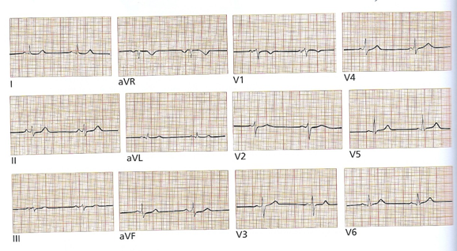
NORMAL ECG

Slide 3
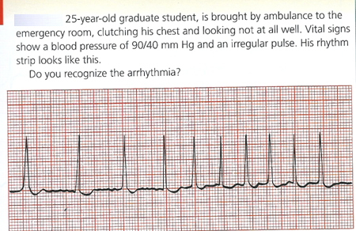

Slide 4
Answer
Atrial Fibrillation
There are no P-waves, QRS complexes
appear irregularly irregular.

Slide 5
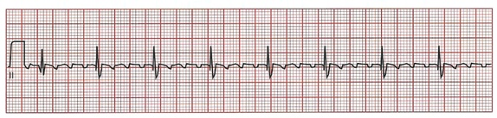
Question
What is the rhythm?

Slide 6
Answer
Aterial flutter – saw tooth pattern

Slide 7

Question:
What is the heart rate ?

Slide 8
Answer
125 / minute
Sinus tachycardia

Slide 9

Question:
What this ECG strip is showing?

Slide 10
Answer
Sinus Bradycardia
Heart rate about 40/minute

Slide 11
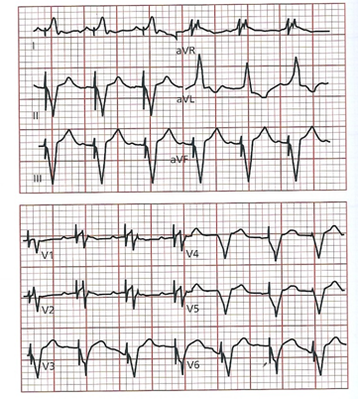
Question
Comment on the ECG.

Slide 12
Answer
There are pace maker spike before each QRS.
This pace maker fires when it senses P-wave
ensuring ventricular response.

Slide 13
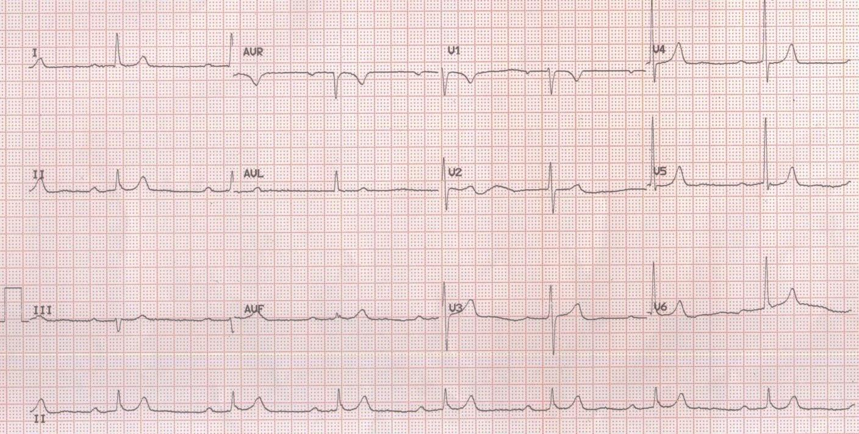
CALCULATE THE PR INTERVAL AND COMMENT
1ST DEGREE HEART BLOCK

Slide 14
Thank you

