Slide 1
DATA INTERPRETATION-2
By Dr. Zahoor

Slide 2
Question 1
A 36 year old male patient presents with tiredness,
headaches and following is the blood count:
Hb 9.2 g/dl
MCV 109 fl
WBC 3.8 × 10⁹ /l
Platelets 154 × 10⁹ /l
Questions
Give is most likely diagnosis.
What investigation would you arrange? Give two.

Slide 3
Answer 1
i). Macrocytic Anemia (due to excessive alcohol intake)
ii). Vitamin B12 deficiency
i). Blood film to see Macrocytes and hyper segmented neutrophil in Vitamin B12 deficiency
ii). Serum B12 and Folate level

Slide 4
Question 2
A 55 year old male complaint of dizziness and headache. He was receiving diuretic treatment for mild hypertension. On examination there were signs of chronic air way obstruction.
Investigation showed
Hb 18.5 g/dl
RBC 6.3 × 10¹²/l
WBC 6.5 × 10⁹/l
Platelet 305 × 10⁹/l
ESR 4mm in first hour
MCH 29.3 g
MCV 87 fl
MCHC 33.5 g/dl
PCV 48%
Question
1. What is likely diagnosis?

Slide 5
Answer 2
Secondary Polycythemia

Slide 6
Question 3
An obese 56 year old woman complains of daytime sleep. Her husband says that she snores loudly. Investigation showed:
Arterial blood on room air:
PO2 10.4 kPa (78mmHg)
PCO2 5.6 kPa (42mmHg)
Questions
What is most likely diagnosis?
How can this diagnosis be confirmed?

Slide 7
Answer 3
Sleep Apnea
Polysomnography

Slide 8
Question 4
A 74 year old man presents with a 2 month history of lethargy and breathlessness. He has hepatosplenomegaly, generalized lymphadenopathy and left pleural effusion.
Investigation showed
Pleural fluid:
Protein 46 g/l
Cytology : abundant lymphocyte
Gram stain : no bacteria
Culture : no bacterial growth
Stain for alcohol acid fast bacilli : negative
Hb 12.6 g/dl
WBC 56.4 × 10⁹/l, 92% lymphocyte, 6% granulocytes, 2% Monocytes
ESR 120 mm/hour
Question
1. What is likely diagnosis?

Slide 9
Answer 4
Chronic Lymphocytic Leukemia with leukemic infiltration causing lymphocytic pleural effusion

Slide 10
Question 5
A 70 year old man who smokes 30 cigarettes daily presents with a 3 month history of Haemoptysis. He has finger clubbing and chest radiograph shows a Cavitating shadow in the left lower lobe.
Investigation show:
Serum calcium 3.4 mmol/l (N : 2.2 to 2.67 mmol/l)
Serum Phosphate 1.2 mmol/l
Question
1. What is likely diagnosis?

Slide 11
Answer 5
Bronchial carcinoma (squamous cell)
[there is hypercalcemia]

Slide 12
Question 6
A 30 year old woman gave birth to her first child and two weeks later presented with breathlessness at rest. Examination and chest X-ray were normal.
Investigation showed:
Hb 13.4 g/dl
Arterial blood gases on room air:
PO₂ 8.3kPa (62mmHg)
PCO₂ 3.5kPa (26mmHg)
pH 7.44
Question
What is most likely diagnosis?
How would you confirm this diagnosis?

Slide 13
Answer 6
Pulmonary embolism
Ventilation (V) and perfusion (Q) isotope lung scan
- Spiral CT

Slide 14
Question 7
A 26 year old man presents with night sweats. Chest radiograph shows bilateral hilar and Mediastinal lymph node enlargement.
Investigation showed:
Hb 12.6 g/dl
WBC 7.3 × 10⁹/l
ESR 55mm/hour
Question
1. Give two possible diagnosis.

Slide 15
Answer 7
i). Sarcoidosis
ii). Lymphoma
iii). Lymph node tuberculosis

Slide 16
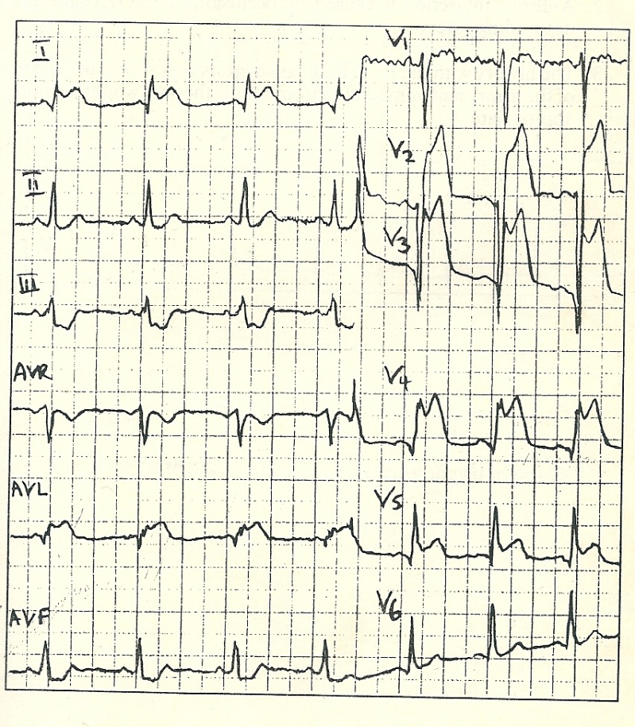
Question 8
A 40 year old man complains of severe chest pain. He is brought to the emergency and his ECG was taken.
Question
1. What does the ECG show?

Slide 17
Answer 8
1. ST elevation in anterior and lateral leads – acute antrolateral myocardial infarction

Slide 18
Question 9
The following pressure recording were taken from cardiac catheterization on a 15 year old boy.
Question
1. What is likely diagnosis?
Site | Pressure
RA | Mean 8
RV | 120/6
PA | Mean 20
LV | 110/6
Aorta | 110/60

Slide 19
Answer 9
1. Pulmonary Stenosis (right ventricular pressure is high with normal pulmonary artery pressure)

Slide 20
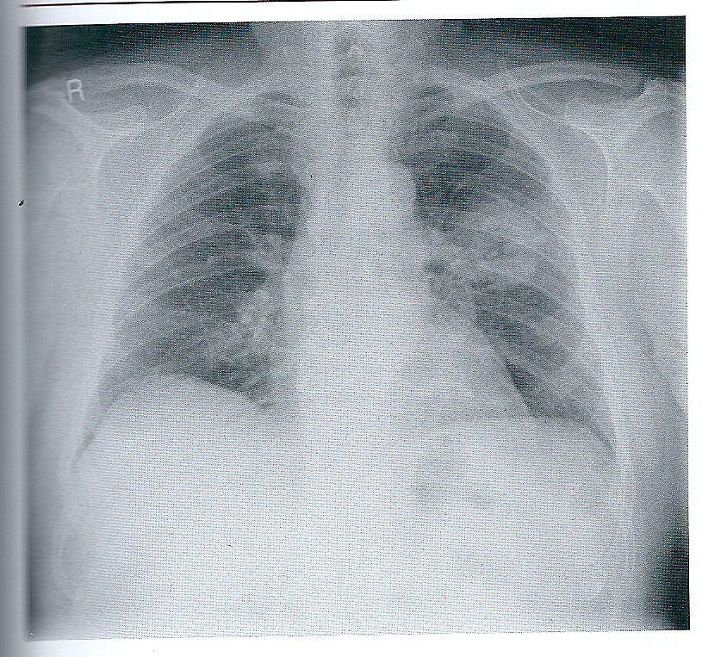
Question 10
Questions
What does this X-ray chest show?
What is the likely diagnosis?

Slide 21
Answer 10
Cavitating lesion left lung
Abscess
Neoplasm

Slide 22
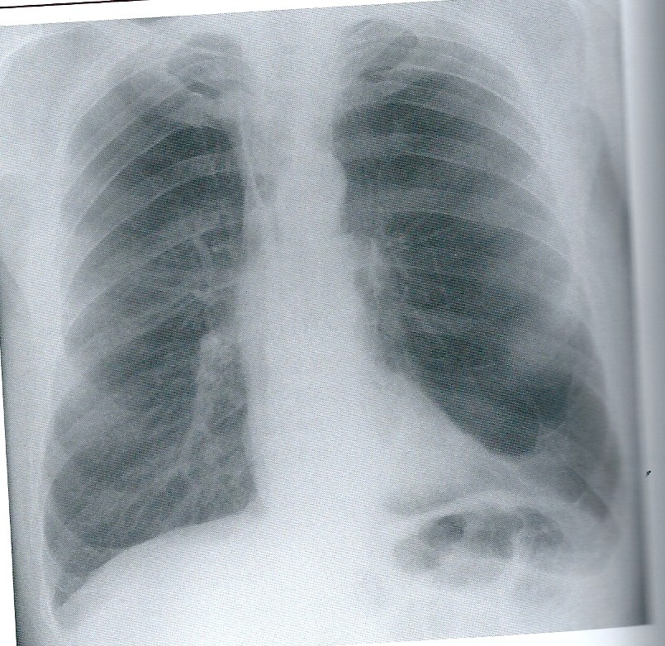
Question 11
Question
1. What is the diagnosis?

Slide 23
Answer 11
1. Chronic Obstructive Pulmonary Disease (COPD)

Slide 24
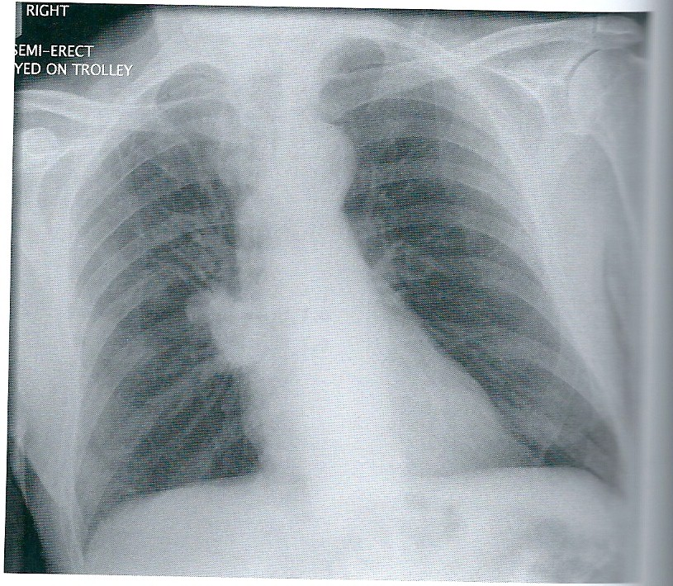
Question 12
Question
1. What abnormality do you see in the X-ray ?

Slide 25
Answer 12
1. Right hilar shadow (lymph node, tumor)

Slide 26
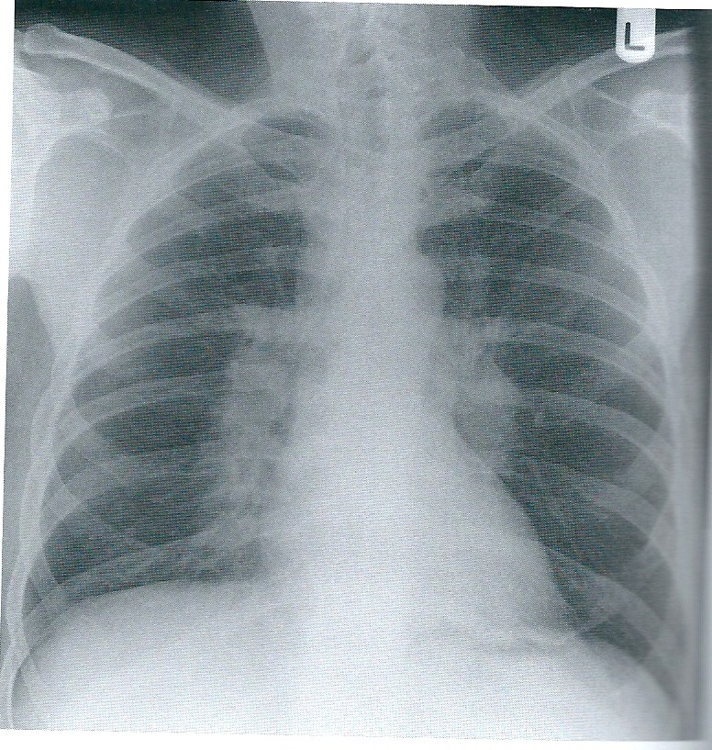
Question 13
Question
What abnormality is seen in the X-ray ?
What is likely diagnosis?

Slide 27
Answer 13
Bilateral hilar lymphadenopathy
Sarcoidosis
Lymphoma

Slide 28
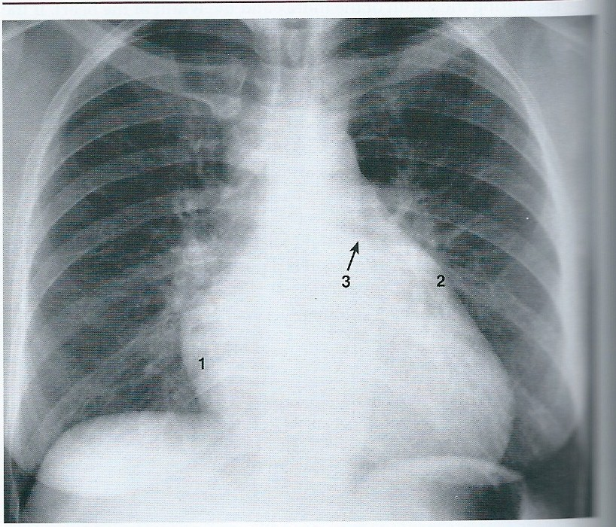
Question 14
Question
Look at the heart shadow, What is likely diagnosis?

Slide 29
Answer 14
Mitral Stenosis

Slide 30
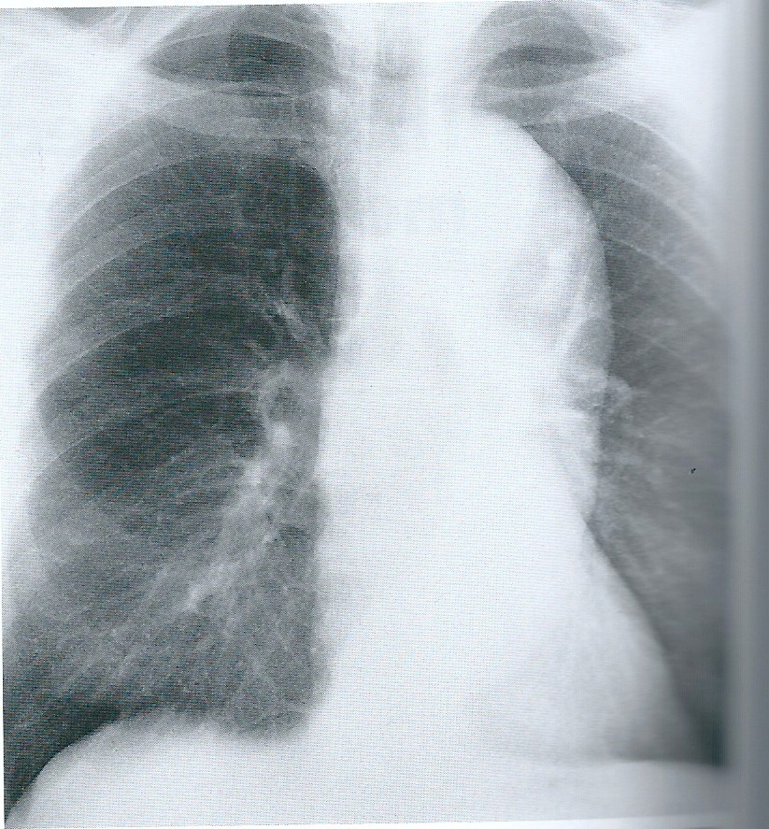
Question 15
Question
What is likely diagnosis?

Slide 31
Answer 15
Aortic Aneurysm (mediastinum is widened to the left of midline with increased convexity around the aortic arc)

Slide 32
Thank you

