Slide 1
Examination of
Cardiovascular System
By Dr. Zahoor

Slide 2
Cardiovascular System
General Examination
Examine – patient should be at 450 in bed.
Clubbing of fingers – in relation to the heart suggest infective endocarditis or cyanotic heart disease
Cold hands with blue nails – suggest poor perfusion, peripheral cyanosis
Tongue for central cyanosis
Conjunctivae for anaemia
Signs of dyspnoea or respiratory distress

Slide 3
Cardiovascular System
General Examination
Look for xanthomata
- Xanthelasma – yellow cholesterol deposit around the eyes in hyperlipidaemia
- Tendon Xanthoma – in hypercholesteremia

Slide 4
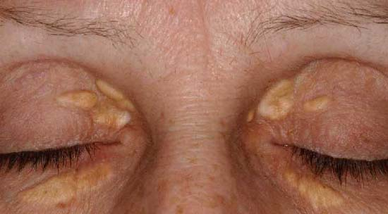
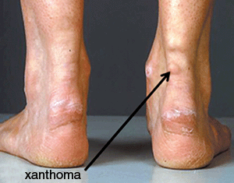
Xanthelasma
Tendon Xanthoma

Slide 5
Cardiovascular System
Palpate the radial pulse
– Rate, Rhythm, Volume, Vessel Wall
Rate - Feel the radial pulse with 2 or 3 fingers
Count the pulse rate for 15 seconds and multiply for 4 to get pulse rate per minute
Rhythm
– regular – normal
– regularly irregular – when extrasystoles
– irregularly irregular – atrial fibrillation,
multiple extrasystoles

Slide 6
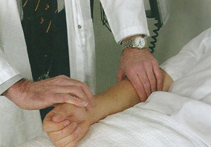
Taking the radial pulse

Slide 7
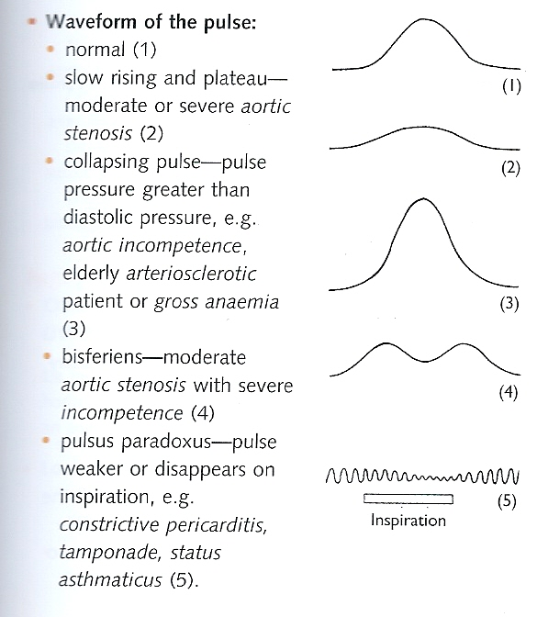

Slide 8
Cardiovascular System
Palpate the radial pulse (cont)
Volume
- Normal volume
- Small volume – low cardiac output
- Large volume – thyrotoxicosis, anaemia
Vessel Wall stiffness
- In the elderly stiff, pulsating radial artery
indicates arteriosclerosis (hardening of arterial
wall that is common with aging)
- Is associated with systolic hypertension

Slide 9
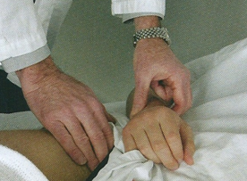
Feeling for the radiofemoral delay

Slide 10
Cardiovascular System
Take the blood pressure
Normal blood pressure 120/80 mmHg (up to 140/85 mmHg)
In diabetic – 130/80 mmHg

Slide 11
Cardiovascular System
Jugular Venous Pulse (JVP)
Observe the height of JVP when patient is in the bed at 45º
Access vertical height in centimeters above the sternal angle (normal 2-4cm)
Observe the character of JVP
Look for a-wave (Atrial contraction)
- v-wave (Atrial filling when tricuspid wall is closed)

Slide 12
Cardiovascular System
Jugular Venous Pulse (JVP)
Large a-waves are caused by
- Tricuspid stenosis
- Pulmonary stenosis
- Pulmonary hypertension
Important - Absent a-wave in Atrial fibrillation
Large v-wave
- Tricuspid incompetence

Slide 13
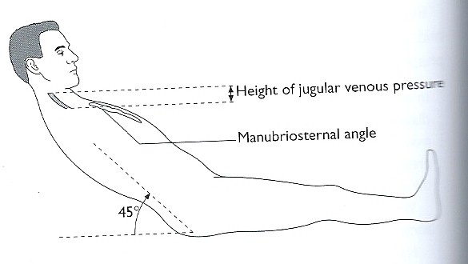
Jugular Venous Pulse
measuring the height of JVP

Slide 14
Cardiovascular System
The precordium
Inspection
Palpation
Percussion
Auscultation

Slide 15
Cardiovascular System
Inspection
Inspect the precordium for abnormal pulsation – in left ventricle enlargement pulsation can be seen on the left side of the chest, some times in the axilla
Look for scars

Slide 16
Cardiovascular System
Palpation
Palpate the apex beat
Feel for the pulsation which is outer most and down/lower most where the pulsation is felt distinctly
Measure the position – the space by counting down from the second intercostal space which lies below the sternal angle
Measure laterally in centimeters from the middle line
Describe the apex beat in relation to the mid clavicular line.
Important – normal position of apex beat is in the fifth left intercostal space just inside or on the mid clavicular line

Slide 17
Cardiovascular System
Apex beat
Assess the character
Normal
Tapping – in mitral stenosis
Heaving (when pressure overload) – aortic stenosis, hypertension
Thrusting (when volume overload) – mitral or aortic incompetence
Impalpable – obesity, COPD (Chronic Obstructive Pulmonary Disease), pericardial effusion

Slide 18
Cardiovascular System
Palpate firmly the left border of the sternum
- Use the flat of your hand – a left sternal heave suggest right ventricular hypertrophy
- Palpate right sternal border, base of the heart with flat of hand for thrills (palpable murmers)
Percussion – not routinely done

Slide 19
Cardiovascular System
Auscultation
Listen with stethoscope the four main areas of the heart
1. Mitral area (left 5th intercostal space ,mid
clavicular line)
2. Tricuspid area (4th intercostal space, left
sternal edge)
3. Aortic area (2nd intercostal space, right sternal
edge)
4. Pulmonary area (2nd intercostal space, left sternal
edge)

Slide 20
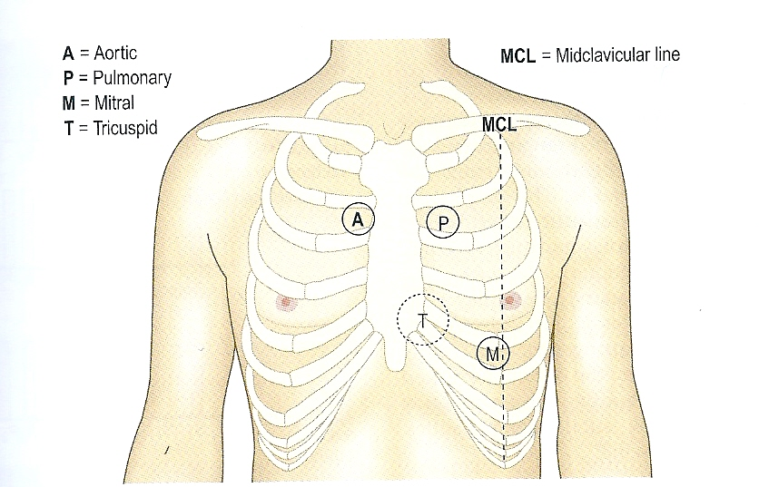
Sites of Auscultation

Slide 21
Cardiovascular System
Auscultation
At each area concentrate on
1. Heart sounds
2. Added sound (3rd sound and 4th heart
sound)
3. Murmers

Slide 22
Thank you

