Slide 1
Examination of
Respiratory System
By Dr. Zahoor

Slide 2
Respiratory System
General Inspection
Respiratory rate – count per minute or for 30 seconds and multiply by 2
Examine the patient for
- Signs of respiratory distress –
use of accessory muscles
- On oxygen therapy
- Sputum pot (cup)

Slide 3
Respiratory System
General Inspection
- Nicotine staining on fingers
Clubbing (Carcinoma bronchus, Bronchiectasis,
lung abscess, fibrosing alveolitis)
- Evidence of respiratory failure
- Hypoxia - Central cyanosis
- Hypercapnia – drowsiness, confusion, warm
hands, bounding pulse, flapping tremor

Slide 4
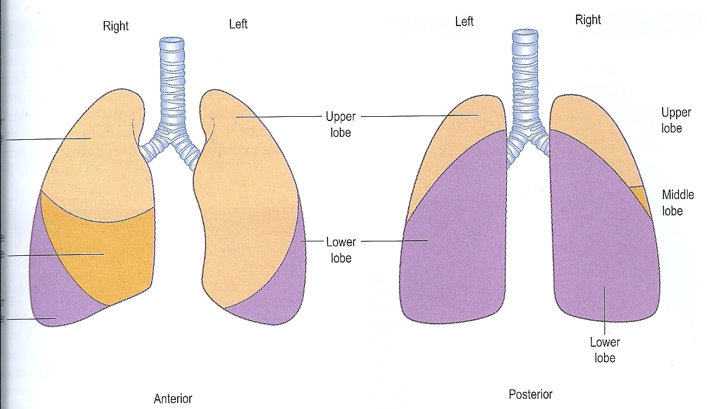
UL
ML
LL
Relevant Anatomy – Anterior and Posterior Aspects of Lungs

Slide 5
Respiratory System
Systemic Examination of Respiratory System
First examine the front of the chest then examine the back of the chest
We do chest examination
1. Inspection
2. Palpation
3. Percussion
4. Auscultation

Slide 6
Respiratory System
Inspection of the Chest
Position the patient comfortably in the bed at 45º while examining the front of chest.
Inspect the shape of the chest
- Normal
- Any scars, swelling, pulsation
- Pectus excavatum – sunken sternum
- Barrel shaped chest (increased anterio-posterior diameter then transverse diameter) in obstructive airway disease

Slide 7
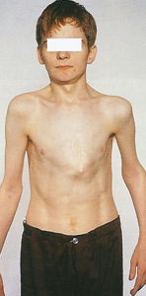
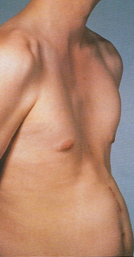
Funnel chest
(pectus excavatum)
Pigeon shape chest

Slide 8
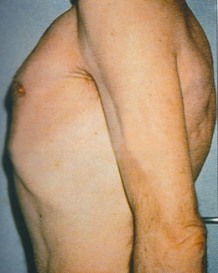
Barrel chest

Slide 9
Respiratory System
Inspection of the Chest (cont)
Symmetry of the chest
Ask the patient to open the mouth and take deep breath – observe the movements of the chest on both sides – moving equally or not

Slide 10
Respiratory System
Palpation
We palpate
1. Position of trachea
2. Apex beat
3. Movements of chest
4. Vocal fremitus

Slide 11
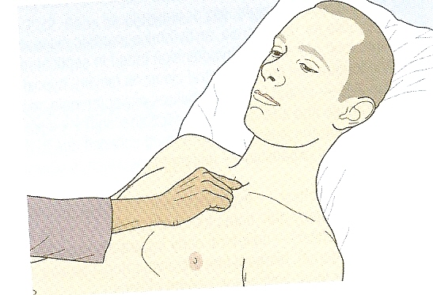
Respiratory System
Palpation of trachea

Slide 12
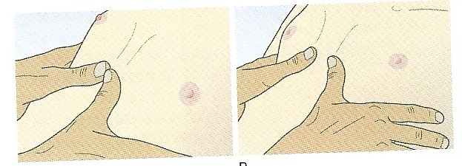
Respiratory System
Palpation of Chest movement
A
B
Assessing chest expansion from the front A. Expiration and B. Inspiration

Slide 13
Respiratory System
Percussion
Put your left hand on the chest, fingers in the intercostal spaces
Percuss with the middle finger of right hand on the middle phalanx of left hand which is already placed on the chest
Right hand middle finger should strike at right angles
Movement of the right hand should be at wrist while striking

Slide 14
Respiratory System
Percussion (cont)
Percuss both sides of the chest (right and left) for resonance and compare
Percuss at top, middle and lower segments of the chest
Compare sides (right and left side of the chest)
If dull area exist, map out its limits

Slide 15
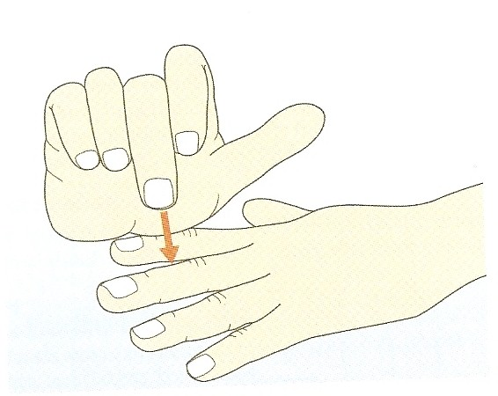
Respiratory System
Percussion technique

Slide 16
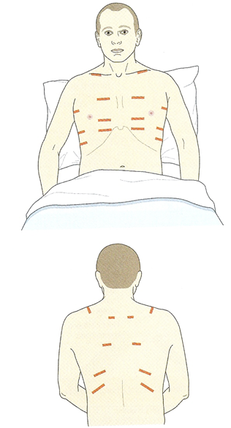
Sites of Percussion
Anterior and Lateral chest wall
Posterior chest wall
A.
B.

Slide 17
Respiratory System
Percussion (cont)
1-Increased resonance may occur in
- Pneumothorax
- Emphysema
2-Decreased resonance
Dull percussion node
- Consolidation
- Collapse
- Neoplasm
Stony Dull percussion node
- Pleural effusion

Slide 18
Respiratory System
Auscultation
With stethoscope listen at the top, middle and bottom of both sides of the chest and then the axilla
Ask the patient to open the mouth and breath deeply (you can demonstrate this yourself to the patient)

Slide 19
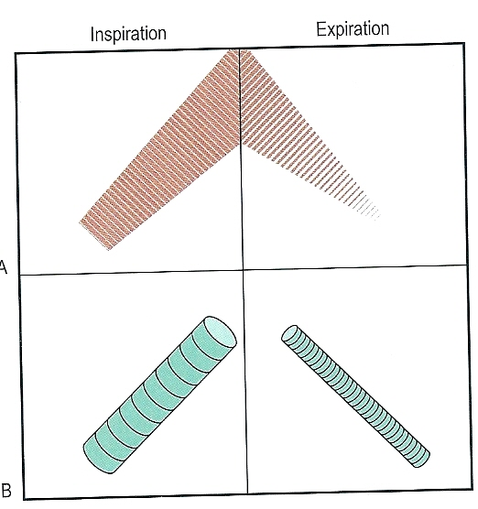
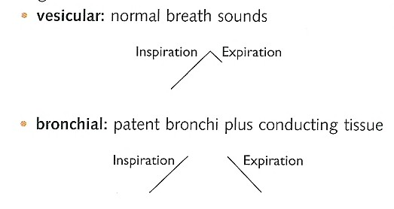
Respiratory System
Auscultation (cont)
On auscultation, we listen
1. Breath sounds normal (vesicular) or abnormal (bronchial)

Slide 20
Respiratory System
Auscultation (cont)
2. Listen for added sounds (note if inspiratory or expiratory)
- Ronchi or wheezing (occur in bronchial constriction)
- Crepitations or crackles
fine – heart failure
medium – infection
course – Bronchiectasis
- Pleural rub
3. Vocal resonance
- Ask the patient to say ‘99’ while listening to the chest in the
same area during auscultation. Compare on both sides.
- Sounds are louder over areas of consolidation

Slide 21
Respiratory System
After examining the front of the chest, ask the patient to sit down and examine the back of chest (Inspection, Palpation, percussion & Auscultation)

Slide 22
Thank you

