Slide 1
Commonest aphasia occurs in?
Hysteria
Brain tumor
Cerebral infarction
Brainstem demyelination
Recurrent of loss of consciousness with jerky movements is suggestive of seizure?
  By duration of the attack.
  Occurrence while in sleep.
  Relation to stress.
  Post attack headache
Cardiac complication of carcinoid tumor is due to secretion of?
Histamine
5 H - HT
Bradykinin
Prostaglandin

Slide 2
Patients with ulcerative colitis usually complain of?
Rectal bleeding
Malodorous bulky stools difficult to flush
Recurrent hematemesis
Diarrhea alternating with constipation
Beta thalassemia is associated with?
Decreased serum iron
Low risk for infections
Extramedullary hematopoiesis
Low fetal hemoglobin on Hb electrophoresis
Left atrial myxoma usually causes?
Mid systolic murmer
Loud first heart sound
Loud 4th heart sound
Early diastolic murmur

Slide 3
A 45 year old man presented with paresthesia and numbness of his left hand. The results of his glucose tolerance test (75 grams orally, venous plasma sugar at 30 minute intervals) were as follows
Time | Venous plasma glucose (mmol/l) | Growth hormone )mU/l) | Reference Growth hormone
0 | 8.9 | 14 | 0-5 ng/mL (Fasting)
30 | 14.2 | 19 | < 0.3 µg/L
60 | 14.9 | 22 | < 0.3 µg/L
90 | 13.6 | 43 | < 0.3 µg/L
120 | 12.6 | 24 | < 0.3 µg/L
Outline 2 abnormalities of the test results?
  ---------------------------
  ---------------------------
What two diagnoses in this patient are linked?
  ------------------------
  -----------------------

Slide 4
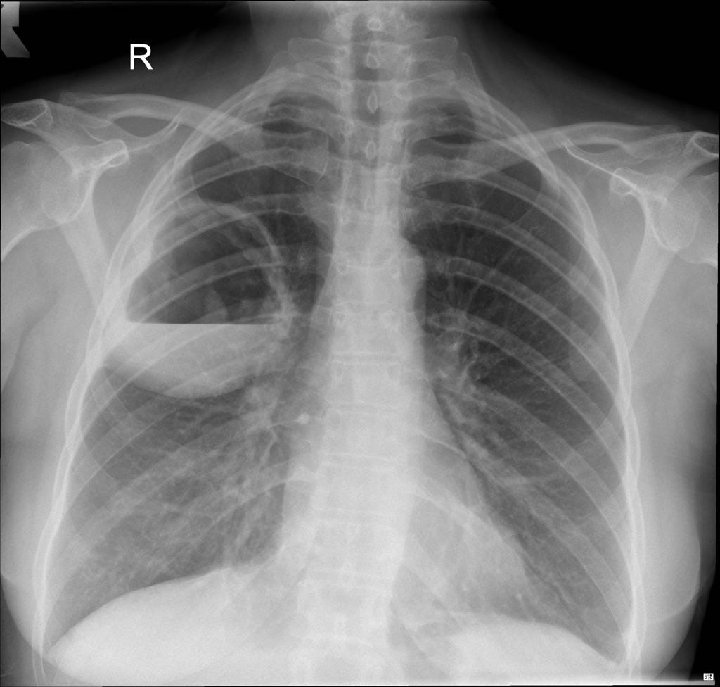
This patient presented with cough, fever, rusty sputum?
What is radiological abnormality present?
  ---------------
Name 2 causes for this condition?
  ----------------
  ----------------

