Slide 1
X-RAY INTERPRETATION
By Dr. Zahoor

Slide 2
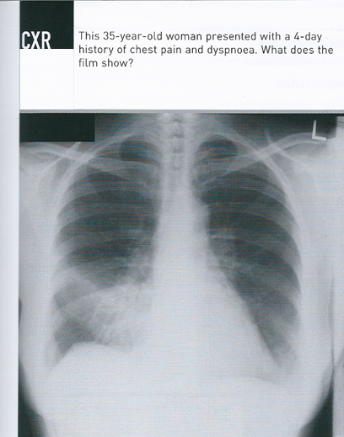
1

Slide 3
Answer 1
Right middle lobe pneumonia
(abnormal whiteness in the right lung)

Slide 4
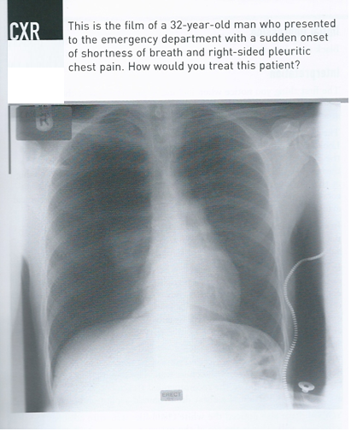
2

Slide 5
Answer 2
Right Pneumothorax
Treatment by aspiration of air

Slide 6
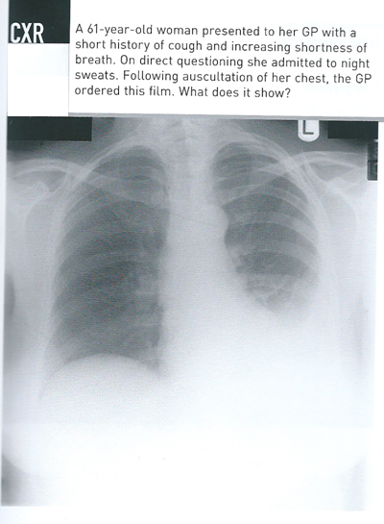
3

Slide 7
Answer 3
Left pleural effusion

Slide 8
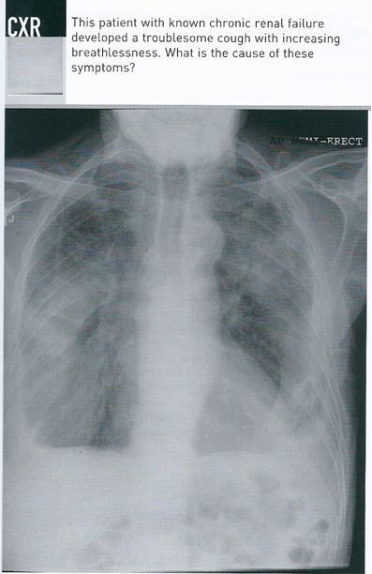
4

Slide 9
Answer 4
Pulmonary edema
(Bilateral white lung fields)

Slide 10
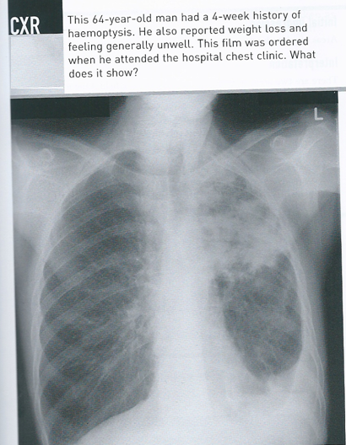
5

Slide 11
Answer 5
Pulmonary tuberculosis

Slide 12
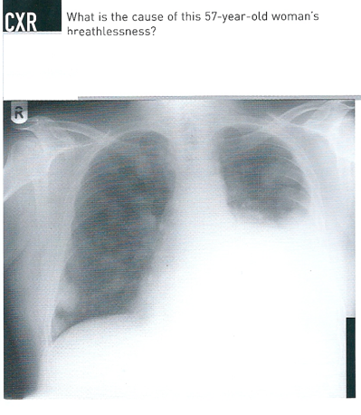
6

Slide 13
Answer 6
Malignant pleural effusion with pulmonary metastases

Slide 14
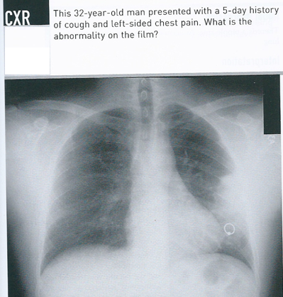
7

Slide 15
Answer 7
Consolidation left lung

Slide 16
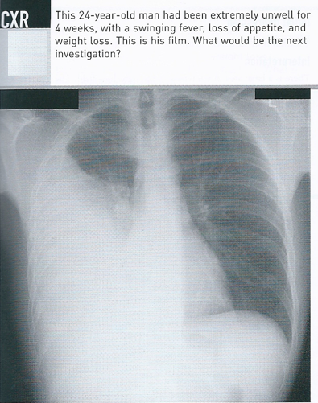
8

Slide 17
Answer 8
Right pleural effusion
Next investigation - Aspiration of this effusion and sent for cytology, microbiology and chemistry

Slide 18
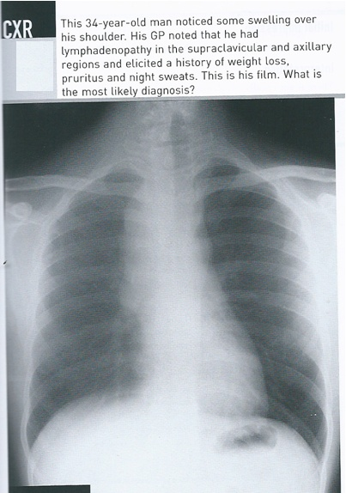
9

Slide 19
Answer 9
Hodgkin’s lymphoma
Mediastinal lymphadenopathy with H/O supraclavicular and axillary lymphadenopathy . Confirm by lymph node biopsy

Slide 20
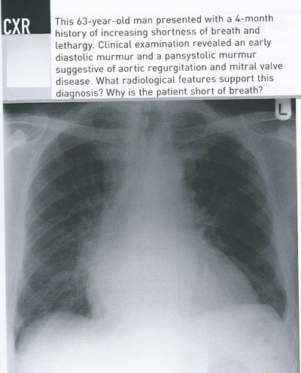
10

Slide 21
Answer 10
Patient has pulmonary edema secondary to mitral and aortic valve disease

Slide 22
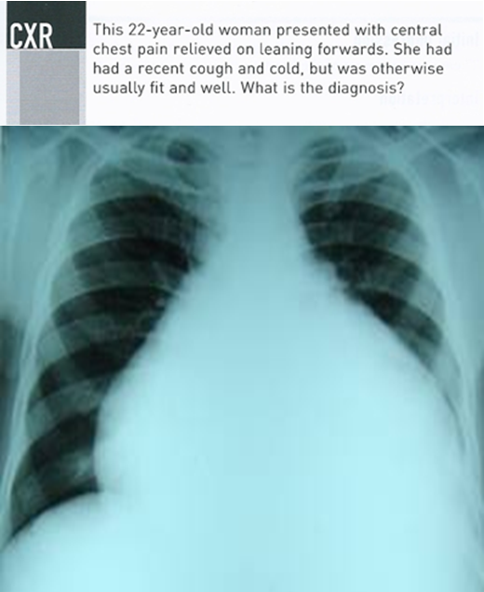
11
11

Slide 23
Answer 11
Pericardial effusion
There is enlargement of heart shadow

Slide 24
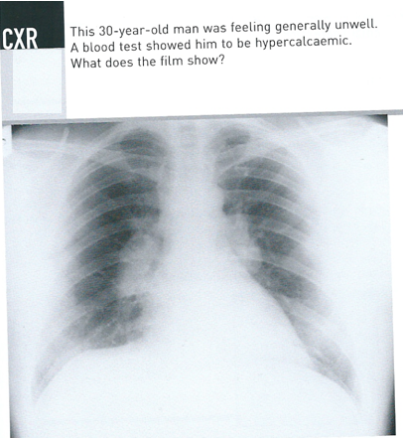
12

Slide 25
Answer 12
Bilateral hilar lymphadenopathy
Likely cause with this clinical history - SARCOIDOSIS

Slide 26
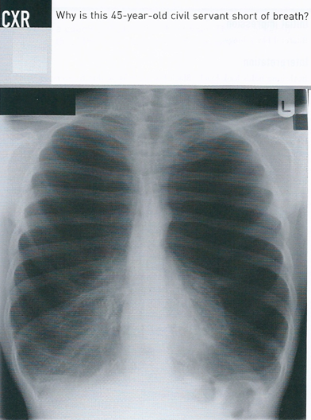
13

Slide 27
Answer 13
Chronic obstructive pulmonary disease (COPD)
(Bilateral black lungs)

Slide 28
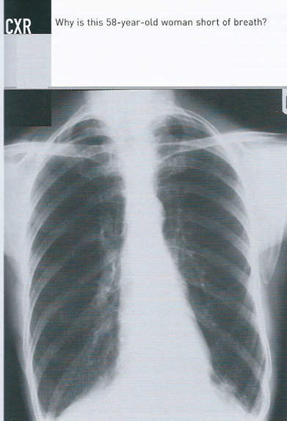
14

Slide 29
Answer 14
Chronic obstructive pulmonary disease (COPD)
(Bilateral black lungs)

Slide 30
How to read chest X-ray
Identify problems as ABCDEF
A – Airway (Trachea position)
B – Bones (Ribs)
Breast shadow in female
C – Cardiac enlargement
Costrophrenic and Cardiophrenic angles
D – Diaphragm (evidence of free air below diaphragm)
E – Edges (Apices of lung for fibrosis)
F – Fields (Lung fields for any abnormality)

Slide 31
CHEST X-RAY
White Lung Field
Pleural effusion
Consolidation
Collapse
Cavitating lung lesion
Left ventricular failure ( Pulmonary edema )
Fibrosis
Pneumonectomy
Asbestos plaques
Bronchiectasis
Miliary shadowing

Slide 32
CHEST X-RAY
Black Lung Field
Chronic obstructive pulmonary disease
Pneumothorax
Tension Pneumothorax
Pulmonary embolus

Slide 33
Thank you

