Slide 1
Urinary system imaging
Dr. Hayam Hebah

Slide 2
Kub(plain x rays)

Slide 3
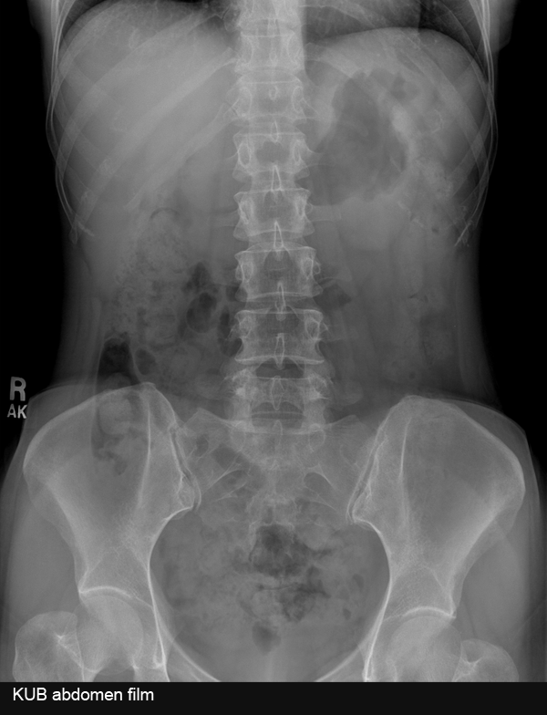

Slide 4
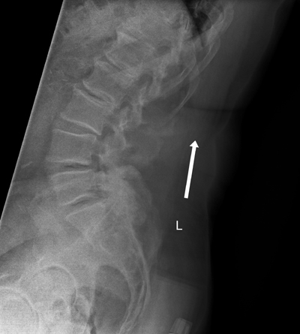
What can be the complaint?

Slide 5
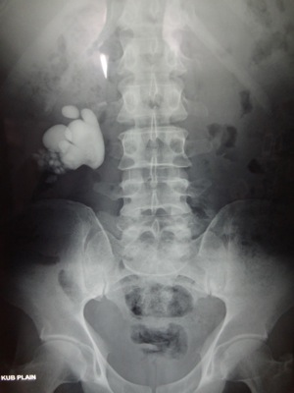
Diagnosis ?
Complications?

Slide 6
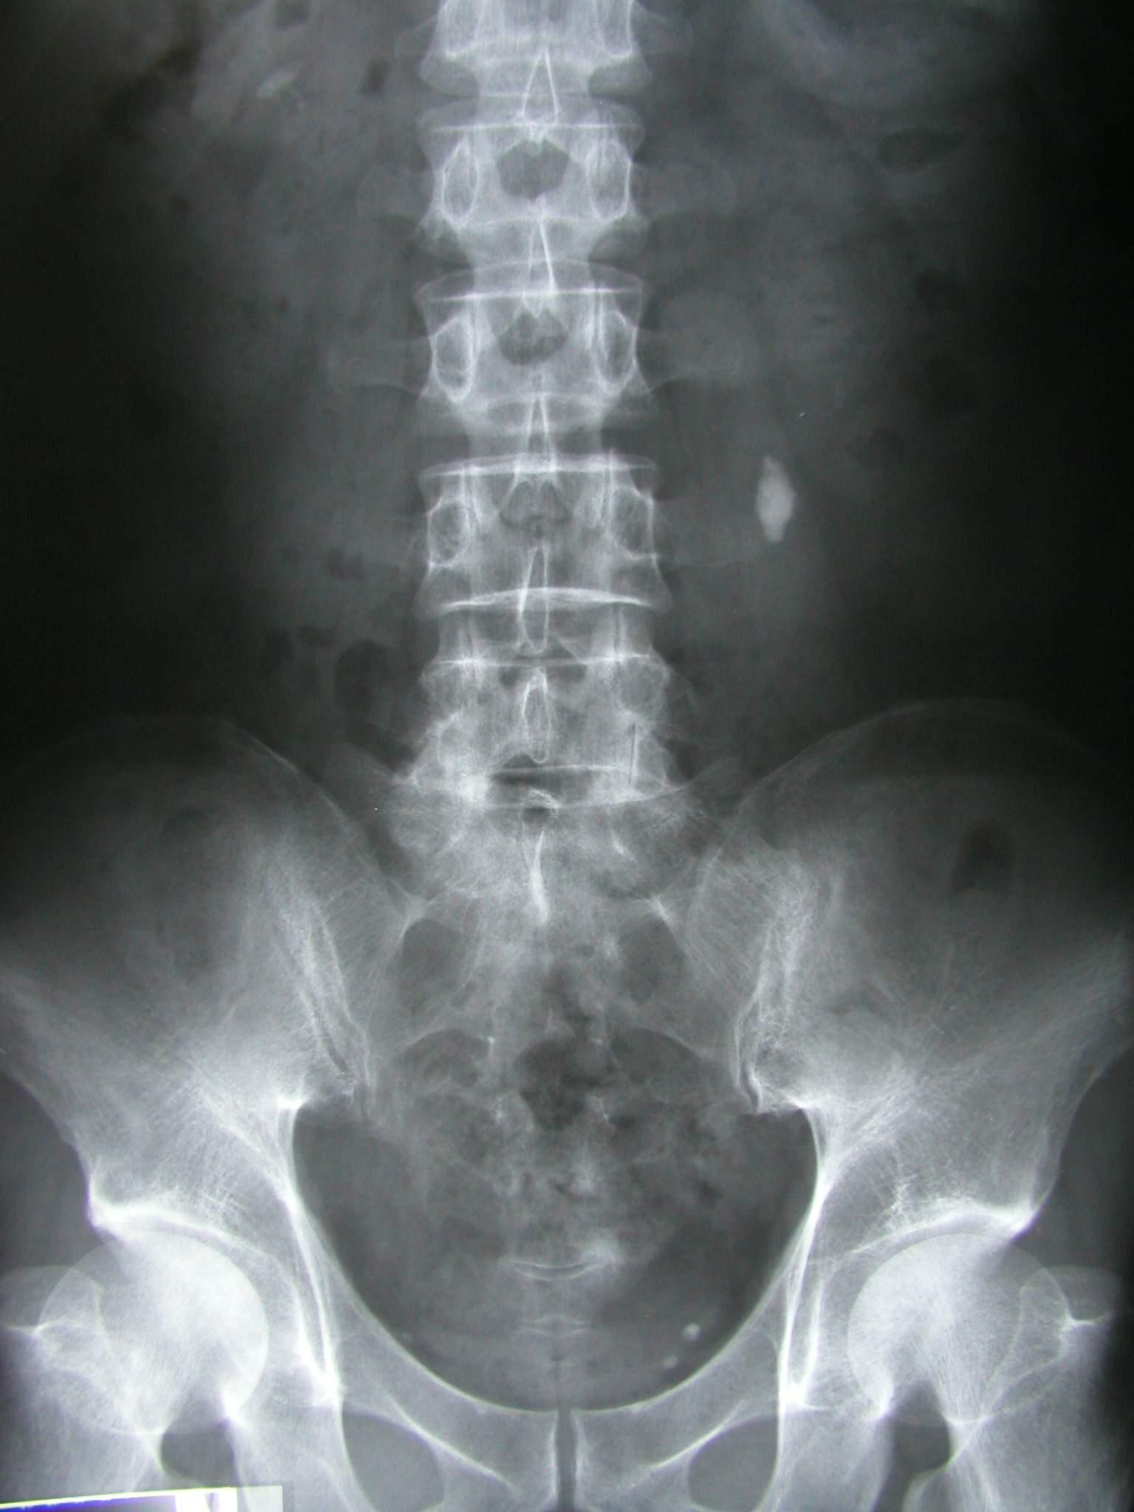
Diagnosis?
Type?

Slide 7
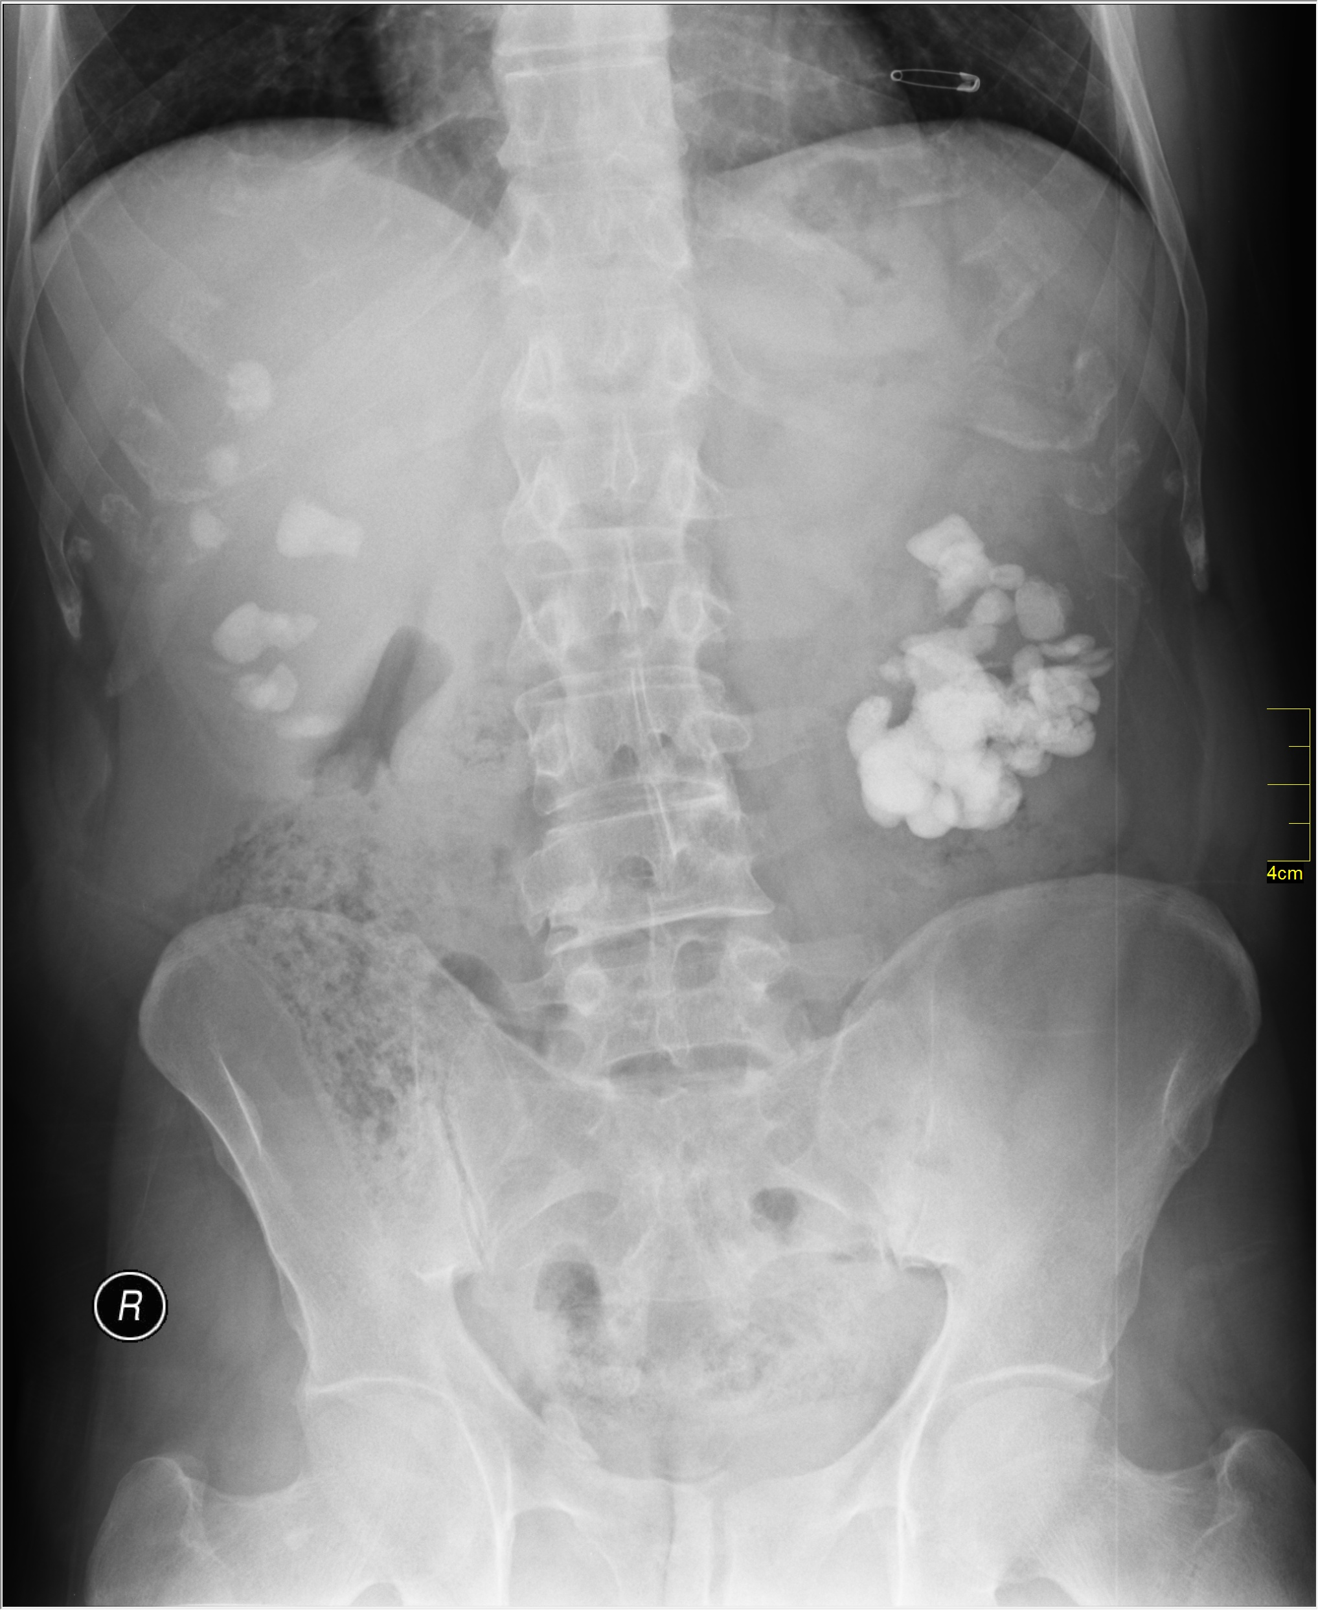

Slide 8
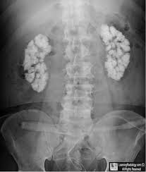

Slide 9
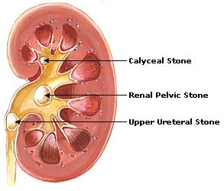

Slide 10
nephrocalcinosis
Causes of medullary nephrocalcinosis
Medullary sponge kidney
Hyperparathyroidism
Renal tubular acidosis (specifically distal RTA)
Renal tuberculosis
Renal papillary necrosis
Hyperoxaluria

Slide 11
And other causes of hypercalcemia (and thus hypercalciuria)
Immobilization (leading to hypercalcemia and hypercalciuria)
Milk-alkali syndrome
Hypervitaminosis D
Sarcoidosis

Slide 12
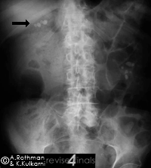

Slide 13
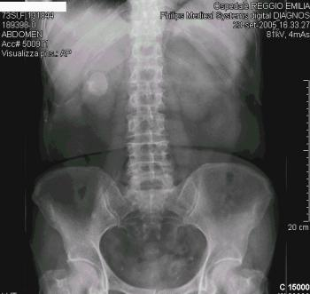

Slide 14
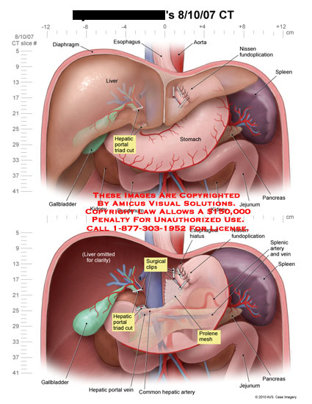

Slide 15
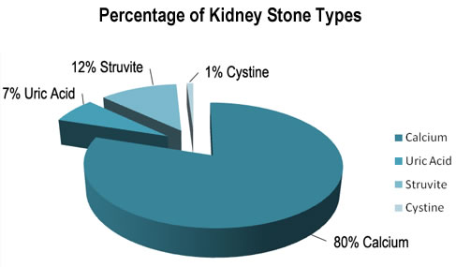
Renal stones

Slide 16
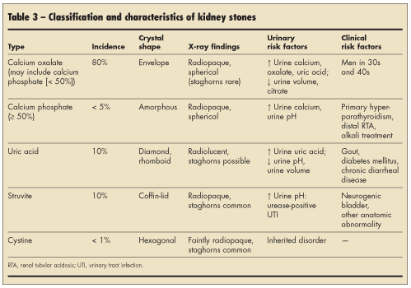

Slide 17
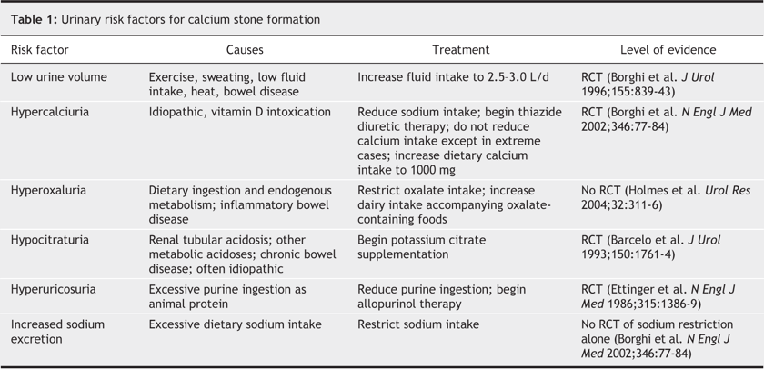

Slide 18
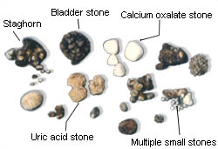

Slide 19
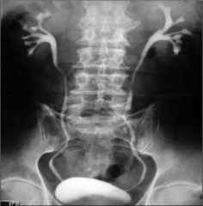
ivp

Slide 20
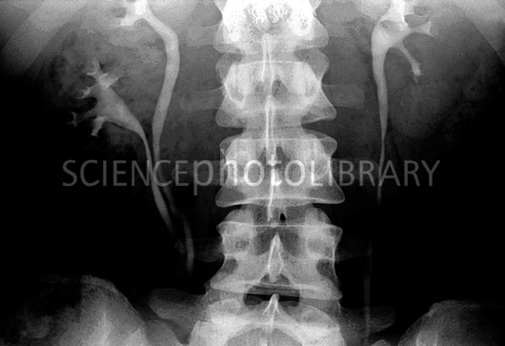

Slide 21
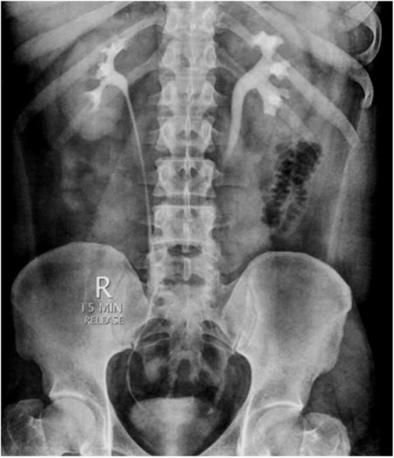

Slide 22
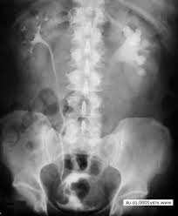
Diagnosis?

Slide 23
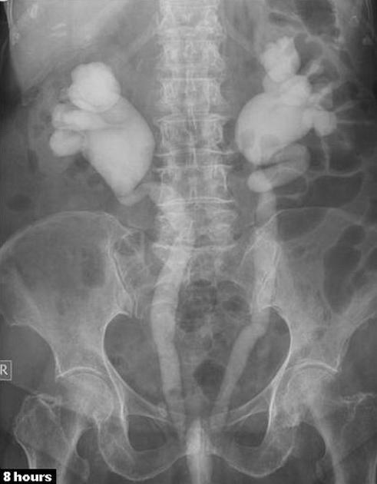
Diagnosis?

Slide 24
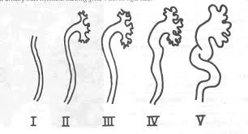
hydronephrosis

Slide 25
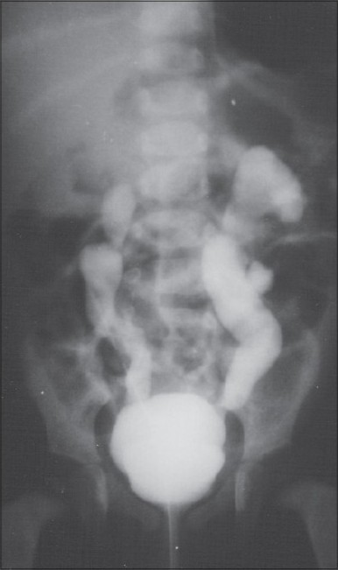
Cystogram showed
satisfactory bladder
capacity, grade 5
bilateral reflux .

Slide 26
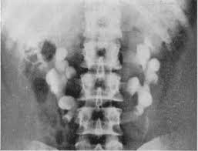
2)

Slide 27
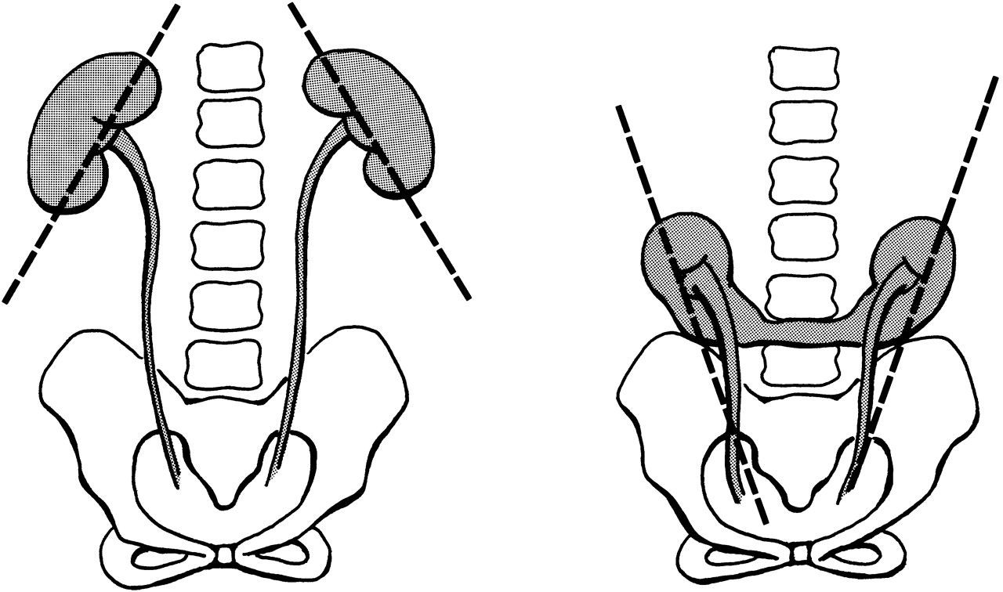

Slide 28
Filling defect

Slide 29
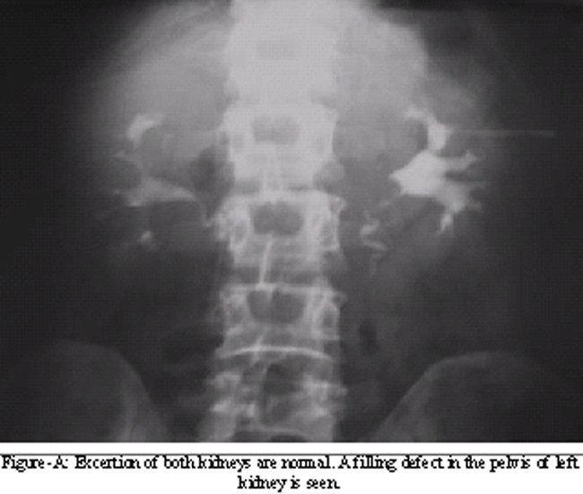

Slide 30
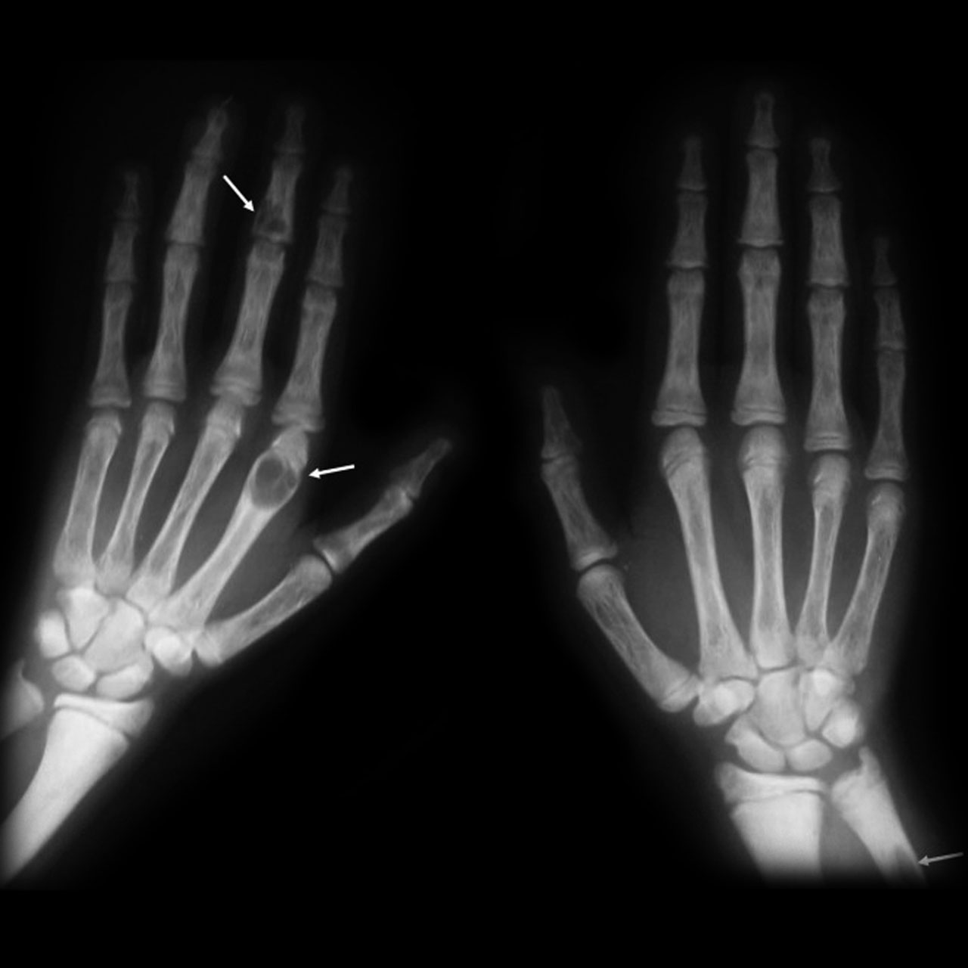

Slide 31
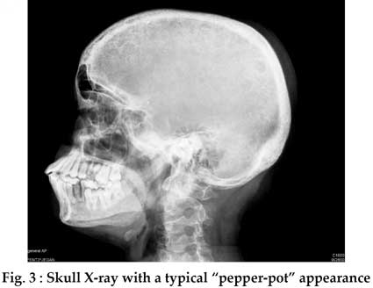

Slide 32
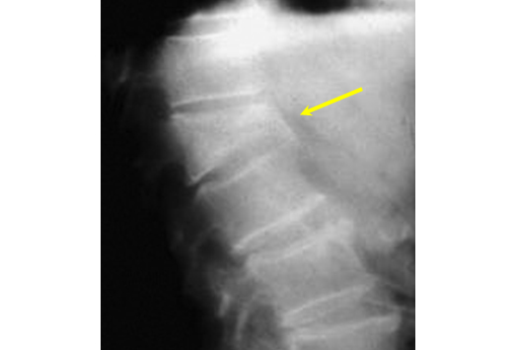
What is the
Lesion?
*diagnosis?

Slide 33
hyperparathyroidism

Slide 34
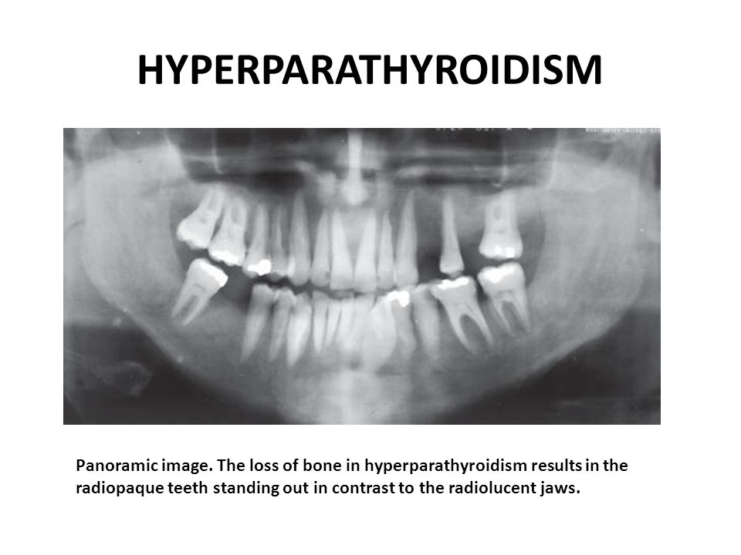

Slide 35
d. d

Slide 36
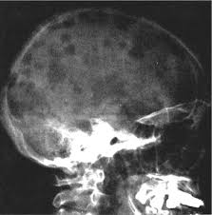

Slide 37
