Slide 1
Nephrology cases
Dr . Hayam Hebah

Slide 2
Case 1
24y old woman presents with nausia, vomiting ,and gross hematuria. She had a sore throat 2 weeks ago .
On examination: BP:160/90, P: 90/min, JVP is 7 cm, +1 pedal edema, chest, heart and abdominal examination is normal
1) DIAGNOSIS?
2)DD?
3) further investigations?

Slide 3
Q:The most likely finding on renal biopsy keeping with post streptococcal GN is:
Diffuse mesangial deposits
No deposits.
Endothelial deposits
Subepithelial humps.

Slide 4
A: SUBEPITHELIAL HUMPS

Slide 5
Q:The hematuria in Ig A nephropathy is:
Synpharyngitic
Postpharyngitic
Terminal
continuous

Slide 6
A: synpharyngitic

Slide 7
Case 2:
63 y old diabetic female , on insulin therapy for past 10 years. She has neuropathy and retinopathy.
Which of the following is not compatible with diabetic nephropathy?
Nephrotic range proteinuria
Microalbuminuria
Hypertension
RBC casts.

Slide 8
A: rbcs casts

Slide 9
Case 3:
24 y old woman‘s urine analysis is positive for blood on dipstick measurement . This is repeated twice between menstrual periods and it remains positive.
Microscopic evaluation reveals RBCS , some of which are in the form of casts.
The most likely cause is:
Stones
GN
Trauma
tumours

Slide 10
A: gn

Slide 11
miscellaneous

Slide 12
history
26 y old woman presents with red rash over her cheeks and pain and swelling in both wrists as well as several small joints in her hands. Rash gets worse on sun exposure.
Medical evaluation reveals a facial rash with nasal folds sparing, oral ulcers and +3 proteinuria

Slide 13
Q:Which is the most specific test for diagnosis of this condition?
LE cells
ANA
Anti-Sm antibody
Anti-Ro antibody
Antiphospholipid antibody

Slide 14
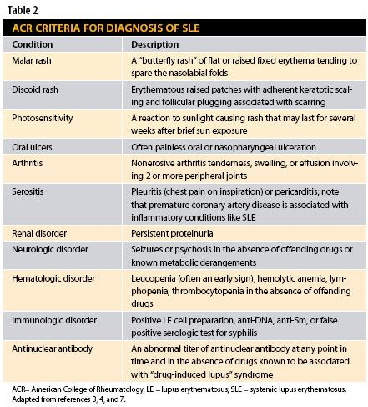

Slide 15
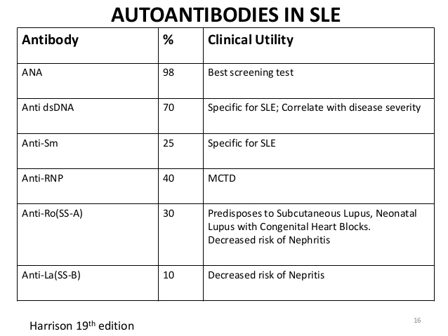
A: anti- Sm antibody
It is believed to be very specific for SLE.
ANA is sensitive marker for SLE but not specific.
Anti-Ro is found in Sjogren syndrome
Antiphospholipid antibody can be found but not diagnostic

Slide 16
Q:which of the following organ involvement will cause the most symptoms in the disease course?
Renal pathology
Cardiopulmonary pathology
Musculoskeletal pathology
Thrombotic events
Skin changes.

Slide 17
A:musculoskeletal pathology
Present in 95% of cases of SLE. Arthralgia and myalgia predominate
85% will have hematological disease
80% will have skin manifestations.

Slide 18
Q:which of the following is the most likely mechanism for the renal damage in this condition?
Vasculitis
Microemboli
Antibasement membrane antibodies
Deposition of circulating immune complexes
Primary tubular atrophy.

Slide 19
A: Circulating immune complex
Although most patients have such deposits, only 50% have clinical nephritis and proteinuria
Renal biopsy is of prognostic and therapeutic information.

