Slide 1
GLOMERULONEPHRITIS
BY
DR. Hayam Hebah
Associate professor of Internal Medicine
AL Maarefa college

Slide 2
DEFINITION:
GN means “ inflammation of glomeruli”.
The term is used to describe all types of glomerular diseases even those not associated with inflammation as MCD
The term GLOMERULOPATHIES is broader and glomerulonephritis is a type of glomerulopathies
Most types are immunologic with antibody deposition but frequently cellular immunity may be involved

Slide 3
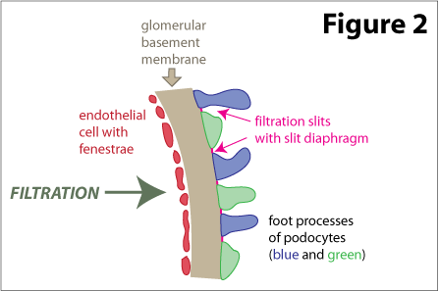
filtration membrane
3 layers
  1. Endothelial cells :
  fenestrated (70-90 nm)
  2. GBM glomerular
  basement membrane
  3. Visceral epithelium:
  podocytes
GFR: glomerular filtration rate

Slide 4
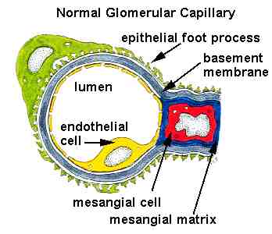
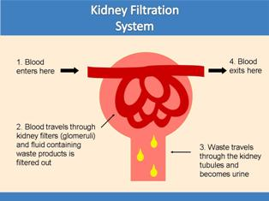
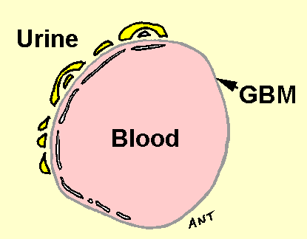

Slide 5
Clinical presentation of glomerular diseases:
Acute nephritic syndrome(Acute GN).
Nephrotic syndrome
Isolated proteinuria
Isolated hematuria
Rapidly progressive disease
Acute renal failure
Chronic renal failure
Chronic glomerulonephritis

Slide 6
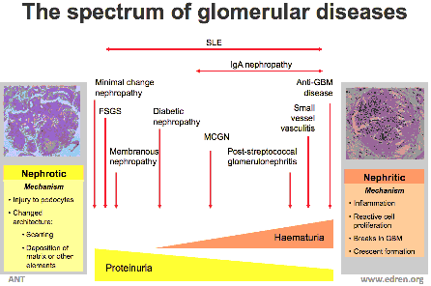

Slide 7
Types of glomerular diseases:
primary
Minimal change nephropathy.
Focal segmental glomerulosclerosis.
Membranous glomerulonephritis
IgA nephropathy
Mesangiocapillary glomerulonephritis

Slide 8
Secondary:
diabetic nephropathy
Infection related glomerulonephritis (post –streptococcal GN)
Henoch-Schönlein purpura
Cryoglobulinemia
Rapidly progressive GN
Inherited glomerular diseases
Alport‘s syndrome
Thin glomerular basement membrane disease.

Slide 9
Pathogenesis of Glomerular Disease
Immune disorder
Circulating immune complex
Immune complex formation
Cell-mediated
Glomerular dysfunction

Slide 10
Pathogenesis
1. Circulating Immune complex nephritis (type III hypersensitivity)
  Antigen is not glomerular origin
  Intrinsic- SLE
  Extrinsic- Poststreptococcal GN, Hepatitis B, Malaria
  Ag-Ab complex is trapped in glomeruli
  Complement activation
  Injury
  what happen
    Short lived Ag-Ab complex---- Recovery
    Repeated Ag-Ab complex------- chronic GN

Slide 11
Pathogenesis
2. In-situ Immune complex nephritis
  In-situ
    Intrinsic
    Extrinsic/planted
Anti-GBM
  Goodpasture syndrome
  In human: auto antibodies
  Pathology:
    Severe glomerular damage
    Cresentic GN
    Ag: alpha3 chain of collagen type IV

Slide 12
  Planted antigen
    DNA
    Bacterial products (group A strep)
    IgG/complex
    IF: granular pattern
Cell mediated Immune GN

Slide 13
NEPHRITIC
SYNDROME
OLIGURIA
HEMATURIA AND RBCs CASTS
HYPERTENSION
PROTEINURIA

Slide 14
ACUTE NEPHRITIC SYNDROME
Diseases commonly associated with acute GN:
Post streptococcal GN
Non- streptococcal post-infectious GN.
Infective endocarditis
Visceral abscess
SLE
Henoch-schonlein syndrome
cryoglobulinemia
Notes:
Other contributing causes include :
Drugs (e.g : sulphonamides)
Malignant tumors
staphylococcus, pneumococcus, syphilis,mumps, hepatitis B & C, toxoplasmosis, malaria, schistosomiasis

Slide 15
Post streptococcal GN

Slide 16
Epidemiology:
follows infection of the throat (in cold wheather)
or skin(in warm wheather) with certain“ nephritogenic" strains of group A ß-hemolytic streptococci.
More in children .
Latency is about 10 days after a throat infection or longer (4-6 weeks) after skin infection.
Immune mechanism rather than direct infection.

Slide 17
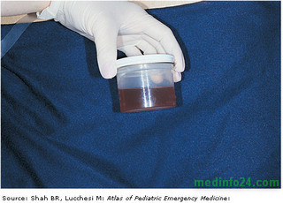
c/p:
Hematuria(smoky or red urine)
POSTPHARYNGITIC
Proteinuria
Reduced urine volume (oliguria may be present) and reduced GFR .
Hypertention and its complications as heart failure and sodium retention
Edema
ARF with its complications
Nonspecific symptoms such as malaise, lethargy, abdominal or flank pain, and fever are common.

Slide 18
Diagnosis:
Hematuria and RBC casts.
proteinuria
-C3 and C4 typically reduced
Evidence of streptococcal infection may be found( throat culture and ASOT)
Best single antibody titer to measure is that to the deoxyribonuclease (DNase) B antigen. An
alternative is the Streptozyme test which detects antibodies to streptolysin o

Slide 19
PATHOLOGY.
Kidneys - symmetrically enlarged.
Light microscopy - all glomeruli appear enlarged
diffuse mesangial cell proliferation
Crescents and interstitial inflammation may be seen in severe cases.
Immunofluorescence microscopy - deposits of immunoglobulin and complement on the glomerular basement membranes (GBMs) and in the mesangium.
Electron microscopy - electron-dense deposits are observed on the epithelial side of the GBM(subepithelial humps)

Slide 20
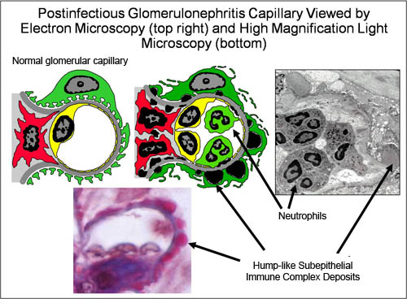

Slide 21
Management:
fluid and salt restriction.
diuretics
Antihypertensives
rest
PROGNOSIS:
-spontaneous recovery within 10-14 days
DD:
Other causes of acute nephritic syndrome and cases of hypocomplementemia.

Slide 22
OTHER INFECTION RELATED GN:
Bacterial infections mostly → mesangiocapillary GN as in case of subacute bacterial endocarditis.
Viral infections as hepatitis B and C
HIV is associated with FSGS particularly in patients of African descent.
Schistosomiasis , leishmaniasis , malaria.
Chronic infections.

Slide 23

GN ASSOCIATED WITH LOW SERUM COMPLEMENT:
POST INFECTIous GN
S.A.B.E
SLE
CRYOGLOBULINEMIA
Mesangiocapillary GN ,usually complement type.

Slide 24
Ig A NEPHROPATHY

Slide 25
Epidemiology:
Most common type.
Different clinical presentations
Slowly progress to ESRD
In D.D of post infectious GN
Occurs with Henoch-Schönlein purpura and with chronic liver disease

Slide 26
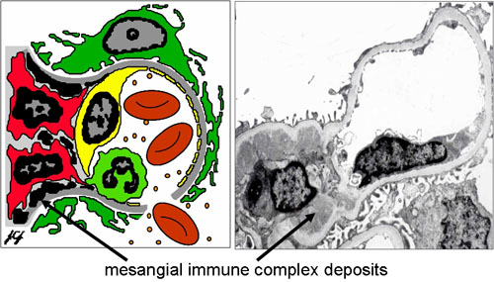

Slide 27
c/p:
Clinical presentation vary with age
Characterised by acute self –limiting exacerbations of gross hematuria in association with minor respiratory infections.
Acute nephritic syndrome with fluid retention, hypertension and oliguria with red urine
Latent clinical infection to nephritis is short : few days or less SYNPHARYNGITIC.
Rapidly progressive form with crescent formation

Slide 28
management:
CONTROL BLOOD PRESSURE: -ACEI
-ARB
poor response to immunosuppressors
TTT is according to the risk .

Slide 29
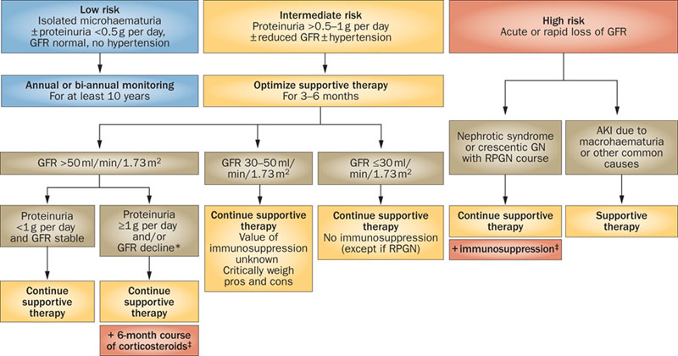

Slide 30
MesangiocapillaryGN(MCGN) Also known as membranoproliferative GN(MPGN)

Slide 31
Mesangiocapillary GN(MCGN)
IMMUNOGLOBULIN TYPE
TYPE 1
Igs deposited in glomeruli
Associated with:
Chronic infections
Autoimmune diseases
Monoclonal gammopathies
Ttt is of the cause or use IMMUNOSUPPRESSIVES as MMF or CYC
COMPLEMENT TYPE
TYPE 2
Complement deposition in glomeruli.
Complement abnormalities are inherited or acquired
Dense deposit disease
No specific ttt

Slide 32
A third subtype is associated with healing following thrombotic microangiopathies ,such as HUS and TTP.
Neither immunoglobulins nor complement are deposited in this subclass.

Slide 33
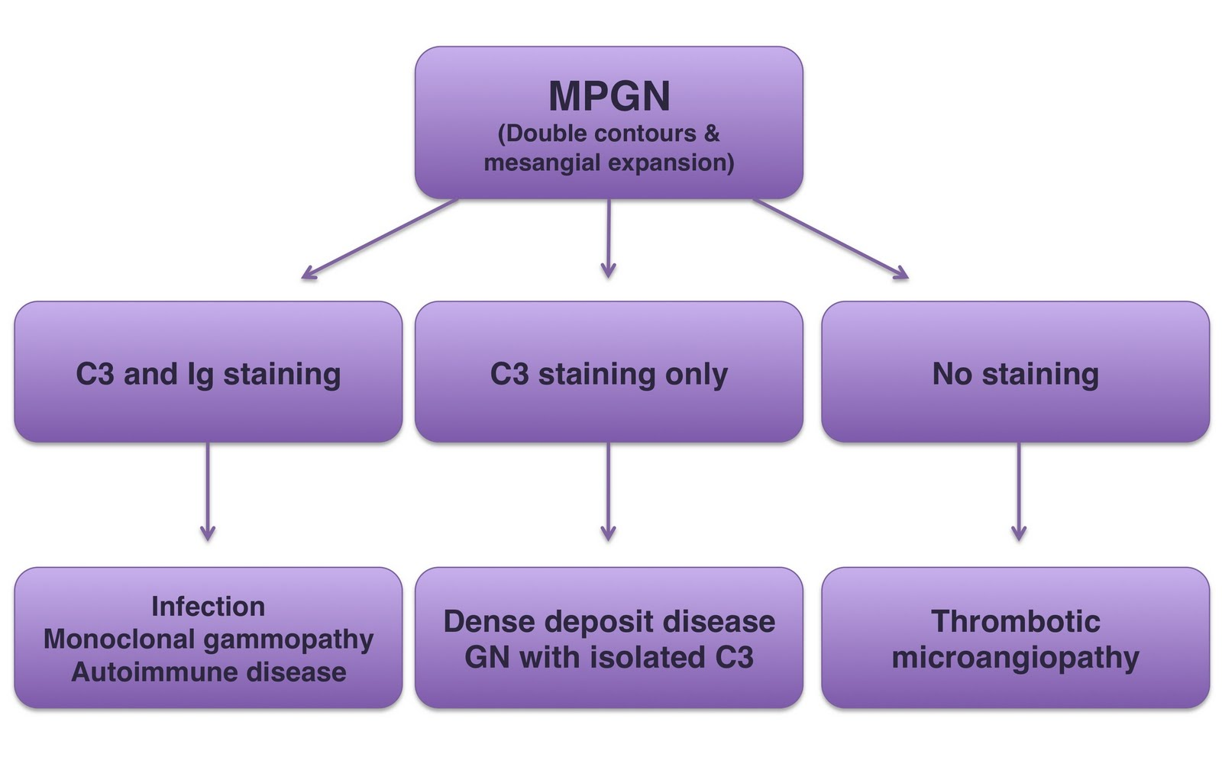

Slide 34
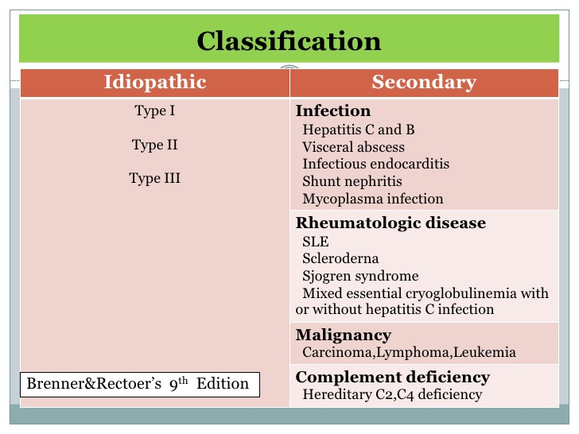

MPGN

Slide 35
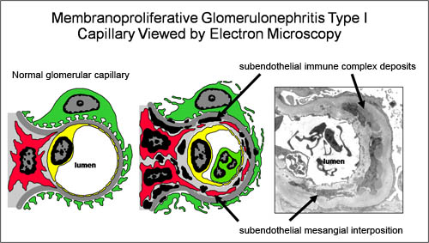
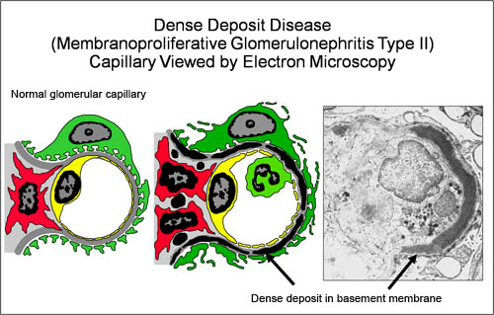

Slide 36
RPGN(CRESENTIC GN)
Loss of renal function occurs over days to weeks.
Biopsy →cresentic lesions
Typically seen in Goodpasture‘s disease(anti GBM antibodies) and in small vessel vasculitis (ANCA-associated vasculitis)
Can be seen in SLE and in IgA .
Immunosuppressive drugs are required
In Goodpasture‘s disease: Plasma exchange combined with steroids and immunosuppressives

Slide 37
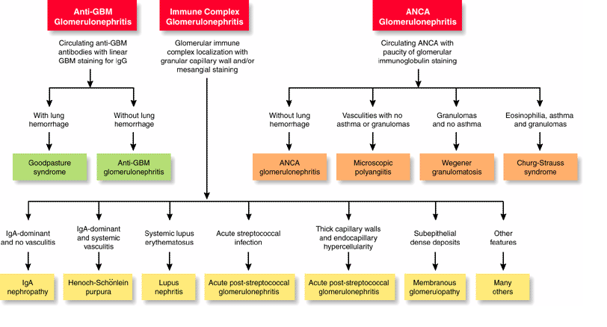

Slide 38
Chronic glomerulonephritis

Slide 39
Causes of chronic GN:
Repeated attacks of acute GN.
Hypertensive nephrosclerosis.
Hyperlipidemia
Chronic tubulointerstitial diseases
Amyloidosis.
Lupus nephritis
Good pasture disease

Slide 40
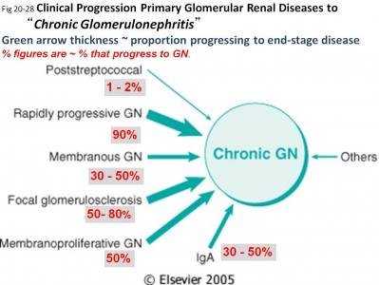

Slide 41
Chronic GN clinically:
History of CKD.
Hematuria
Proteinuria
Shrunken kidnies by U/S
Size up to 1/5 of normal size
End in ESRD .

Slide 42
THANK YOU

