Slide 1
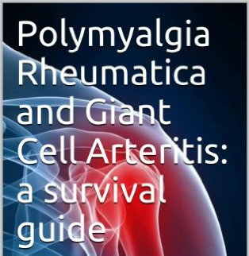
POLYMYALGIA RHEUMATICA & GIANT CELL ARTERITIS
Dr. M.Sofi MD; FRCP (London); FRCPEdin; FRCSEdin

Slide 2
Polymyalgia Rheumatica
“Polymyalgia rheumatica is an inflammatory disorder that causes muscle pain and stiffness”.
It is characterized by proximal myalgia of the hip and shoulder girdles with accompanying morning stiffness that lasts for more than 1 hour.
Symptoms of polymyalgia rheumatica usually begin quickly, within two weeks

Slide 3
Polymyalgia Rheumatica
Polymyalgia rheumatica (PMR) is a relatively common chronic inflammatory condition of unknown etiology that affects elderly individuals.
Approximately 15% of patients with PMR develop giant cell arteritis (GCA)
40-50% of patients with GCA have associated PMR.
Despite the similarities of age at onset and some of the clinical manifestations, the relationship between GCA and PMR is not yet clearly established

Slide 4
Etiology
The exact cause (or causes) of PMR is unknown.
The disease is more common among northern Europeans, which may indicate a genetic predisposition.
Other risk factors for PMR are an age of 50 years or older and the presence of GCA.
An autoimmune process may play a role in PMR development.
PMR is associated with the HLA-DR4 haplotype. High level of IL-6 is associated with increased disease activity.
Many investigators believe that nonerosive synovitis and tenosynovitis are responsible for many symptoms of PMR

Slide 5
Etiology
Although PMR causes severe pain and stiffness in the proximal muscle groups, no evidence of disease is present on muscle biopsy.
Muscle strength and electromyographic findings are normal.
MRI studies reveal periarticular inflammation as well as bursitis in the bursae associated with both the shoulder and hip girdles
Increased FDG uptake in PET scan was seen in the shoulders (95%) in the hips (89%), and in the spinous processes of the cervical and lumbar vertebrae (correlating with interspinous bursitis) of 51% of the patients with isolated PMR

Slide 6
Epidemiology
The average annual incidence is 52.5 cases per 100,000 persons aged 50 years and older.
The prevalence is approximately 0.5-0.7%.
In Europe, the frequency decreases from north to south, with a high incidence in Scandinavia and a low incidence in Mediterranean countries.
Whites are affected more than other ethnic groups.
PMR is twice as common in females.
The incidence increases with advanced age. PMR rarely affects persons younger than 50 years. The median age at diagnosis is 72 years.

Slide 7
Symptoms
Abrupt onset in about 50% of patients.
In most symptoms appear first in the shoulder girdle. In the remainder, the hip or neck are involved at onset.
Symptoms may be unilateral but they usually become bilateral within a few weeks.
The symptoms include pain and stiffness of the shoulder and hip girdle.
The stiffness may be so severe that the patient may have a great difficulty in raising the arms above shoulder height.
Stiffness after periods of rest (gel phenomenon) as well as morning stiffness of more than 1 hour typically occurs.
Patients may also describe distal peripheral joint swelling

Slide 8
Diagnostic criteria
Age of onset 50 years or older
Erythrocyte sedimentation rate ≥40 mm/h
Pain persisting for ≥1 month and involving 2 of the following areas: neck, shoulders, and pelvic girdle
Absence of other diseases capable of causing the same musculoskeletal symptoms
Morning stiffness lasting ≥1 hour
Rapid response to prednisone (≤20 mg)

Slide 9
Physical examination
PMR is a clinical diagnosis based on the presenting symptoms and exclusion of the other potential diseases.
The symptoms and signs of PMR are nonspecific, and objective findings on physical examination are often lacking.
General symptoms include:
Fatigued appearance
Low-grade temperature
Distal extremity swelling with pitting edema
Musculoskeletal findings:
Normal muscle strength; no muscle atrophy
Pain in the shoulder and hip with movement
Decreased range of motion may because of pain
Transient synovitis of the knee, wrist, sternoclavicular joints
Peripheral nonerosive arthritis may be seen in some cases
Muscle tenderness to palpation

Slide 10
Other features of PMR
Systemic findings in ˃ 50% of patients are include:
Low-grade fever and weight loss
Malaise, fatigue, and depression
Difficulty rising from bed in the morning
Difficulty getting up from the toilet or out of a chair
Difficulty completing ADL
Musculoskeletal findings:
Morning stiffness for ≥1 hour, often more prolonged
Muscle stiffness after prolonged inactivity
Synovitis of proximal joints and periarticular structures
Peripheral arthritis (in 25%)
Carpal tunnel syndrome (15%)
Distal extremity swelling (12%)

Slide 11
The EULAR/ACR classification criteria for GCA/PMR
Giant cell arteritis (GCA)
Age ≥50 years, bilateral shoulder aching
New onset localized headache
Abnormality of temporal artery (tenderness, reduced pulsation)
Raise ESR (≥ 50 mm/1st hour )
Abnormal artery biopsy (vasculitis with predominantly mononuclear cell infiltration or granulomatous inflammation or evidence of giant cells)
Polymyalgia rheumatica (PMR)
Morning stiffness > 45 minutes (2 points)
Absent RF or anti-cyclic citrullinated protein antibody (2 points)
Pain or limited range of motion at the hip (1 point)
No other painful joint (1 point)
U/S inflammatory changes in both shoulders (1 point)
U/S inflammatory changes in at least one shoulder and hip joint (1 point)

Slide 12
Differential diagnosis
Acute or chronic infection
Infective endocarditis
Bursitis/tendinitis
Cervical spondylosis
Dermatomyositis
Malignancy
Myopathy
Parkinson’s disease
Remitting seronegative symmetrical synovitis with pitting edema
Shoulder disorders (e.g., shoulder synovitis, rotator cuff tendinitis, and subdeltoid bursitis)
Calcium pyrophosphate deposition disease
Late-onset ankylosing spondylitis

Slide 13
Laboratory investigations
Laboratory studies in
polymyalgia rheumatica
(PMR) include the
following :
Erythrocyte sedimentation rate (ESR)
C-reactive protein (CRP)
Complete blood count with differential
Liver function tests
Creatine kinase level
Serum creatinine and urinalysis
Thyroid function test
Serum calcium
Blood glucose
ANA
RF
c-ANCA
p-ANCA

Slide 14
Treatment
The goals of therapy (PMR):
Control painful myalgia
Improve muscle stiffness
Resolve constitutional features of the disease.
Oral corticosteroids are the first line of treatment
Polymyalgia rheumatica is rapidly responsive to low doses of prednisone.
However, patients may require treatment for several months to several years
Nonsteroidal anti-inflammatory drugs (NSAIDs) may be helpful
Adjuncts to corticosteroids during tapering, or alone in mild cases
They are associated with increased drug-related morbidity, they should be used with caution, especially in elderly patients.

Slide 15
Giant Cell Arteritis
Giant cell arteritis, a systemic vasculitis of unknown cause that occurs in older persons
Most common form of systemic vasculitis in adults.
GCA can manifest as:
  systemic
  neurologic
  ophthalmologic complications.
Other names for GCA include arteritis cranialis, Horton disease, granulomatous arteritis,
GCA typically affects the superficial temporal arteries—hence the term temporal arteritis.
GCA commonly affects
  ophthalmic
  occipital
  vertebral
  posterior ciliary
  proximal vertebral arteries.
It can also involve medium- and large-sized vessels, including the aorta and the carotid, subclavian, and iliac arteries

Slide 16
Giant Cell Arteritis
Giant-cell arteritis (GCA)is an inflammatory disease of blood vessels most commonly involving large and medium arteries of the head, predominantly the branches of the external carotid artery.
It is a form of vasculitis.
GCA affects arteries of the
  head and neck
  arch of the ascending aorta
  vertebral arteries
  ophthalmic arteries
  external carotid arteries (the temporal and occipital arteries)
Histopathologically, GCA is:
Transmural inflammation of the intima, media, and adventitia of affected arteries
Patchy infiltration by lymphocytes, macrophages, and multinucleated giant cells.
Mural hyperplasia can result in arterial luminal narrowing, resulting in subsequent distal ischemia.
GCA and PMR are different manifestations of the same disease
Others see them as closely related but different diseases.

Slide 17
GCA: Clinical Presentation
GCA typically presents with:
  Temporal headache
  Myalgia
  Malaise or fever.
(Typical features may be absent or subtle. )
Acute blindness occurs in up to 20% of patients.
Delay in diagnosis may cause irreversible vision loss
Jaw or tongue claudication indicates a high risk of ischemic complications.
Symptoms moderately predictive of a positive biopsy result include:
Jaw claudication (pain comes on gradually during chewing, whereas temporomandibular pain or dental pain is immediate).
Diplopia.
Any abnormality on palpation of the temporal artery (absent pulse, beaded, tender or enlarged).

Slide 18
GCA: Clinical presentation
Headache: 85% of patients.
  Recent onset
  change in character from previous headaches.
  Often in the temporal or occipital region.
  May be worse at night.
Scalp tenderness -
  Making simple tasks such as combing hair, or resting the head on a pillow extremely painful.
Jaw claudication –
  Prominent when the patient is talking or eating, and is present in more than half of patients with temporal arteritis.

Slide 19
GCA: Clinical presentation
Visual disturbances:
Inflammation of the ophthalmic artery ischaemic optic neuritis.
Occur in around 50% of cases.
Central retinal artery thrombosis can also occur.
Visual manifestations include
  Blurred vision
  Amaurosis fugax
  Transient or permanent visual loss
  Diplopia (3rd , 4th , 6th nerve palsy).
These symptoms can occur in the absence of, or before the development of headache.
If GCA remains untreated, the second eye may become affected within 1-2 weeks.

Slide 20
GCA: Clinical presentation
Systemic symptoms (similar to those of PMR) include: anorexia, weight loss, fever, sweats, malaise, fatigue and depression.
About 50% of patients with GCA have features of PMR: proximal stiffness, soreness and pain.
Thoracic aorta and aortic root involvement: occurs in about 15%. This is more common in women and younger patients.
Thoracic aneurysms can develop as late as 15 years after the diagnosis and successful treatment of GCA.

Slide 21
GCA: Clinical presentation
Occasionally, symptoms relate to intermittent or persistent brain ischaemia, due to a subclavian steal syndrome (SSS)
Narrowing of other aortic arch vessels or intracerebral vascular disease.
About 1% of cases present with symptoms of brainstem stroke.
Abdominal aorta involvement can occur, with symptoms of aortic aneurysms and intestinal infarction.
Renal involvement is rare

Slide 22
GCA: Diagnosis
Age at disease onset: development of symptoms or findings beginning at the age of ≥50 years.
New headache: new onset of or new type of localized pain in the head.
Temporal artery abnormality: temporal artery tenderness to palpation or decreased pulsation, unrelated to arteriosclerosis of cervical arteries.
Elevated ESR: ESR ≥50 mm/hour.

Slide 23
GCA: Diagnosis
Abnormal artery biopsy: biopsy specimen with artery showing vasculitis with predominance of mononuclear cell infiltration or granulomatous inflammation, usually with multinucleated giant cells.
A patient is said to have GCA if at least three of these five criteria are present. The presence of any three or more criteria yields a sensitivity of 93.5% and a specificity of 91.2%.

Slide 24
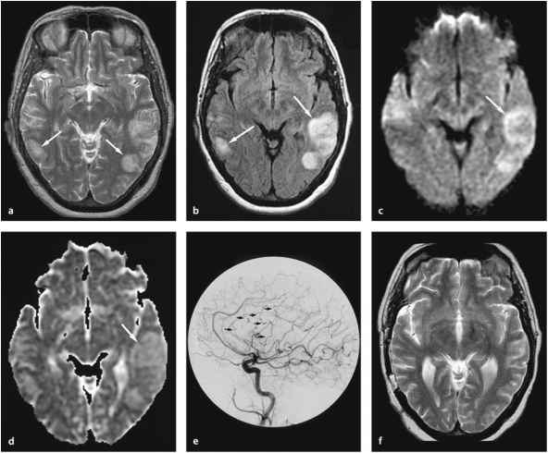

Slide 25
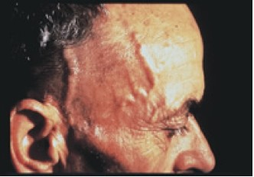
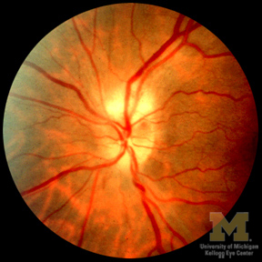
Temporal arteritis GCA
Disc infarction GCA

Slide 26
GCA: Differential diagnosis
Differential diagnosis
Migraine
Tension headache
Trigeminal neuralgia
Takayasu's arteritis
Polyarteritis nodosa
Polymyositis
Rheumatoid arthritis
Remitting seronegative symmetrical synovitis with pitting edema

Slide 27
GCA: Diagnosis
Investigations
Raised acute phase reactants:
ESR; 83% have a rate above 50 mm/hour. A normal ESR does not exclude the diagnosis.
CRP can sometimes be elevated in the presence of a normal ESR.
Normocytic normochromic anaemia and are common.
Auto-antibody and complement levels are normal.

Slide 28
GCA: Diagnosis
Investigations
Cryoglobulins and monoclonal immunoglobulins are absent.
Muscle enzyme levels - are normal.
LFTs, may be elevated.
Temporal artery biopsy:
  The sensitivity has been estimated to be 87%.
  Biopsy should be taken on the symptomatic side.
Colour duplex ultrasonography has been shown to be relatively accurate for diagnosing

Slide 29
GCA: Management
If temporal artery biopsy is negative (either due to the presence of skip lesions or suboptimal biopsy):
Patients should be treated for GCA if there is a typical clinical and laboratory picture.
  Response to glucocorticosteroids,
  Typical findings on ultrasound
  Ischemic complications typical of GCA (such as anterior ischemic optic neuritis).
Steroids: High dose corticosteroid immediately:
40 mg prednisolone daily.
Claudication symptoms:
60 mg prednisolone daily.
If the patient has visual symptoms, admit for treatment with
I/methylprednisolone.
Once symptoms and abnormal test results resolve, the dose can be reduced in 10 mg steps each two weeks to 20 mg, then in 2.5 mg steps.

Slide 30
THANK
YOU
FOR
YOUR
ATTENTION

