Slide 1
Diseases of Pleura
By Dr. Zahoor

Slide 2
Objectives
We will discuss
1. Pleurisy
2. Pleural effusion
3. Pneumothorax

Slide 3
Pleura
Pleura is layer of connective tissue covered by simple squamous epithelium.
Pleura are the covering to the lungs. There are two layers visceral and parietal pleura.

Slide 4
Pleura
Visceral pleura covers the surface of lung and parietal pleura lines the inside of thorax.
Normal intrapleural pressure is negative.
There is small amount of lubricating fluid (5-10 ml ) between the visceral and parietal pleura.

Slide 5
1. Pleurisy
What is Pleurisy?
Pleurisy is pain due to localized inflammation of pleura due to disease process
Pain is sharp, localized which is worse on deep inspiration, coughing .
On breathing there is evidence of pleural rub, pleural rub is heard on deep inspiration on auscultation.

Slide 6
1. Pleurisy
Common causes of pleurisy
- Pneumonia
- Pulmonary infarct
- Carcinoma
Rare causes
- Rheumatoid arthritis
- SLE

Slide 7
Bornholm Disease
It is upper respiratory infection due to coxsackie B virus in young adult, followed by pleuritic chest pain, upper abdominal pain with tender muscles
X-ray chest is normal
Illness clears in a week

Slide 8
Asbestosis
Asbestosis is defined as fibrosis of the lung due to asbestos dust. It may or may not be associated with fibrosis of parietal and visceral layer of pleura
Symptoms
-Breathlessness
-Finger clubbing
-Bilateral end inspiratory crackles

Slide 9
Asbestosis
What is Asbestos?
It is mixture of silicate of iron, magnesium, nickel, cadmium, and aluminum
It occurs as fiber and is used for roofing, insulation, fire proofing .
Types of Asbestos
Chrysotile- white asbestos accounts for 90% of worlds production .
Crocidolite- blue asbestos
Amosite – brown asbestos

Slide 10
Asbestosis
Exposure to Asbestos occurs particularly in ship yards and in power stations (occupational)
After exposure to Asbestos – Mesothelioma occurs 20-40 years later
Asbestos dust causes pleural thickening, asbestosis, mesothelioma and Adeno- carcinoma lung.

Slide 11
Mesothelioma
Mesothelioma is malignant tumour of pleura usually associated with Asbestos. Crocidolite blue type of asbestos is potent cause and occurs after 20 years of exposure
There is chest pain, pleural effusion
Treatment
- Chemotherapy

Slide 12
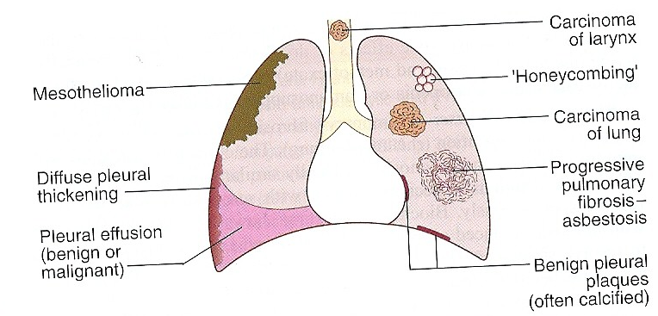
Asbestosis – the range of possible effects on the respiratory tract

Slide 13
Pleural Disease caused by drugs
Amiodarone - antiarrhythmic for SVT and ventricular arrhythmias – causes pleural thickening and pleural effusion
Bromocriptine – used in Parkinson's – causes pulmonary fibrosis and pleural effusion
Methotrexate – anti-cancer drug – causes pleural effusion
Methysergide – used for migraine – causes pulmonary fibrosis and pleural effusion

Slide 14
2. Pleural Effusion

Slide 15
Pleural Effusion
Pleural effusion is the accumulation of fluid in the pleural space
It is detected on X-ray when 300ml of fluid is present.
Small pleural effusion can be identified by ultrasound, CT.
Clinically it is detected when 500ml fluid or more is present

Slide 16
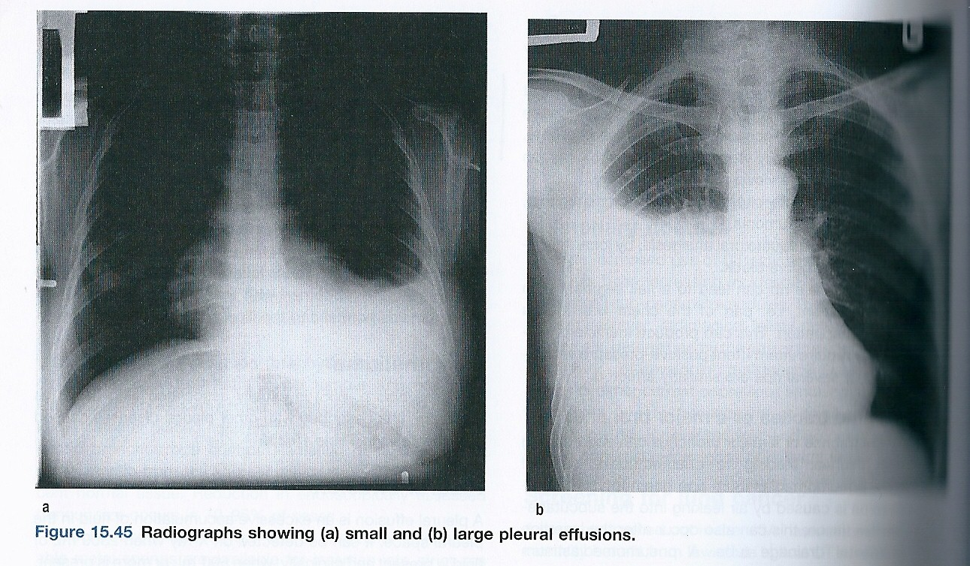

Slide 17
Pleural Effusion
X-ray chest
- may show obliteration of the Costrophrenic angle or dense homogenous white shadows occupying part or all of the hemithorax

Slide 18
Pleural Effusion
Physical signs
- Chest movement reduced on the affected side
Mediastinal displacement away from lesion in massive effusion
Percussion note – stony dull
Breath sound – reduced or absent
Vocal resonance – reduced or absent
Added sound – none

Slide 19
Pleural Effusion
Diagnosis
It is done by Pleural aspiration, under ultrasound guidance, using aseptic precaution
A needle attached to 20ml syringe is inserted under local anesthesia through intercostal space towards the top of area of dullness
Pleural fluid may be transduate or exudate

Slide 20
Transduate Pleural Effusion
Usually bilateral
Protein content < 30g/l
LDH < 200 iu/L
Pleural fluid to serum LDH ratio < 0.6

Slide 21
Transduate Pleural Effusion
Causes of Transduate Pleural Effusion
- Heart failure
- Nephrotic syndrome
- Constrictive pericarditis
- Hypothyroidism
- Meigs syndrome – ovarian tumor producing
right sided pleural effusion

Slide 22
Exudate Pleural Effusion
Protein content > 30 g/l
LDH > 200 iu/l
Pleural fluid to serum LDH ratio > 0.6
Causes of Exudate Pleural Effusion (common)
- Bacterial pneumonia
- Tuberculosis
- Carcinoma of bronchus
- Pulmonary Infarction

Slide 23
Exudate Pleural Effusion
Rare causes
- Post MI
- Acute pancreatitis – there is increased amylase content
Mesothelioma
Very rare causes
Sarcoidosis
Yellow nail syndrome (pleural effusion due to lymph oedema)
Familial Mediterranean fever

Slide 24
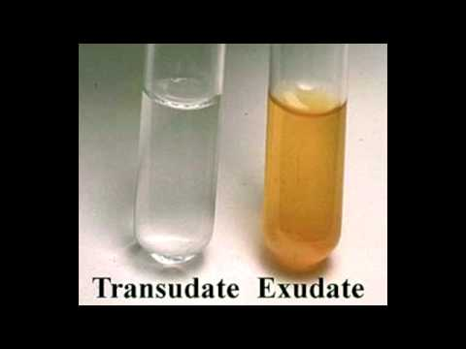
Pleural Fluid

Slide 25
Treatment of Pleural Effusion
Treat the underlining condition
If fluid is large, drainage is advised
Maximum aspiration of pleural fluid at one time – 1000ml
Malignant pleural effusion
Malignant pleural effusion that reaccumulate and are symptomatic can be aspirated to dryness followed by instillation of sclerosing agent as tetracycline or talc ( Magnesium silicate).

Slide 26
Pleural Effusion
Empyema
This is presence of pus in the pleural space and can be complication of bacterial pneumonia .
Haemothorax
Accumulation of blood in pleural space. Cause may be pulmonary infarction, malignancy. Sometime traumatic tape

Slide 27
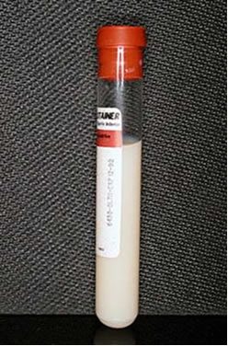
Chylothorax
It is due to collection of lymph in the pleural space usually due to leakage of lymph from the thoracic duct following trauma or infiltration of carcinoma
Chylothorax
(milky appearance due to lymph)

Slide 28
3. Pneumothorax

Slide 29
Pneumothorax
Pneumothorax is the collection of air in the pleural space
It may be spontaneous or due to trauma to the chest
Spontaneous Pneumothorax
- More common in male, M : F ratio 6 : 1
- It is caused by rupture of pleural bleb usually apical, due to congenital defect in the connective tissue of alveolar wall

Slide 30
Spontaneous Pneumothorax
Causes (cont)
It may be due to COPD
Rarely due to bronchial asthma
Carcinoma
Lung abscess – breaking down and leading to bronchopleural fistula
Severe pulmonary fibrosis with cyst formation

Slide 31
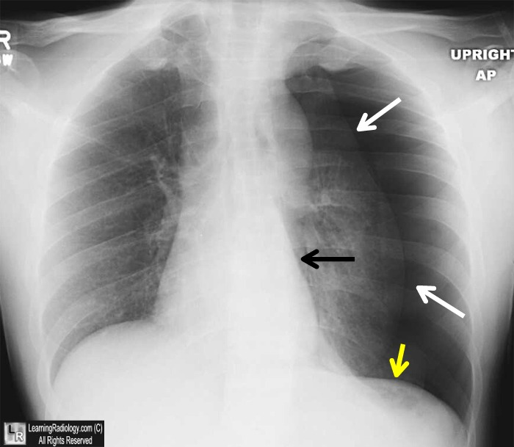
Pneumothorax
left side

Slide 32
Pneumothorax
Physical signs
- Chest movement reduced on the affected side
Mediastinal displacement away from lesion in tension Pneumothorax
Percussion note – hyper resonant
Breath sound – reduced or absent
Vocal resonance – reduced or absent
Added sound – none

Slide 33
Pneumothorax
Normally intrapleural pressure is negative
In Pneumothorax, it becomes positive and causes collapse of lung
Tension Pneumothorax
Very rare, occurs due to valvular mechanism when air is sucked into the pleural space during inspiration but not expelled during expiration

Slide 34
Tension Pneumothorax (cont)
Pressure increases in the pleura causing further collapse of the lung and shifting of mediastinum
Venous return to the heart decreases
Increase respiratory difficulty
Tachycardia

Slide 35
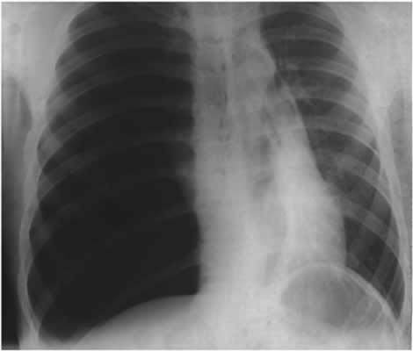
Tension Pneumothorax
There are completely absent lung markings on the right, with the right lung collapsed and pushed across into the left hemithorax, along with the mediastinal contents.

Slide 36
Management of Pneumothorax
Small Pneumothorax
When < 20% of radiographic volume is there
Best seen in expiratory film
It causes minimal symptoms
Observe 2 weeks until air is reabsorbed
Patient can resume normal activity but avoid strenuous exercise

Slide 37
Management of Pneumothorax
Moderate Pneumothorax
When there is 20-50% of radiographic volume
Aspirate air

Slide 38
Management of Pneumothorax
Large Pneumothorax
When more than 50% of the radiographic volume and it causes shift of trachea and mediastinum
Aspirate air
If reoccurrence, insert intercostal drainage tube with under water seal for 2-3 days
Look for reexpansion (tube not bubbling) and remove tube and do X-ray chest

Slide 39
Management of Pneumothorax
Tension Pneumothorax
Causes collapse of lung and shifting of trachea and mediastinum
Aspirate air
If reoccurrence, insert intercostal drainage tube with under water seal for 2-3 days
Look for reexpansion (tube not bubbling) and remove tube and do X-ray chest

Slide 40
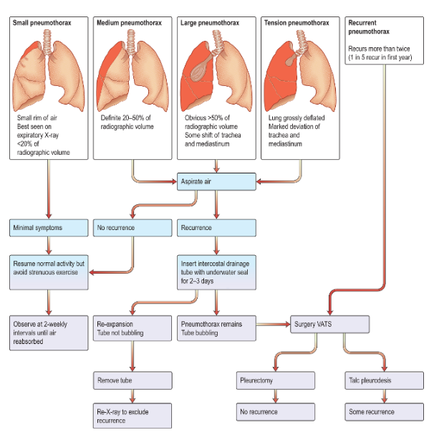
Pneumothorax and Algorithm For Management

Slide 41
CASE HISTORY
Shortness of breath and cough
A 64 year old woman presented to the emergency department. She has been feeling generally unwell for several weeks and has become increasingly breathless over the last 4 days. She describes a non-productive cough but denies any fever or night sweats. Her medical history is significant for a recent diagnosis of right-sided carcinoma of breast that was treated with removal of the tumor in the breast (lumpectomy) and a course of chemotherapy.

Slide 42
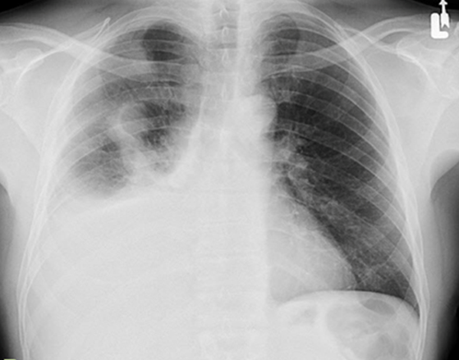
Chest examination
She has reduced breath sounds on the right side of the chest, with dullness to percussion.
Pulse oximetry applied to her finger shows reading of 92% on room air.
Chest X-ray is performed in emergency department is shown.

Slide 43
Case History - Questions:
What does the chest X-ray show?
How would you investigate the underlying cause? What is the likely cause.

Slide 44
Case History - Answers:
Answer to Questions 1:
Right side Pleural Effusion
Answer to Question 2:
Aspiration of Pleural Fluid and then analyzed. In this case, patient has history of breast cancer, so the pleural fluid is likely to be malignant effusion.

Slide 45
Thank you

