Slide 1
Bronchial Asthma
By Dr. Zahoor

Slide 2
Bronchial Asthma
Bronchial Asthma is reversible obstructive lung disease
It may be due to chronic air way inflammation and increased air way hyper-responsiveness

Slide 3
Bronchial Asthma
Typical symptoms include
- Wheeze
- Cough
- Chest tightness
- Dyspnea
- Air flow obstruction that is variable over short periods of time or is reversible with treatment

Slide 4
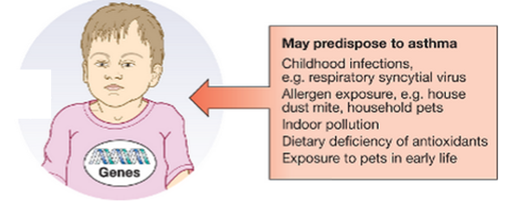
Bronchial Asthma
Epidemiology
Bronchial Asthma affects 300 million people world wide
Genetic and environmental factors are important
Factors implicated in development of asthma

Slide 5
Bronchial Asthma
Pathophysiology
Airway hyper-reactivity (AHR) – means tendency of airways to contract too easily and too much in response to triggers that have little or no effect in normal person
In chronic asthma – remodeling of airway occurs, leading to fibrosis of the airway wall, fixed narrowing of airway and reduced response to broncho dilator

Slide 6
Bronchial Asthma
Pathophysiology ( cont )
Relationship between IgE and bronchial asthma is well established
Allergen inhalation is followed by two phase broncho constrictor response – early and late phase
E.g. Inhalation of house dust mites, pets e.g. cats, dogs, pests such as cockroaches and fungi (aspergillus)

Slide 7
Bronchial Asthma
Pathophysiology ( cont )
Allergic mechanism are also responsible in some cases of occupational asthma
Aspirin sensitive asthma – they inhibit cyclo-oxygenase which leads to shunting of arachyidonic acid metabolism through lipo-oxygenase pathway resulting in production of cysteinyl leukotrines

Slide 8
Bronchial Asthma
Pathophysiology
Exercise induced asthma
Hyper ventilation results in water loss from respiratory mucosa, which triggers mediator response

Slide 9
Bronchial Asthma
Drugs causing Bronchial Asthma
β-blockers – given orally or even eye drops
Aspirin
NSAIDS
Oral contraceptive pill
Cholinergic agents
Prostaglandin F₂
Betal nuts

Slide 10
Bronchial Asthma
Clinical Features
Typical symptoms include
Recurrent episodes of wheeze
Chest tightness
Breathlessness
Cough

Slide 11
Bronchial Asthma
Churg-Struss Syndrome
Bronchial asthma with systemic and pulmonary Vasculitis
Eosinophilia (> 1000/mm³)
Systemic Vasculitis in small vessel associated with purpura, mononeuritus multiplex
Rarely diffuse alveolar hemorrhage

Slide 12
Bronchial Asthma
Diagnosis
Diagnosis is mainly clinical based on history and examination
Supportive evidence is provided by
- Spirometry – FEV₁ is reduced and there is ≥ 15% increase in FEV₁ following administration of broncho dilator
FEV1 ≥ 15% decrease after 6mins of exercise

Slide 13
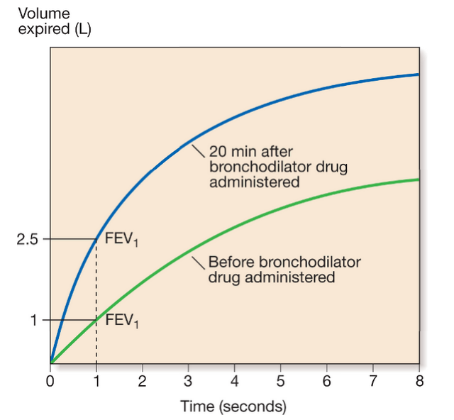
Reversibility Test

Slide 14
Bronchial Asthma
Peak Flow Meter at Home
Patients are advised to record peak flow reading after arising in the morning and before retiring in the evening
PEF (Peak Expiratory Flow) if reduced more than 20% in the morning is considered diagnostic of bronchial asthma

Slide 15
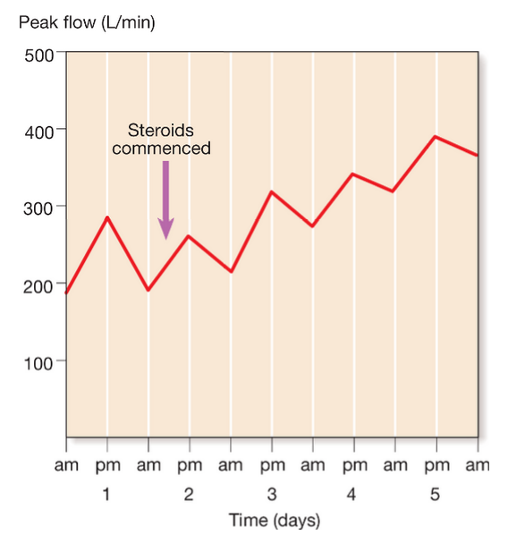
Serial Recording of PEF in Patient with Asthma

Slide 16
Bronchial Asthma
Other useful test
Allergic status – skin prick test
IgE measurement
Blood CBC – may show increase Eosinophil count
Radiological examination – normal or hyperinflation of lung fields

Slide 17
Bronchial Asthma
Management
Bronchial asthma is chronic condition
Aim of treatment is to obtain sustained complete control
- Control means
no symptoms during the day OR two or less per week
No nocturnal symptoms
No limitation of activities
Lung function test normal
No exacerbation

Slide 18
Bronchial Asthma
Management
Patient should be encouraged to manage their own disease.
How ?
By monitoring PEF (Peak Expiratory Flow) at home to guide their management
Avoid aggravating factors like
avoid pet animal exposure, dust mite exposure by replacing carpets, eliminate cockroaches, stop smoking, avoid medicine which precipitate

Slide 19
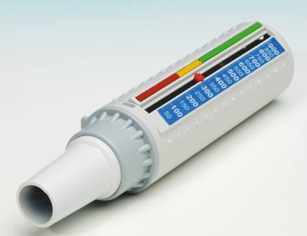
Peak Flow Meter

Slide 20
Stepwise Approach To the Management of Asthma
Step 1
Occasional use of inhaled short acting β₂ adrenoreceptor agonist – Broncho dilator
For whom ?
For patients with mild intermittent asthma symptoms less than once a week for three months

Slide 21
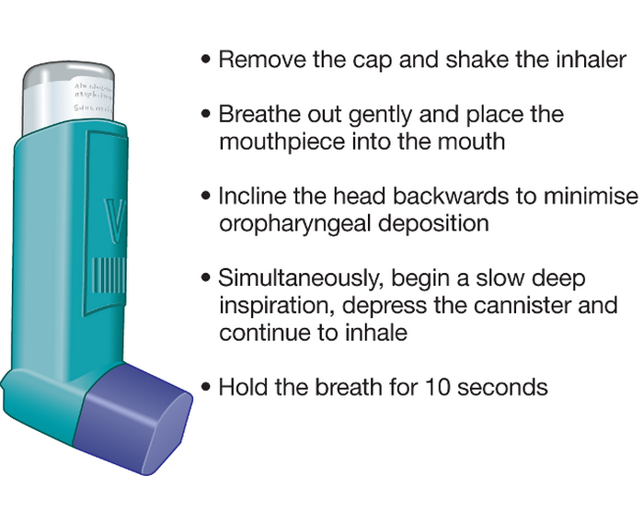
How to use a metered dose inhaler

Slide 22
Stepwise Approach To the Management of Asthma
Step 2
Introduction of regular prevention therapy
Regular therapy with inhaled corticosteroids (ICS) such as beclometasone in addition to inhaled β₂ agonist is taken on required basis
For whom ?
Patients who have mild persistent asthma

Slide 23
Stepwise Approach To the Management of Asthma
Step 3
If patient remains poorly controlled on regular ICS (inhaled Corticosteroid), then add inhaled long acting β₂ agonist (LABA) salmeterol, still not controlled add oral salbutamol
Step 4
If still poor control, give high dose inhaled corticosteroid plus inhaled long acting β₂ agonist , plus add oral therapy with leukotrine receptor antagonist e.g. montelukast ,or theophylline or salbutamol.
Step 5- Severe syomtoms , deteriorating
Add predinisolone 40 mg daily to step 4.

Slide 24
Stepwise Approach To the Management of Asthma
What are leukotrines ?
Leukotrines are important mediators of asthma, which are fatty compounds produced by immune system that cause bronhoconstriction, inflammation and mucus secretion in asthma
What are Antileukotrine agents ?
These are drugs which function as leukotrine receptor antagonist e.g. montelukast or leukotrine enzyme inhibitor – 5 lipooxygenase inhibitor like zileuton

Slide 25
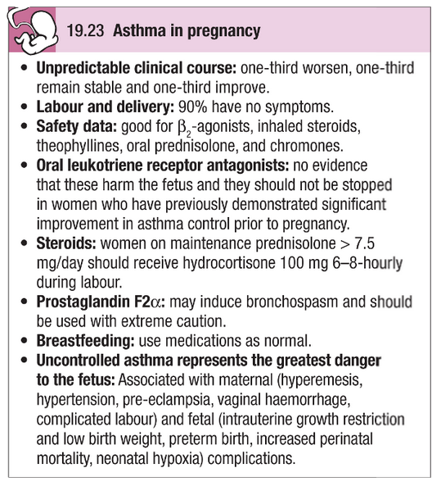

Slide 26
Exacerbation of Asthma
Exacerbation are characterized by increased symptoms, deterioration in lung function, PEF<60% of patient’s best recording
Exacerbation are precipitated by
- Viral infection
- Pollen
- Air pollution
Management – short course of oral predinisolone 30-60mg/day

Slide 27
Management of Acute Severe Asthma
What is acute severe asthma ?
The features of acute severe asthma are
- Respiratory rate ≥ 25/min
- Heart rate ≥ 110/min
- Inability to complete sentence in 1 breath
- PEF 33-50% predicted (< 200L/min)

Slide 28
Life Threatening Features of Acute Severe Asthma
Silent chest
Cyanosis
Feeble respiratory effort
Bradycardia or arrhythmias
Hypotension
PEF < 33% predicted (<100 L/min)
Sp0₂ < 92% or Pa0₂ < 8 kPa (60mmHg)
Exhaustion
Coma

Slide 29
Management of Acute Severe Asthma
Treatment
Oxygen – high concentration of oxygen to maintain oxygen saturation above 92%
Inhaled Broncho dilator – β₂ agonist e.g. ventolin via Nebulizer
- Apratropium bromide (Atrovent) – anticholinergic drug, should be added to ventolin
Systemic corticosteroid – oral or intravenous
IV fluids

Slide 30
Monitoring of Acute Severe Asthma Treatment
PEF should be recorded 15-30mins initially and then every 4-6 hours
Pulse oxymetery – SaO₂ should remain > 92%
Arterial blood gases to be monitored

Slide 31
Indications for assisted ventilation in Acute Severe Asthma
Respiratory arrest
Coma
Deterioration of Arterial blood gas tensions despite therapy
PaO₂ < 8 kPa (60mmHg) and falling
PaCO₂ > 6 kPa (45mmHg) and rising
pH low and falling (H+ high and rising)
Exhaustion, confusion, drowsiness

Slide 32
Acute Bronchial Asthma
Prognosis
Outcome of acute severe asthma is good. Death is rare
Death can occur when failure to recognize the severity of attack by physician or the patient

Slide 33
Acute Severe Bronchial Asthma
When to discharge the patient who is admitted
with severe acute asthma
Nebulized therapy has been stopped for at least 24 hours
Peak expiratory flow (PEF) has reached 75% of predicted value
Give follow up appointment with GP within two days and specialist hospital in a month

Slide 34
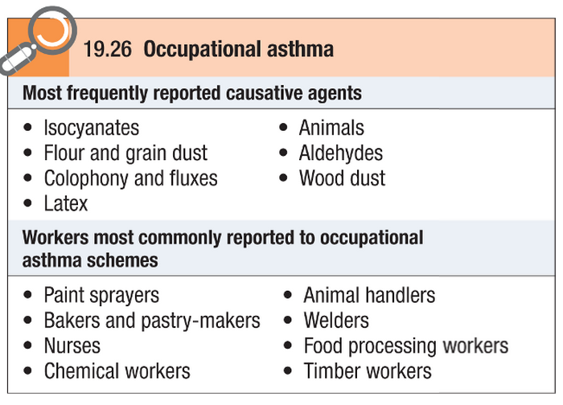
Occupational Asthma

Slide 35
How to Diagnose Occupational Asthma?
Record PEF- 2 hourly
Skin prick test
Specific IgE test
Bronchial provocation test with suspected agent

Slide 36
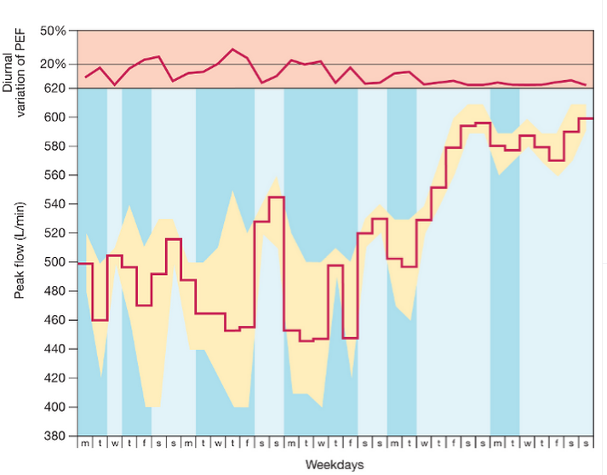
Peak Flow Reading in Occupational Asthma

Slide 37
CASE HISTORY – An asthmatic patient with dyspnoea and wheeze
A 25 year old male with long standing asthma is admitted with 2 days history of dyspnoea and wheeze. He has been unable to sleep because of cough and wheeze and his inhalers have run out. On examination, he appears dyspnoeic at rest, his respiratory rate is 28/min and oxygen saturation on air is 90%. There is reduced but equal expansion of chest with audible wheeze. There is no evidence of Pneumothorax clinically or on X-ray chest. Patient is given a nebulizer and put on 60% oxygen.
Arterial blood gases show
pH 7.53
PaO₂ 11kPa
PaCO₂ 3.5kPa
HCO₃ 20mmol/L
SaO₂ 96%

Slide 38
Questions:
Which of the following does the patient have?
a. Acute respiratory acidosis
b. Acute respiratory alkalosis
c. Acute metabolic acidosis
d. Acute metabolic alkalosis
Which of the following is true?
a. Patient is hypoxemic
b. Patient requires intubation
c. Oxygen should be reduced as pH is abnormal
d. Patient should be given steroids
Later on,Patient appears more drowsy and no wheeze is audible. Repeat blood gas pH 7.22, PaO₂ 10.5kPa, PaCO₂ 10.1kPa, HCO₃ 26mmol/L, SaO₂ 96%. Which of the following may the patient has developed?
a. Acute respiratory acidosis
b. Acute respiratory alkalosis
c. Acute metabolic acidosis
d. Acute metabolic alkalosis

Slide 39
Answers:
Answer to Question 1:
b. Acute respiratory alkalosis
pH is above 7.45 (alkalosis) and PaCO₂ is low
Answer to Question 2:
d. Patient should be given steroids.
Steroids will treat underlying Bronchospasm
Answer to Question 3:
a. Acute respiratory acidosis
Because muscle pump has exhausted due to increased work
of breathing. Patient requires intubation and mechanical
ventilation

Slide 40
Thank you

