Slide 1
CUSHING’S SYNDROME
Dr. M. SOFI MD; FRCP (London); FRCPEdin; FRCSEdin

Slide 2
CUSHING’S SYNDROME
A metabolic disorder caused by overproduction of
corticosteroid hormones by the adrenal cortex and
often involving obesity and high blood pressure.
Diagnosis is often difficult because none of the
symptoms or signs are pathognomonic of the
syndrome.
Patients with obesity, hypertension, and glucose
intolerance are common who do not have adrenal
hyperfunction.
An important clinical clue to the presence of
glucocorticoid excess is the simultaneous
development and increasing severity of several of
these symptoms.

Slide 3
CUSHING’S SYNDROME: Causes
Iatrogenic CS is likely the most common cause
In pituitary Cushing's, a benign pituitary adenoma secretes ACTH. This is also known as Cushing's disease and is responsible for 70% of endogenous Cushing's syndrome.
In adrenal Cushing's, excess cortisol is produced by adrenal gland tumors, hyperplastic adrenal glands, or adrenal glands with nodular adrenal hyperplasia.
Tumors outside the normal pituitary-adrenal system can produce ACTH that affects the adrenal glands. This etiology is called ectopic or paraneoplastic Cushing's disease and is seen in diseases such as small cell lung cancer.
Finally, rare cases of CRH-secreting tumors (without ACTH secretion) have been reported, which stimulates pituitary ACTH production.

Slide 4
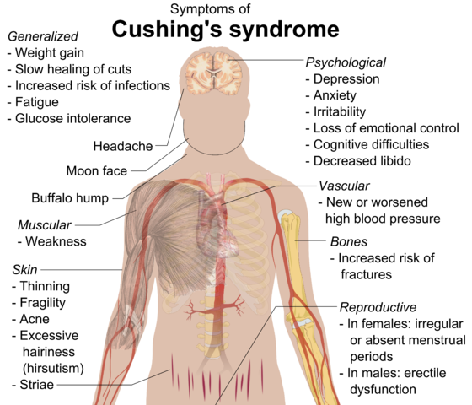

Slide 5
Physical Examination
Obesity
Patients may have increased adipose tissue in the face (moon facies), upper back at the base of neck (buffalo hump), and above the clavicles (supraclavicular fat pads).
Central obesity with increased adipose tissue in the mediastinum and peritoneum; increased waist-to-hip ratio greater than 1 in men and 0.8 in women; and, upon CT scan of the abdomen, increased visceral fat is evident.
Cardiovascular and renal
Hypertension and possibly edema may be present due to cortisol activation of the mineralocorticoid receptor leading to sodium and water retention.
Gastroenterologic
Peptic ulceration may occur with or without symptoms Particularly at risk are patients given high doses of glucocorticoids (rare in endogenous hypercortisolism).

Slide 6
Physical Examination
Skin
Facial plethora may be present, especially over the cheeks.
Violaceous striae, often wider than 0.5 cm, are observed most commonly over the abdomen, buttocks, lower back, upper thighs, upper arms, and breasts.
Patients may have telangiectasias and purpura.
Cutaneous atrophy with exposure of subcutaneous vasculature tissue and tenting of skin may be evident.
  Glucocorticoid excess may cause increased lanugo facial hair.
  Ecchymoses may be present.
  Acanthosis nigricans, which is associated with insulin resistance and hyperinsulinism, may be present. The most common sites are axilla and areas of frequent rubbing, such as over elbows, around the neck, and under the breasts.

Slide 7
Physical Examination
Endocrine
Galactorrhea may occur when anterior pituitary tumors compress the pituitary stalk, leading to elevated prolactin levels.
Hypothyroidism, may occur from an anterior pituitary tumor whose size interferes with proper thyroid-releasing hormone (TRH) and thyroid-stimulating hormone (TSH) function.
Low testosterone levels in men may lead to decreased testicular volume from inhibition of LHRH and LH/FSH function.
Skeletal/muscular
Proximal muscle weakness may be evident.
Osteoporosis may lead to incident fractures and kyphosis, height loss, and axial skeletal bone pain. Avascular necrosis of the hip is also possible from glucocorticoid excess.
Neuropsychological
Emotional liability, fatigue, and depression.
Visual-field defects, often bitemporal, and blurred vision may occur in individuals with large ACTH-producing pituitary tumors that impinge on the optic chiasma.

Slide 8
History & Physical Examination
New-onset or worsening of hypertension and DM,
Difficulty with wound healing, increased infections,
Patients with Cushing disease may develop
  Neadaches,
  Polyuria and
  Nocturia,
  Visual problems
  Galactorrhea.
Rapid onset of symptoms of glucocorticoid excess in conjunction with:
  virilization in women or
  feminization in men suggests an adrenal carcinoma as the underlying cause of the Cushing syndrome.

Slide 9
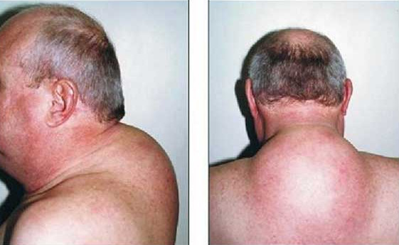
Buffalo hump refers to an unsightly lump of fat that develops at the top of the back between the shoulders. It can arise from a variety of conditions that are characterized by an increase in cortisol or glucocorticoid (hormones produced by the adrenal gland) levels in the bloodstream

Slide 10
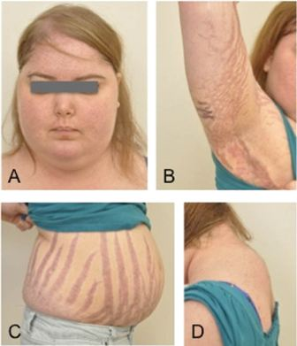
Moon shaped face (A)
Acanthosis nigricans (B)
Violaceous striae abdomen strea (C)
Buffalow hump (D)

Slide 11
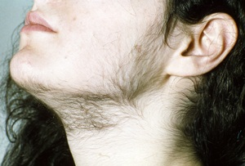
Hirsutism: It develop because adrenal glands make too much cortisol, or it can occur Congenital adrenal hyperplasia. This inherited condition is characterized by abnormal production of steroid hormones, including cortisol and androgen, by your adrenal glands.

Slide 12
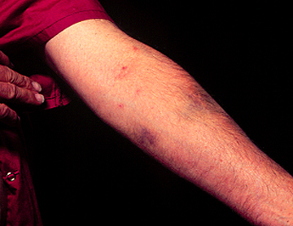
Easy bruisability in Cushing's disease
Forearm of a 42-year-old man with Cushing's disease showing multiple ecchymosis due to minimal trauma.

Slide 13
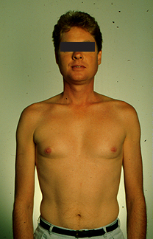
Proximal muscle wasting and
weakness are common in
Cushing's syndrome, being
induced by the catabolic
effects of excess glucocorticoid
on skeletal muscle .
As a result, many patients
cannot rise from a squatting
position without assistance.
patients with more severe
disease may be unable to
climb stairs or get up from a
deep chair.
Muscle wasting and weakness
are rare in patients with
pseudo-Cushing's syndrome.

Slide 14
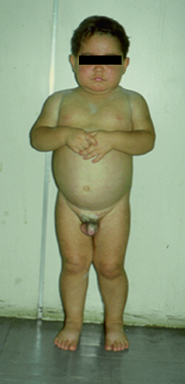
Premature puberty in Cushing's syndrome
A 2.5 year-old boy with an adrenocortical carcinoma that secreted excess cortisol and androgens. He presented with signs of Cushing's syndrome (moon face, obesity) and premature puberty (Tanner III pubic hair and penis enlargement, with prepubertal testicular volume).

Slide 15
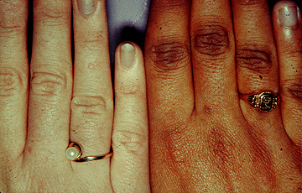
Right hand of a 16-year-old woman with Nelson's syndrome (right) next to that of a woman without endocrine disease (left), demonstrating skin hyperpigmentation that is accentuated over the knuckles Hyperpigmentation occurs in patients with other causes of chronic ACTH excess such as Cushing's disease or primary adrenal insufficiency.

Slide 16
Who should be tested? — Patients in whom a diagnosis is most likely, include:
  Unusual findings for their age (osteoporosis or
  hypertension in young adults)
  Multiple progressive features of Cushing’s CS,
  particularly those that are predictive of CS such
  as:
    facial plethora,
    proximal myopathy
    striae (>1 cm wide and red/purple)
    easy bruising
  Unexplained severe features (resistant
  hypertension, osteoporosis) at any age

Slide 17
Initial testing —
  The initial diagnostic tests for hypercortisolism should be
  highly sensitive
  The diagnosis of CS is established when at least two
  different first-line tests are unequivocally abnormal.
  Once the diagnosis is established, additional evaluation is
  done to identify the cause of the hypercortisolism.
  Screening testes:
  late-night salivary cortisol (two measurements),
  24-hour urinary free cortisol (UFC) excretion (two
  measurements), or the
  overnight 1 mg dexamethasone suppression test (DST).

Slide 18
Physiologic hypercortisolism that may have some clinical features of CS include
Pregnancy
Patients with severe obesity, especially those with visceral obesity or PCOS
Patients with psychological stress, especially patients with a severe major depressive disorder and melancholic symptoms
Poorly controlled diabetes mellitus
Rarely, chronic alcoholism
Physical stress (illness, hospitalization/surgery, pain)
Malnutrition, anorexia nervosa
Intense chronic exercise
Hypothalamic amenorrhea
High corticosteroid-binding globulin (CBG) (increased serum cortisol but not UFC)
Glucocorticoid resistance

Slide 19
Diagnostic Testing for Cushing’s Syndrome
Late-Night Salivary Cortisol
Late-night salivary cortisol is one of the most sensitive diagnostic tests (sensitivity 93-100% ) for CS.
Elevated cortisol between 11:00 p.m. and midnight appears to be the earliest detectable abnormality in CS
Normal levels of late-night salivary cortisol usually exclude the diagnosis of Cushing’s syndrome due to an ACTH secreting tumor.
Urine Free Cortisol
A 24 hour urine free cortisol level does reflect the cortisol secretion throughout an entire day.
Majority of patients with Cushing’s have elevated levels of urine free cortisol
It is estimated that 20-25% of patients with Cushing’s syndrome may have a normal urine cortisol.
Depression, chronic alcoholism, and eating disorders may increase urine free cortisol.

Slide 20
Differential Diagnostic Testing
The majority of patients with Cushing’s syndrome have a
ACTH-secreting tumor usually from the pituitary gland (Cushing’s disease).
Ectopic ACTH syndrome.
Solitary or multiple tumors in their adrenal glands secreting excessive cortisol.
CRH-secreting tumors have been reported, which stimulates pituitary ACTH production.
ACTH Levels
The first step is the measurement of morning ACTH.
Patients with ACTH-secreting tumors will either have a normal or elevated level of ACTH.
In contrast, patients with adrenal Cushing’s will have a subnormal level.

Slide 21
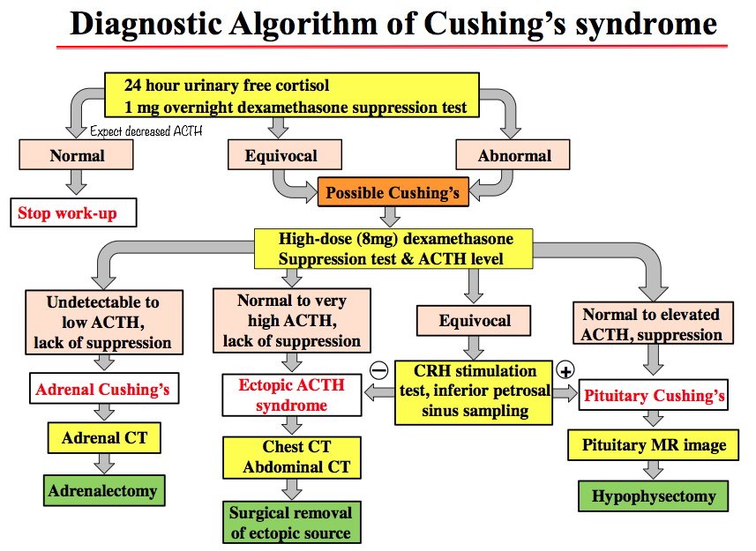

Slide 22
Cushing’s syndrome etiology
ACTH-dependent
(Pseudo-CS)
Pituitary (CD) (70%)
  Microadenomas (95%)
  Macroadenomas (5%)
  Ectopic ACTH or CRH (10%)
  Small cell lung ca
  Carcinoids: lung, pancreas, thymus
ACTH-independent
  Unilateral
  Adrenal adenoma (10%)
  Adrenal carcinoma (5%)
  Bilateral
  Macronodular Hyperplasia (AIMAH) (<2%)
  Primary pigmented Micronodular Adrenal disease (PPNAD) (<2%)
  McCune Albright Syndrome (<2%)

Slide 23
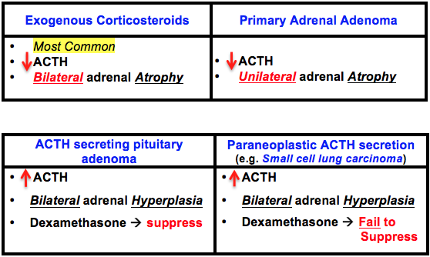
Cushing’s syndrome: Establishing cause
Clinical features may provide a clue. First step is to measure plasma ACTH to differentiate ACTH-dependent from ACTH independent CS
  If ACTH <1 pmol/L--- adrenal CS
  If ACTH >3.3 pmol/L—ACTH-dependent
  If ACTH 1-3→CRH stim

Slide 24
Treatment
The goal of treatment of all patients with Cushing's syndrome is to achieve normalization of hypothalamic-pituitary-adrenal function and subsequent reversal of Cushingoid signs/symptoms and co-morbidities
Optimal treatment involves localization and complete removal of a corticotropin (ACTH)-secreting pituitary or ectopic tumor or cortisol-secreting adrenal tumor(s).
In patients with Cushing’s disease who were not cured by pituitary surgery, medical therapy targeting the corticotrophin tumor such as cabergoline or pasireotide can result in normalization of 24-hour urinary free cortisol in 20 to 40 percent of them.
Pituitary irradiation is another second-line treatment for persistent or recurrent Cushing's disease.
Adrenal enzyme inhibitors must be used to control hypercortisolism until it is effective in approximately 85 percent of them.
Bilateral adrenalectomy is a definitive treatment for ACTH-secreting pituitary or ectopic tumors.

Slide 25
Trans-sphenoidal surgery
75 – 90 %
initial cure
5 – 20 % recurrence Adults
60 - 70 % final cure
75 – 90 %
initial cure
Pituitary irradiation ±
Mitotane
Pituitary irradiation ± Mitotane
80 - 85% cure
Total bilateral adrenelectomy
100% cure

Slide 26
THANK
YOU
FOR
YOUR
ATTENTION

