Slide 1
1. Addison’s Disease
2. Hypernatremia
By Dr. Zahoor

Slide 2
Addison’s Disease
What is Addison’s Disease?
It is primary Hypoadrenalism.
Therefore, we will study adrenal gland structure and function first, then we will discuss Addison’s disease.

Slide 3
Adrenal Gland
Adrenal Gland Anatomy and Function
The human adrenal glands weigh 8-10 gram together. Each adrenal gland is situated above the kidney.
Adrenal gland has outer cortex and inner medulla.
The cortex has three zones:
1. Zona glomerulosa
2. Zona fasciculata
3. Zona reticularis
Adrenal medulla – synthesizes, stores and secrete catecholamines (epinephrine and Norepinephrine).

Slide 4
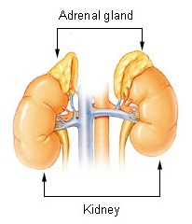
The adrenal glands lie above the kidneys.
The Adrenal gland lie above the kidney

Slide 5
Adrenal Gland
Adrenal Cortex – three zones
Zona glomerulosa – secrete aldosterone, mainly controlled by renin angiotensin aldosterone mechanism
Zona fasciculata
Zona reticularis
Produce Cortisol and Androgen. Under feedback control of Hypothalamic – Pituitary – Adrenal (HPA) axis

Slide 6
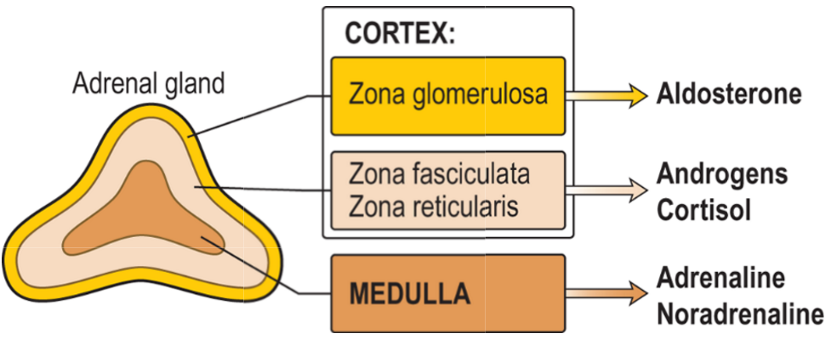
Adrenal gland and its hormone

Slide 7
Adrenal Gland
We are mainly concerned with Cortisol production (Zona fasciculata and Zona reticularis)
Glucocorticoids production by Adrenals is under hypothalamic – pituitary control
Pituitary ACTH is secreted in response to hypothalamic CRH (Corticotrophin-Releasing Hormone)
ACTH stimulates the secretion of Cortisol from adrenal

Slide 8
Adrenal Gland (cont)
ACTH contain melanocyte stimulating hormone (MSH) like sequences which cause pigmentation when ACTH level is markedly raised
Cortisol when secreted (or synthetic corticosteroid when given to patient) cause negative feedback on the hypothalamus and pituitary and inhibit ACTH release

Slide 9
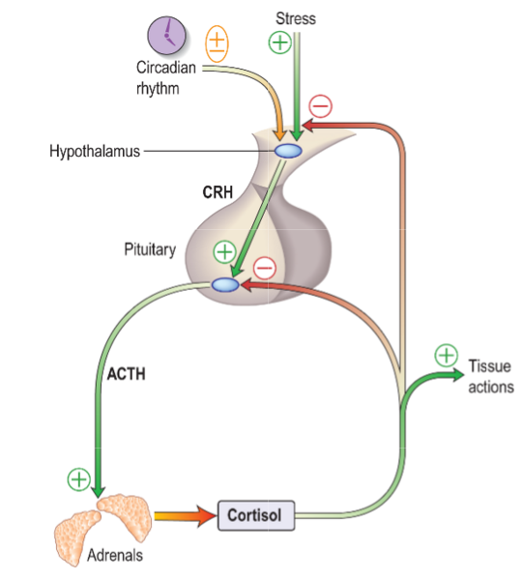
Control of Hypothalamic Pituitary Axis

Slide 10
Addison’s Disease
Primary Hypoadrenalism
Pathophysiology
In this condition, there is destruction of entire adrenal cortex, therefore, Glucocorticoids, Mineralocorticoids and sex steroids production are reduced
Note – Please remember in hypothalamic – pituitary disease, Mineralocorticoids secretion remains largely intact as it is predominantly stimulated by angiotensin II (Renin angiotensin aldosterone mechanism)

Slide 11
Addison’s Disease
In Addison’s disease, reduced Cortisol level leads to increased CRH and ACTH production
If ACTH increases markedly, it causes hyper pigmentation
Addison’s disease is rare, 3-4 cases per million per year
There is female preponderance

Slide 12
Addison’s Disease
Causes
It is most often caused by auto immune disease (more than 90% in UK)
Other cause is tuberculosis – most common in 3rd World countries

Slide 13
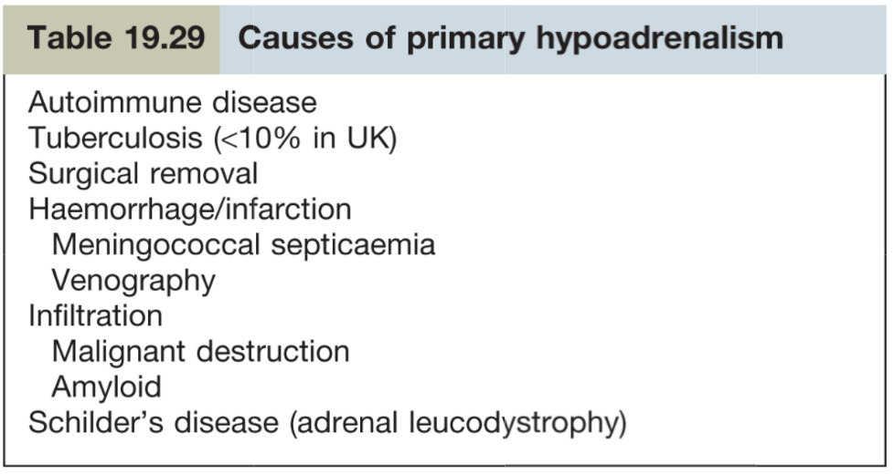

Slide 14
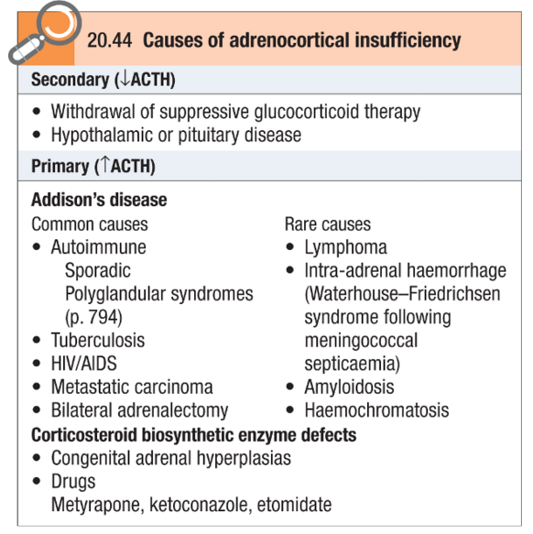

Slide 15
Addison’s Disease
Addison’s disease has association with other auto immune conditions e.g. type I DM, pernicious anemia, thyroditis, Hypoparathyroidism, premature ovarian failure

Slide 16
Addison’s Disease
Clinical Features
Symptoms
- Weight loss
- Weakness
- Amenorrhoea
- Syncope
- Abdominal pain
Signs
- Pigmentation – specially of new scars, palmer
creases, Buccal pigmentation
- Postural hypotension

Slide 17
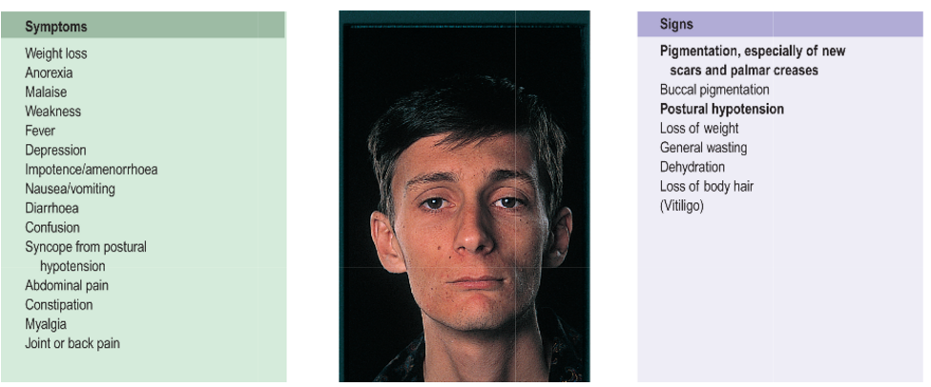
Addison’s Disease Symptoms and Signs

Slide 18
Addison’s Disease
Pigmentation (dull, slaty, grey brown) is predominant sign in over 90% of cases
Postural hypotension due to hypovolemia and Na loss is present in 80-90% of cases. Mineralocorticoids deficiency is a cause of hypotension

Slide 19
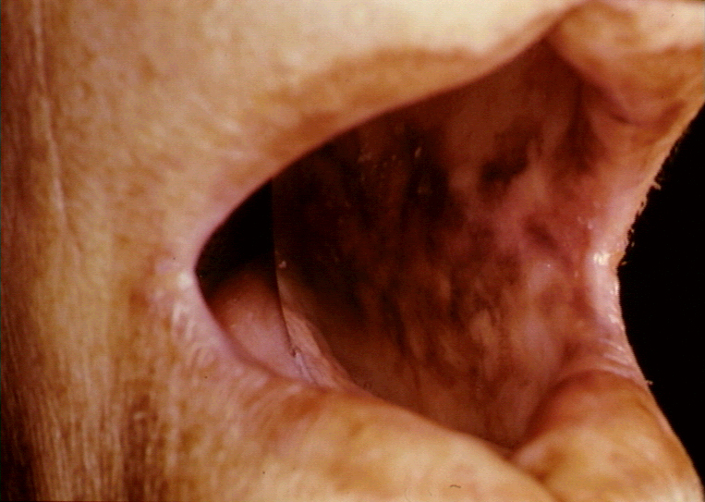
Addison’s Disease – Buccal pigmentation

Slide 20
Addison’s Disease
Investigation
1- Single Cortisol measurement
Random Cortisol > 550 nmol/L makes the diagnosis of Addison’s unlikely (Normal Random in adult 136- 635 nmol/L )
Random Cortisol below 100 nmol/L during the day is highly suggestive of Addison’s

Slide 21
Addison’s Disease
Investigation (cont)
2. Short synacthen test – short ACTH stimulation test
-Draw blood for Cortisol (zero time )
- Give ACTH 250 Microgram (o.25mg) i.m. injection
- take blood sample after 30 min for Cortisol
RESULT
- In Addison disease there is minimal or no response to ACTH
- In normal subject plasma Cortisol > 460nmol/L either at baseline or at 30 min

Slide 22
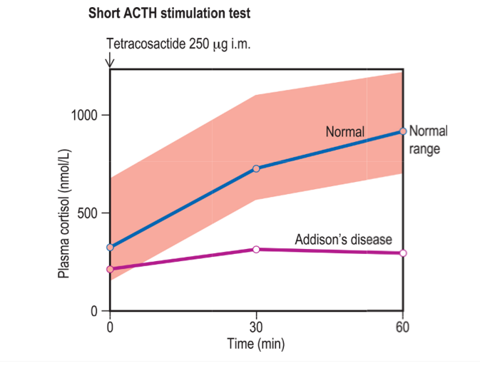

Slide 23
Addison’s Disease
Investigations (cont)
3. High plasma ACTH with low cortisol confirms primary hypoadrenalism
4. Electrolytes and Urea
Hyponatraemia
Hyperkalemia
High urea
5. Blood Glucose – maybe low with hypoglycemia
6. Adrenal antibodies – are present in auto immune adrenalitis

Slide 24
Addison’s Disease
Investigations (cont)
7. Chest and abdominal X-rays – may show evidence of tuberculosis and/or calcified adrenals
8. Plasma Renin activity is high due to low serum aldosterone
9. Hypercalcemia and anemia are seen some times

Slide 25
Addison’s Disease
Treatment
Acute Hypoadrenalism (Adrenal crisis) needs urgent treatment
Patient might present with hypotension, hyponatremia, hyperkalaemia, hypoglycemia, dehydration, pigmentation often with precipitating factors like infection, trauma or operation
The major deficiencies are salt, steroid and glucose

Slide 26
Addison’s Disease
Treatment of Adrenal crisis (cont)
1 liter of 0.9% saline over 30 to 60 mins
100mg I/V bolus of hydro cortisone
I/V glucose
Several liters of saline are required within 24 hours and hydrocortisone 100mg im 6 hourly until the patient is clinically stable.

Slide 27
Addison’s Disease
Treatment (cont)
When patient is clinically stable, Oral replacement medication is started
- Hydrocortisone 20mg 8 hourly reducing to 20-30mg in divided doses over a few days
Long term treatment
Replacement of Glucocorticoids and Mineralocorticoids
Tuberculosis must be treated if present

Slide 28
Addison’s Disease
Treatment (cont)
Adequacy of Glucocorticoid dose is judged by
- normal Cortisol level
- patient clinically feeling better
Adequacy of fludrocortisones replacement is assessed by
- Serum electrolytes restored to normal
- Blood pressure should not fall more than 10mm systolic after 2 minutes of standing
- Plasma Renin activity restored to normal

Slide 29
Addison’s Disease
Advise to patient
All patients taking replacement steroids should know
- To increase steroid during intercurrent illness, infection, injury, stress, surgery
- carry a steroid card
- wear a Medic-Alert bracelet which gives details of their condition so that replacement therapy can be given if found unconscious
- keep hydrocortisone ampule at home in case oral therapy is impossible

Slide 30
Secondary Hypoadrenalism
Secondary Hypoadrenalism may arise from
1 - Hypothalamic – pituitary disease – inadequate ACTH production
2 - Long term steroid therapy – leading to hypothalamic-pituitary-adrenal suppression
IMPORTANT – ACTH level is low in secondary Hypoadrenalism

Slide 31
Historical Information
Why we call Addison’s disease ?
Because Thomas Addison, British Physician, in year 1855 described 6 cases of Addison’s at Guy’s Hospital in London.
Cause was tuberculosis in all 6 cases
Now TB is controlled in the west so common cause is auto immune disease there

Slide 32

One of the most famous and well known President of USA, John F. Kennedy, Jan 1961-NOV 1963, suffered from Addison's disease.

Slide 33
Thank you

Slide 34
Hypernatremia
By Dr. Zahoor

Slide 35
Hypernatremia
What is Hypernatremia?
Increased serum sodium level, more than 145mEg/L is called Hypernatremia
Important
– Normal serum sodium is 135-145mEq/L

Slide 36
Hypernatremia
Hypernatremia is generally not caused by excess of Na⁺, but usually by related deficit of free water in the body, therefore, Hypernatremia often coincides with dehydration
How water is lost?
Perspiration
In breathing
In the feces and urine

Slide 37
Hypernatremia
Normal plasma osmolality282- 295mosmol/L
Normal urine osmolality 600mosmol/L
(Range 50 – 1400mosmol/L) as kidney can concentrate urine or dilute urine

Slide 38
Hypernatremia
Hypernatremia is always associated with increase plasma osmolality, which is a potent stimulus to thirst
Clinical Features
Symptoms of Hypernatremia are non specific
Nausea, vomiting, fever and confusion may occur
Convulsions occur in severe Hypernatremia

Slide 39
Hypernatremia
Causes of Hypernatremia
Diabetes Insipidus
Administration of hypertonic sodium solutions
Drugs e.g. piperacillin
Nephrogenic Diabetes Insipidus – insensitivity to ADH caused by drugs e.g. Lithium, tetracycline, Democlocycline, amphotericin B
- Acute tubular nacrosis
- Osmotic diuresis e.g. total Parenteral nutrition
- Deficient water intake
- Increase water loss through skin or lungs

Slide 40
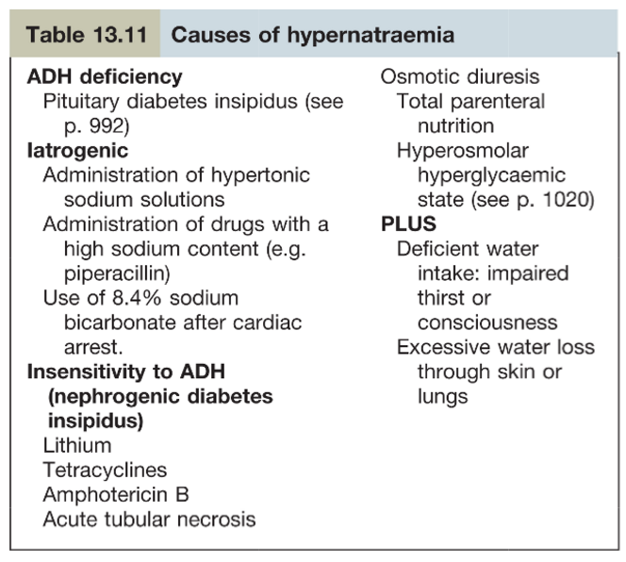

Slide 41
Hypernatremia
Investigations
Do urine, plasma osmolality and serum
sodium at the same time.
EXAMPLES
In diabetes insipidus (ADH is decreased , it causes decreased water reabsorption, increased water loss by kidneys ) therefore
- Plasma osmolality is high
- Serum sodium is high
- Urine osmolality is low ( less than plasma , 250mosom/L) and urine volume is increased

Slide 42
Hypernatremia
Examples (cont )
In DEHYDRATION
Serum sodium is increased, plasma osmolality is high
Urine osmolality is increased, urine volume is decreased

Slide 43
Hypernatremia
Treatment
In ADH deficiency , replace ADH in the form of Desmopressin (analogue of ADH)
Withdraw Nephrotoxic drugs where possible
In severe Hypernatremia ( sodium > 170mmol/l )- 0.9% saline is given. Correct Hypernatremia over a period of 48 hours as rapid correction may lead to cerebral edema.

Slide 44
Hypernatremia
Treatment (cont )
In les sever Hypernatremia,
(serum sodium > 150mmol/L ) – treatment is 5% glucose or o.45% saline .

Slide 45
THANK YOU

Slide 46
Case History – A tired patient with weakness and dizziness
A 25 year old woman is referred to outpatients feeling tired all the time. She has lost weight and feels dizzy on standing. She also describes muscle aches and weakness. On examination, she appears suntanned. She has postural hypotension of 90/50mmHg when lying, but 75/40mmHg on standing.
You make a clinical diagnosis of Addison’s disease.

Slide 47
Questions:
Laboratory investigation are likely to show which of the following?
a. Hypokalaemia
b. Hyperkalaemia
c. Hypernatremia
d. Polycythaemia
The appropriate diagnostic investigation is?
a. Dexamethasone suppression test
b. 24 hour urinary Cortisol
c. Mantoux test
d. Short synacthen test
3. What is the appropriate long term treatment?
a. Glucocorticoid and Mineralocorticoids replacement
b. Glucocorticoid replacement
c. Mineralocorticoid replacement
d. None of the above

Slide 48
Answer:
Answer to Question 1:
b. Hyperkalaemia
Answer to Question 2:
d. Short synacthen test
Answer to Question 3:
a. Glucocorticoid and Mineralocorticoids replacement

Slide 49
Thank you

