Slide 1
AORTIC DISSECTION
Dr. M. SOFI MD; FRCP (London); FRCPEdin; FRCSEdin

Slide 2
AORTIC DISSECTION
Aortic dissection is defined as separation of the layers within the aortic wall. The primary event in aortic dissection is a tear in the aortic intima.
Degeneration of the aortic media, or cystic medial necrosis, is felt to be a prerequisite for the development of non-traumatic aortic dissection.
Blood passes into the aortic media through the tear, separating the intima from the surrounding media and/or adventitia, and creating a false lumen.
Mortality is still high despite advances in diagnostic and therapeutic modalities

Slide 3
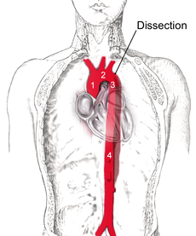
Dissection of the descending part of the aorta (3), which starts from the left subclavian artery and extends to the abdominal aorta (4). The ascending aorta (1) and aortic arch (2) are not involved.

Slide 4
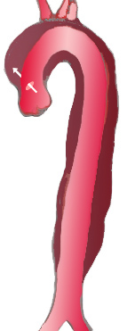
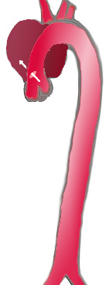
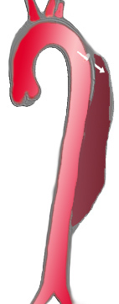
Classification
Type I – Originates in ascending aorta, propagates at least to the aortic arch and often beyond it distally. It is most often seen in patients less than 65 years of age and is the most lethal form of the disease.
Type II – Originates in ascending aorta and is confined to the ascending aorta.
Type III – Originates in descending aorta, rarely extends proximally but will extend distally. It most often occurs in elderly patients with atherosclerosis and hypertension.
Percentage | 60% | 10 -15% | 25 – 30 %
Type | DeBakey I | DeBakey II | DeBakey III
 | Stanford A (Proximal) |  | Stanford B Distal

Slide 5
Pathophysiology
Aorta is made up of three layers, the intima, the media, and the adventitia.
The intima is in direct contact with blood and consists of a layer of endothelial cells on a basement membrane;
Media contains connective and muscle tissue
Adventitia, comprising connective tissue outer layer
Blood penetrates the intima and enters the media layer. The high pressure rips the tissue of the media apart along the laminated plane splitting the inner 2/3 and the outer 1/3 of the media apart.
This can propagate along the length of the aorta for a variable distance forward or backwards

Slide 6
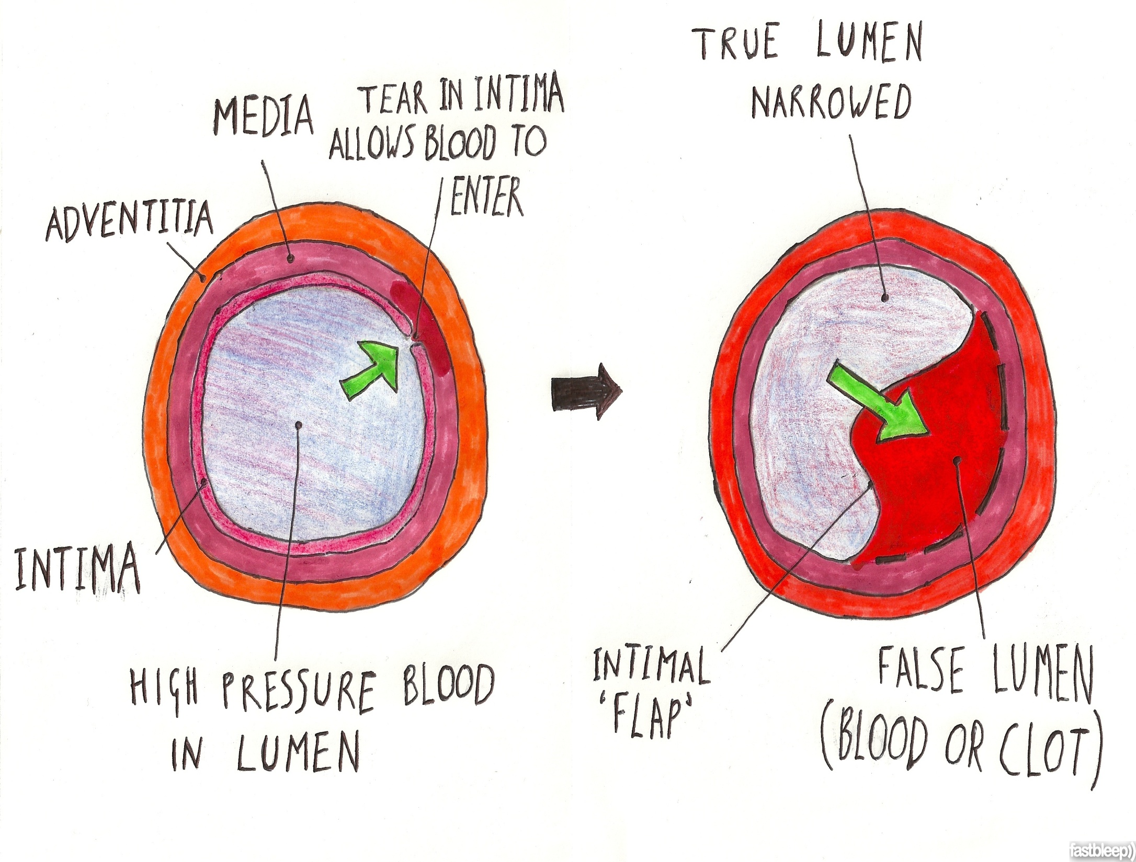

Slide 7
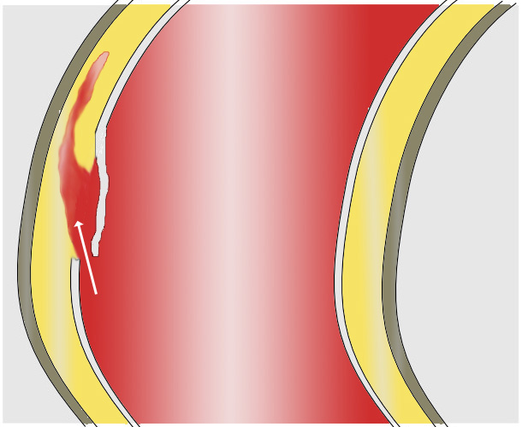
Pathophysiology:
The aortic dissections originate with an intimal tear in:
Ascending aorta (65%)
Aortic arch (10%)
Descending thoracic aorta (20%)
No evidence of tear (13%)
Blood penetrates the intima and enters the media layer.

Slide 8
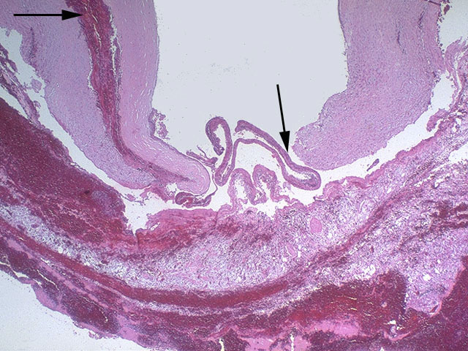
A
U
T
O
P
S
Y
H
E
A
R
T
Dissection media as well outer media

Slide 9
Pathophysiology
The initiating event is a tear in the intimal lining of the aorta.
High pressure blood enters the media at the point of the tear.
The force of the blood causes the tear to extend.
May extend proximally or distally or both.
The blood traveling through the media, creating a false lumen separating from the true lumen is a layer of intimal tissue.
This tissue is known as the intimal flap.
The majority of dissection are in
  ascending aorta (65%)
  aortic arch (10%),
  descending thoracic aorta (20%).

Slide 10
Signs and symptoms
Aortic dissection can be rapidly fatal, with many patients dying before presentation to the emergency department or before diagnosis is made in the ED.
Sudden onset of severe chest pain that often has a tearing or ripping quality
Chest pain may be mild
Anterior chest pain: Usually associated with anterior arch or aortic root dissection
Neck or jaw pain: Aortic arch involvement and extension into the great vessels
Tearing or ripping intra-scapular pain: indicate dissection involving the descending aorta
No pain in about 10% of patients
Syncope

Slide 11
Signs and symptoms
CVA symptoms: hemianesthesia, and hemiparesis, hemiplegia)
Altered mental status
Numbness and tingling, pain, or weakness in the extremities
Horner syndrome (ptosis, miosis, anhidrosis)
Dyspnea
Hemoptysis
Dysphagia
Flank pain (with renal artery involvement
Abdominal pain (with abdominal aorta involvement)
Fever
Anxiety and premonitions of death

Slide 12
Possible physical examination findings include:
Hypertension/Hypotension
Inter-arm blood pressure differential greater than 20 mm Hg
Signs of aortic regurgitation (bounding pulses, wide pulse pressure, diastolic murmurs)
Cardiac tamponade (muffled heart sounds, hypotension, pulsus paradoxus, jugular venous distention, Kussmaul sign)
Neurologic deficits (e.g., syncope, altered mental status)
Peripheral paresthesias
Horner syndrome
New diastolic murmur
Asymmetrical pulses (e.g., carotid, brachial, femoral)
Progression or development of bruits

Slide 13
Laboratory findings include the following:
Leukocytosis: Stress state
Decreases in hemoglobin and hematocrit values: Leaking or rupture of the dissection
Elevation of the BUN and creatinine levels: Renal artery involvement or prerenal azotemia
Elevation of the cardiac enzymes, myoglobin, and troponin I and T levels: Myocardial ischemia from coronary artery involvement
LDH: Hemolysis in false lumen
Smooth muscle myosin heavy-chain assay: levels in the first 24 hours are 90% sensitive and 97% specific
FDP elevation:
FDP of 12.6 μg/mL or higher suggests possible aortic dissection with a patent false lumen
FDP level of 5.6 μg/mL or higher suggests possibility of dissection with complete thrombosis of false lumen

Slide 14
Causes
Aortic dissection is often associated with hypertension
Chest trauma. 72 to 80% of individuals have a previous history of hypertension.
A bicuspid aortic valve (a type of congenital heart disease involving the aortic valve) is found in 7–14%.
Risk is not associated with the degree of stenosis of the valve.
Marfan syndrome is noted in 5–9%. Individuals with Marfan syndrome tend to have aneurysms of the aorta and are more prone to proximal dissections of the aorta.

Slide 15
Diagnosis
The diagnosis of acute aortic dissection requires a high index of suspicion and involves the following:
History and physical examination
Imaging studies
Chest X-Ray
CT with contrast
MRI
Aortoraphy
Electrocardiography
Complete blood count, serum chemistry studies, cardiac marker assays

Slide 16
Imaging studies
Chest radiography:
Initial imaging technique if it is readily available at the bedside
Widening of the mediastinum is the classic finding
Hemothorax may be evident if the dissection has ruptured
CT with contrast:
The definitive test in most patients with suspicion of aortic dissection
Useful only in hemodynamically stable patients
Findings help determine whether hypothermic circulatory arrest is necessary for surgery

Slide 17
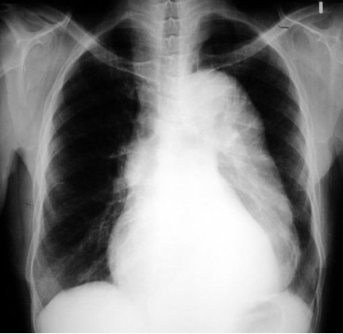
Chest X-Ray
Mediastinum widening: CXR has moderate sensitivity in an ascending aortic dissection.
Pleural effusions may be seen on CXR. Commonly in descending aortic dissections. Typically in left hemi-thorax.
Obliteration of the aortic knob, depression of the left mainstream bronchus, loss of the para-tracheal stripe, and tracheal deviation.
About 12 to 20% of individuals presenting with an aortic dissection have a "normal" chest x-ray
Chest radiograph demonstrating widened mediastinum in a patient with aortic dissection.

Slide 18
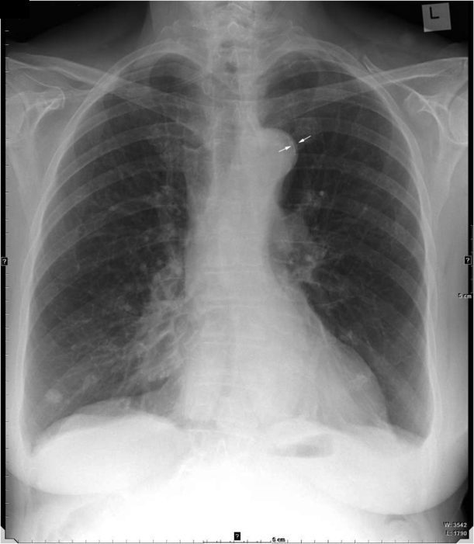
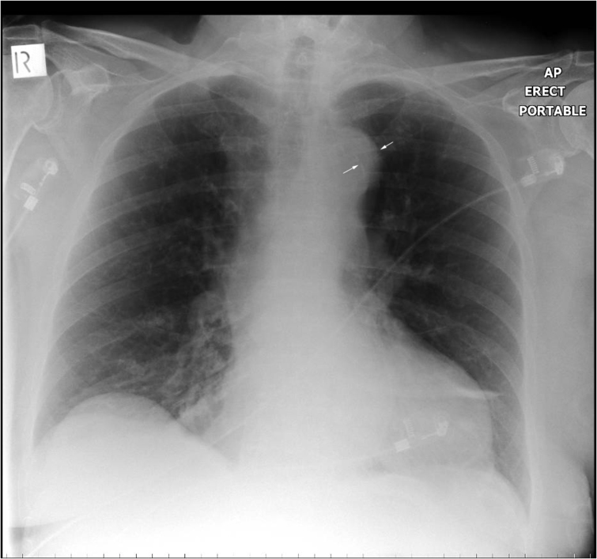
Calcium sign: Aortic dissection
The calcium sign on CXR suggests aortic dissection. It is the separation of the intimal calcification from the outer aortic soft tissue border by 10 mm

Slide 19
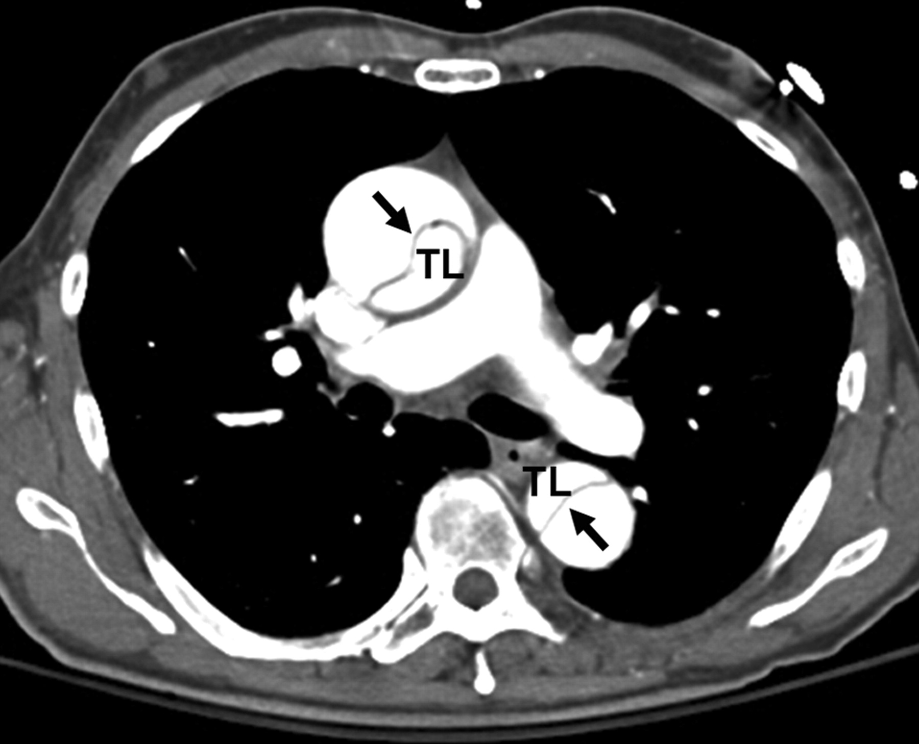

Slide 20
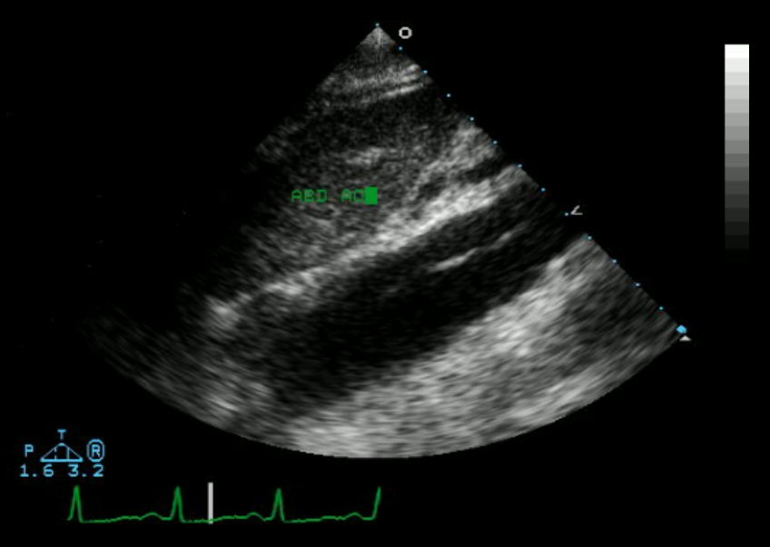
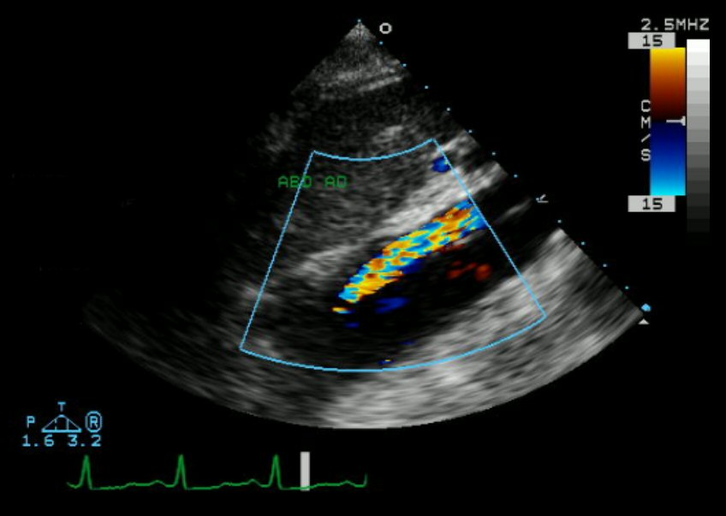
The transesophageal echocardiogram (TEE) is a relatively good test in the diagnosis of aortic dissection, with a sensitivity of up to 98% and a specificity of up to 97%. It has become the preferred imaging modality for suspected aortic dissection.
An echocardiogram displaying the true lumen and false lumen of an aortic dissection. In the image to the left, the intimal flap can be seen separating the two lumens. In the image to the right, color flow during ventricular systole suggests that the upper lumen is the true lumen

Slide 21
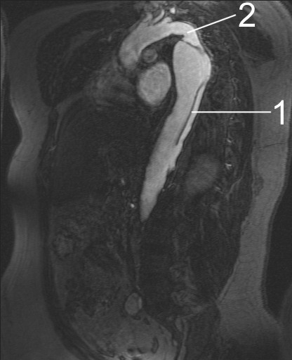
(MRI) is currently the gold standard test, sensitivity of 98% and a specificity of 98%.
An MRI, allowing the physician to determine the:
  Location of the intimal tear
  Involvement of branch vessels
  Locate any secondary tears.
  Detect and quantitate the degree of aortic insufficiency.
MRI of an aortic dissection
1 Aorta descends with dissection
2 Aorta isthmus

Slide 22
Management: Medical
Beta blockers are first line treatment for acute and chronic
In acute dissection, rapidly acting, titratable parenteral agents (such as esmolol, or labetalol)
Vasodilators such as sodium nitroprusside for ongoing hypertension, but they should never be used alone.
Calcium channel blockers can be used if there is a contraindication to the use of beta blockers.
The calcium channel blockers typically used are verapamil and diltiazem, for their combined vasodilator and negative inotropic effects.
Pain management: Narcotics and opiates are the preferred agents

Slide 23
Surgical Treatment
Indications for the surgical treatment include:
Acute proximal aortic dissection
Acute distal aortic dissection with complications.
Complications include:
  Risk of a vital organ damage
  Rupture of the aorta
  Retrograde dissection ascending aorta
Marfan syndrome
Ehlers-Danlos Syndrome
In surgical treatment, the area of the aorta with the intimal tear is usually resected and replaced with a Dacron graft.
Resect the most severely damaged segments of the aorta
Obliterate blood into false lumen
Endovascular repair is emerging as the preferred treatment for descending aortic dissection.

Slide 24
Epidemiology & Prognosis
Of all people with aortic dissection, 40% die almost straight away and do not reach hospital.
Of the remainder, 1% die every hour, making prompt diagnosis and treatment a priority.
Even after diagnosis, 5–20% die during surgery or in the immediate postoperative period.
In ascending aortic dissection, if there is a decision that surgery is not appropriate, 75% die within 2 weeks.
With aggressive treatment 30-day survival for thoracic dissections may be as high as 90%

Slide 25
THANK
YOU
FOR
YOUR
ATTENTION

