Slide 1
1- ATRIAL MYXOMA
2- CARCINOID HEART DISEASE
By Dr. Zahoor

Slide 2
Atrial Myxoma ( Tumor of atrium )
Primary cardiac tumor are rare (0.2%)
Most primary tumors are benign (75%) and of these majority are myxomas.
The remainder are fibromas, lipomas and haemangiomas.

Slide 3
Atrial Myxoma
This is most common primary cardiac tumor.
It occurs at all ages and there is no sex difference.
They are benign tumors.
Majority of myxomas usually develop in left atrium.

Slide 4
Atrial Myxoma
Myxoma arise in left atrium as single or multiple polypoid tumors, attached by a pedicle to the interatrial septum.
The tumor may obstruct the mitral valve and may be site of thrombi and can embolize.

Slide 5
Atrial Myxoma
Presentation
Patient may present with constitutional symptoms:
-Dyspnoea
-Syncope
-Palpitation
-Mild fever

Slide 6
Atrial Myxoma
Physical signs
Loud first sound
A loud third heart sound (tumor plop) due to Prolapse of the mass through the mitral valve during diastole
Mid – diastolic murmer
Signs due to emobilization may be there
Increased ESR is usually present
Differential diagnosis
– Mitral Stenosis

Slide 7
Atrial Myxoma
Complication of Myxoma
Arrhythmias
Pulmonary oedema
Peripheral emboli
Blockage of mitral heart valve

Slide 8
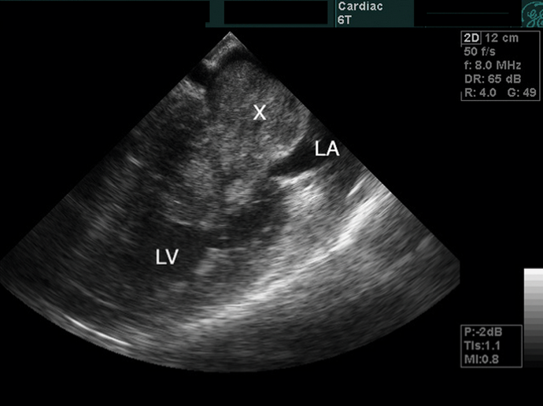
Atrial Myxoma
Diagnosis
Echo cardiography – tumor is demonstrated as a dense space occupying lesion

Slide 9
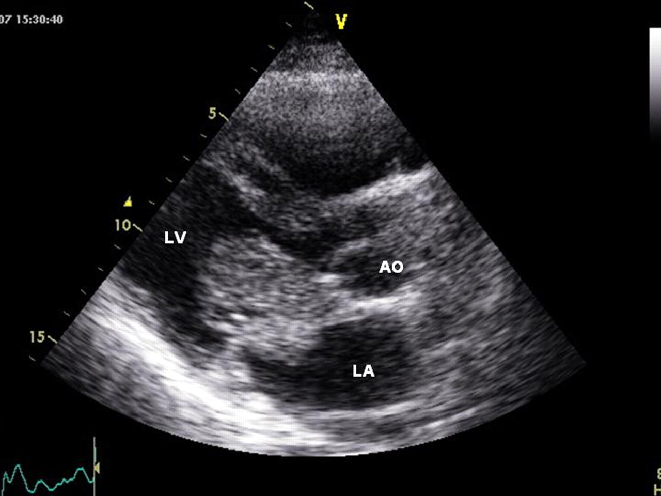
Left atrial mass attached to the atrial septum protruding into the left ventricle during diastole

Slide 10
Atrial Myxoma
Treatment
Surgical excision usually results in cure
Note – Myxoma may occur in right atrium or in ventricles

Slide 11
CARCINOID HEART DISEASE

Slide 12
We will discuss
1- Carcinoid tumors
2- Carcinoid Heart Disease

Slide 13
Carcinoid tumors
Carcinoid tumors originate from enterochromaffin cells (APUD cells- Amine precursor uptake decarboxylase) of the intestine (Endocrine cells)
They make up 10% of small bowel neoplasms, common site being appendix and terminal ileum
Carcinoid tumor may present with liver enlargement due to metastasis

Slide 14
Carcinoid Syndrome
Carcinoid Syndrome occurs in 5% of patients with Carcinoid tumors and Carcinoid syndrome presents only ,when there are liver metastases from carcinoid tumors.
Patient complains of
- Face flushing, sometimes leading to telangiectases

Slide 15
Carcinoid Syndrome
Gastrointestinal symptoms
- Abdominal pain
- Recurrent watery diarrhoea
- Liver enlargement on examination of abdomen
Cardiac abnormalities are found in 50% of patients and consist of tricuspid -incompetence or pulmonary stenosis
Respiratory – Cough, wheezing, dyspnea

Slide 16
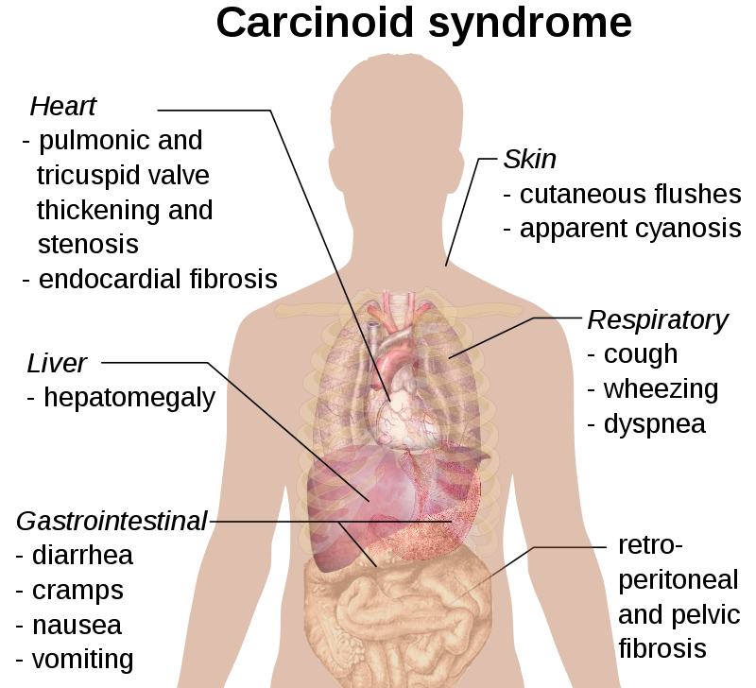

Slide 17
Carcinoid Syndrome
Carcinoid tumors secrete
- Serotonin (5-Hydroxy-Tryptamine ,5-HT)
- Bradykinin
- Histamine
- Tachykinins
- Prostaglandins

Slide 18
Carcinoid Syndrome
The diarrhoea and cardiac complications are probably caused by 5-HT
The cutaneous flushing is produced by kinins e.g. Bradykinin
Kinin also cause vasodilatation, Bronchospasm and increased intestinal motility

Slide 19
Carcinoid Syndrome
Diagnosis
Identification of primary tumor and confirmed presence of liver secondary deposits by ultrasound examination.
Urine examination – shows increased concentration of 5-hydroxy indol acetic acid (5-HIAA) which is major metabolite of 5-HT ( serotonin)
Serum chromogranin A (secretory protein) is raised

Slide 20
Carcinoid Syndrome
Treatment
Octreotide
Lanreotide
Both are octapeptide somatostatin analogues that inhibit the release of many gut hormones ( 5-HT, VIP, Motilin)
Most patients survive 5-10 years after diagnosis

Slide 21
Carcinoid Heart Disease

Slide 22
Carcinoid Heart Disease
It occurs in 50% of patients with Carcinoid syndrome and may be initial presentation of Carcinoid disease
Pathophysiology
Carcinoid heart disease is characterized by pathognomonic plaque like deposits of fibrous tissue

Slide 23
Carcinoid Heart Disease
These deposits occur on endocardium of valve cusps, the cardiac chambers and occasionally on the intima of pulmonary arteries and aorta
Important – The valves and endocardium of the right side of the heart is most often affected

Slide 24
Carcinoid Heart Disease
Pathophysiology (cont)
Carcinoid plaque is composed of smooth muscle cells, myofibroblasts and endothelial cell layer
Carcinoid plaque affect tricuspid valve and pulmonary valve
Tricuspid valve lesion – tricuspid regurgitation, and less often tricuspid stenosis
Pulmonary valve is also affected commonly and may cause pulmonary stenosis or pulmonary regurgitation

Slide 25
Carcinoid Heart Disease
Pathophysiology (cont)
Metastasis to heart can occur from small bowel Carcinoid tumor
Note – High circulating concentration of serotonin (5-HT) cause Carcinoid heart disease

Slide 26
Carcinoid Heart Disease
Clinical Features
Symptoms due to severe tricuspid and pulmonary valve disease cause
- fatigue
- dyspnea of exertion
- right sided heart failure – Increased JVP, oedema, ascites

Slide 27
Carcinoid Heart Disease
Physical Examination
Increased JVP
Palpable right ventricular impulse
Murmers of tricuspid or pulmonary valve regurgitation/stenosis is audible

Slide 28
Carcinoid Heart Disease
Investigation
ECG
- Chest X-ray – cardiomegly
- Echocardiography – thickening and retraction of immobile tricuspid valve leaflets with tricuspid regurgitation, less commonly tricuspid stenosis is noted
- Pulmonary valve involvement may be there also

Slide 29
Carcinoid Heart Disease
Investigation
CMR and CT – Cardiovascular magnetic resonance (CMR) and computed tomography (CT)
They are done to see valve pathology, right ventricle size and function, ejection fraction

Slide 30
Carcinoid Heart Disease
Management of Carcinoid Syndrome
Somatostatin analog – octreotide or lanreotide
Without treatment, duration of survival with malignant Carcinoid syndrome is 1-3 years
Tumor removal is of limited value since patient with Carcinoid syndrome typically have metastatic disease and chemotherapy had not much success

Slide 31
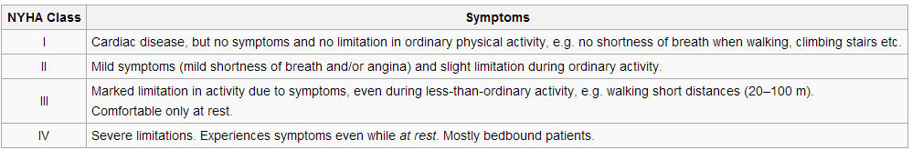
Carcinoid Heart Disease
Management of Carcinoid Heart Disease ( cont)
Patients having advanced symptoms (NYHA class III and IV) has poor prognosis.
Medium survival one year.
Cardiac surgery – tricuspid valve replacement, when pulmonary valve disease is present also then both tricuspid valve and pulmonary valve should be replaced

Slide 32
Carcinoid Heart Disease
Summary
Carcinoid heart disease occurs in 50% of patients with Carcinoid Syndrome
Carcinoid heart disease is rare form of heart disease characterized by plaque like deposits of fibrous tissue frequently affecting right side heart valves and endocardium
Most commonly tricuspid regurgitation occurs

Slide 33
Carcinoid Heart Disease
Summary (cont)
Serotonin plays role in pathogenesis of carcinoid heart disease
Clinical manifestation are fatigue, dyspnea, right side heart failure
Echocardiogram is recommended in all patients with Carcinoid syndrome
Cardiac surgery - tricuspid valve and pulmonary valve replacement improve symptoms and survival

Slide 34
CASE REPORT- Large atrial myxoma mimicking severe mitral stenosis
A 58 year old woman was referred after complaining of dyspnoea and chest pain on exertion for 3 months. Dyspnoea had progressed to orthopnea and paroxysmal nocturnal dyspnoea. She denied experiencing fever, weight loss, or syncopy. Blood pressure was 110/70 mmHg with a pulse rate of 80/min.
Cardiac auscultation revealed loud S₁ with high pitched grade III systolic murmur at the cardiac apex, which was thought to be a sign of significant mitral regurgitation. An additional low – pitched grade III rumbling diastolic murmur suggested mitral stenosis. Mild edema was found in lower limbs.
Chest radiograph revealed cardiomegly. Transthoracic echocardiography was notable for enlargement of both atrium and right ventricle with a large (58mm × 30mm) elliptical, mobile hyper echoic mass inside the left atrium that prolapsed into the left ventricle during diastole.

Slide 35
Color Doppler revealed moderate mitral regurgitation and severe tricuspid regurgitation with pulmonary artery systolic pressure of 88mmHg.
Patient was referred for open heart surgery which was performed with cardiopulmonary bypass. A large mass was identified inside left atrium and was successfully excised. Histopathalogical examination showed typical features of myxoma.

Slide 36
CASE HISTORY – Right heart failure in Carcinoid Syndrome
A 49 year old man with history of Carcinoid syndrome presented with 8 week history of progressive dyspnea, leg swelling, 40 pound weight gain and fatigue.
He had been diagnosed with Carcinoid syndrome 10 years earlier when he was admitted in the hospital for alcohol Detoxication. At that time, he had complaint of abdominal pain and diarrhea, CT scan was done which revealed hyper vascular hepatic lesion and 4cm by 5cm small bowel mass. Liver biopsy was performed and result were constant with neuroendocrine carcinoma. His 24 hour urine 5- hydroxyindolacetic acid ( 5-HIAA) levels were elevated.
Biopsy results and elevated 5-HIAA levels confirmed a diagnosis of Carcinoid Syndrome.

Slide 37
On physical examination, his heart rate was 125/min with irregular rhythm. There was grade 3 holosystolic murmur at lower left sternal border and grade II systolic ejection murmur at upper left sternal border. There was severe pitting edema in his lower legs and arms, hepatomegaly and tense Ascites were present. JVP was raised. X-ray chest demonstrated bilateral pleural effusions. CT scan of liver demonstrated multiple metastatic lesions and marked Ascites. ECG showed atrial fibrillation with rapid ventricular response. Echo demonstrated severe tricuspid stenosis and regurgitation, as well as pulmonary valve stenosis.
Patient was diagnosed Carcinoid heart disease. He was given i/v diuretics and paracentesis and lost 60lbs of fluid. With amiodarone he reverted to normal sinus rhythm. He was seen by Cardiothoracic surgeons and offered tricuspid and pulmonary valve replacement, but he refused. He was discharged to follow as an Outpatient.

Slide 38
Thank you

