Slide 1
Anemia
Iron Deficiency
Sideroblastic
By Dr. Zahoor

Slide 2
Anemia
What is Anemia?
Anemia is present when there is decrease in hemoglobin (Hb) in the blood below the reference level for the age and sex

Slide 3
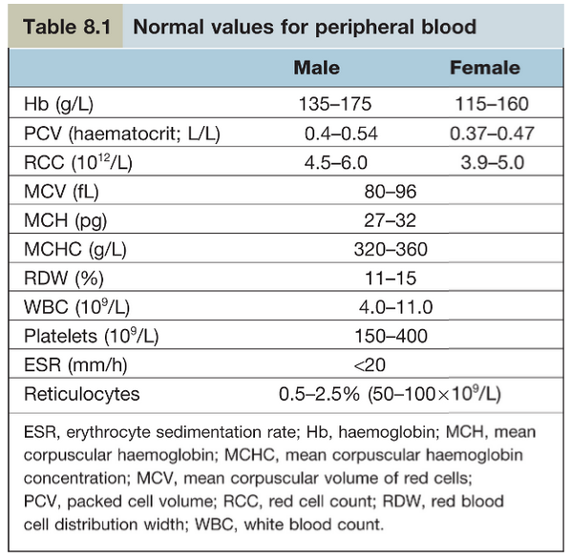
Normal Values for Peripheral Blood

Slide 4
Classification of Anemia
Classification of Anemia based on
MCV (Mean Cell Volume). There are 3 major
types:
Microcytic Hypochromic Anemia with low MCV
Normocytic Normochromic anemia with normal MCV
Macrocytic anemia with high MCV

Slide 5
CLINICAL FEATURES
Symptoms (these are non specific)
Fatigue, headache, faintness
Breathlessness
Palpitation
Angina
Intermittent claudication
Signs
Pallor
Tachycardia
Systolic flow murmer
Cardiac Failure

Slide 6
Anemia
Specific signs are seen in different type of Anemia
Koilonychia – spoon shaped nails seen in long standing iron deficiency anemia
Jaundice – found in hemolytic anemia
Leg ulcers – seen in sickle cell disease
Bone deformities – seen in thalassaemia major

Slide 7
INVESTIGATION
When hemoglobin is low, then always evaluate with red cell indices (MCV, MCH, MCHC)
WBC count
Platelet count
Reticulocyte count (it indicates bone marrow activity)
Blood film to see red cell morphology e.g. microcytic, macrocytic

Slide 8
INVESTIGATION (cont)
Bone marrow
– To see the cellularity of marrow
– Type of erythropoiesis e.g. normoblastic or megloblastic
– Any infiltration e.g. presence of cancer cells
– Iron stores
– Special test for further diagnosis e.g. immunological, cytogenetic, microbiological culture

Slide 9
Classification of Anemia Based On MCV (Mean Corpuscular Volume)
Microcytic Anemia
Red cell appearance – small cell (microcyte)
Indices – low MCV < 80fL
Diagnosis – Iron deficiency
– Thalassaemia
– Anemia of Chronic Disease
– Sideroblastic anemia

Slide 10
Classification of Anemia Based On MCV (Mean Corpuscular Volume)
Macrocytic Anemia
Red cell appearance – large cells (macrocyte)
Indices – high MCV > 96 fL
1. Appearance of bone marrow – megloblastic
Diagnosis – vitamin B12 or Folate deficiency
2. If appearance of bone marrow – normoblastic but macrocytosis in the peripheral blood
Diagnosis – Alcohol
– Increased reticulocyte e.g. haemolysis
– Liver disease
– Hypothyroidism
– Drug therapy e.g. Azathioprine

Slide 11
Classification of Anemia Based On MCV (Mean Corpuscular Volume)
Normal size RBC
Red cell appearance – normal cells
Indices – normal MCV
Diagnosis – Acute blood loss
– Haemolytic anemia
– Anemia of chronic disease
– Chronic kidney disease
– Auto immune rheumatic disease
– Endocrine disease

Slide 12
We will discuss Microcytic Hypochromic
(Iron Deficiency) Anemia

Slide 13
MICROCYTIC HYPOCHROMIC ANEMIA
IRON DEFICIENCY
Iron Deficiency is the most common cause of anemia in the World, affecting 30% of World’s population
Iron is absorbed in upper small intestine in Fe²⁺ form
Why microcytic (iron deficiency anemia) is common?
Because of limited ability to absorb iron, and loss of iron due to hemorrhage

Slide 14
IRON
We will discuss important points regarding Iron:
Dietary intake
The average daily diet contains 15-20mg of iron, normally only 10% of this is absorbed
Iron is absorbed in proximal intestine, specially duodenum
Iron is present in ferric form in the diet, it is reduced to ferrous form by brush border

Slide 15
IRON
Iron Transport
Iron is transported in the plasma bound to transferrin (beta globulin that is synthesized in the liver)
Most of the iron bound to transferrin comes from macrophages in the Recticulo Endothelial system and not from Iron absorbed by the intestine

Slide 16
IRON
Iron Stores
About two third of total body iron is in the circulation as hemoglobin
Iron is stored in recticuloendothelial cells, Hepatocyte and skeletal muscle cells

Slide 17
IRON
About two third of iron is stored as ferritin and one third as haemosiderin
Ferritin is water soluble and easily mobilized
Haemosiderin is insoluble, found in macrophages in the bone marrow, liver and spleen

Slide 18
IRON
Requirements
Daily requirement is 1mg
Each day 0.5-1mg of iron is lost in the faeces, urine and sweat
Menstruating women lose 30-40ml of blood per month, an average of 0.5-0.7mg of iron per day
Blood loss through menstruation in excess of 100ml will usually result in iron deficiency
Demand of iron also increases during growth and pregnancy

Slide 19
IRON DEFICIENCY ANEMIA
Iron deficiency anemia occurs, when there is less iron available for Hb synthesis
The causes are
- Blood loss
- Increased demand such as growth and
pregnancy
- Decreased absorption e.g. post gastrectomy
- Poor intake – Diet which contains vegetable
predominantly

Slide 20
IRON DEFICIENCY ANEMIA
Clinical Features
Symptoms
- Fatigue, headache, faintness
- Palpitation
- Breathlessness
- Angina
- Intermittent claudication

Slide 21
IRON DEFICIENCY ANEMIA
Clinical Features
In long standing iron deficiency anemia, well known clinical features are
- Brittle nails
- Spoon shaped nails (Koilonychia)
- Atrophy of papillae of the tongue
- Angular stomatitis
- Brittle hair
IMPORTANT
– Plummer-Vinson or Paterson-Brown-Kelly Syndrome
It is presence of Iron deficiency anemia, Dysphagia and glossitis

Slide 22
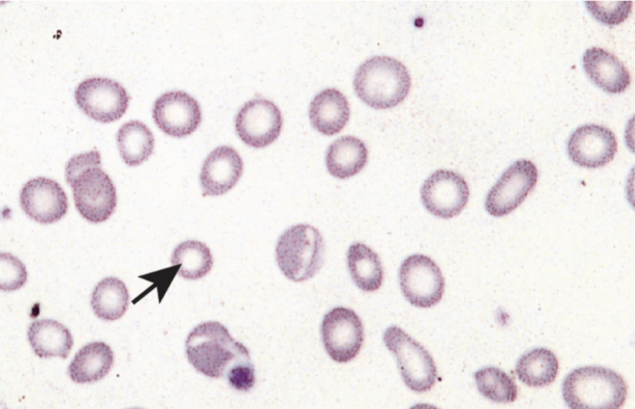
IRON DEFICIENCY ANEMIA
Investigations
Blood film shows RBC – microcytic MCV < 80fL and hypochromic MCH < 27 pg
There are poikilocytosis (variation in shape) and anisocytosis (variation in size). Target cells are seen
Microcytic hypochromic cells, Poikilocytosis and Anisocytosis is seen

Slide 23
IRON DEFICIENCY ANEMIA
Investigations (cont)
Serum iron and iron binding capacity
Serum iron is low and total iron binding capacity (TIBC) is increased
Serum ferritin
Serum ferritin is low (serum ferritin level tells us about the amount of stored iron)
Serum soluble transferrin receptors
Number of transferrin receptors increases in iron deficiency anemia
It is done by immunoassay

Slide 24
DIFFERENTIAL DIAGNOSIS
Differential Diagnosis of Microcytic
Hypochromic Anemia
Iron Deficiency Anemia – iron stores (ferritin) is low
Thalassaemia – iron stores are normal
Sideroblastic Anemia – iron stores are raised
Anemia of Chronic Disease – iron stores are normal or raised

Slide 25
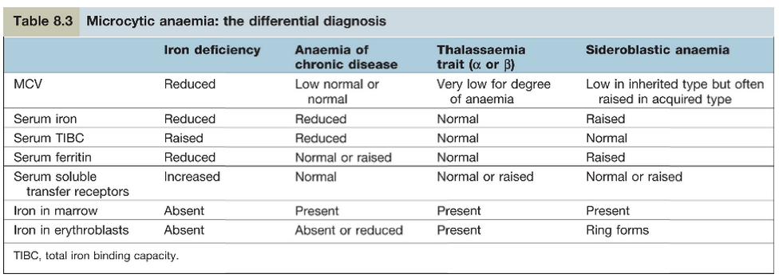
Microcytic Anemia: the differential diagnosis

Slide 26
TREATMENT
Find and treat the underlying cause e.g. diet, blood loss due to peptic ulcer, hemorrhoids
Oral iron
– ferrous sulphate 200mg three times daily (it provides 180mg ferrous iron), it is best absorbed when patient is fasting
– Oral iron is given for 6 months to correct hemoglobin level and replenish the iron stores
Parenteral iron
– Given by slow IV infusion of low molecular weight iron dextrin (test dose is required)
– It is given when patient is intolerant to oral preparation e.g. severe malabsorption

Slide 27
ANEMIA OF CHRONIC DISEASE
In hospital patients, common type of Anemia is the anemia of chronic disease, occurs in patient with TB, inflammatory bowel disease, rheumatoid arthritis, SLE, Malignant disease
Cause
- Decrease release of iron from bone marrow to developing erthythroblast
- Decreased response to erythropoietin
- Decrease RBC survival

Slide 28
ANEMIA OF CHRONIC DISEASE
Investigation
- Decreased serum iron, decreased TIBC
- Serum ferritin is normal or raised
- Patient do not respond to iron therapy and treatment is for underlying cause

Slide 29
SIDEROBLASTIC ANEMIA

Slide 30
SIDEROBLASTIC ANEMIA
What is Sideroblastic Anemia?
It is characterized by refractory anemia, Microcytic hypochromic cells in peripheral blood, Ring sideroblast in bone marrow and excess iron.
In Sideroblastic anemia, the body has iron available but can not incorporate it into hemoglobin .

Slide 31
SIDEROBLASTIC ANEMIA
Sideroblastic Anemia may be
Inherited or Acquired.
1- Inherited as x- linked recessive
2-Acquired as Myelodysplastic syndrome e.g. Myeloid leukaemia or
Acquired as Reversible Sideroblastic Anemia e.g. lead toxicity, Alcohol abuse, INH drug ( patient responds when Alcohol or Drug is withdrawn)
It can also occur in other disorders such as rheumatoid arthritis, carcinomas

Slide 32
SIDEROBLASTIC ANEMIA (cont)
Congenital form present with microcytic(low MCV ) or normocytic anemia
Acquired form present with macrocytic ( high MCV) or normocytic anemia
Presence of ring sideroblast in bone marrow is diagnostic feature of Sideroblastic anemia, ring is due to accumulation of iron in the mitochondria of erythroblast (due to disordered haem synthesis). Ring sideroblast can be seen with Perl's reaction, Prussian blue staining

Slide 33
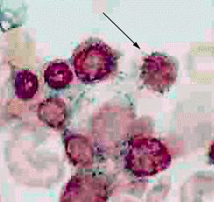
Sideroblastic Anemia
Bone marrow showing sideroblast stained with Perl’s Prussian blue

Slide 34
SIDEROBLASTIC ANEMIA
Ring Sideroblast are named because iron – laden mitochondria form a ring around the nucleus.
Ring sideroblast are seen in bone marrow. 40% of the developing erythrocyte are rings sideroblast.

Slide 35
SIDEROBLASTIC ANEMIA
Symptoms
Skin is pale, fatigue, dizziness
Enlarge spleen and liver
Heart disease, liver damage and kidney failure can result from iron built up in these organs

Slide 36
SIDEROBLASTIC ANEMIA
Diagnosis
Ringed sideroblasts are seen in the bone marrow
MCV is commonly decreased i.e. microcytic anemia but MCV may be normal or even high
Serum iron and ferritin are increased
Total iron binding capacity is normal

Slide 37
CASE 1
– A patient with shortness of breath
A 51 year old shop assistant presents to his GP with increasing shortness of breath on exertion. Normally his exercise tolerance when walking is unlimited but more recently he can walk approximately 50m before having to stop to catch his breath. On direct questioning, he denies cough, Orthopnoea or haemoptysis. He has not noticed blood in the stool or haematuria. He has never smoked and only drinks occasional alcohol. On examination, he had a pulse of 110 beats/min (regular, normal character), BP 115/80mmHg, pale conjunctive but no jaundice, and a soft ejection systolic murmur loudest at the aortic area, with no radiation. Abdominal examination was normal.

Slide 38
CASE 1
– A patient with shortness of breath
A full blood count taken 3 years ago showed a hemoglobin of 12.3 g/L with a mean cell volume of 89 fL.
At present Blood tests showed:
Hb 7.3g/dL
MCV 72.5 fL
WCC 11.2 × 10⁹/L
Platelets 420 × 10⁹/L
Electrolytes, liver function and inflammatory markers: normal.

Slide 39
CASE 1 – Questions:
What is the most likely cause for his systolic murmur?
(a). Aortic sclerosis
(b). Flow murmur due to a hyperdynamic circulation
(c). Aortic stenosis
(d). Mitral regurgitation
Which of the following is the likely cause of his anemia?
(a). Iron deficiency
(b). Thalassaemia trait
(c). Vitamin B12 deficiency
(d). Anaemia of chronic disease

Slide 40
CASE 1 – Answers:
Answer to Question 1:
(b). Flow murmur due to a hyperdynamic circulation
Answer to Question 2:
(a). Iron deficiency

Slide 41
THANK YOU

