Slide 1
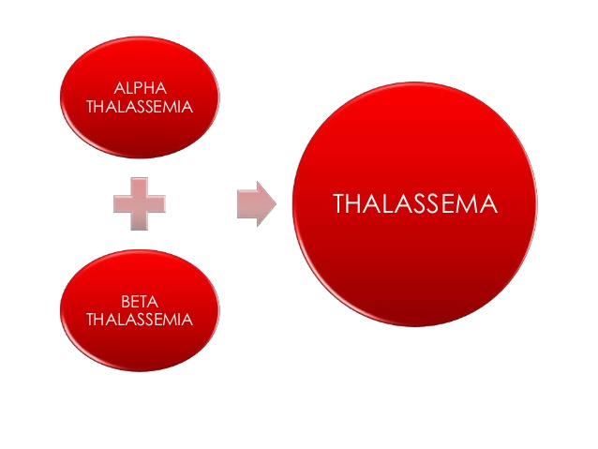
THALASSEMIA
Dr. M. A. SOFI
MD; FRCP (London); FRCPEdin; FRCSEdin

Slide 2
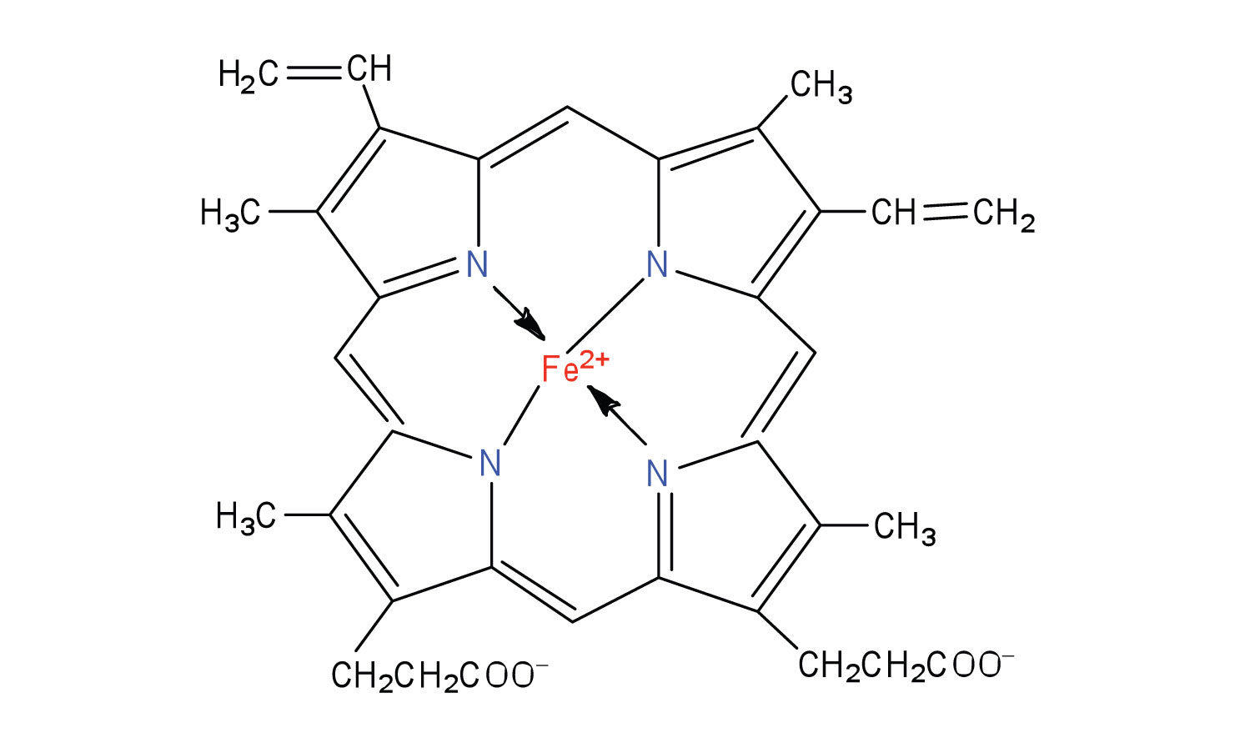
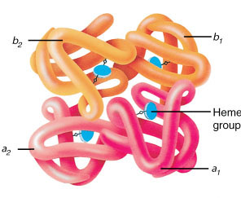
Thalassemia
Hemoglobin molecule: is the iron-containing oxygen-transport metalloprotein in the red blood cells of all vertebrates.

Slide 3
THALASSEMIA
The normal haemoglobin molecule has a haem base surrounded by two pairs of globin chains.
The types of globin are called alpha (α), beta (β), gamma (γ) and delta (δ).
Most types of hemoglobin have two α chains and two other identical types.
HbA, the most common form of adult haemoglobin, has two α and two β chains.
Fetal haemoglobin (HbF) has two α and two γ components (this is the predominant type of Hb before birth).
HbA2 is present in smaller amounts, with two α and two δ chains.

Slide 4
THALASSEMIA
The thalassaemias are a group of recessively autosomal inherited conditions characterized by decreased or absence of synthesis of one of the two polypeptide chains (α or β) that form the normal adult human haemoglobin molecule (HbA, α₂/β₂).
β-globin gene defects may give rise to β thalassemia, while mutations of the α globin gene may cause α thalassemia.
Over 300 mutations giving rise to thalassemia have been identified and its clinical severity varies enormously.
Thalassemia major, intermediate and minor refer largely to disease severity.

Slide 5
THALASSEMIA: EPIDEIOLOGY
Approximately 5% of the worldwide population has a variation in the alpha or beta part of the haemoglobin molecule, although not all of these are symptomatic and some are known as silent carriers.
β thalassaemia is prevalent in areas around the Mediterranean, in the Middle East, in Central, South, and Southeast Asia.
α thalassaemia is prevalent in Southeast Asia, Africa, and India.
Increasing migration has resulted in increasing prevalence of thalassemia gene mutations in all parts of the world.

Slide 6
α thalassaemia
αo thalassaemia heterozygous (genotype α,α/,--): slightly anemic, low MCV and MCH;
Clinically asymptomatic.
HbH disease (genotype α,-/-,-): HbH. Anemic, very low MCV and MCH; splenomegaly, variable bone changes.
α thalassaemia major (genotype -,-/-,-): Hb Bart's.
Severe non-immune intrauterine hemolytic anaemia.
Hb Bart's hydrops fetalis, usually fatal.

Slide 7
α thalassemias: Genetic, clinical, laboratory findings
Disorder | Genotype | MCV | Anemia | Signs and symptoms
Silent carrier | α α / α - | NL | None | Asymptomatic
Minor | α α / - - or α - / α - | Low | Mild | Asymptomatic
Hb H disease deletional | α - / - - | Low | Moderate | Moderate to severe hemolytic anemia, ineffective erythropoiesis, splenomegaly, variable bone changes
Major (fetal hydrops) | - - / - - | Low | Fatal | Causes non-immune hydrops fetalis, usually fatal

Slide 8
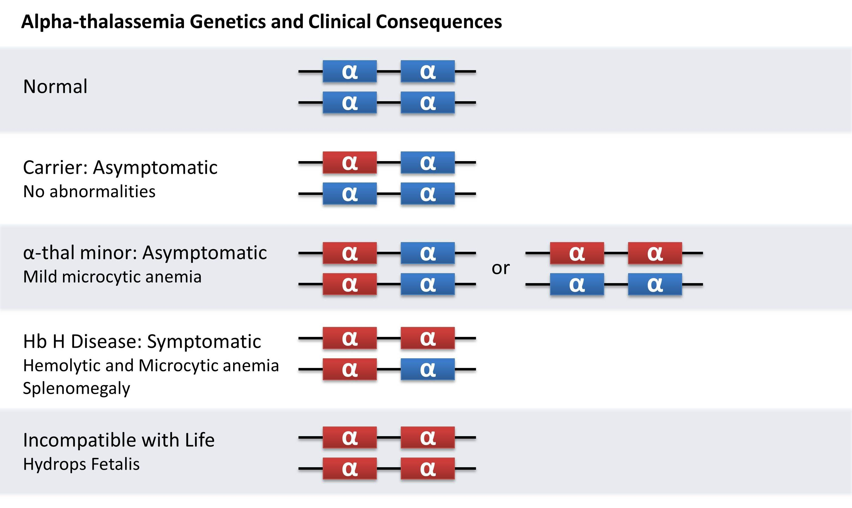

Slide 9
β thalassaemia
Normal: genotype β₂/β₂.
β-thalassaemia trait (genotype -/β₂): HbA₂ >4%. Slightly anemic, low MCV and MCH
Clinically asymptomatic.
β thalassaemia intermedia (genotype -/βo or β+/β+): high HbF, variable.
Anemic (symptoms usually develop when the haemoglobin level remains below 7.0 g/dL)
Very low MCV and MCH;
Splenomegaly
Variable bone changes
Variable transfusion dependency.
β thalassaemia major (genotype -o/-o): HbF >90% (untransfused).
Severe haemolytic anaemia,
Very low MCV and MCH
Hepatosplenomegaly,
Chronic transfusion dependency.

Slide 10
Prototypical Forms of Beta Thalassemia
VARIANT | CHROMOSOME 11 | SIGNS AND SYMPTOMS
Beta thalassemia trait | One gene defect | Asymptomatic
Beta thalassemia intermedia | Two genes defective (mild to moderate decrease in beta globin synthesis) | Variable degrees of severity of symptoms of thalassemia major
Beta thalassemia major | Two genes defective (severe decrease in beta globin synthesis) | Abdominal swelling, growth retardation, irritability, jaundice, pallor, skeletal abnormalities, splenomegaly; requires lifelong blood transfusions

Slide 11
β thalassaemia Signs:
Presentation varies with severity. Thalassemia minor rarely has any physical abnormalities with haemoglobin ≥9 g/dL.
In patients with the severe forms, the findings vary widely depending on how well the disease is controlled.
In severe, untreated cases there may be:
Hepatosplenomegaly.
Bony deformities (frontal bossing, prominent facial bones).
Marked pallor
Slight to moderate jaundice.

Slide 12
β thalassaemia Signs:
Presentation varies with severity. Thalassemia minor rarely has any physical abnormalities with haemoglobin ≥9 g/dL.
In patients with the severe forms, the findings vary widely depending on how well the disease is controlled.
In severe, untreated cases there may be:
Hepatosplenomegaly.
Bony deformities (frontal bossing, prominent facial bones).
Marked pallor
Slight to moderate jaundice.

Slide 13
β thalassaemia Signs:
Exercise intolerance, cardiac flow murmur or heart failure secondary to severe anemia.
These features are absent in well-treated patients
Growth restriction is common even with well-controlled chelation therapy.
Iron overload can cause endocrinopathy with diabetes, thyroid, adrenal and pituitary disorders.

Slide 14
Investigations:
FBC shows a microcytic, hypochromic anaemia
In the severe forms hemoglobin level ranges from 2-8 g/dL.
WBC is elevated due to hemolytic process.
Platelet count may be depressed in splenomegaly.
Serum iron level is elevated with saturation as high as 80%.
Ferritin is also raised.
Hemoglobin electrophoresis usually reveals the diagnosis.
Normal HbA₂ is between 1.5 and 3.0% whilst HbA2 >3.5 % is diagnostic of β-thalassaemia trait .
DNA analysis should be offered to confirm couples at risk, in prenatal testing
α-thalassemia trait requires measuring either the α-β chain synthesis ratio or using polymerase chain reaction (PCR) assay tests.

Slide 15
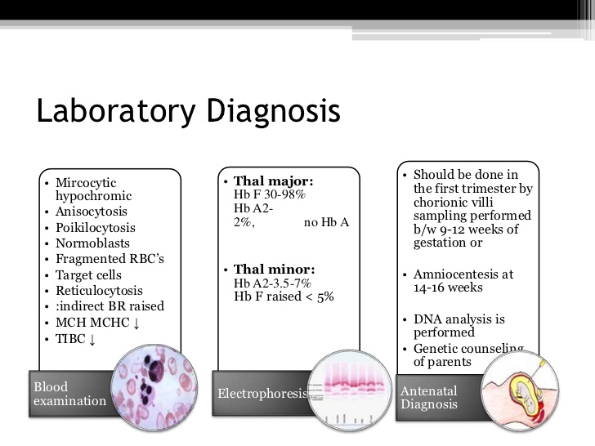

Slide 16
Electrophoretic patterns in common hemoglobinopathies
Condition | HbA | HbS | HbC | HbF | HbA2
Normal | 95 to 98* | 0 | 0 | <1 | 2.5 ± 0.2
Beta thalassemia minor | 90 to 95 | 0 | 0 | 1 to 3 | >3.5¶
Sickle cell trait | 50 to 60 | 35 to 45^{Δ} | 0 | <2 | <3.5
Sickle-beta(+) thalassemia | 5 to 30 | 65 to 90 | 0 | 2 to 10 | >3.5
Sickle-beta(0) thalassemia | 0 | 80 to 92 | 0 | 2 to 15 | >3.5
Sickle-HbC disease | 0 | 45 to 50 | 45 to 50 | 1 to 8 | <3.5
Homozygous sickle cell disease | 0 | 85 to 95 | 0 | 2 to 15 | <3.5
Hb: hemoglobin.* Numbers indicate the percent of total hemoglobin for an untransfused adult patient. ¶ Beta thalassemia minor, due to Hbδβ thalassemia, have normal or low HbA2 levels with markedly increased HbF levels.
Δ Percent HbS can be as low as 21 percent in patients with sickle cell trait in conjunction with alpha thalassemia.

Slide 17
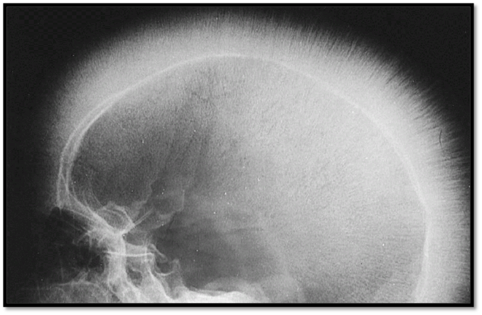
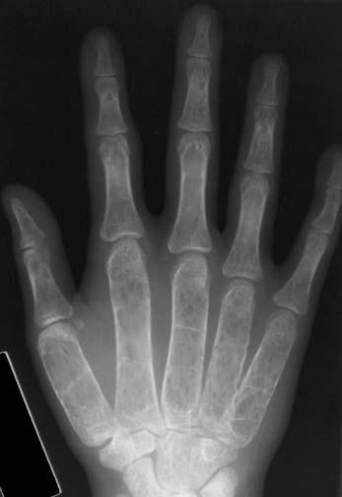
Investigations:
Imaging
Skeletal surveys show classical changes to the bones
Plain skull X-ray may show the classical 'hair on end' appearance.
A generalized loss of bone density is observed. The cortex is thinned, and the trabeculae are coarsened and outline localized lucency. Widening of the medullary cavity has resulted in squaring of the metacarpals.
Classic Hair on end appearance
Osteoporosis

Slide 18
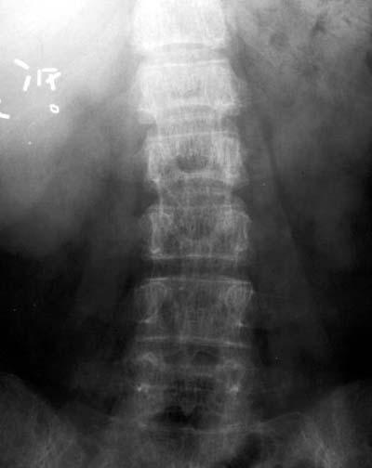
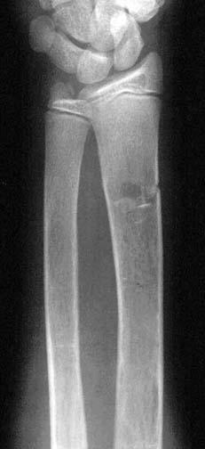
Osteopenia is present; note striated appearance of the vertebral bodies resulting from preservation and thickening of the vertical trabeculae.
A fracture is noted in the distal radius. Evidence of medullary expansion and cortical thinning is observed

Slide 19
MANAGEMENT
The general principles of management include:
Asymptomatic carriers: require no specific treatment but should be protected from detrimental iron supplementation
Thalassemia intermedia or HbH disease:
Need to be closely monitored for progression of complications induced by chronic hemolytic anemia.
  Occasional blood transfusion:
  Infection-associated aplastic or hyper-hemolytic crises
  Pregnancy
  Growth impairment
  Skeletal deformities.
  Hypersplenism develops, splenectomy may be considered, although this carries severe risks of life-threatening infections, pulmonary hypertension, and thrombosis

Slide 20
Management:
Thalassemia major:
Regular transfusion to maintain a haemoglobin level higher than 9.5 g/dL.
Transfusion improves both quality and quantity of life in severe cases. The target is not to let Hb fall below 9.5 g/dL.
Iron chelation to prevent overload syndrome.
Care by multidisciplinary team (hematologist, specialised nurse, social worker, psychologist, genetic counselor, cardiologist and liver specialist).
Splenectomy may be indicated if hypersplenism causes a marked increase in transfusion requirements.
Non-drug
Psychological support.
Genetic counseling.
Avoid food rich in iron.
Extra vitamin E, folic acid and some vitamin C may be beneficial.

Slide 21
Management:
Do not treat anemia with iron unless iron deficiency had been substantiated.
Desferrioxamine is given parenterally to aid iron excretion. The dose and means of delivery vary according to the needs of the patient.
Oral chelating agents have been developed and are now in use, including deferasirox and deferiprone.
Hydroxyurea may increase the expression of γ chains (HbF) and remove the excess α chains, which could potentially correct ineffective erythropoiesis.
There is hope for new combination therapies - e.g., oral deferiprone used in combination with desferrioxamine, producing a greater effect than either alone

Slide 22
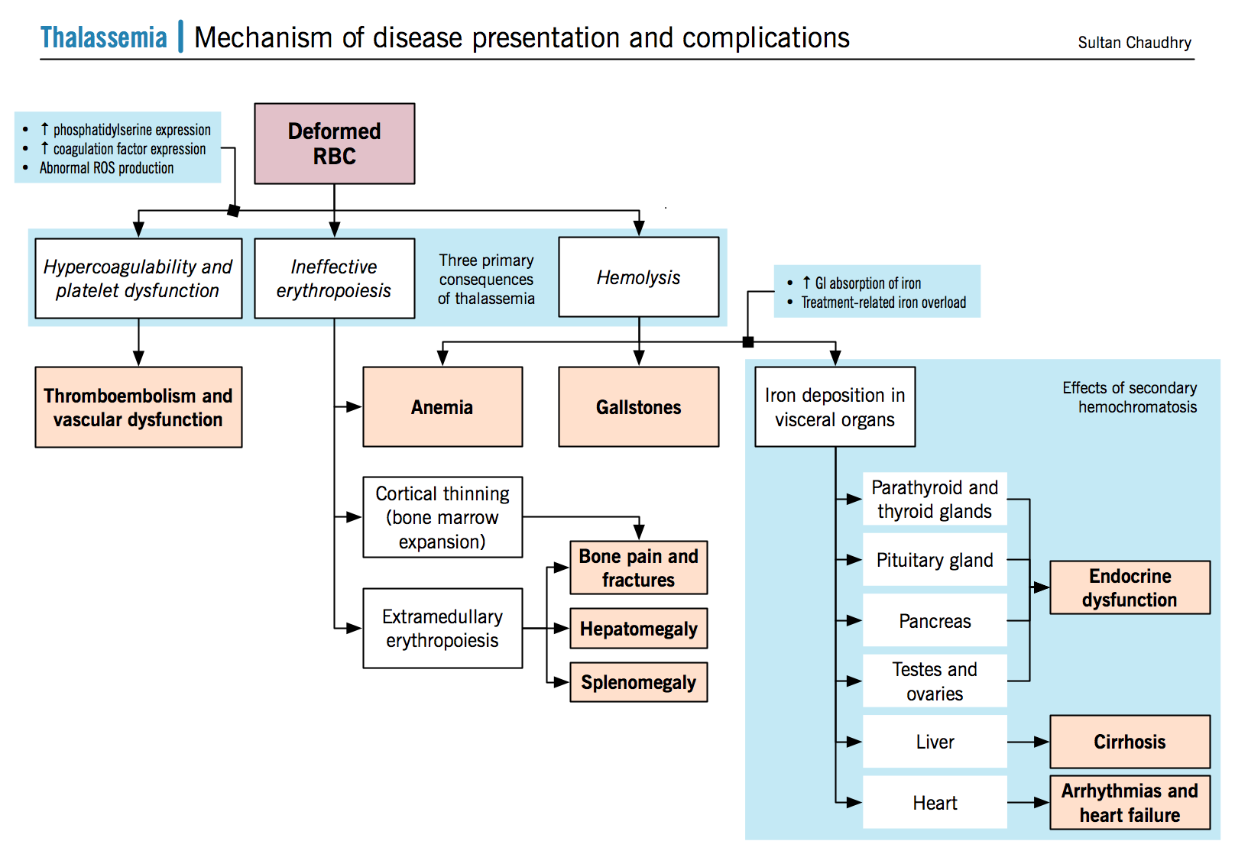

Slide 23
THANK
YOU
FOR
YOUR
ATTENTION

