Slide 1
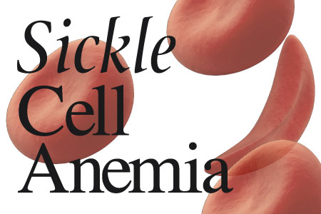
SICKLE CELL ANEMIA
Dr. M. A. SOFI
Dr. M. Sofi MD; FRCP (London); FRCPEdin; FRCSEdin

Slide 2
SICKLE CELL DISEASE
The term sickle cell disease (SCD) is generally used to describe all of the conditions associated with the phenomenon of sickling, whereas the term sickle cell anemia is generally used to describe homozygosity for hemoglobin S (i.e., Hb SS).
The disorder is :
Most severe in patients with homozygosity for HbS
Intermediate severity in hemoglobin SC disease (HbSC, combined heterozygosity for hemoglobins S and C)
Generally benign in those with sickle cell trait (heterozygosity for HbS)

Slide 3
Genetics
Major sickle genotypes include:
HbSS disease or sickle cell anemia - Homozygote for the S globin with usually a severe or moderately severe phenotype and with the shortest survival
Sickle cell trait or the carrier state is the heterozygous form characterized by the presence of around 40% HbS, absence of anemia, inability to concentrate urine (isosthenuria), and hematuria.

Slide 4
Genetics
HbSC disease - Double heterozygote for HbS and HbC characterized by moderate clinical severity
HbS/hereditary persistence of fetal Hb (S/HPHP) - Very mild or asymptomatic phenotype
HbS/b-0 thalassemia - Double heterozygote for HbS and b-0 thalassemia; clinically indistinguishable from sickle cell anemia (SCA)
HbS/b+ thalassemia - Mild-to-moderate severity with variability in different ethnicities

Slide 5
Sickle cell trait:
Heterozygotes; typically 60% HbA and 40% HbS.
Sickle cell trait protects against malaria.
Sickle cell trait occurs in approximately 300 million people worldwide, with the highest prevalence of approximately 30% to 40% in sub-Saharan Africa.
Patients with sickle cell trait are generally asymptomatic
Laboratory tests are normal:
  No anaemia,
  No haemolysis
  Only presence of haemoglobin AS on haemoglobin electrophoresis.
At risk for sickle crisis in severe hypoxia during:
  General anesthesia
  Severe dehydration
  Severe physical exertion

Slide 6
Sickle cell disease
SCD is the most common severe genetic disease.
The prevalence is highest in sub-Saharan Africa.
The sickle beta globin gene is spread widely throughout Africa, the Middle East, the Mediterranean and India
The frequency of sickle cell carriers is up to 1 in 4 in West Africans and 1 in 10 in Afro-Caribbeans.
There is evidence for partial resistance of carriers to all forms of Plasmodium falciparum malaria in many populations.

Slide 7
Sickle cell disease
Symptoms of SCD can begin between 3 months and 6 months of age when HbF levels are falling and include:
Anemia,
Jaundice
Pallor
Lethargy
Growth restriction and
General weakness
Susceptibility to encapsulated bacteria such as pneumococcus
Risk of overwhelming infection is highest before the age of 3 years.
Splenomegaly may be present in infancy and childhood but recurrent splenic infarcts then cause autosplenectomy.
Delayed puberty.

Slide 8
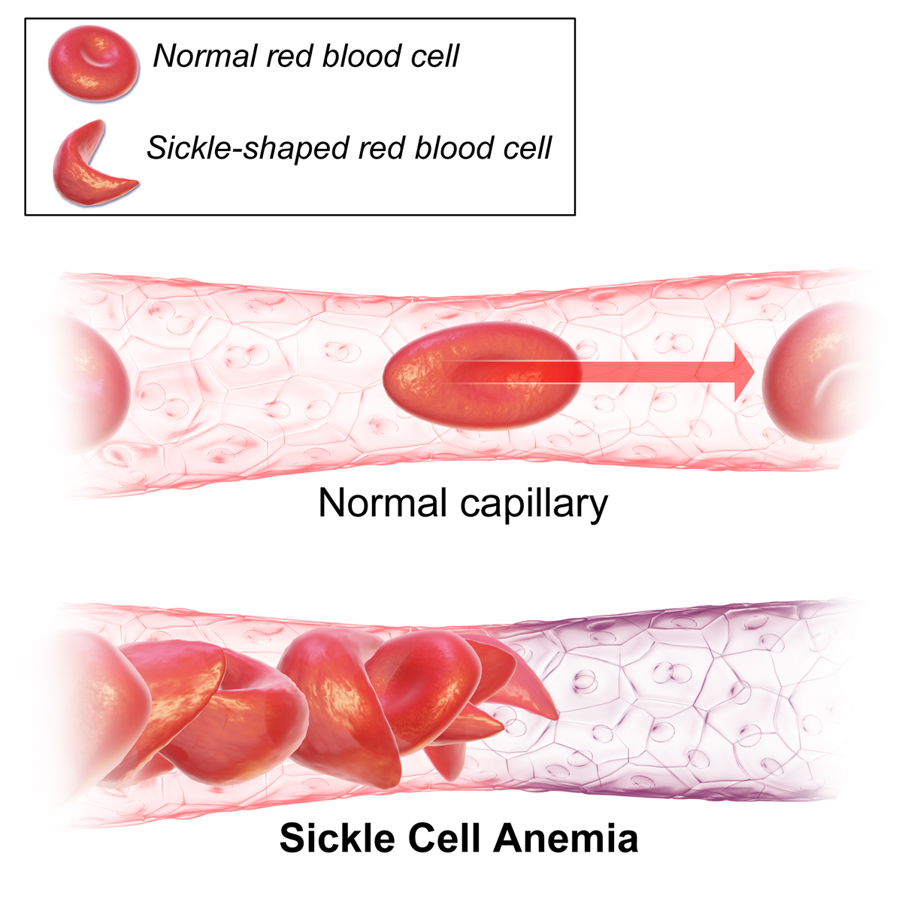
Vaso-occlusive crises (obstruction of the microcirculation by sickled red blood cells, causing ischemia):
Small vessels occlusion by sickled erythrocytes causes pain from mild to severe.
It may be precipitated by:
  Cold
  Infection
  Dehydration
  Exertion or ischemia.
  Often no cause can be found.

Slide 9
Presentation
Loin pain (renal papillary necrosis may cause renal colic or severe hematuria)
Acute sickle chest syndrome
Priapism
Hyphaema
Retinal occlusion.
Large vessels may also be involved, causing thrombotic strokes
Stroke:
Variable presentation, including fits and focal neurological signs.
Cerebral infarction is more common in children.
Hemorrhage from micro-aneurysms which develop around infarctions
“Moyamoya” is more common in adults.

Slide 10
Sequestration crisis:
Acute splenic sequestration an acute fall of haemoglobin and markedly elevated reticulocyte count, together with an acute increase in spleen size.
Mainly in babies and young children.
Recurrent splenic sequestration is an indication for splenectomy.
Severity is variable but can present with hypovolemic shock.
Sequestration causes significant mortality.
Mortality rates can be reduced substantially by parental education, regular palpation of the abdomen at home to detect early signs of splenic enlargement, and prompt transfusion.

Slide 11
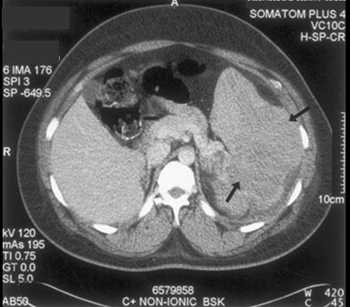
Splenic sequestration
Splenic sequestration is an acute emergency and can be fatal in 1-2 hours secondary to circulatory hypovolemia. Treatment is with volume resuscitation and blood transfusion. The CT image shown demonstrates splenomegaly with a mass-like process (arrows) from splenic sequestration.

Slide 12
Aplastic crisis
Aplastic crisis (temporary cessation of erythropoiesis, causing severe anemia):
Usually precipitated by infection with parvovirus B19.
There is usually a drop in hemoglobin over about one week.
Recovery may be spontaneous but a transfusion is usually required.
Severe anemia associated with an aplastic crisis, may present with high-output Congestive cardiac failure.
Hyperhemolytic crisis (excessive hemolysis):
Uncommon; during painful crises there may be a marked increase in the rate of hemolysis with a fall in the hemoglobin level.

Slide 13
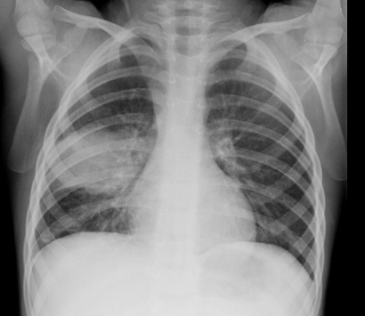
Acute chest syndrome
Acute chest syndrome (vaso-occlusive crisis affecting the lungs):
Defined as a new pulmonary infiltrate on the chest radiograph combined with one or more manifestations such as fever, cough, sputum production, tachypnoea, dyspnoea, or new-onset hypoxia.
Lung infections tend to predominate in children, and infarcts predominate in adults.

Slide 14
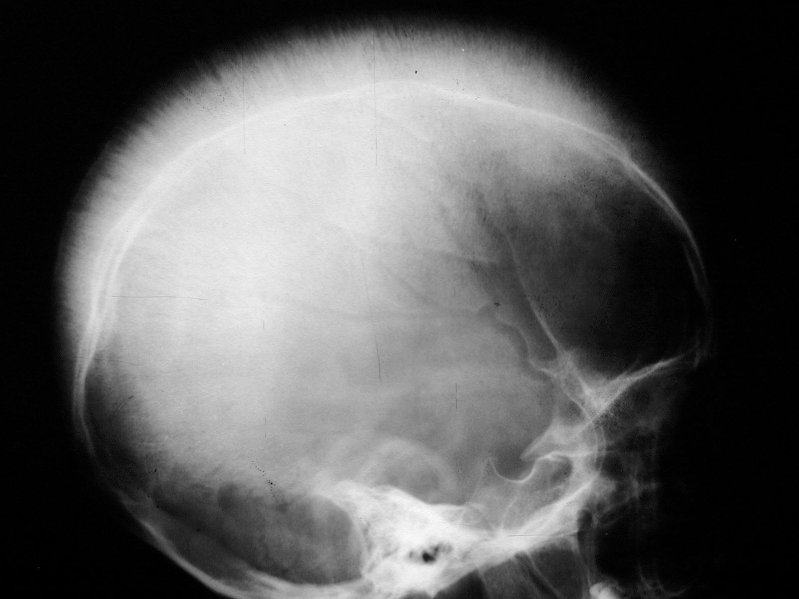
Skeletal sickle cell anemia.
Expanded medullary cavity. The diploic space is markedly widened due to marrow hyperplasia. Trabeculae are oriented perpendicular to the inner table, giving a hair-on-end appearance.
Skeletal sickle cell anemia.

Slide 15
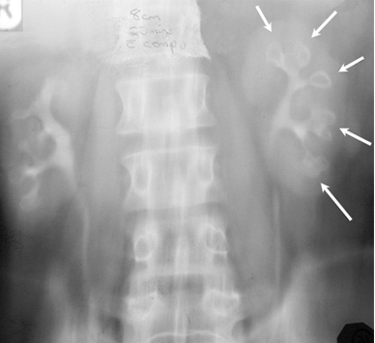
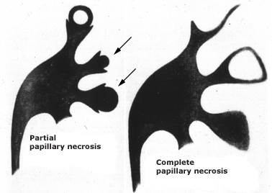
Renal papillary necrosis
Repeated vascular occlusion infarcts lead to necrosis of the renal medullary pyramids and papillae. This causes sloughing of papillae, which obstructs the urinary tract.
The IVP demonstrates the "egg-in-a-cup" appearance of sloughed renal papillae (arrows) secondary to renal papillary necrosis.

Slide 16
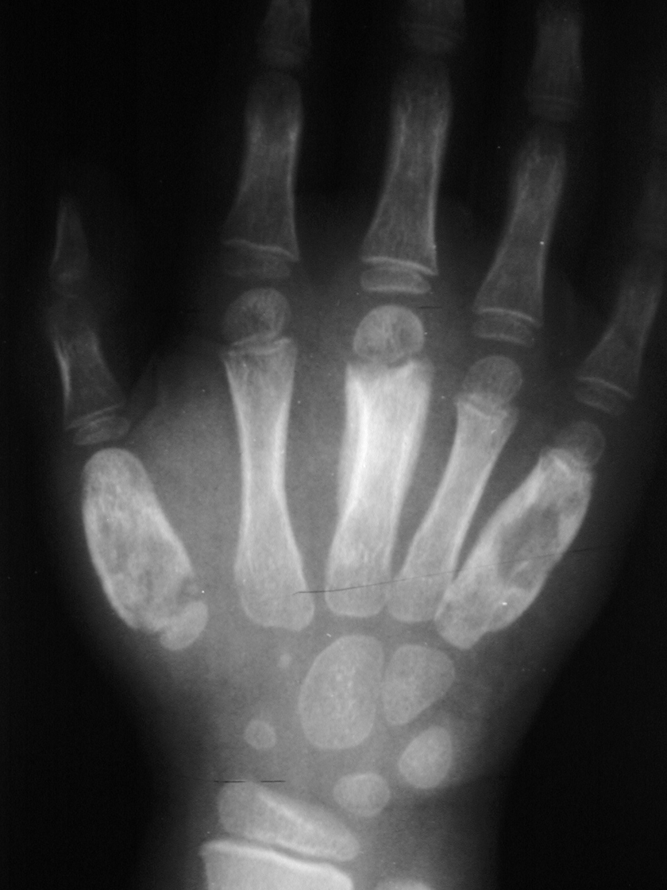
Dactylitis
Dactylitis also known as hand foot syndrome is an early manifestation of sickle cell disease in first two years of life which results from bone infarcts in the diaphyses of small long bones.
Advanced dactylitis. Lytic processes are present at the first and fifth metacarpals, along with periostitis, which is most prominent in the third metacarpal.

Slide 17
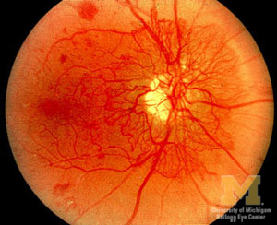
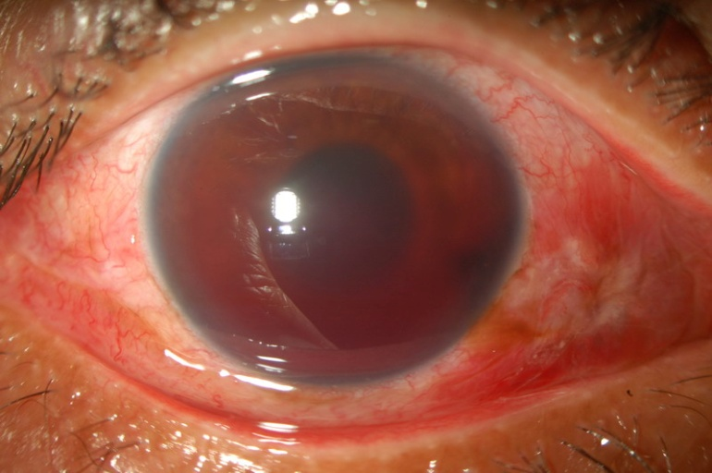
Sickle cell retinopathy
Sickle cell retinopathy: believed to be vaso-occlusion of peripheral arterioles of the retina leading to:
Retinal hypoxia, ischemia, and infarction.
New vessels then form at the junction of the vascular and avascular areas of retina.
Another common ocular manifestation is hyphema.
Anterior chamber bleeding occurs spontaneously leading to glaucomatous changes
Optic nerve damage from even mildly elevated intraocular pressures.
Retinal neovasculrization
Hyphema

Slide 18
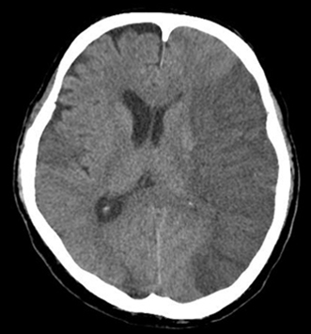
Sickle cell anemia
A 12-year-old boy with HgbSS disease presents to the pediatric emergency department with altered mental status, left-sided gaze paralysis with his head tilted to the left, and flaccid paralysis of the right arm and leg. A CT scan of the brain was obtained immediately.

Slide 19
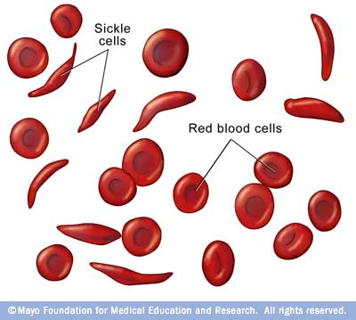
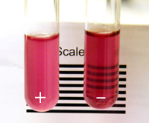
Laboratory tests
Sickling of red cells on a blood film with 2% sodium metabisulphite.
Sickle solubility test: a mixture of HbS in a reducing solution such as sodium dithionite gives a turbid appearance because of precipitation of HbS, whereas normal haemoglobin gives a clear solution.
Sickle solubility test

Slide 20
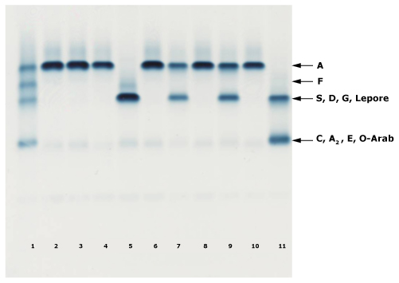
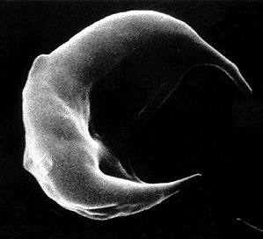
Hemoglobin electrophoresis (alkaline pH)
Lane 1 is standard containing equal amounts of hemoglobins A, F, S, C.
Lanes 2, 3, 4, 6, 8, and 10 are from normal subjects (Hb A only).
Lanes 7 and 9 are from subjects with sickle cell trait (Hbs A and S).
Lane 5 is from a subject with homozygous sickle cell anemia (Hbs F and S).
Lane 11 is from a subject with hemoglobin SC disease (Hbs S and C).

Slide 21
Screening
Pre-operative screening for sickle cell disease should be carried out in patients from ethnic groups in which there is a significant prevalence of the condition.
Emergency screening with sickle solubility tests must always be followed by definitive analysis.
Prenatal diagnosis: sickle cell disease can also be diagnosed in a fetus through from amniocentesis, chorionic villus sampling and fetal blood sampling

Slide 22
Management
Palpation for splenic size to ensure early detection of splenic sequestration can significantly reduce deaths.
All patients should be advised to avoid alcohol because of its dehydrating effects and smoking because it may cause the acute sickle chest syndrome.
Folic acid supplements may be required.
Zinc supplementation should also be considered if growth is restricted.
Vitamin D deficiency is very prevalent and may co-exist with sickle cell disease, so advice should be given regarding vitamin supplementation

Slide 23
Management
Routine childhood vaccinations include:
  Haemophilus influenzae type B
  Streptococcus pneumoniae in most high-income countries.
Children should also receive pneumococcal vaccine from 2 years of age, repeated every three to five years
Immunisation against
    Meningococcus
    Hepatitis B.
Because malaria is a significant cause of morbidity and mortality in patients with sickle cell disease, malaria chemoprophylaxis is often recommended

Slide 24
Management
Blood transfusions:
Transfusion therapy in decreasing morbidity and mortality.
Transfusion may be required for:
  Severe anemia
  Reduce the proportion of HbS if there are:
  lung or central nervous system complications.
Partial exchange transfusion is in acute life-threatening complications:
  Acute chest syndrome
  Acute stroke
  Multi-organ failure
  Major surgery
Iron overload
  Iron chelation should be started in all children receiving regular blood transfusions

Slide 25
Management
Hydroxycarbamide (hydroxyurea):
Cytotoxic drugs increase fetal haemoglobin concentrations, which is potentially beneficial for patients with sickle cell disease.
Benefits include increasing haemoglobin concentrations, and decreasing platelet and white cell counts.
Concerns remain about its myelosuppressive and teratogenic effects and its possible long-term toxicity.
Hydroxycarbamide (hydroxyurea) should be stopped at least three months before conception

Slide 26
Management
Hydroxyurea can reduce:
The frequency of crises in SCD.
The episodes of acute chest sydnrome
The need for blood transfusions.
It should still be used only on a named patient basis with close haematological supervision.
Bone marrow transplantation:
Haematopoietic stem cell transplantation is potentially curative but is currently used only in patients with a severe clinical course and a matched sibling donor.
Its use is limited by the toxicity and the availability of suitable donors.

Slide 27
Management
Stroke Prevention: Transcranial Doppler ultrasonography be performed annually in children aged 2-16 years with sickle cell disease.
Regular blood transfusions should be considered in those with abnormal findings on transcranial doppler ultrasonography.
Exchange transfusion should be performed when a stroke occurs.
Stroke is considered an indication for bone marrow transplantation in children and adolescents who have siblings with identical HLA.

Slide 28
Management
Treatment of acute chest syndrome:
Treatment includes
Inspired oxygen,
Incentive spirometry (also used for pain crises with back or chest pain)
Continuous positive airways pressure and exchange transfusion.
Occasionally ventilation may be necessary.
Antibiotics are given using a combination of a macrolide with I/V cephalosporin.
Hydroxycarbamide decreased the episodes of acute chest syndrome in one multicentre study.
Periodic transfusion is also effective in preventing recurrences.

Slide 29
Management
Treatment of priapism:
Priapism is an emergency requiring hydration and analgesia.
In minor episodes, bladder emptying, exercise such as jogging, warm baths and analgesia may help abort an attack.
Oral etilefrine may reduce the frequency of stuttering priapism.
In a prolonged episode, aspiration and irrigation of the corpora cavernosa with adrenaline (epinephrine) or etilefrine is now the treatment of choice.

Slide 30
Management
Painful crises
Many episodes of uncomplicated acute pain can be managed at home with simple analgesia.
Pain experienced in a vaso-occlusive crisis results from oxygen deprivation of tissues and avascular necrosis of the bone marrow.
The risk of vaso-occlusive episodes is increased by exposure to cold, fever, and dehydration.
Over 90% of hospital admissions for patients with sickle cell disease are for painful crises.

Slide 31
Management
Painful crises:
Hydroxycarbamide can reduce the frequency of painful crises in SCD.
Avoid exposure to cold, fever, dehydration and stress.
A simple analgesic ladder starting with paracetamol and/or ibuprofen.
Weak opioids (e.g., codeine or dextropropoxyphene) for patients with mild pain.
Admit patients if pain does not subside promptly, if there is a need for strong opioid treatment, or if fever, pallor or signs of respiratory compromise are noted.
Benzodiazepines may be helpful to reduce anxiety

Slide 32
Complications
Prognosis
Clinical severity and prognosis are very variable, ranging from survival into the 60s and 70s to a severe disease with substantial organ damage and early death.
Median life expectancy is currently 40-60 years in high-income countries but much less in low-income areas.
The most common cause of death in the first two years of life is infection, with or without splenic sequestration.
In adults, common causes of death are cerebrovascular accidents, sepsis, acute chest syndrome and pulmonary hypertension

Slide 33
THANK
YOU
FOR
YOUR
ATTENTION

