Slide 1
Inflammatory Bowel Disease (IBD)
By Dr. Zahoor

Slide 2
Inflammatory Bowel Disease (IBD)
Two major forms of IBD are recognized
1. Crohn’s Disease (CD) – it can affect any part of gastrointestinal tract
2. Ulcerative Colitis (UC) – it affects only colon
Overlap between these two conditions in clinical features, histological and radiological abnormalities occur in 10% of cases

Slide 3
Inflammatory Bowel Disease (IBD)
Aetiology
Not known, but interaction between several cofactors e.g. genetic, environmental, intestinal microbiota and host immune response occurs

Slide 4
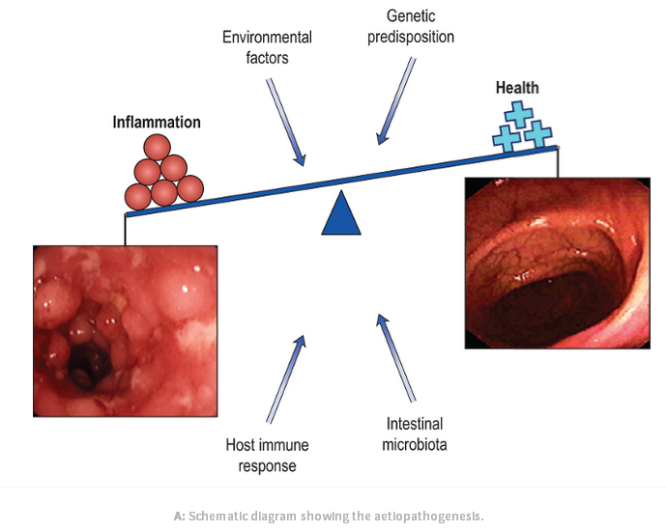

Slide 5
Inflammatory Bowel Disease (IBD)
Aetiology
Genetic factors
NOD₂ gene (nucleotide oligomerization domain)
NOD₂ protein on chromosome 16 has increased risk of development of ilial Crohn’s disease
Environmental & Other factors
Smoking – smoking exacerbate CD, most patients having Crohn’s disease are smokers
By contrast, smoking (nicotine) has been effective treatment in ulcerative colitis in small clinical trial

Slide 6
Inflammatory Bowel Disease (IBD)
Environmental & Other factors (cont)
NSAID – associated with both onset of IBD and flares of disease
Nutritional factor – breast feeding may provide protection against IBD
Psychological factors – Chronic stress and depression increase relapses in IBD patients
Intestinal immune system – IBD occurs when mucosal immune system gives inappropriate response to luminal antigen e.g. bacteria

Slide 7
Inflammatory Bowel Disease (IBD)
Pathology
Crohn’s disease (CD) is a chronic inflammatory condition that may affect any part of GIT from mouth to the anus but has tendency to affect terminal ileum and ascending colon
CD can involve small area or multiple areas with relatively normal bowel in between (skip lesion)

Slide 8
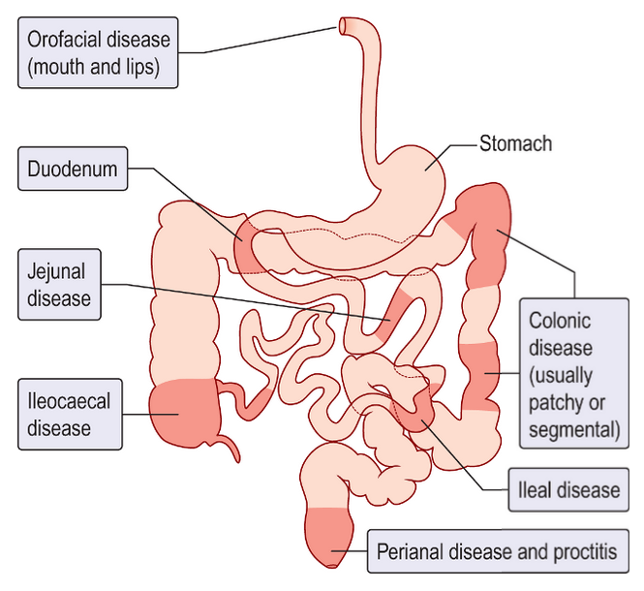
Sites of Crohn’s Disease

Slide 9
Inflammatory Bowel Disease (IBD)
Pathology – Ulcerative Colitis
UC can affect the rectum alone (proctitis), but can extend proximally to involve sigmoid and descending colon (left sided colitis) or may involve whole colon

Slide 10
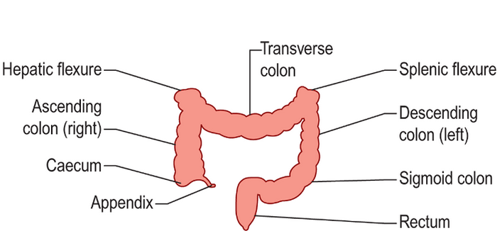
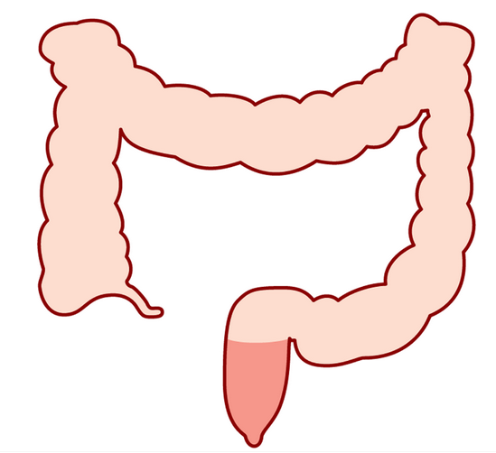
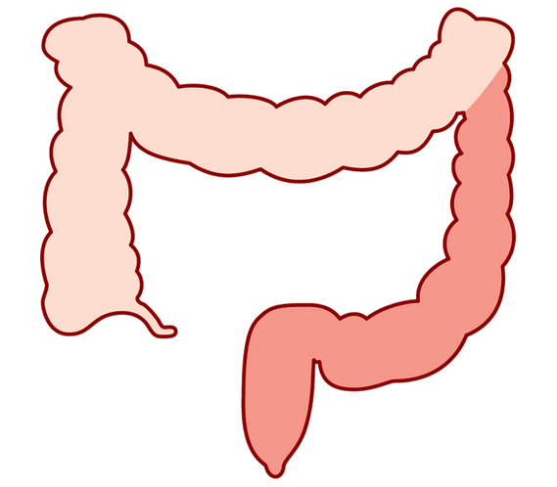
Sites of UC
A. Extensive Colitis
Left sided Colitis + rectum
C. Proctitis
(rectum)

Slide 11
Inflammatory Bowel Disease (IBD)
Pathology
Macroscopic changes – Crohn’s Disease
The involved bowel is usually thickened and narrowed
Deep ulcers and fissures in the mucosa produce a cobble stone appearance
Fistulae and abscesses may be seen
Large and deep ulcers appear in a patchy distribution producing cobble stone appearance

Slide 12
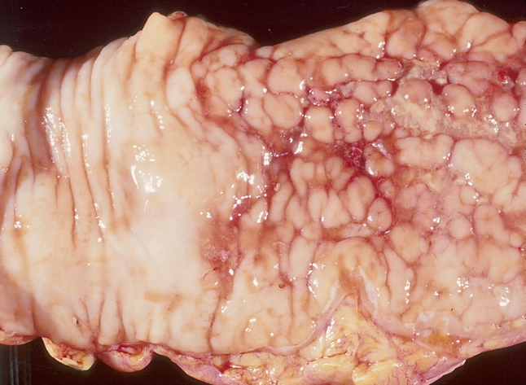
There is sharp demarcation between the affected areas on the right and uninvolved areas on the left. The cobblestone appearance is due to a combination of ulceration and elevation of the remainder of the mucosa.

Slide 13
Inflammatory Bowel Disease (IBD)
Pathology
Macroscopic changes – Ulcerative Colitis
Mucosa looks reddened, inflamed and bleeds easily (friability)
In severe disease, there is extensive ulceration with adjacent mucosa showing inflammation
Note – In fulminant colonic disease, in both CD and UC, most of the mucosa is lost and toxic dilatation occurs

Slide 14
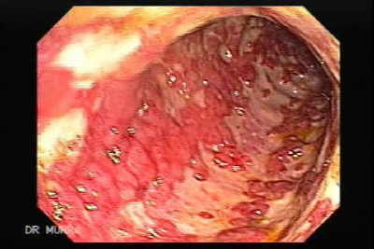
Superficial ulceration and loss of mucosa in Ulcerative Colitis

Slide 15
Inflammatory Bowel Disease (IBD)
Pathology
Microscopic changes - Crohn’s Disease
Inflammation extends through all layers of bowel (transmural)
Microscopic changes – Ulcerative Colitis
Superficial inflammation is seen in the bowel mucosa

Slide 16
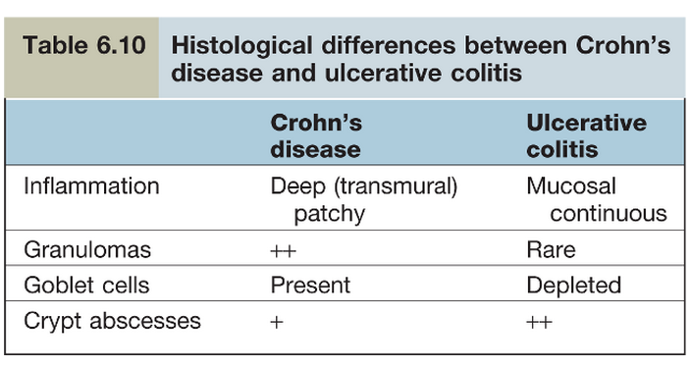

Slide 17
Inflammatory Bowel Disease (IBD)
Serology Test
UC – ANCA (Anti Neutrophil Cytoplasmic Antibodies) occur
CD – Anti – Saccharomyces Cerevisiae Antibodies (ASCA) occur

Slide 18
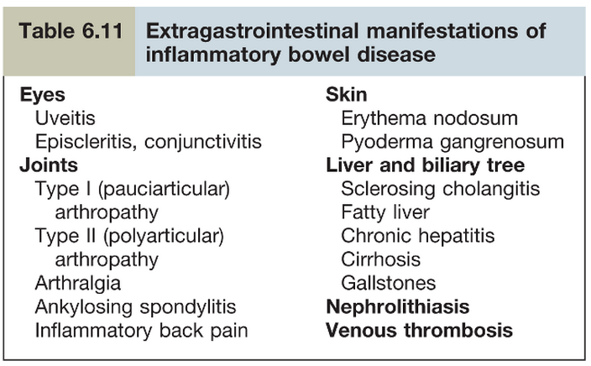
Inflammatory Bowel Disease (IBD)
Extra GIT Manifestation of IBD

Slide 19
Inflammatory Bowel Disease (IBD)
Crohn’s Disease

Slide 20
Crohn’s Disease
Clinical Features
Major symptoms
Diarrhea – present in 80% of cases and contains blood if due to colonic disease
Abdominal pain
Weight loss
Constitutional symptoms
Malaise, Lethargy, Anorexia, Nausea, Vomiting, Low grade fever

Slide 21
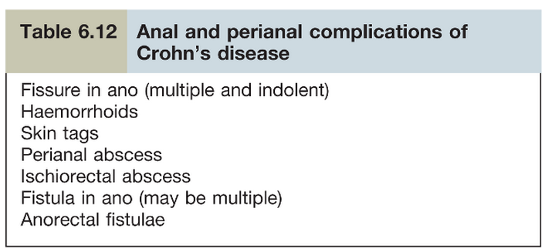
Crohn’s Disease
Crohn’s disease may present with anal and perianal disease in 25% cases

Slide 22
Crohn’s Disease
Examination
Loss of weight
Signs of mal nutrition
Aphthous ulceration of mouth – often seen
Abdominal examination – normal
But right iliac fossa mass is found occasionally (due to inflamed loops of bowel or abcess)

Slide 23
Crohn’s Disease
Investigation
Anaemia – normocytic Normochromic anaemia of chronic disease
Iron, Folate, vitamin B₁₂ deficiency occur
Increased ESR and C-reactive protein (CRP)
Increased WBC and platelet count

Slide 24
Crohn’s Disease
Investigation
Hypoalbumiaemia
Liver biochemistry may be abnormal
Serology test - _{P}ANCA is negative,
- ASCA is positive

Slide 25
Crohn’s Disease
Endoscopy and Radiological imaging
Sigmoidoscopy
Finding vary from mild Patchy superficial ulceration to wide spread large and deeper ulcers producing cobble stone appearance
Colonoscopy
It is done if colonic involvement is suspected
Upper GI endoscopy
To exclude oesophageal and gastro duodenal disease

Slide 26
Crohn’s Disease
Small Bowel Imaging
Barium meal follow through
CT – scan with oral contrast
Small bowel ultrasound
MRI
Finding of imaging may be deep ulceration, narrowing or stricture, skip lesion with normal bowel between the affected sites. Terminal ileum is commonly affected

Slide 27
Crohn’s Disease
Medical Management
General consideration
Aim is to induce and than maintain remession.
Stop smoking
For Diarrhoea – Loperamide, codeine-phosphate
For Anaemia- If due to Vit B₁₂, Folic acid, Iron should be treated accordingly

Slide 28
Crohn’s Disease
Induction of Remission
1. Glucocoticosteriods
2.Aminosalicylates- less useful
3. Antibiotics- Ciprofloxan and Metranidozole
4. Entral Nutrition- For moderate to severe cases

Slide 29
Crohn’s Disease
Refractory Cases
If disease is limited to Terminal ileum, surgical resection is done
If patient has extensive Disease, remission is achieved by Anti- TNF antibodies Infliximab anti-NF&IgG₁ monoclonal antibody.
Note- Infliximab is Anti- TNF (tumour necrosis factor) antibody used for treatment of inflammatory diseases

Slide 30
CROHN’S DISEASE
Maintenance of Remission
-Azathioprine
- Mercaptopurine
- Methotrexate
CHECK FOR LEUCOPENIA, BONE MARROW SUPPRESSION

Slide 31
ULCERATIVE COLITIS (UC)

Slide 32
ULCERATIVE COLITIS (UC)
Clinical features:
  General features of UC:
    Malaise, Lethargy, Anorexia with weight loss
    Aphthous ulcers in mouth may be seen
    Disease can be mild, moderate or severe
    Disease runs course of remission and exacerbations

Slide 33
ULCERATIVE COLITIS
Disease extend is defined
  Limited to rectum (Proctitis)
  Affecting left side of the colon
  Extensive
  Proctitis is characterized by frequent passage of blood and mucus, urgency and tenesmus
  Stool passed may be solid

Slide 34
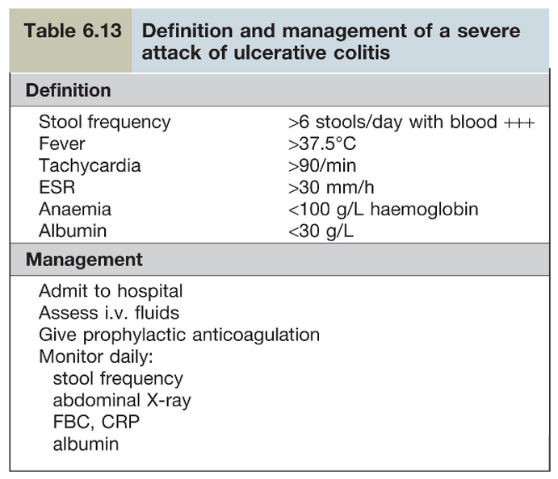
ULCERATIVE COLITIS
In left sided or
extensive Ulcerative
colitis
Patient may have
bloody diarrhoea
passing 10-20 liquid
stools per day

Slide 35
ULCERATIVE COLITIS
Toxic Megacolon
It is serious complication of severe colitis
Plain abdominal X-ray shows dilated colon with diameter of more than 6 cm
It is gas filled and there is danger of perforation and high mortality (15-25 %)

Slide 36
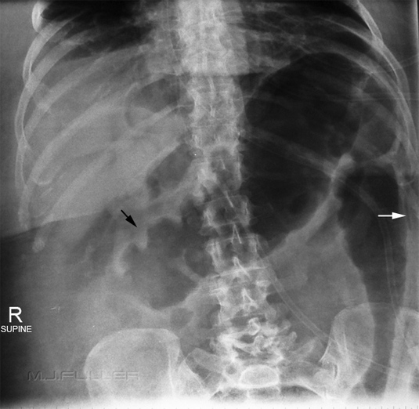
ULCERATIVE COLITIS
X-Ray Abdomen Toxic Megacolon:
Transverse and Descending
colon affected

Slide 37
ULCERATIVE COLITIS
Examination
Abdominal examination- Abdomen may be distended or tender on palpation
Tachycardia and pyrexia are signs of severe colitis
Rectal Examination with rigid sigmoidoscope shows inflamed, bleeding, friable mucosa

Slide 38
ULCERATIVE COLITIS
Investigations:
Blood tests
  WBC, Platelet counts are raised
  Iron deficiency anemia is commonly present
  ESR and CRP are often raised
  Liver Biochemistry may be abnormal with hypoalbumiaemia in severe disease
  PANCA may be positive

Slide 39
ULCERATIVE COLITIS
Investigations (cont)
Stool cultures should always be done to exclude infective cause of colitis
Stool microscopy to exclude Amoebiasis
Colonoscopy
Endoscopy with mucosal biopsy is gold standard test for diagnosis of UC

Slide 40
ULCERATIVE COLITIS
Investigations (cont)
Imaging
Plain X-ray abdomen is essential to exclude colonic dilatation
Ultrasound Abdomen – Inflammation of colonic wall can be detected
Technitium-labelled white cell scan – helps to assess the extent of disease

Slide 41
ULCERATIVE COLITIS
Medical Management:
For mild to moderate cases of UC
Aminosalicylate – the active substance of these drugs is 5-aminosalicylic acid (5-ASA) which is absorbed in small intestine
Drugs used are
  Sulfasalazine
  Asacol
These drugs induce remission

Slide 42
ULCERATIVE COLITIS
Medical Management ( cont)
For Proctitis and left sided colitis
Rectal 5-ASA enema are first line of treatment
Oral 5-ASA will increase rate of remission
Patient who don’t respond may require oral prednisolone

Slide 43
ULCERATIVE COLITIS
Medical Management ( cont)
Sever colitis – patient should be admitted to the hospital and treated with
Hydrocortisone 100 mg IV 6 hourly
s/c Low molecular weight Heparin(LMWH) to prevent thromboembolism
IV fluids
Nutritional support via enteral route

Slide 44
ULCERATIVE COLITIS
Medical Management:
Monitor clinical status daily – fever, tachycardia & stool frequency
Do FBC, CRP, Urea & Electrolyte daily

Slide 45
ULCERATIVE COLITIS
Indication for surgery:
Failure of medical treatment
Toxic dilatation
Hemorrhage
Danger of perforation

Slide 46
ULCERATIVE COLITIS
Inflammatory Bowel disease (IBD) and cancer:
  Patients with UC and CD have increased incidence of developing colon cancer
Pregnancy and IBD
  Women with inactive IBD have normal fertility
  If there is active IBD, fertility may be reduced and they are likely to suffer spontaneous abortion
  ASA, steroid and Azathioprine are safe during pregnancy but Methotrexate is Teratogenic and is contraindicated

Slide 47
ULCERATIVE COLITIS
Important note:
  In male Sulfapyridine moiety present in sulfasalazine impairs spermatogenesis therefore alternate aminosalicylate should be used in patients who want to have children

Slide 48
Case History – Ulcerative Colitis
A 22 year old man complains of 5 weeks history of passing small volume loose, bloody stool. He has urgency to move his bowels. He has occasionally crampy left lower abdominal pain that diminishes after a bowel movement. He has occasional low grade fever.

Slide 49
Question:
What would you most likely see on colonoscopy?
In long term, what is the likely risk in this patient having ulcerative colitis?
If this patient has fever, severe abdominal pain and distension of abdomen, what would be your immediate concern?

Slide 50
Answers:
Answer to Question 1:
Erythema, superficial ulceration, friable mucosa ( bleeds easily )
Answer to Question 2:
Colon cancer
Answer to Question 3:
Toxic mega colon

Slide 51
Thank You

