Slide 1
Dyspepsia & Peptic Ulcer
By Dr. Zahoor

Slide 2
Dyspepsia
What is Dyspepsia ?
Dyspepsia is used to describe number of upper abdominal symptoms such as
- Heart burn
- Acidity
- Pain or discomfort
- Nausea
- Feeling fullness

Slide 3
Dyspepsia
Features of Dyspepsia which are suggestive of serious disease e.g. cancer are known as alarm symptoms, they include
- Dysphagia
- Weight loss
- Vomiting
- Anorexia
- Haematemesis
- Melana
These patients should be investigated

Slide 4
Peptic Ulcer Disease
What is Peptic Ulcer ?
Peptic Ulcer consist of break in the superficial epithelial cells, penetrating down to the muscularis mucosa of stomach or the duodenum and increase inflammatory cell
What is Erosion ?
Erosions are superficial breaks in the mucosa alone

Slide 5
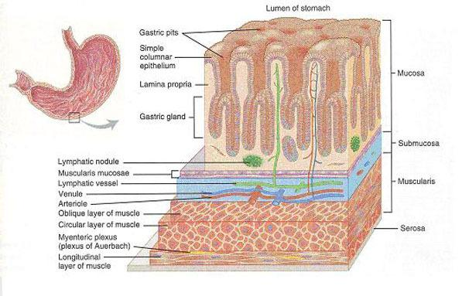
Layers of Stomach

Slide 6
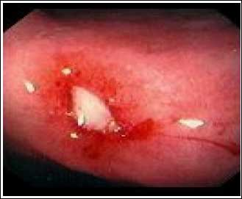
Bleeding Gastric Ulcer

Slide 7
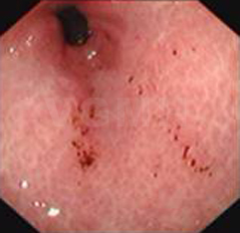
Erosions in antrum

Slide 8
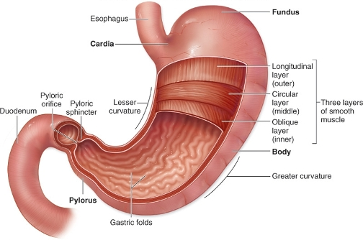
Peptic Ulcer Disease
Most duodenal ulcers are found in duodenal cap
Gastric ulcers most commonly occur on the lesser curvature but can be found in any part of stomach

Slide 9
Peptic Ulcer Disease
Epidemiology
Duodenal ulcer (DU) affect about 10% of adult population
DU are 2-3 times more common than gastric ulcers
Peptic ulcer disease is more prevalent in developing countries related to high Helicobacter pylori [H.pylori] infection
In developed World, percentage of NSAID induced peptic ulcer has increased and prevalence of H.pylori has declined

Slide 10
Peptic ulcer disease
Causes of Peptic ulcer
Helicobacter pylori
NSAID eg Aspirin, Ibuprofen, Diclofenac
Biphosphonates – used for Osteoporosis eg Fosamax
Stress
Diet may be minor factor eg Caffeine
Other risk factors- smoking increases the risk in people who are infected with H.Pylori
Drinking Alcohol

Slide 11
Peptic Ulcer Disease
Clinical Features
Pain in epigastric region, burning, recurrent
If patient points with one finger to the epigastrium, this is strongly suggestive of peptic ulcer disease
Relationship of pain to food is variable and not helpful for diagnosis of peptic ulcer

Slide 12
Peptic Ulcer Disease
Clinical Features (cont)
Pain of duodenal ulcer classically occurs at night (as well as during the day) and is worse when patient is hungry, but this is not reliable
Pain of both duodenal ulcer and gastric ulcer may be relieved by antacids

Slide 13
Peptic Ulcer Disease
Clinical Features (cont)
Nausea may be there with pain, but vomiting is infrequent
Anorexia and weight loss can occur particularly with gastric ulcers
Persistent and severe pain suggest complications e.g. penetration
Untreated DU relapse and remit spontaneously
Examination – there is epigastric tenderness but not so helpful as it is common in non ulcer dyspepsia

Slide 14
Peptic Ulcer Disease
Diagnosis of Helicobacter Pylori Infection
Diagnosis of H.Pylori is necessary to treat
Non invasive method
- Serological test – detection of IgG anti bodies, sensitivity 90% and specificity 83%
- ¹³C urea breath test – this is quick and reliable test for H.Pylori and can be used as screening test.
- Measurement of ¹³CO₂ in breath after ingestion of ¹³C urea is done.
- Sensitivity 90% , Specificity 96%

Slide 15
Peptic Ulcer Disease
Diagnosis of Helicobacter Pylori Infection (cont)
Stool antigen test
- Monoclonal antibodies detect H.Pylori antigen
- Sensitivity 97.6%, Specificity 96%
Note – For stool antigen test - Patient should be off proton pump inhibitors for 2 weeks but can continue H₂ blockers

Slide 16
Peptic Ulcer Disease
Diagnosis of Helicobacter Pylori Infection (cont)
Invasive test – endoscopy
Biopsy urease test – gastric biopsies are added to substrate containing urea and phenol red
- If H.pylori are present, the urease enzyme causes a rapid color change (yellow to red)
Histology – H.pylori can be detected hitologicaly on Giemsa stained sections of gastric mucosa obtained at endoscopy
Culture – Biopsy obtained can be cultured and invtro sensitivity to anti biotic can be tested

Slide 17
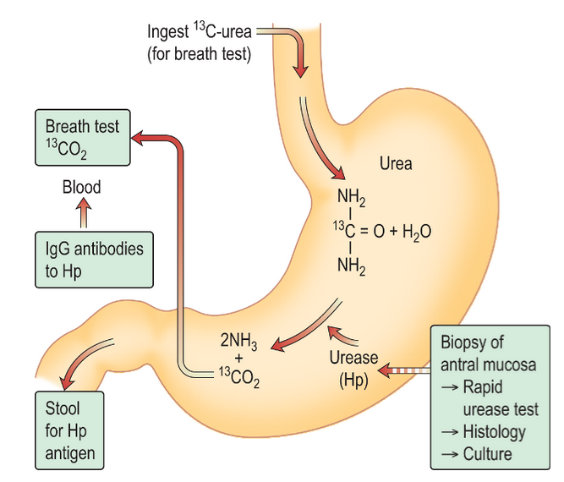
Different test that are available for detection of H.pylori

Slide 18
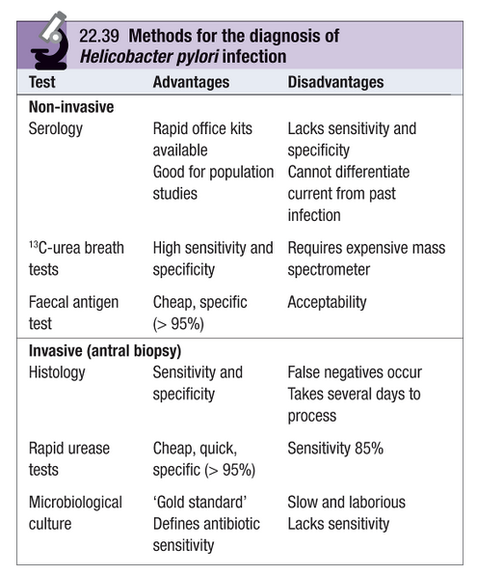

Slide 19
Peptic Ulcer Disease
Investigation of suspected peptic ulcer disease
If patient is under 55 years with typical symptoms of peptic ulcer, who test positive for H.Pylori can start eradication therapy
Exclusion of cancer is required in older patient
Endoscopy is required in all patients with alarmed symptoms (Dysphagia, weight loss)

Slide 20
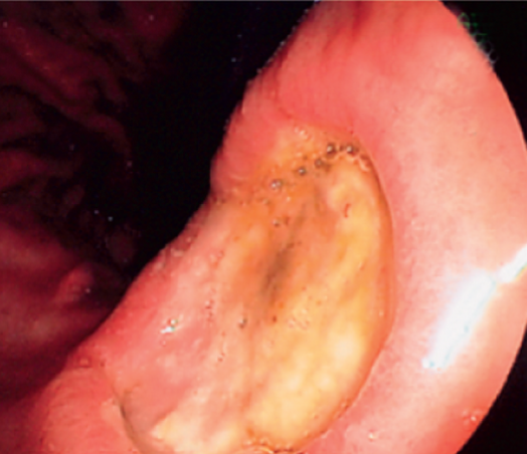
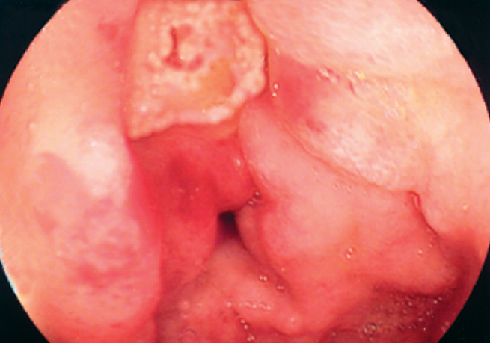
Endoscopic view Duodenal Ulcer
Endoscopic View Benign Gastric Ulcer

Slide 21
Peptic Ulcer Disease
Management
Eradication Therapy for H.Pylori
Current recommendation are that all patient with DU and GU should have H.Pylori eradication therapy if the bacteria is present

Slide 22
Peptic Ulcer Disease
Eradication therapy for H.Pylori
- Omeprezole 20 mg twice daily
- Clarithromycin 500 mg twice daily
- Amoxicillin 1 gm twice daily
These drugs are given for 7-14 days
OR
- Omeprezole 20 mg twice daily
- Clarithromycin 500 mg twice daily
- Metronidazole 400 mg twice daily
These drugs are given for 7-14 days

Slide 23
Peptic Ulcer Disease
Complications of Peptic Ulcer Disease
Hemorrhage
Perforation
Gastric Outlet Obstruction – causes projectile vomiting, large in volume which contain particles of previous meals
NOTE- Complications are rare due to Medicine available now for Peptic ulcer disease

Slide 24
Peptic Ulcer Disease
Management
General Measures
Avoid cigarette smoking
Avoid aspirin and NSAIDs
No special dietary advise is required

Slide 25
Peptic Ulcer Disease
Management
Short term management
Many drugs are available
- Antacid
- Aluminum hydroxide
- H₂ Antagonist
- Ranitidine, Cimitidine (inhibit H₂ receptors on parietal cells)
- Proton Pump inhibitors (PPIs)
- Omeprazole, Pantoprazole (Inhibitors of H+/K+ ATPase on parietal cell surface)
- Prostaglandin analogues
- Misoprostol – stimulate mucus and bicarbonate secretion
- H. Pylori eradication therapy if H.Pylori is positive

Slide 26
Peptic Ulcer Disease
Surgical treatment
Cure of most ulcers by H.Pylori eradication therapy and availability of potent acid – suppressing drugs have made elective surgery for peptic ulcer disease uncommon
Surgery is used only for complications in peptic ulcer like recurrent uncontrolled hemorrhage, perforation
Non healing gastric ulcer is treated by partial gastrectomy

Slide 27
Peptic Ulcer Disease
Complications of Gastric Resection
Although gastric surgery is rarely needed, when
done it can cause
Dumping Syndrome
- Rapid gastric emptying leads to distension of proximal small intestine as there is rapid fluid shift from plasma to dilute the high osmotic load
- This causes abdominal discomfort, flushing, sweating, tachycardia, hypotension and diarrhoea after eating

Slide 28
Peptic Ulcer Disease
Complications of Gastric Resection
Nutritional complications
- Iron deficiency, Folate and vitB₁₂ deficiency
- Weight loss due to reduced intake

Slide 29
Peptic Ulcer Disease
Prophylactic Cytoprotective Therapy
PPI (Proton Pump Inhibitors) are given in risk
patient like
Patients on corticosteroids, NSAIDs, anticoagulants

Slide 30
Peptic Ulcer Disease
Zollinger Ellison Syndrome
It is rare cause of Peptic ulcer
This is rare disorder, and is characterized by triad of
1. Severe peptic ulceration
2. Gastric acid hypersecretion
3. Non-beta cell islet tumor of pancreas (Gastrinoma)
Gastrinoma secrete large amount of gastrin which stimulates the parietal cells

Slide 31
Peptic Ulcer Disease
Zollinger Ellison Syndrome (cont)
High acid output inactivates pancreatic lipase and precipitates bile acid
Diarrhoea and steatorrhoea results
It is common between 30 to 50 years of age
Serum gastrin is grossly elevated (10 to 1000 fold)
Tumor localization is by endoscopic ultrasound

Slide 32
Case History
A 40 year old man, had history of joints pain, he presented with upper abdominal pain and nausea after receiving oral NSAID ketoprofen. His GIT symptoms did not improve with addition of Ranitidine 150mg twice daily.
His upper gastrointestinal endoscopy showed duodenal ulcer, biopsy was taken. Histopathology examination and culture of biopsy was done.
Diagnosis – Helicobacter pylori positive duodenal ulcer.
Question:
What treatment you’ll give for eradication of H.pylori?

Slide 33
Answer:
Answer to Question 1:
Triple therapy for 10 days (7 to 14 days).
- Omeprazole 20 mg twice daily
- Clarithromycin 500 mg twice daily
- Amoxicillin 1 g twice daily or metranidazole
400mg twice daily

Slide 34
Thank you

