Slide 1
TUBERCULOSIS
By Dr. Zahoor

Slide 2
Tuberculosis (TB)
Epidemiology
It is estimated that 1/3 of the World’s population are infected with latent TB
Majority of the cases around 65% are seen in Africa and Asia (India and China)
Co-infection with HIV remains a problem
Drug resistant strain are problem

Slide 3
Tuberculosis (TB)
Factors affecting prevalence and risk of developing TB in the
developed countries:
Contact with high risk group
- Frequent travel to high incidence area
Immune deficiency
- HIV infection
- Immunosuppressant therapy
- Chemotherapy
- Corticosteroids
- Diabetes Mellitus
- Chronic Kidney Disease
- Malnutrition

Slide 4
Tuberculosis (TB)
Factors affecting prevalence and risk of
developing TB in the developed countries(cont):
Life Style Factors
- Drug abuse
- Alcohol misuse
- Homeless/Hostel/Overcrowd
- Prison inmates

Slide 5
Tuberculosis (TB)
Pathophysiology
TB is caused by four main myobacterial species
1. Mycobacterium tuberculosis
2. Mycobacterium bovis
3. Mycobacterium africanum
4. Mycobacterium microti
They are aerobes and intracellular pathogen,
usually infecting mononuclear phagocytes
They are slow growing
They are acid – fast bacilli, and stained with Ziehl Neelson
stain

Slide 6
Tuberculosis (TB)
Pathogenesis
TB is airborne infection spread via respiratory droplet
When bacteria are inhaled, all people do not develop disease, because after exposure to TB bacilli, outcome depends on number of factors
After initial inhalation of TB bacilli, innate immune response clears bacilli, therefore, no infection

Slide 7
Tuberculosis (TB)
Pathogenesis (cont)
If bacteria are not destroyed, they can cause
- Pulmonary TB - 55%
- Extra pulmonary TB - 45%
- Extra pulmonary may be - lymph node, bone, brain, GIT, genitourinary, pericardial, eye, skin, Miliary, disseminated

Slide 8
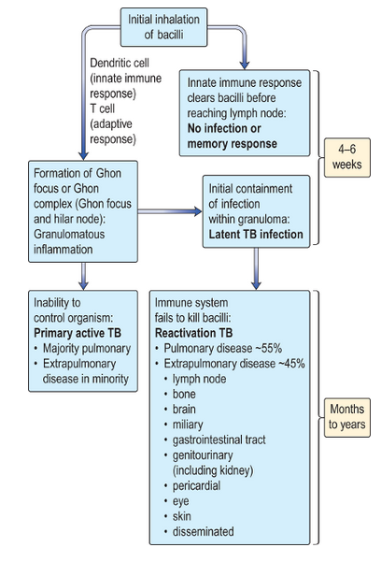
The consequences of exposure to TB

Slide 9
Primary Tuberculosis
It is the first infection with mycobacterium tuberculosis (MTb)
Once inhaled in the lung, alveolar macrophages ingest the bacteria
The bacilli, then proliferate inside the macrophage and cause attraction of neutrophil and cytokines resulting in inflammatory cell infiltrate in the lung and hilar lymph nodes

Slide 10
Primary Tuberculosis
Macrophages present the antigen to the T-lymphocyte with development of cellular immune response
A delayed hypersensitivity type reaction occurs, resulting in tissue nacrosis and formation of granuloma
Granulomatous lesion consist of central area of nacrotic material called caseation, surrounded by epitheloid cells and langans giant cells with multiple nuclei, both cells being derived from macrophage

Slide 11
Primary Tuberculosis
Later caseated areas heal and become calcified
Some of these calcified nodules contain bacteria and are capable of lying dormant (inactive) for many years
The initial focus of disease is termed Ghon focus
On chest X-ray Ghon focus is seen as small calcified nodule in mid zone
A focus can also develop within draining lymph node

Slide 12
Latent Tuberculosis
In majority of TB cases, who are infected, the immune system contains (stops) the infection (Granuloma formation) and patient develops cell mediated immune memory cells to the TB bacilli. This is termed Latent Tuberculosis.
In latent TB infection, the TB bacilli remain inactive and does not cause active infection

Slide 13
Reactivation Tuberculosis
The majority of the TB cases are due to reactivation of latent TB infection
The initial contact with TB bacilli occurred many years or decade earlier
Factors implicated in the development of active disease
- HIV co-infection
- Immunosuppressant/Chemotherapy/Corticosteriods
- Diabetes Mellitus
- End stage chronic kidney disease
- Malnutrition
- Aging

Slide 14
DIFFERENCE BETWEEN
LATENT TB & ACTIVE TB
Latent TB
Bacilli present in Ghon focus
Sputum smear and culture negative
Tuberculin skin test or Mantoux test usually positive
Chest X-ray normal – calcified Ghon focus usually seen
Asymptomatic
Not infectious to others

Slide 15
DIFFERENCE BETWEEN
LATENT TB & ACTIVE TB
Active TB
Bacilli present in tissues or secretions
In pulmonary disease, sputum smear and culture positive
Tuberculin skin test usually positive and can ulcerate
Chest X-ray shows signs of TB (consolidation, cavitation, pleural effusion)
Symptomatic – fever, cough, night sweats, weight loss
Infectious to others if bacilli present in sputum

Slide 16
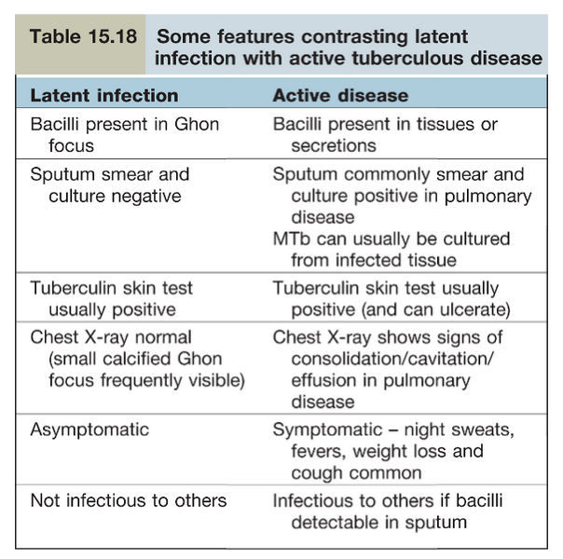

Slide 17
Clinical Features and Diagnosis
Pulmonary, pleural and laryngeal TB
Pulmonary TB
- Patients are frequently symptametic, with productive cough and occasionally hemoptysis
- There are systemic symptoms of weight loss, fever and sweats (commonly at night)
Laryngeal TB
- There is hoarse voice and severe cough
Pleural TB
- If pleura is involved then pleuritic pain is frequent complain

Slide 18
PULMONARY TB INVESTIGATION
Chest X-ray demonstrate several findings
Consolidation with or without cavitation
Pleural effusion or thickening
Widening of the mediastinum caused by hilar or paratracheal lymphadenopathy

Slide 19
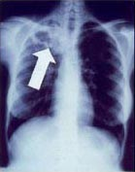
CHEST X-RAY SHOWING TB RIGHT UPPER LOBE WITH CAVITATION

Slide 20
PULMONARY TB INVESTIGATION (cont)
Sputum smear and culture
Bronchoalveolar Lavage
Pleural fluid aspiration and pleural biopsy
Bronchoscopic examination/Biopsy of vocal cord for culture and histology in laryngeal disease

Slide 21
LYMPH NODE TB
The next commonest site of TB infection is lymph node
Extra thoracic lymph node are more commonly involved than Intrathoracic or Mediastinal
Lymph node are firm, non tender enlargement of cervical or supraclavicular nodes
Lymph node become matted, necrotic centrally and can liquefy and can be fluctuant
There can be sinus tract formation with prulent discharge (cold abscess formation) but there is no Erythema
On CT central area appears necrotic

Slide 22
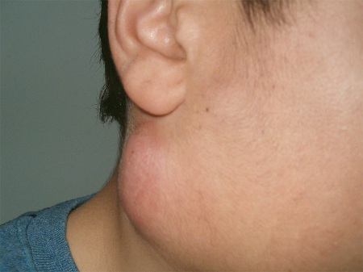
Cervical Lymphadenopathy

Slide 23
MILIARY TB
Miliary TB occurs through Haematogenous spread of the bacilli to multiple sites, including CNS
There are respiratory symptoms, other findings are liver, and splenic micro -abscesses, with abnormal liver enzymes and GI symptoms
X-ray chest shows multiple nodules 1-2 mm which appear like millet seeds, hence the term Miliary

Slide 24
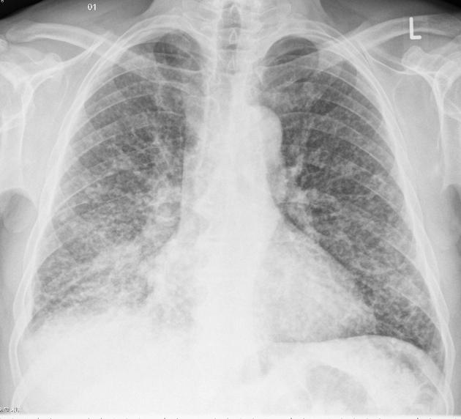
Miliary Tuberculosis

Slide 25
CNS TB
In TB meningitis, lumber puncture findings are
CSF finding
- Protein is high
- Glucose is low
- Cells Lymphocytosis

Slide 26
OTHER FORMS OF TB
Gastrointestinal
TB of bone and spine
Central nervous system
Pericardial
Skin
Details of this, you will do with related chapters

Slide 27
MICROBIOLOGICAL DIAGNOSIS
Rapid identification of the bacteria by stains is essential and should be performed
Stains
- Ziehl Neelson Stain of TB bacilli
- Auramine – rhodamine staining
Culture
- Lowenstein – Jensen slopes (solid culture)
- Liquid culture
Nucleic acid amplification (NAA)
- For rapid identification of MTb
PCR (Polymerase Chain Reaction)

Slide 28
MANAGEMENT
Pulmonary tuberculosis – six month treatment
CNS TB – 12 month treatment
Pulmonary tuberculosis
- Six months treatment
- For 2 months 4 drugs are given
– Isoniazid ( INH)
– Rifampicin
– Pyrazinamide
– Ethambutol
- For next 4 months 2 drugs are given
– Isoniazid (INH)
– Rifampicin

Slide 29
MANAGEMENT
For CNS TB – 12 month treatment
- For 2 months 4 drugs are given
– Isoniazid (INH)
– Rifampicin
– Pyrazinamide
– Ethambutol
- For next 10 months 2 drugs are given
– Isoniazid (INH)
– Rifampicin
- In CNS TB Predinisolone 20-40mg daily, weaning over 2-4 weeks is also given

Slide 30
TREATMENT FOR LATENT TB
Treatment is given for 3 months or 6 months, if given for 3 months 2 drugs are used, when given for 6 months 1 drug is used
3 months drugs used
- INH
- Rifampicin
6 months drug used
- INH

Slide 31
MANAGEMENT
Directly Observed Therapy (DOT)
Due to poor compliance by the patient, WHO advocates DOT by health care persons to reduce the incidence of TB
Criteria for DOT implementation
- History of serious mental illness
- History of non adherence to TB therapy
- Homeless people
- Multi drug resistance TB

Slide 32
SIDE EFFECTS OF DRUG TREATMENT
Side effects of Rifampicin
Induces liver enzymes, which are transiently increased, drug should be stopped if serum bilirubin or enzymes are elevated more than 3 times, but it is uncommon
Thrombocytopenia
Rifampicin stains body secretions to pink color, therefore, patient should be warned of change of color in urine, tears, sweat
Oral contraception will not be effective, so alternate birth control methods should be used

Slide 33
SIDE EFFECTS OF DRUG TREATMENT
Side Effects of Isoniazid (INH)
Polyneuropathy at high dose due to vitamin B6 (pyridoxine deficiency), therefore, pyridoxine 10mg is prescribed to prevent this
Allergic reaction of skin – skin rash, fever
Hepatitis – less than 1%
Side Effects of Pyrazinamide
Hepatitis
Decrease renal excretion of urate, therefore, may precipitate gout

Slide 34
SIDE EFFECTS OF DRUG TREATMENT
Side Effect of Ethambutol
Optic retro bulbar neuritis – patient may present with color blindness for green, decrease visual acuity and central scotoma
If drug is stopped, above side effects are reversible
Side Effects of Streptomycin
Damage to vestibular nerve, more effect in elderly
Renal impairment

Slide 35
TB IN SPECIAL SITUATION
HIV co-infection
Specially seen in Africa, India, Eastern Europe and Russia
Chronic Kidney Disease (CKD)
CKD is risk factor for reactivation of TB infection due to immune paresis

Slide 36
LATENT TB INFECTION (LTBI)
Diagnosis of Latent TB Infection involves demonstration of immune memory cells to mycobacterial protein, tuberculin skin test or Mantoux Test is done
1. Tuberculin skin test (TST)
- A positive test is indicated by delayed hypersensitivity reaction seen in 48-72 hours after the interdermal injection of PPD (Purified Protein Derivative) resulting in
- raised indurated lesion > 6mm in diameter in non vaccinated adults
- raised indurated lesion > 15mm in BCG vaccinated adults

Slide 37
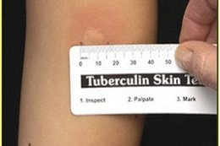
Tuberculin Skin Test

Slide 38
Tuberculin skin test (TST)
False negative test are common in
Immunosuppression due to
- HIV
- Chemotherapy
- Steroids
- Sarcoidosis
False positive tuberculin test or Mantoux test
- BCG vaccination

Slide 39
GLOBAL TB STRATEGY
To identify and treat latent TB infection to reduce the risk of conversion to active disease, active case finding programs are followed
- Contact tracing – carried out after diagnosis of new case of TB
- Screening of health workers
- Screening of new entrants – those arriving from country of high incidence of TB
- Home less people
- Immunocompromised people – HIV, malignancies, chemotherapy .

Slide 40
CASE HISTORY
Case History of patient with night sweats and haemoptysis.
A 35 year old Asian male had a 4 month history of night sweats and weight loss. Recently he had become more short of breath and had haemoptysis. He shared a room with four other family members. He has lived in the UK for 6 months. Though he remained haemodynamically stable, he had a temperature of 38ºC. Bronchial breathing was heard in the right upper zone of his chest. He had a mantoux test which was read 48 hours later and found to be strongly positive. His X-ray chest is shown and his sputum showed acid fast bacilli.

Slide 41
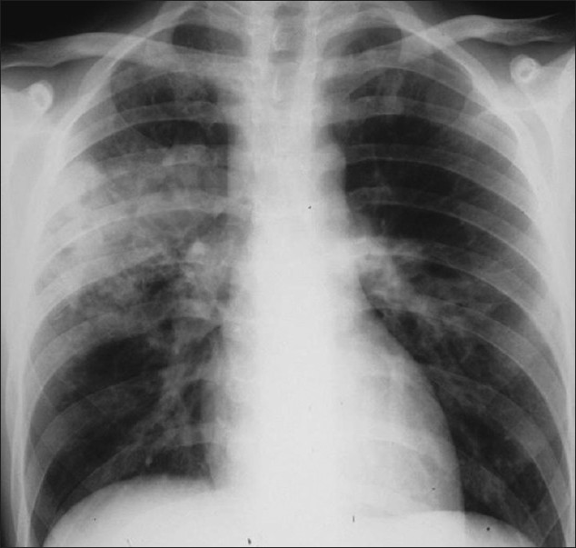
Chest X-ray shows right upper lobe and left midzone consolidation and lymph adenopathy.

Slide 42
Questions:
1. What does a positive mantoux test mean?
Indurated area > 6mm after 48 hours
Indurated area > 10mm after 48 hours
Indurated area > 15mm after 48 hours
2. What initial management steps should you take ?
a. Isolate the patient
b. Commence on antibiotics
c. Commence on anti-TB medication

Slide 43
Questions:
3. Which of the following does not typically cause a Cavitating lung lesion?
Mycobacteria tuberculosis
Staphylococcus aureus
Haemophilus influenza
Bronchogenic carcinoma

Slide 44
Answers:
Answer to Question 1:
a. Indurated area > 6mm after 48 hours
Answer to Question 2:
a. Isolate the patient
Answer to Question 3:
c. Haemophilus influenza

Slide 45
THANK YOU

