Slide 1
Brucellosis
Dr. Zahoor

Slide 2
Brucellosis
Brucellosis also called Mediterranean fever or Malta fever or Undulant fever
It is called Brucellosis after its bacterial cause.
It is called Undulant fever because of its rising and falling like a wave.

Slide 3
Brucellosis
Brucellosis is Zoonosis infection (endemic in animals). It is infectious disease.

Slide 4
Brucellosis
Brucella is gram negative bacilli, four types are important to human
1. Brucella abortus – reservoir cattle
2. Brucella melitensis – sheep, goat , camel
3. Brucella suis – reservoir pigs
4. Brucella canis – reservoir dogs

Slide 5
Brucellosis
Brucella infection is transmitted to human mainly by ingestion of unpasteurized (raw) milk from infected animals
Brucellosis has world wide distribution, although it is almost eliminated from cattle in UK, USA

Slide 6
Brucellosis
Highest incidence of Brucellosis is in the Mediterranean countries, Middle East and Tropics
There are about 500,000 new cases diagnosed per year world wide

Slide 7
Brucellosis
How the organism gets entry into the human body?
By ingestion of infected milk, uncooked meat, less frequently via respiratory tract, abraded skin, animal urine, faeces may act as source of infection
Occupational exposure can occur

Slide 8
Brucellosis
In human, bacilli travel in the lymphatics and infect lymph node, this is followed by haematogenous spread with localization in reticulo – endothelial system

Slide 9
Brucellosis
Clinical Features
Incubation period 1-3 weeks ( 5- 60 days )
Acute infection is characterized by undulant fever (high swinging temperature), rigors, lethargy, headache, joint and muscle pain
Onset may be insidious, with malaise, headache, weakness, generalized myalgia and night sweats

Slide 10
Brucellosis
Clinical Features (cont)
Lymphadenopathy - is common
Hepatosplenomegaly – is common
Pancytopenia
Arthritis, Sacroilitis, Osteomyelitis
Endocarditis can occur

Slide 11
Brucellosis
Brucellosis acute infection lasts few days to few months
After acute Brucellosis , infection , symptoms persist in some patients for more than one year , such patients are defined as having Chronic brucellosis.

Slide 12
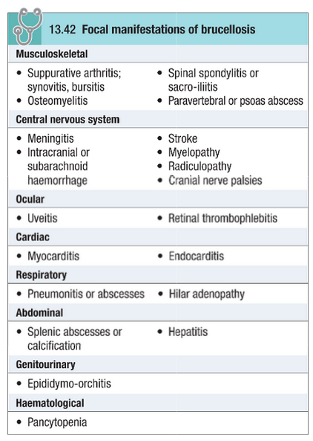
Focal Manifestation of Brucellosis

Slide 13
Brucellosis
Diagnosis
Definitive diagnosis depend on isolation of organism
Blood or bone marrow cultures are positive during acute phase of illness in 80% of patients caused by B.melitensis
Serological test – Brucella agglutination test, 4 fold or more rise in titre over a 4 week period

Slide 14
Brucellosis
Diagnosis (cont)
Increased serum IgG signifies recent infection
Neurobrucellosis-CSF culture is Positive in 30%

Slide 15
Brucellosis
Management
Anti biotic
- Doxycyclin
- Rifampicin
- Gentamicin
- Streptomycin
Combination of these drugs can be used. Treatment is given for 6 weeks
Neurobrucellosis is treated for 3-6 months

Slide 16
Brucellosis
Prevention & Control
Careful attention to hygiene when handling infected animals
Vaccination of animals
Pasteurization of milk
Note – No vaccine is available for use in humans

Slide 17
Thank you

