Slide 1
BLEEDING DISORDERS
Dr. M. A Sofi
MD; FRCP (London); FRCPEdin; FRCSEdin

Slide 2
HEMOSTASIS
Hemostasis is the arrest of bleeding from an injured blood vessel. The process of hemostasis initiates:
NORMAL CLOTTING
Response to vessel injury
1. Vasoconstriction to reduce blood flow
2. Platelet plug formation (von Willebrand factor binds damaged vessel and platelets)
3. Activation of clotting cascade with generation of fibrin clot formation
4. Fibrinolysis (clot breakdown)
HEMOSTASIS
Depends Upon:
Vessel Wall Integrity Adequate Numbers of Platelets
Proper Functioning Platelets
Adequate Levels of Clotting Factors
Proper Function of Fibrinolytic Pathway

Slide 3
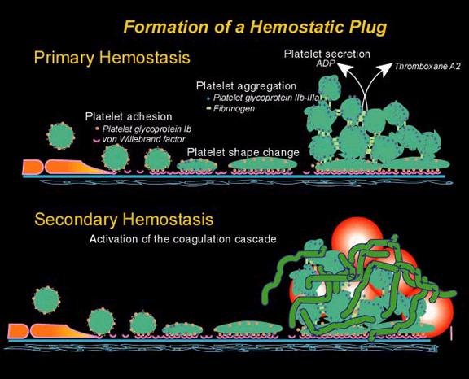

Slide 4
Hemostasis
Lab Tests
CBC-Plt
BT,(CT)
PT
PTT
BV Injury
Tissue Factor
Neural
Blood Vessel
Constriction
Platelet
Aggregation
Coagulation
Cascade
Primary hemostatic plug
Reduced
Blood flow
Platelet
Activation
Fibrin formation
Plt Study
Morphology
Function
Antibody
Stable Hemostatic Plug

Slide 5
Hemophilia A
Hemophilia A is an X-linked, recessive disorder caused by deficiency of functional plasma clotting factor VIII (FVIII), which may be inherited or arise from spontaneous mutation.
The development of inhibitory antibodies to FVIII can result in acquired hemophilia A or can complicate the treatment of genetic cases.
Hemophilia B
Hemophilia B, or Christmas disease, is an inherited, X-linked, recessive disorder that results in deficiency of factor IX.
Spontaneous mutation and acquired immunologic processes can result in this disorder as well.
Hemophilia B constitutes about 20% of hemophilia cases, and about 50% of these cases have factor IX levels greater than 1%.

Slide 6
Severity, Factor Activity, and Hemorrhage
 | Hemophilia A | Hemophilia B
Factor deficiency | Factor VIII | Factor IX
Inheritance | X-linked recessive | X-linked recessive
Incidence | 1/10,000 males | 1/50,000 males
Severity
Complications | Soft tissue bleeding
Classification | Factor Activity, % | Cause of Hemorrhage
Mild | >5-40 | Major trauma or surgery
Moderate | 1-5 | Mild-to-moderate trauma
Severe | < 1 | Spontaneous

Slide 7
Clinical manifestations of bleeding disorders
Bleeding symptoms | Bleeding disorder
 | Platelet defects (qualitative or quantitative) | Clotting factor deficiencies (eg, factor VIII or factor IX deficiencies)
Overview of bleeding events | Mucocutaneous bleeding (oral cavity, nasal, gastrointestinal, and genitourinary sites) | Deep tissue bleeding (including joints and muscles)
Excessive bleeding after minor cuts | Yes | Not usually
Petechiae | Common | Uncommon
Ecchymoses | Generally small and superficial | May develop large subcutaneous and soft tissue hematomas
Hemarthroses, muscle hematomas | Uncommon | Common in severe deficiency states
Bleeding with invasive procedures, including surgery | Often immediate, dependent upon the severity of the defect, ranging from none to mild to severe | May be associated either with procedural bleeding or delayed bleeding

Slide 8
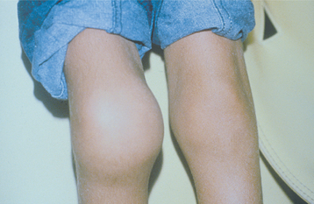
Hemarthrosis

Slide 9
Diagnosis
Laboratory studies for suspected hemophilia include:
Complete blood cell count
Coagulation studies
FVIII assay
Expected laboratory values are:
Hemoglobin/hematocrit: Normal or low
Platelet count: Normal
Bleeding time: Normal
Prothrombin time: Normal
Activated partial thromboplastin time (aPTT): Significantly prolonged in severe hemophilia, but may be normal in mild or even moderate hemophilia
Normal values for FVIII assays are 50-150%.
Values in hemophilia are as follows:
Mild: >5%
Moderate: 1-5%
Severe: < 1%

Slide 10
Imaging studies: Based on clinical suspicion and anatomic location:
CT Brain without contrast to assess for spontaneous or traumatic ICH
MRI scans of the head and spinal cord for spontaneous or traumatic hemorrhage
MRI for evaluation of the cartilage, synovium, and joint space
Ultrasonography for evaluation of joint acute or chronic effusions
Testing for inhibitors is indicated when bleeding is not controlled after adequate amounts of factor concentrate are infused during a bleeding episode.
Inhibitor concentration is titrated using the Bethesda method, as follows:
Positive result: Over 0.6 Bethesda units (BU)
Low-titer inhibitor: Up to 5 BU
High-titer inhibitor: Over 5 BU

Slide 11
Management:
The treatment of hemophilia may involve:
Management of hemostasis
Management of bleeding episodes
Factor replacement products and medications
Treatment of inhibitors
Treatment and rehabilitation of patients with hemophilia synovitis
Disposition of treatment:
Management ideally comprehensive hemophilia care center
Home administration of treatment and infusions by the family or patient is customary
FVIII treatment may be given prophylactically or on demand
Hospitalization is reserved for severe or life-threatening bleeds

Slide 12
Management:
For treatment of acute bleeds, target levels by hemorrhage severity are:
Mild hemorrhages (early hemarthrosis, epistaxis, gingival bleeding): Maintain an FVIII level of 30%
Major hemorrhages (e.g., hemarthrosis or muscle bleeds with pain and swelling, prophylaxis after head trauma with negative findings on examination): Maintain an FVIII level of at least 50%
Life-threatening bleeding episodes (i.e., major trauma or surgery, advanced or recurrent hemarthrosis): Maintain an FVIII level of 80-100%
To find the number of units of factor VIII needed to correct the factor VIII activity level, use formula:
Units factor VIII
Formula:
weight ÷ 4.4 × factor level desired = number of factor VIII units needed

Slide 13
FVIII regimens:
The second dose 12 hours after the initial dose and is one half the initial dose.
Minor hemorrhage requires 1-3 doses of FVIII
Major hemorrhage requires many doses and continued FVIII activity monitoring with the goal of keeping the trough activity level at least 50%
Continuous infusions of FVIII may be considered for major hemorrhage.
FVIII concentrates are:
First-generation rFVIII : First-generation rFVIII concentrates are stabilized with human albumin.
Second-generation rFVIII:
Second-generation rFVIII products contain sucrose instead of albumin in the final formulation.
Third-generation rFVII: Third-generation rFVIII products are without additional human or animal plasma proteins.

Slide 14
Desmopressin vasopressin analog, or 1-deamino-8-D-arginine vasopressin (DDAVP), has the following attributes:
Considered the treatment of choice for mild and moderate hemophilia A
Not effective in the treatment of severe hemophilia
Can be intravenously administered at a dose of 0.3 mcg/kg of body weight in the inpatient setting
Peak effect is observed in 30-60 minutes
A concentrated DDAVP intranasal spray is available for outpatient use
Antifibrinolytics are used in addition to FVIII replacement for oral mucosal hemorrhage and prophylaxis:
Epsilon aminocaproic acid (Amicar)
Tranexamic acid (Cyklokapron)

Slide 15
INHIBITORS
30% of people with haemophilia develop an antibody to the clotting factor they are receiving for treatment. These antibodies are known as inhibitors.
These patients are treated with high does of FVIIa for bleeds or surgery. This overrides defect in FVIII or FIX deficiency.
Long-term management involves attempting to eradicate inhibitors by administering high dose FVIII (or FIX) in a process called immune tolerance

Slide 16
Hemophilia B, or Christmas disease, is an inherited, X-linked, recessive disorder that results in deficiency of functional plasma coagulation factor IX.
Spontaneous mutation and acquired immunologic processes can result in this disorder as well.
Hemophilia B constitutes about 20% of hemophilia cases, and about 50% of these cases have factor IX levels greater than 1%.
Signs and symptoms:
Neonates: Prolonged bleeding and/or severe hematoma following procedures such as circumcision, phlebotomy; intracranial hemorrhage
Toddler: Trauma-related soft-tissue hemorrhage; oral bleeding during teething
Children: Hemarthrosis and hematomas; chronic arthropathy (late complication); traumatic intracranial hemorrhage (life threatening)

Slide 17
Diagnosis
Examination in patients with hemophilia B may reveal the following signs of hemorrhage:
Systemic: Tachycardia, tachypnea, hypotension, and/or orthostasis
Musculoskeletal: Joint tenderness, pain with movement, decreased range of motion, swelling, effusion, warmth
Neurologic: Abnormal findings, altered mental status, meningismus
Gastrointestinal: Can be painless or present with hepatic/splenic tenderness and peritoneal signs
Genitourinary: Bladder spasm/distention/pain, costovertebral angle pain
Other: Hematoma leading to location-specific signs (eg, airway obstruction, compartment syndrome)

Slide 18
Von Willebrand's Disease
This is the most common hereditary coagulopathy in humans. It can be congenital or acquired.
Pathophysiology
Von Willebrand's disease (vWD) results from the deficiency or abnormal function of von Willebrand factor (vWF).
vWF is a multimeric glycoprotein encoded for by gene map locus 12p13.
It is made in the endothelium and stored in Weibel-Palade bodies. It has two main functions:
It assists in platelet plug formation by attracting circulating platelets to the site of damage.
It binds to coagulation factor VIII preventing its clearance from the plasma.

Slide 19
von Willebrand Disease:
Clinical Features
von Willebrand factor
  Synthesis in endothelium and megakaryocyte
  Forms large multimer
  Carrier of factor VIII
  Anchors platelets to sub-endothelium
  Bridge between platelets
Inheritance - autosomal dominant
Incidence - 1/10,000
Clinical features - mucocutaneous bleeding

Slide 20
Von Willebrand's Disease
Epidemiology
Prevalence is as high as 1-2% in the general population on unselected screening.
Worldwide incidence is around 125 per million with between 0.5 and 5 per million being severely affected.
Most patients have mild disease.
It is more common in females.
It is more severe with blood type O.

Slide 21
Von Willebrand's Disease
Etiology
Hereditary - three types
vWD Type I, vWD Type II, and vWD Type III
Within the three inherited types of vWD there are various subtypes.
Acquired - also called pseudo-von Willebrand's disease or platelet-type; it is frequently found in:
Lymphoproliferative
Myeloproliferative disorders
Solid tumors
Immunological disorders
Cardiovascular disorders e.g., aortic stenosis,
Wilms'tumor,
Hypothyroidism.

Slide 22
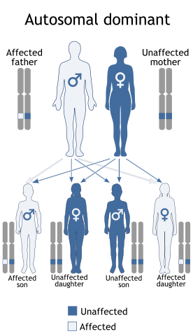
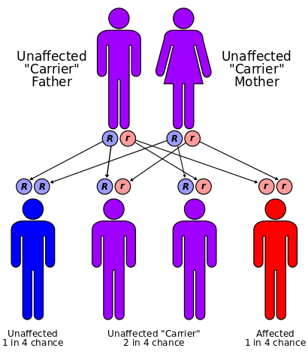
The vWF gene is located on chromosome 12 (12p13.2). Types 1 and 2 are inherited as autosomal dominant traits and type 3 is inherited as autosomal recessive.

Slide 23
Signs and symptoms:
Easy bruising - Common but nonspecific
Prolonged bleeding - After minor trauma to skin or mucous membranes
Severe hemorrhage - After major surgery; less common
Delayed bleeding - May occur up to several weeks after surgery
Menorrhagia – Common complaint in women
Heavy bleeding - Common after tooth extraction or other oral surgery, such as tonsillectomy and adenoidectomy
Exacerbation of bleeding symptoms - After ingestion of aspirin
Amelioration of bleeding symptoms with use of oral contraceptives

Slide 24
Diagnostic Considerations
Conditions to consider in the differential diagnosis of von Willebrand disease include the following:
Hemophilia A
Hemophilia B
Factor X deficiency
Factor XI deficiency
Bernard-Soulier syndrome
Platelet function defects
Antiplatelet drug ingestion
Fibrinolytic defects
Platelet-type (or pseudo) vWD
Acquired vWD

Slide 25
Laboratory tests:
Screening tests typically include the following:
Prothrombin time (PT)
Activated partial thromboplastin time (aPTT)
Factor VIII coagulant activity
Ristocetin cofactor (RCoF) activity
Concentration of vWF antigen (vWF: Ag)
Bleeding time
Historically, the bleeding time was a test used to help diagnose vWD.
PT and aPTT
The aPTT is mildly prolonged in approximately 50% of patients with vWD.
The prolongation is secondary to low levels of FVIII because one of the normal functions of vWF is to protect FVIII from degradation.
The PT should be within reference ranges.

Slide 26
Treatment of von Willebrand Disease
Cryoprecipitate
Source of fibrinogen, factor VIII and VWF
Only plasma fraction contains VWF multimers consistently
DDAVP (deamino-8-arginine vasopressin)
Releases stored FVIII (and von Willebrand factor)
↑ plasma VWF levels
Not generally used in type 2 disease
Dosage 0.3 µg/kg q 12 hr IV
ANTIFIBRINOLYTICS
Aminocaproic acid and tranexamic acid are antifibrinolytics agents that prevent the breakdown of blood clots. These drugs are often recommended before dental procedures, to treat nose and mouth bleeds, and for menorrhagia.

Slide 27
Autoimmune Thrombocytopenias
ITP is one of the most common autoimmune disorders.
ITP is caused by autoantibodies to platelets. The antigenic target in most patients appears to be the platelet GP IIb/IIIa complex.
Platelets with antibodies on their surface are trapped in the spleen, where they are efficiently removed by splenic macrophages.
ITP occurs in healthy individuals and rarely as the initial manifestation of lupus and other autoimmune disorders.
Human immunodeficiency virus (HIV) infection is often associated with ITP in both adults and children.

Slide 28
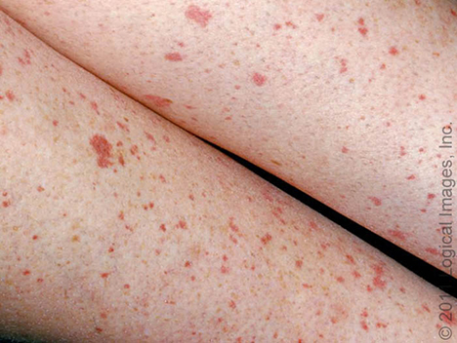
Autoimmune Thrombocytopenias
ITP occurs in two distinct clinical types:
Acute self-limiting form observed almost exclusively in children (five cases per 100,000 persons) and
Chronic form, observed mostly in adults (three to five cases per 100,000 persons) and rarely in children

Slide 29
Ideopathic thrombocytopenic purpura
Common signs, symptoms, and precipitating factors include the following:
Abrupt onset (childhood ITP)
Gradual onset (adult ITP)
Purpura
Menorrhagia
Epistaxis
Gingival bleeding
Recent live virus immunization (childhood ITP)
Bruising tendency

Slide 30
Ideopathic thrombocytopenic purpura
Physical findings
Nonpalpable petechiae, which mostly occur in dependent regions
Hemorrhagic bullae on mucous membranes
Purpura
Gingival bleeding
Signs of GI bleeding
Menometrorrhagia, menorrhagia
Retinal hemorrhages
Evidence of intracranial hemorrhage, with possible neurologic symptoms
Nonpalpable spleen: The prevalence of palpable spleen in patients with ITP is approximately the same as that in the non-ITP population (i.e., 3% in adults, 12% in children).
Spontaneous bleeding when platelet count is less than 20,000/mm ³.

Slide 31
Diagnostic Considerations
Pseudothrombocytopenia (platelet clumping in the presence of ethylenediaminetetra acetic acid [EDTA])
Liver disease
Lymphoproliferative, autoimmune, or infectious diseases
Drug-induced immune thrombocytopenia (alcohol, heparin, quinine/quinidine, sulfonamides)
Pregnancy-associated thrombocytopenia
Infection/sepsis
Acute leukemia
Myelodysplastic syndrome
Malignancy
Megaloblastic anemia
Isoimmune neonatal purpura
Transfusion

Slide 32
ITP: Treatment & Management
Life-threatening bleeding requires critical care.
Patient with known ITP, high-dose parenteral glucocorticoids and IV immunoglobulin (IVIg), with or without platelet transfusions.
Platelet transfusion is indicated for controlling severe hemorrhage.
Platelet survival is increased if the platelets are transfused immediately after IVIg infusion.
Guidelines for transfusion dosage are as follows:
6-8 U of platelet concentrate, or 1 U/10 kg
1 U of platelets to increase count of a 70-kg adult by 5-10,000/mm ³ and an 18-kg child by 20,000/mm ³
Splenectomy is reserved for patients in whom medical therapy fails.
Emergent splenectomy is indicated in patients with life-threatening bleeding in whom medical therapy fails.

Slide 33
THANK
YOU
FOR
YOUR
ATTENTION

