Slide 1
HODJKIN’S LYMPHOMA
Dr. M. Sofi MD; FRCP (London); FRCPEdin; FRCSEdin

Slide 2
Hodgkin’s Lymphoma:
Hodgkin’s lymphoma is a malignant disease that affects the lymphatic system. In the majority of cases the neoplastic cells can be derived from B lymphocytes.
Most common primary localizations are cervical (60-80%), mediastinal, and inguinal lymph nodes.
Hodgkin’s lymphomas disseminate both via lymphatic vessels or per continuitatem into lymphatic organs as well as by blood vessels or per continuitatem into extralymphatic organs.
Characteristic feature is a low number of malignant Hodgkin-Reed-Sternberg (H-RS) cells surrounded by numerous reactive cells (bystander cells).

Slide 3
Hodgkin’s Lymphoma
Epidemiology
The incidence rate is at 2-3/100,000 per year. The age peak lies at approx. 32 years.
Hodgkin lymphoma is one of the most treatable forms of cancer.
About 75 percent of people diagnosed with Hodgkin lymphoma can be cured with treatment.
Over 90 percent of people live at least 10 years after treatment.

Slide 4
Classification
Classification of Hodgkin’s lymphomas is according to the WHO classification:
I. Nodular Lymphocyte-predominant Hodgkin’s lymphoma (NLPHL)
The NLPHL encompasses almost 5% of all Hodgkin’s lymphomas.
As opposed to the classical Hodgkin’s lymphomas the malignant cells are referred to as L&H (lymphocytic and histiocytic)
For therapeutic purposes, nodular lymphocyte-predominant HL is managed in the same way as indolent non-Hodgkin lymphoma

Slide 5
Classification
II. Classical Hodgkin’s lymphoma (cHL)
  Nodular sclerosing (NSHL)
  Mixed cellularity (MCHL)
  Lymphocyte-rich (LRHL)
  Lymphocyte-depleted (LDHL)
Tumor cells of the classical Hodgkin’s lymphomas are referred to as Hodgkin and Reed-Sternberg cells (H-RS)
Stage-adapted therapy allows long term cure in more than 80 percent of all patients. Hodgkin’s lymphoma is one of the oncological diseases with the highest cure rates in adults

Slide 6
Features of Hodgkin lymphoma include:
Asymptomatic lymphadenopathy may be present (above the diaphragm in 80% of patients)
Constitutional symptoms
  unexplained weight loss [>10% of total body weight],
  unexplained fever, night sweats) are present in 40% of patients; collectively, these are known as "B symptoms"
Intermittent fever is observed in approximately 35% of cases
Pel-Ebstein fever is observed (high fever for 1-2 wk, followed by an afebrile period of 1-2 wk)

Slide 7
Features of Hodgkin lymphoma include:
Chest pain, cough, SOB, or a combination of those may be present due to a large mediastinal mass or lung involvement; rarely, hemoptysis occurs
Pain at sites of nodal disease, precipitated by drinking alcohol, occurs in fewer than 10% of patients but is specific for Hodgkin lymphoma
Back or bone pain rarely occur
May present with pruritus
A family history is also helpful; in particular, nodular sclerosis Hodgkin lymphoma (NSHL) has a strong genetic component and has often previously been diagnosed in the family

Slide 8
Physical Examination
Physical examination include:
Painless lymphadenopathy can be seen in the cervical area (neck, 60-80%), axilla (armpit, 6-20%), and, less commonly, in the inguinal area (groin, 6-20%)
Waldeyer ring (back of the throat, including the tonsils) or occipital (lower rear of the head) or epitrochlear areas is infrequently observed
Splenomegaly and/or hepatomegaly may be present
Superior vena cava syndrome may develop in patients with mediastinal lymphadenopathy
CNS symptoms or signs may be due to paraneoplastic syndromes, including:
  Cerebellar degeneration, neuropathy
  Guillain-Barre syndrome
  Multifocal leukoencephalopathy

Slide 9
Differential Diagnoses
Cytomegalovirus
Infectious Mononucleosis
Non-Hodgkin Lymphoma
Systemic Lupus Erythematosus
Sarcoidosis
Serum Sickness
Small Cell Lung Cancer
Syphilis
Toxoplasmosis
Tuberculosis

Slide 10
Investigations
Test | Comments
Case history | B symptoms Fever Night sweats (change of night clothes) Unintentional weight loss (<10% of body weight within 6 months)
Physical examination | Palpable lymph nodes Hepatosplenomegaly
Laboratory analyses | Complete blood cell count, including leukocyte count with differential Erythrocyte sedimentation rate LDH, GOT, GPT, AP, Gamma GT, uric acid, creatinine
Imaging | Chest X-rays CT scan of the neck (with contrast medium) CT scan of the chest (with contrast medium) CT scan of the abdomen (with contrast medium) PET scan: Initial staging of Hodgkin lymphoma
Bone-marrow puncture | Aspirate (cytology) Biopsy (histology)

Slide 11
Staging according to Ann Arbor Classification
Stage I | A single lymph node area or single extranodal site
Stage II | 2 or more lymph node areas on the same side of the diaphragm
Stadium III | Lymph node areas on both sides of the diaphragm
Stadium IV | Disseminated or multiple involvement of the extranodal organs
Addendum A | No B symptoms
Addendum B | Presence of B symptoms

Slide 12
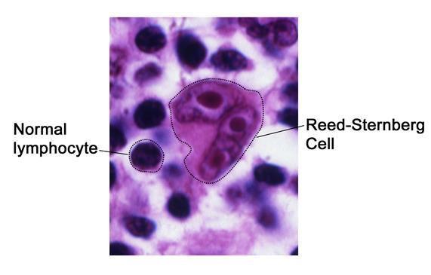
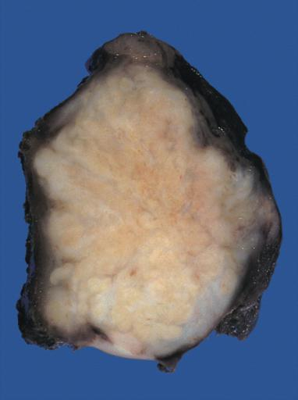
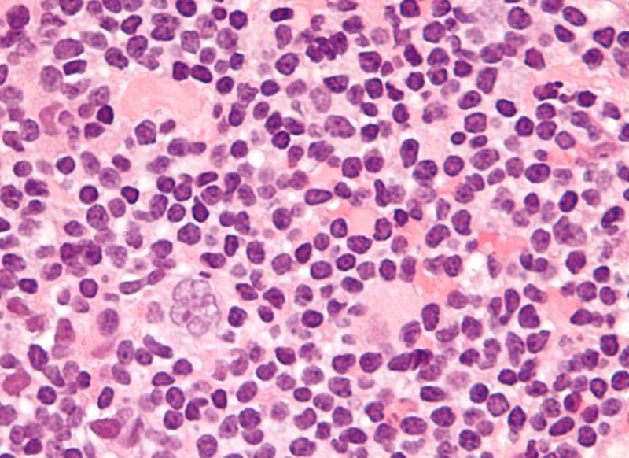
Nodular sclerosing Hodgkin lymphoma of the mediastinum. The diagnosis is strongly suggested by the presence of distinct nodules on the cut surface of this lymph node.
Very high magnification micrograph of NLPHL, with a popcorn-shaped Reed-Sternberg cell (hematoxylin and eosin).

Slide 13
Non-Hodgkin lymphomas (NHLs)
Non-Hodgkin lymphomas (NHLs) are tumors originating from lymphoid tissues, mainly of lymph nodes. These tumors may result from chromosomal translocations, infections, environmental factors, immunodeficiency states, and chronic inflammation
Signs and symptoms
Peripheral adenopathy: Painless and slowly progressive; can spontaneously regress
Primary extranodal involvement and B symptoms: Uncommon at presentation; however, common with advanced, malignant transformation or end-stage disease
Bone marrow: Frequent involvement; may be associated with:
  Cytopenias(s)
  Fatigue weakness more common in advanced-stage disease

Slide 14
Non-Hodgkin lymphomas (NHLs)
Signs and symptoms
Intermediate- and high-grade lymphomas have a more varied clinical presentation:
Adenopathy: Most patients
Extranodal involvement: More than one third of patients; most common sites are GI/GU tracts (including Waldeyer ring), skin, bone marrow, sinuses, thyroid, CNS.
B symptoms: Temperature >38°C, night sweats, weight loss >10% from baseline within 6 months; in approximately 30-40% of patients

Slide 15
Physical Examination
Examination in patients with
low-grade lymphomas may demonstrate:
  Peripheral adenopathy
  Splenomegaly
  Hepatomegaly.
Intermediate- and high-grade lymphomas may result:
  Rapidly growing and bulky lymphadenopathy
  Splenomegaly
  Hepatomegaly
Large abdominal mass: Usually in Burkitt lymphoma
Skin lesions: Associated with cutaneous T-cell lymphoma
  Mycosis fungoides
  Anaplastic large-cell lymphoma
  Angioimmunoblastic lymphoma

Slide 16
Complications
Potential disease-related complications include:
Cytopenias (neutropenia, anemia, thrombocytopenia)
Bleeding secondary to thrombocytopenia, DIC
Infection secondary to neutropenia
large pericardial effusion or arrhythmias secondary to cardiac metastases
Pleural effusion and/or parenchymal lesions
Superior vena cava (SVC) syndrome secondary to a large mediastinal tumor
Spinal cord compression secondary to vertebral metastases
Neurologic problems secondary to Primary CNS lymphoma or lymphomatous meningitis
GI obstruction, perforation, and bleeding in a patient with GI lymphoma
Pain secondary to tumor invasion
Leukocytosis (lymphocytosis) in leukemic phase of disease

Slide 17
Testing:
Laboratory studies with suspected NHL include:
CBC count: May show anemia, thrombocytopenia leukopenia/pancytopenia, thrombocytosis
Serum chemistry: May show elevated LDH, LFT and calcium levels
HIV serology: Especially in patients with diffuse large cell immunoblastic or small non cleaved histologies
Human T-cell lymphotropic virus-1 serology: Patients with adult T-cell leukemia/lymphoma
Hepatitis B testing: In patients in whom rituximab therapy is planned
Immunophenotypic analysis of lymph node, bone marrow, peripheral blood
Cytogenetic studies: NHL associated with monoclonal gammopathy

Slide 18
Imaging:
The imaging studies for NHL include:
Chest radiography
Upper GI series with small bowel follow-through: In patients with head and neck involvement and those with a GI primary lesion
CT scanning of the neck, chest, abdomen, and pelvis
PET scanning
Testicular U/S: For opposite testis in male patients with a testicular primary lesion
Bone scanning: Only in patients with bone pain, elevated alkaline phosphatase, or both
MRI of brain/spinal cord: For suspected primary CNS lymphoma, lymphomatous meningitis, paraspinal lymphoma, or vertebral body involvement by lymphoma

Slide 19
Procedures:
Bone marrow aspiration and biopsy: For staging rather than diagnostic purposes
Excisional lymph node biopsy (extranodal biopsy): For lymphoma protocol studies
Lumbar puncture for CSF analysis in patients with:
  Diffuse aggressive NHL with bone marrow, epidural, testicular, paranasal sinus, or nasopharyngeal involvement.
  High-grade lymphoblastic lymphoma
  High-grade small non-cleaved cell lymphomas
  HIV-related lymphoma
  Primary CNS lymphoma
  Neurologic signs and symptoms

Slide 20
Management:
The treatment of NHL varies greatly and include:
Chemotherapy: Most common; usually combination regimens
Radiation therapy
Rituximab administration
Bone marrow transplantation: Possible role in relapsed high-risk disease
Radioimmunotherapy
Transfusions of blood products
Antibiotic
Pharmacotherapy
Medications include:
Cytotoxic agents
Histone deacetylase inhibitors (eg, vorinostat)
Colony-stimulating factor (eg, epoetin filgrastim)
Monoclonal antibodies (eg, rituximab, ibritumomab)
Proteasome inhibitors (eg, bortezomib)
Immunomodulators (eg, interferon alfa-2a or alfa-2b)
Corticosteroids (prednisone, dexamethasone,

Slide 21
THANK
YOU
FOR
YOUR
ATTENTION

