Slide 1
DIABETES MELLITUS
By Dr. Zahoor

Slide 2
DIABETES MELLITUS
What is Diabetes Mellitus?
Diabetes Mellitus (DM) is commonly referred as Diabetes.
Diabetes Mellitus is a syndrome of chronic hyperglycaemia due to decreased insulin production by beta cells of pancreas or insulin resistance or both

Slide 3
DIABETES MELLITUS
Normal fasting blood glucose 70-110mg/dl
Normal random blood glucose 110-140mg/dl
Random Blood glucose > 200mg/dl – diabetes mellitus
Random Blood glucose between 140-200mg/dl is called prediabetes

Slide 4
DIABETES MELLITUS (DM)
It affects 220 million people world wide
DM is usually irreversible, and patient can lead a reasonably normal life style with treatment
Its late complications ( Cardiovascular, Renal) result in reduced life expectancy and major health costs

Slide 5
DIABETES MELLITUS
Complications include
Macro vascular e.g. coronary artery disease, stroke, peripheral vascular disease
Micro vascular damage e.g. diabetic-retinopathy, nephropathy, neuropathy

Slide 6
DIABETES MELLITUS
Classification of Diabetes
Diabetes may be
- Primary DM or Type 1 DM
- Secondary DM or Type 2 DM
TYPE 1 DM
It has immune pathogenesis and severe insulin deficiency
TYPE 2 DM
It is due to less severe insulin deficiency ( as 50% of beta cells are retained at time of diagnosis ) or insulin resistance
Other types of diabetes
– gestational DM
– other secondary causes – endocrine, drugs
– LADA – Latent Autoimmune DM of adult in which type I DM develops in adults

Slide 7
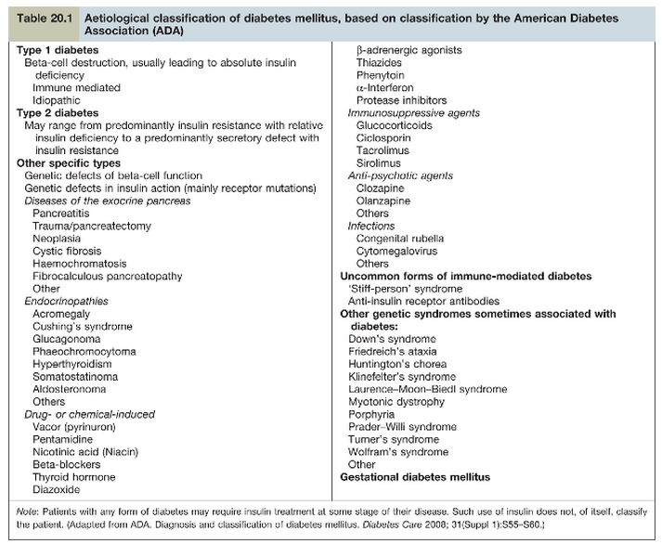

Slide 8
Comparison of DIABETES Type 1 and Type 2
 | Type 1 | Type 2
Age | Usually < 30 | Usually > 30
Weight | Lean | Overweight
Pathogenesis | Auto immune disease | No Immune disturbance
Ketonuria | Yes | No
Heredity | HLA-DR3 or DR4 in more than 90% | No HLA links
Clinical | Insulin deficiency Always need insulin ± Ketoacidosis | Partial insulin deficiency Need insulin when beta cell fail ± Hyperosmolar state
Biochemical | C-peptide disappears | C-peptide persists

Slide 9
TYPE 1 DM
Aetiology
Immune mediated – anti bodies against beta cell of pancreas
Disease starts in childhood, reaching peak at the time of puberty, but can present at any age
Type 1 DM is associated with auto immune thyroid disease, Coeliac disease, Addison’s disease and pernicious anemia

Slide 10
TYPE 2 DM
Four major determinants are
1. Increasing age
2. Obesity – increase risk 80-100 fold
3. Ethnicity (common cultural tradition)
4. Family history
Type 2 DM is associated with central obesity, hypertension, hypertriglyceridaemia, decrease HDL, increased insulin resistance, increase CVS risk
This group is referred as metabolic syndrome

Slide 11
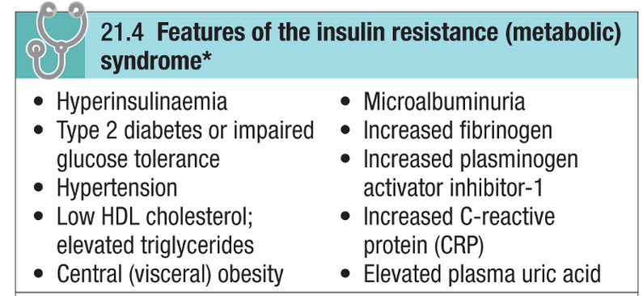

Slide 12
DIABETES TYPE 2
Metabolic syndrome, defined by international diabetes federation
Criteria
BMI > 30 + 2 of the following
- Fasting blood glucose > 6mmol/L
- Hypertension
- Raised triglycerides
- Low HDL cholesterol

Slide 13
DIABETES TYPE 2
Clinical Presentation
Presentation may be acute, sub acute or asymptomatic
Acute presentation
Usually young people, present with 2-6 week history of
- Polyurea – due to osmotic diuresis as blood glucose level is high
- Polyphagia
- Polydepsia - Thirst – due to loss of fluid and electrolyte
- Weight loss – due to breakdown of fat and muscle secondary to insulin deficiency

Slide 14
DIABETES TYPE 2
Sub acute presentation
Patient present with history of thirst, polyurea and weight loss
Patient may complain of loss of energy, visual blurring (due to glucose induced changes in refraction)
Following complication as presenting feature. These include:
- Staphylococcal skin infection
- Polyneuropathy causing tingling and numbness in feet
- Retinopathy noted by optician on visit

Slide 15
DIABETES TYPE 2
Asymptomatic presentation
Glycosuria or raised blood glucose may be detected on routine examination e.g. insurance purpose
If patient has insulin resistance, they may have Acanthosis nigricans (characterized by blackish pigmentation at the neck and in axillae)

Slide 16
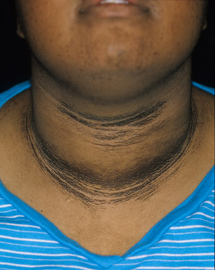
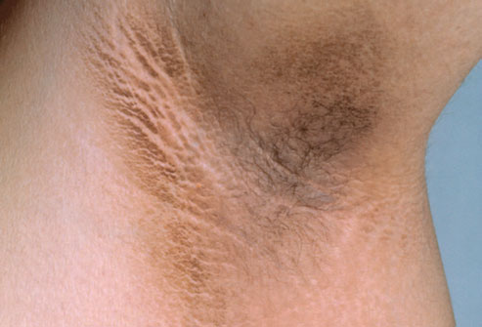
Axilla
Anterior neck
Acanthosis nigricans

Slide 17
DIABETES MELLITUS
WHO Diagnostic Criteria
Fasting plasma glucose > 7 mmol/L (126mg/dL)
Random plasma glucose > 11.1 mmol/L (200mg/dL)
(1mmol = 18 mg)
One abnormal lab value is diagnostic in symptomatic patient. Two abnormal values are needed in Asymptomatic patient
HbA_{1c} > 6.5 (48mmol/mol)
Glucose tolerance test (GTT) is only required for border line cases and for diagnosis of gestational diabetes

Slide 18
Glucose Tolerance Test
WHO criteria
Adult are given 75g glucose in 300ml water
After doing fasting blood glucose level
 | Normal | Impaired GTT | Diabetes Mellitus
Fasting | < 7 mmol/L | < 7 mmol/L | > 7 mmol/L
2 h after glucose | < 7.8 mmol/L | 7.8 – 11 mmol/L | > 11.1 mmol/L

Slide 19
HbA_{1c}
HbA_{1c} tells us blood glucose concentration over past several weeks ( 2-3 months )
HbA_{1c} more than 6.5 would be considered diagnostic of DM

Slide 20
Other investigations in DM
Urine for protein
CBC, blood urea and electrolytes
Liver biochemistry
Random lipids to exclude hyperlipidaemia
Note
– Hypertension is present in 50% of patients with type 2 DM
– Many patients with type 2 DM will require insulin eventually

Slide 21
Treatment of Diabetes
Aim is to educate patient, to understand the risk of DM and benefits of glycaemic control
Maintain normal weight
Stop smoking
Taking care of feet
DIET
Low in sugar (though not sugar free)
High in carbohydrate (but food taken with low glycaemic index)
Low in fat
High in fibre

Slide 22
Treatment of Diabetes
DIET
Total carbohydrate – 40-60% of total energy
Total fat – < 35% of energy intake
Protein – 10-15% (1g/kg body weight)
Vitamins and antioxidant – best taken as fruit and vegetable
Salt < 6g/day (lower in hypertension)
Exercise regularly

Slide 23
Treatment of Diabetes
Tablet Treatment of Type 2
1. Biguanide (metformin, glucophage )
It reduces the rate of Gluconeogenesis, therefore, hepatic glucose output is reduced
Increases insulin sensitivity
Decreases absorption of glucose in the intestine
Note
Metformin does not affect insulin secretion, does not induce hypoglycaemia when taken alone and does not predispose to weight gain
It can be given with insulin injection

Slide 24
Treatment of Diabetes
Tablet Treatment of Type 2 ( cont )
2. Sulfonylureas – tolbutamide
They act on beta cell to increase insulin secretion.
They can cause Hypoglycemia
They are avoided in pregnancy

Slide 25
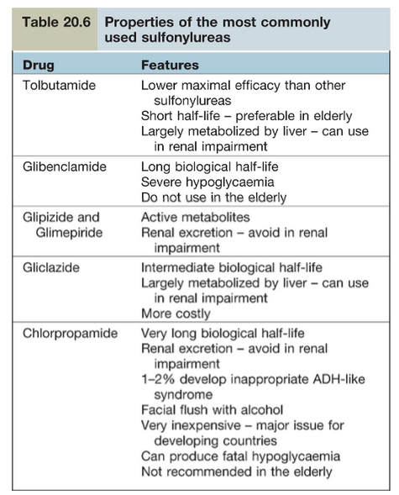
Sulfonylureas

Slide 26
Treatment of Diabetes(cont)
3. Meglitinids e.g. repaglinide
They increase insulin secretion
4. Thiazolidinediones also known as glitazones e.g. Piogliatazone
They reduce insulin resistance, they also reduce hepatic glucose production and increase glucose utilization at periphery
They potentiate the effect of injected insulin
New drugs
5. Dipeptidyl peptidase -4 (DPP 4) inhibitors, (Normally GIP and GLP-1 increase insulin from beta cell but GIP and GLP-1 are degraded by enzyme DPP4 )
- Therefore DPP4 inhibitors e.g. Sitagliptin are used to increase insulin

Slide 27
Treatment of Diabetes
Injection therapy for Type 2 DM
Insulin is formed in every vertebrate, but there are species differences
Insulin derived from beef or pig pancreas have been replaced in most countries by biosynthetic human insulin
They are produced by adding a DNA sequence coding

Slide 28
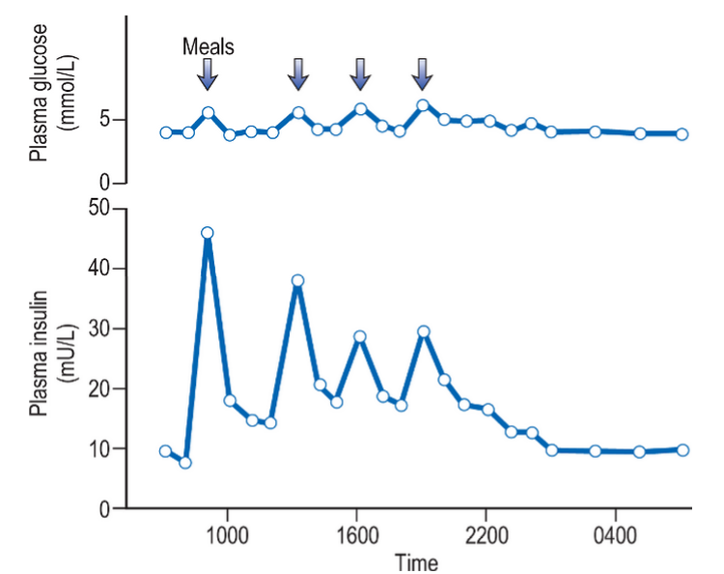
Glucose and Insulin profiles in normal subjects

Slide 29
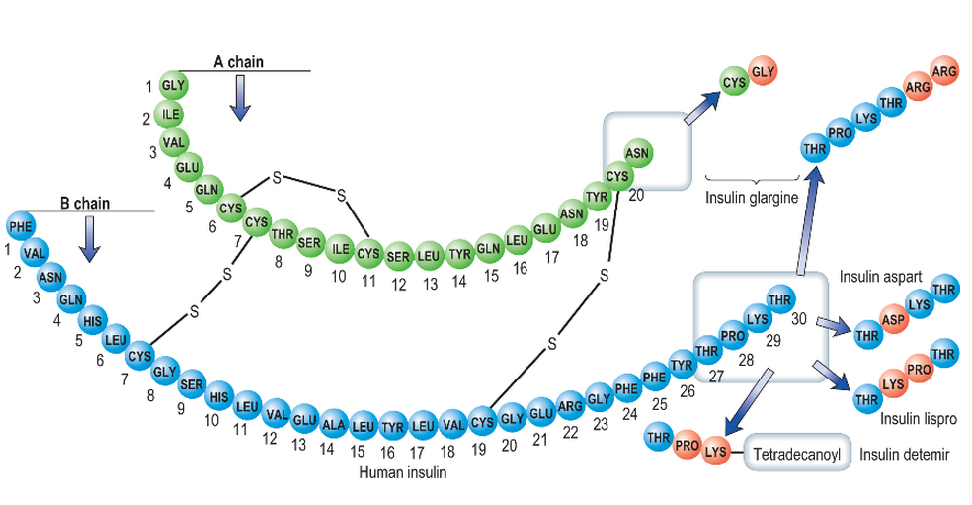
Amino Acid Structure of Human Insulin. Lispro, Glargine, Aspart insulin are genetically engineered by changing amino acid order.

Slide 30
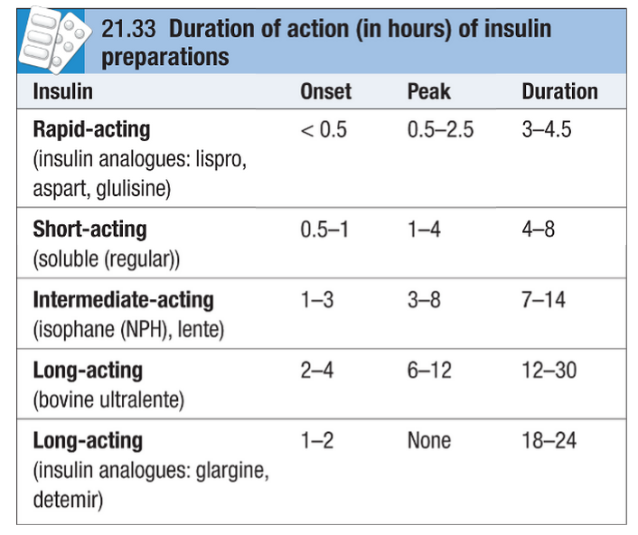
Different Types of Insulin

Slide 31
Practical Management of Diabetes
Type 2 DM
Oral therapy
Oral + Insulin
Type 1 DM
Insulin is required

Slide 32
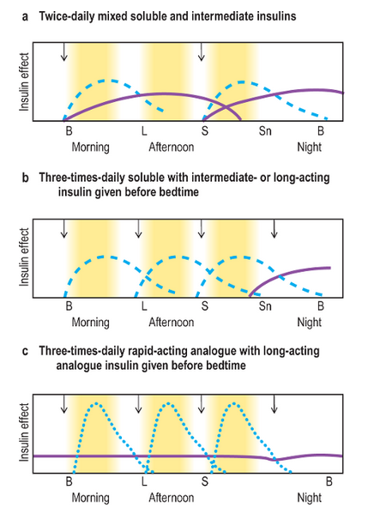
Insulin Regimens

Slide 33
Practical Management of Diabetes
Infusion Devices
CS II (Continuous Subcutaneous Insulin Infusion)
Insulin is delivered by a small pump strapped around the waist that infuses a constant insulin via a needle in the subcutaneous tissue
At meal time, doses are given as bolus of insulin at start of meal by the pump

Slide 34
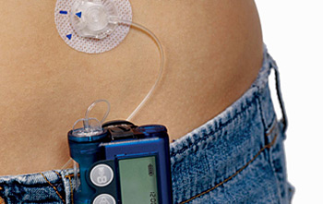
Continuous Subcutaneous Insulin Infusion in Long Term Care (CSII)

Slide 35
Complication of Insulin Therapy
Pain at time of delivery of injection
Fatty lumps – lipohypertrophy (usually occur due to single injection site)
Weight gain
Hypoglycemia (occurs when blood glucose falls below 3mmol/L) and most patient experience adrenergic response that is sweating, tremor and pounding heart beat
- Hypoglycemia can cause convulsions, coma
NOTE - Patient should always be advised to carry glucose or sweets to use when he feels hypoglycemic symptoms

Slide 36
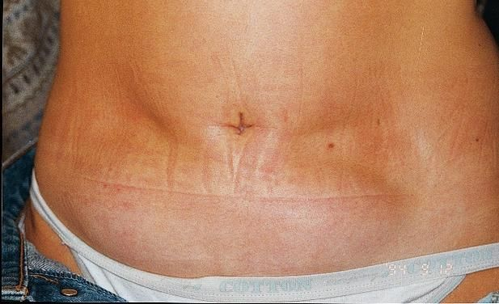
lipohypertrophy with insulin therapy

Slide 37
DM Treatment
Whole Pancreas and Pancreatic Islet Transplantation
Whole pancreas transplantation has been performed for 30 years
Immunosuppressive therapy is needed
Islet transplantation is done by harvesting pancreatic islets from 2-3 cadavers pancreas and then injected into the portal vein and they seed themselves in liver
Immunosuppressive therapy is needed

Slide 38
Measuring the metabolic control of Diabetes
Urine Test – Dipstic test
Home blood glucose testing – Prick at the side of the finger and not at the tip of the finger as it is densely innervated
HbA_{1c} – target for glucose control HbA_{1c} less than 7%

Slide 39
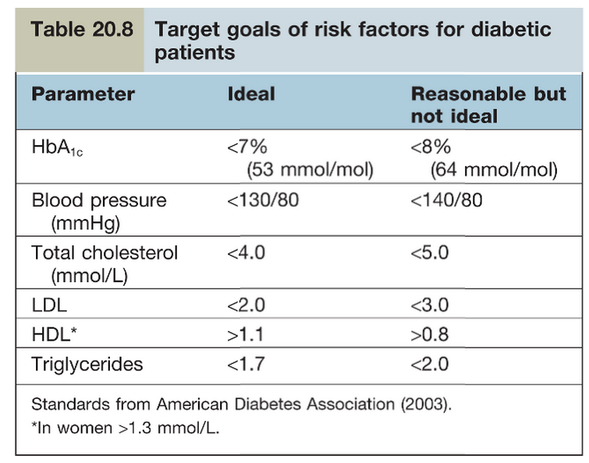

Slide 40
Diabetic Metabolic Emergencies
1. Diabetic Ketoacidosis (DKA)
2. Hyperosmolar Hyperglycaemic State

Slide 41
Diabetic Metabolic Emergencies
Diabetic Ketoacidosis (DKA)
DKA is seen in Type 1 DM and occurs in
- previously undiagnosed diabetes 10%
- interruption of insulin therapy 15%
- stress of intercurrent illness 30%
Pathogenesis of DKA
- decreased insulin
- increased blood glucose
- osmotic diuresis
- dehydration

Slide 42
Diabetic Metabolic Emergencies
Pathogenesis of DKA ( cont )
fat is utilized more, therefore, formation of
ketone bodies – metabolic acidosis
Vomiting – loss of fluid and electrolyte
Increased ketone excreted in urine
Increased ketone excreted in breath, produce smell of acetone
Metabolic acidosis causes stimulation of respiratory center therefore hyperventilation
pH < 7

Slide 43
Diabetic Ketoacidosis
Clinical Features of DKA
Diabetes Miletus and acidosis
Hyper ventilation – kussmaul respiration (deep and labored breathing associative with severe metabolic acidosis)
Nausea, vomiting, dehydration, abdominal pain
Confusion
5% present with coma
Smell of Ketone in breath.

Slide 44
Diabetic Ketoacidosis
Diagnosis
Increased blood glucose
Ketonaemia (ketone in blood) heavy ketone urea
Arterial blood gases – acidosis
Clinical
Pulse > 100 b.p.m or < 60 b.p.m
Systolic BP < 90 mmHg
Oxygen saturation < 92% on room air

Slide 45
Diabetic Ketoacidosis
Diagnosis (cont)
Blood Ketone > 6mmol/L
Bicarbonate < 12mmol/L
Arterial pH < 7.1
Hypokalemia – K < 3.5 mmol/L

Slide 46
Diabetic Ketoacidosis
Management
Replace fluid with 0.9% saline, average 5-7L is required in 24 hours
Replace electrolyte loses – K may be normal initially but insulin therapy leads to uptake of K by cells, therefore K level falls, therefore K is given as soon as insulin is started
Restore acid base balance – HCO₃ is seldom necessary, only used when pH is < 7

Slide 47
Diabetic Ketoacidosis
Management (cont)
Short acting insulin as IV intravenous infusion or hourly IM injection (avoid SC injection as blood flow is decreased in shock)
Monitor blood glucose
Look for underlying cause
Do X-ray chest, blood CBC, cultures
ECG
Serum amylase

Slide 48
Hyperosmolar Hyperglycaemic State

Slide 49
Hyperosmolar Hyperglycaemic State
There is severe hyperglycaemia without significant ketosis
Occurs in type 2 uncontrolled diabetic patient
Precipitating factors
- Consumption of glucose rich fluids
- Thiazide diuretics
- Steroids
- Intercurrent illness

Slide 50
Hyperosmolar Hyperglycaemic State
Electrolyte changes in Diabetic Ketoacidosis and Hyperosmolar hyperglycemic state
Example of Blood Values
 | Severe Ketoacidosis | Hyperosmolar Hyperglycemia State
Na⁺ (mmol/L) | 140 | 155
K⁺ (mmol/L) | 5 | 5
Cl⁻ (mmol/L) | 100 | 110
HCO₃ (mmol/L) | 5 | 25
Urea (mmol/L) | 8 | 15
Glucose (mmol/L) | 30 | 50
Arterial pH | 7.0 | 7.35

Slide 51
Hyperosmolar Hyperglycaemic State
Normal range of osmolality 285-300mOsm/kg
It can be calculated 2(Na + K) + glucose + urea
Normal 2 (140 + 5) + 5 + 5 = 300 mOsm/kg
Let us calculate Osmolality from values given in our previous slide:
In DKA 2 (140 + 5) + 30 + 8 = 328 mOsm/kg
Hyperosmolar Hyperglycemia state
2 (155 + 5) + 50 + 15 = 385 mOsm/kg

Slide 52
Normal ANION GAP
Normal ANION GAP is < 17
Formula for calculation:
(Na⁺ + K⁺) – (Cl⁻ + HCO₃⁻)
(136 + 4) - (100 + 24) = 16
Note. High anion gap occurs in Lactic acidosis

Slide 53
Hyperosmolar Hyperglycaemic State
Why there is no Ketoacidosis in Hyperosmolar
Hyperglycemia?
Because endogenous insulin level are sufficient to inhibit hepatic ketogenesis, but insufficient to inhibit hepatic glucose production
Clinical Features
Dehydration
Stupor or coma
Impairment of consciousness is directly related to degree of hyperosmolality
Hyperosmolar state may predispose to stroke, MI

Slide 54
Hyperosmolar Hyperglycaemic State
Investigation and Treatment
Plasma osmolality – directly or using formula
Insulin 3unit/hour for first 2-3 hours
0.9% saline (0.45% saline can cause rapid dilution of blood and cerebral damage, therefore, should be avoided)
Low molecular weight heparin to avoid risk of thromboembolic complications
Prognosis -mortality ranges 20-30%

Slide 55
Complication of DM
Major cause of death
– CVS problems 60-70%
– Renal failure 10%
– Infection 6%
Macrovascular complication
– Atherosclerosis
– MI
– Stroke
– Amputation of foot for gangrene
Microvascular complication
– Retinopathy
– Nephropathy
– Neuropathy ( symmetrical sensory polyneuropathy, Autonomic )

Slide 56
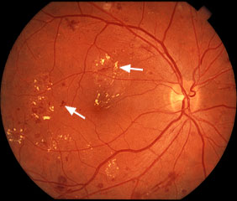
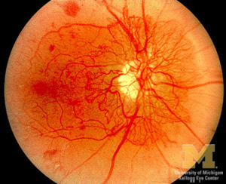
Diabetic Retinopathy
Background or non proliferative retinopathy showing micro aneurysm, dot and blot hemorrhage, hard exudate
Proliferative retinopathy showing new vessel formation

Slide 57
Case History – Patient with confusion and vomiting
A 50 year old woman is transferred with a 7 day history of increasing confusion and vomiting. She is severely dehydrated. Urgent investigation show a blood glucose of 50mmol/L, urine Dipstick 1+ ketone, arterial blood gas (ABG) Bicarbonate 20mmol/L and pH 7.35.

Slide 58
Questions:
What is likely diagnosis?
a. Diabetic Ketoacidosis (DKA)
b. Hyperosmolar non-ketotic confusion (HONK) in a patient with type II DM
c. Lactic acidosis
d. Urinary tract infection (UTI)
Serum osmolality can be calculated according to which equation?
a. 2 (creatinine + urea) + glucose + sodium
b. 2 (glucose + sodium) + urea
c. 2 (sodium + potassium) + glucose + urea
d. 2 (urea + glucose)
Which of the following statement is true?
a. She will need life long insulin in view of very high glucose level
b. DKA is uncommon in type I diabetes
c. Undiagnosed diabetes mellitus is commonest cause of DKA
d. Most cases of HONK (Hyperosmolar non-ketotic confusion) are associated
with undiagnosed type II diabetes

Slide 59
Answers:
Answer to Question 1:
b. Hyperosmolar non-ketotic confusion (HONK) in a patient with type II DM
Answer to Question 2:
c. 2 (sodium + potassium) + glucose + urea
Answer to Question 3:
d. Most cases of HONK (Hyperosmolar non-ketotic
confusion) are associated with undiagnosed type II
diabetes

Slide 60
Thank you

