Slide 1
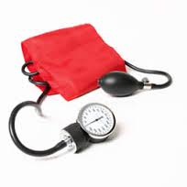
Hypertension and renovascular hypertension
BY
Dr. Hayam Hebah
Associate professor of Internal Medicine
AL Maarefa College

Slide 2
In 2000, ¼ of the world‘s population was estimated to have hypertension.
It is a risk factor for cardiovascular disease including myocardial infarction and stroke.

Slide 3
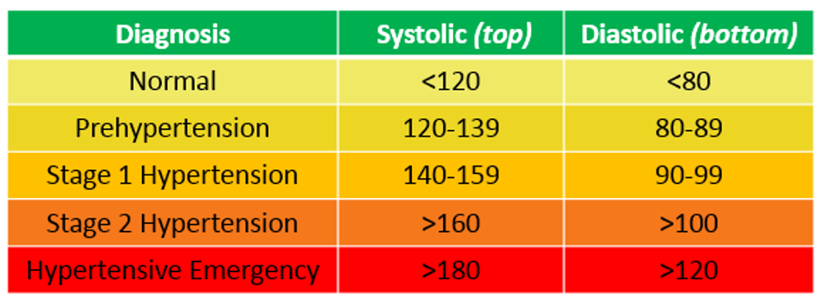
Definition and stages of hypertension:

Slide 4
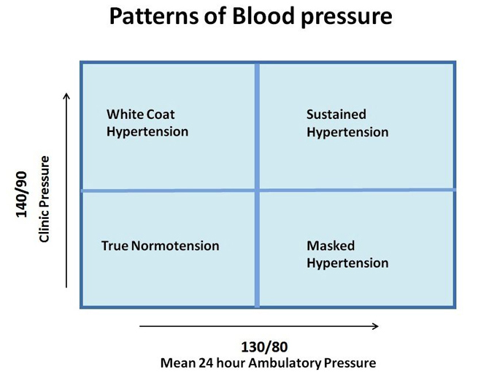

Slide 5
Types of Hypertension
Primary HTN:
also known as essential HTN.
accounts for 95% cases of HTN.
no universally established cause known.
Secondary HTN:
less common cause of HTN ( 5%).
secondary to other potentially rectifiable causes.

Slide 6
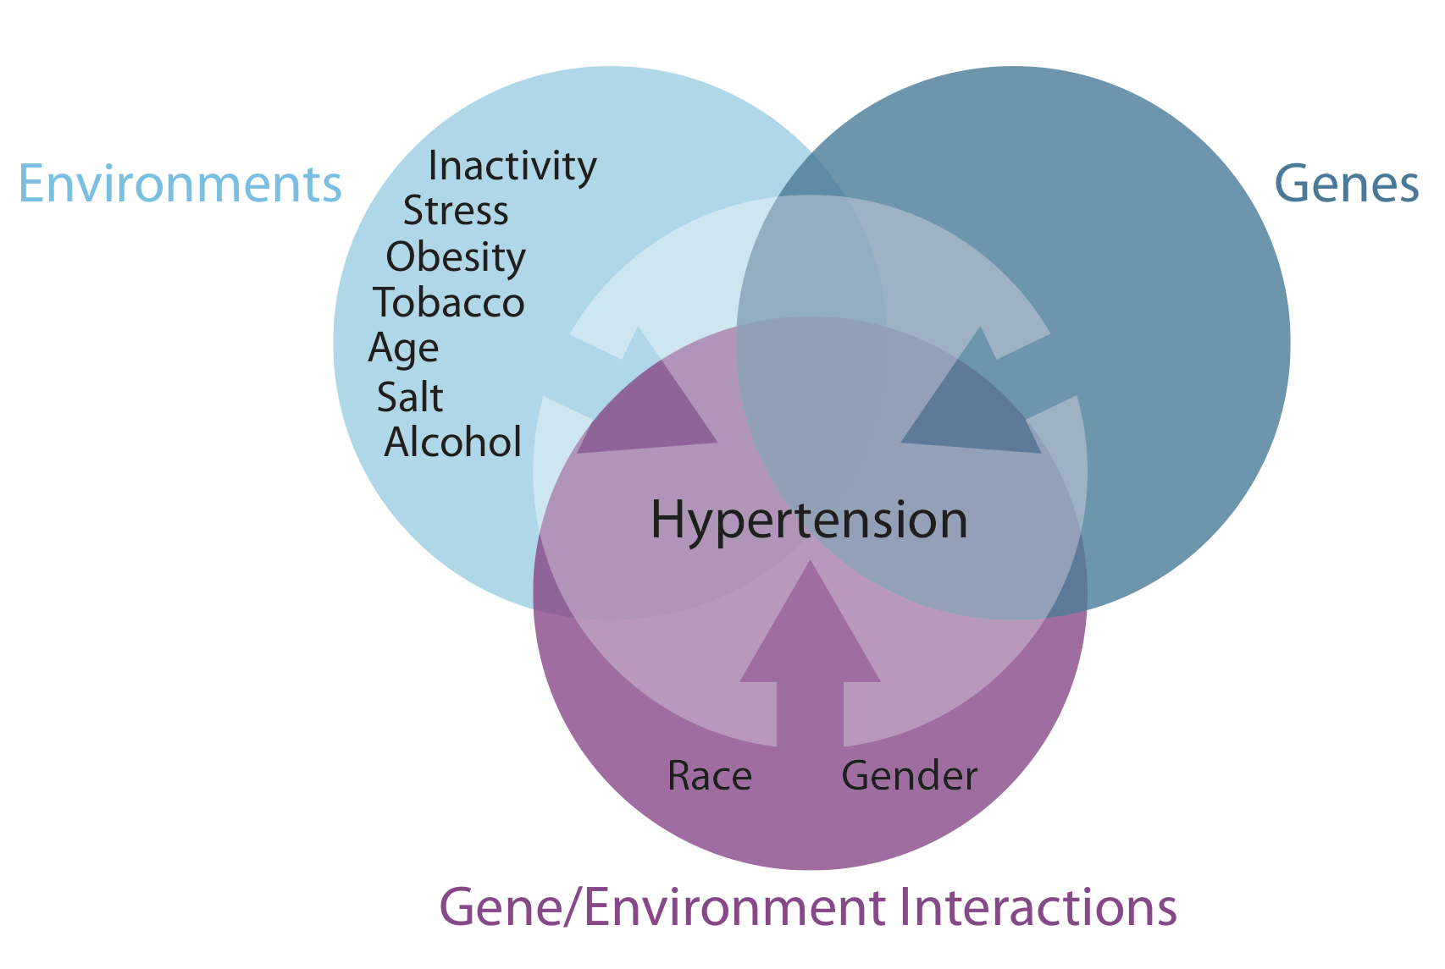
Primary hypertension

Slide 7
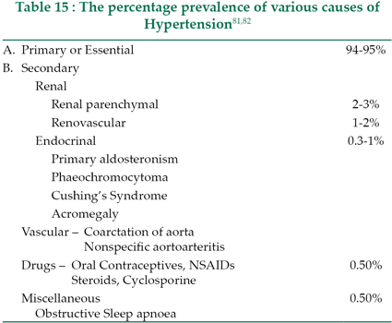

Slide 8
Drugs causing hypertension:
EXCESS SALT INTAKE.
NSAIDS
CORTICOSTEROIDS
OCP: estrogen and progesterone.
SYMPATHOMIMETICS as amphetamine, ephedrine and pseudoephedrine.
IMMUNOSUPPRESSANTS as cyclosporine and tacrolimus.
DIETERY SUPPLEMENTS including liquorice.

Slide 9
Secondary HTN-Clues in Medical History
Onset: at age < 30 yrs ( Fibromuscular dysplasia) or > 55 (athelosclerotic renal artery stenosis), sudden onset (thrombus or cholesterol embolism).
Severity: Grade II, unresponsive to treatment.
Episodic, headache and chest pain/palpitation (pheochromocytoma, thyroid dysfunction).
Morbid obesity with history of snoring and daytime sleepiness (sleep disorders)

Slide 10
Secondary HTN-Clues on Routine Labs
Increased creatinine, abnormal urinalysis ( renovascular and renal parenchymal disease)
Unexplained hypokalemia (hyperaldosteronism)
Impaired blood glucose ( hypercortisolism)
Impaired TFT (Hypo-/hyper- thyroidism)

Slide 11
Secondary HTN-Screening Tests
www.nhlbi.nih.gov

Slide 12
Isolated Systolic Hypertension
Not distinguished as a separate entity as far as management is concerned.
SBP should be primarily considered during treatment and not just diastolic BP.
Systolic BP is more important cardiovascular risk factor after age 50.
Diastolic BP is more important before age 50.

Slide 13
Hypertensive Crises
1-Hypertensive Urgencies
Accelerated hypertension
Severe elevated BP in the upper range of stage II hypertension.
Without progressive end-organ dysfunction.
Examples: Highly elevated BP without severe headache, shortness of breath or chest pain.
Usually due to under-controlled HTN.
Can be managed by oral medications.

Slide 14
2-Hypertensive Emergencies (Malignant Hypertension)
Severely elevated BP (>180/120mmHg).
With progressive target organ dysfunction.
Require emergency lowering of BP. By iv drugs as esmolol, labetalol, nicardipine , nitroglycerin , nitroprusside
Examples: Severely elevated BP with:
Hypertensive encephalopathy
Acute left ventricular failure with pulmonary edema
Acute MI or unstable angina pectoris
Dissecting aortic aneurysm

Slide 15
Resistant hypertension
Definition:
It is blood pressure remaining higher than 140/90 mmHg despite optimal or best tolerated doses of 3 drugs.
Confirmed by ABPM
Consider add fourth antihypertensive

Slide 16
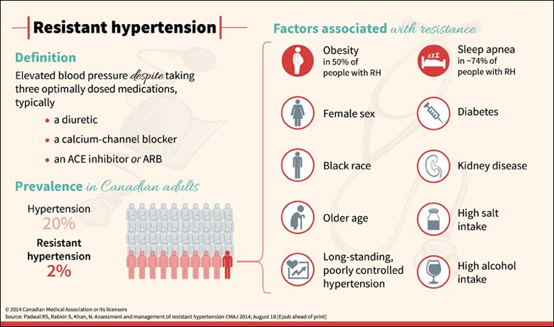

Slide 17
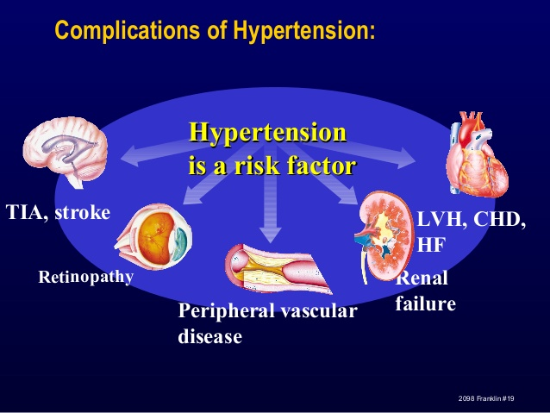

Slide 18
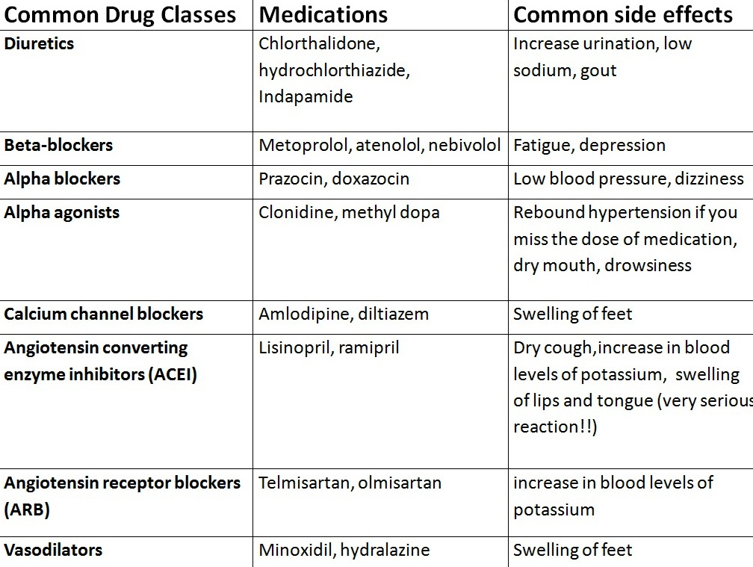

Slide 20
Special groups consideration
Diabetics
Ischemic heart disease
Renal patients
Patients with bronchial asthma

Slide 21
RENAL ARTERY STENOSIS

Slide 22
CAUSES OF RAS
ATHEROSCLEROSIS
(85%)
FIBROMUSCULAR DYSPLASIA(15%)
LARGE VESSEL -
VASCULITIS
TAKAYASAU & PAN
-THROMBOEMBOLISM
-ANEURYSM OF THE RENAL ARTERY

Slide 23
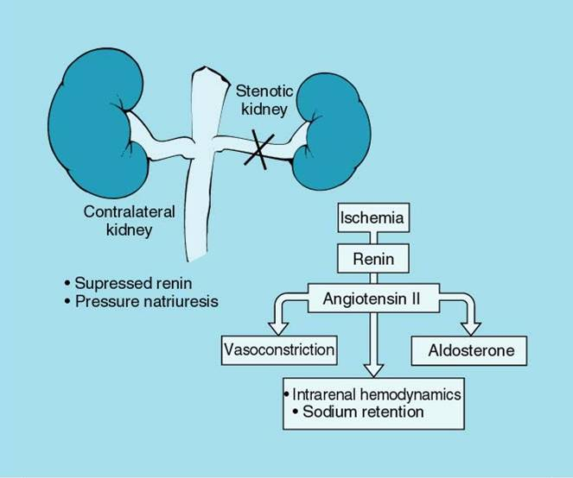
Pathophysiology:
Mark A. Pohl

Slide 24

Clinical Clues
Onset of diastolic hypertension after age 55
Refractory or malignant hypertension
Development of resistant hypertension in a previously well-controlled patient
Progressive increase in Creatinine, even if still “normal”
Presence of atherosclerotic macrovascular disease elsewhere heightens suspicion
Left heart failure out-of-proportion to LV dysfunction or ischemic burden
Clinically silent RAS
Risk Factors: Family History Of Vascular Disease ,smoking, diabetes, hypertension, dyslipidemia, elderly.

Slide 25
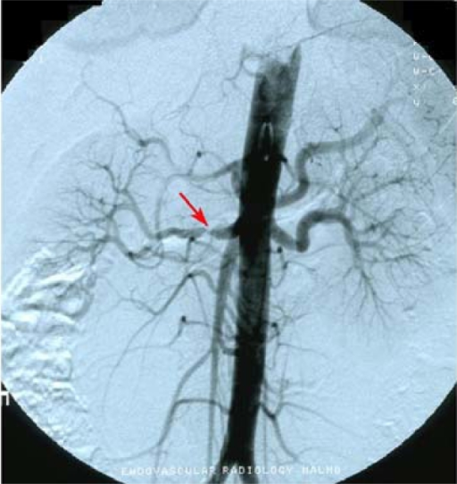
Atherosclerotic RAS:
Commonest cause of RAS(75-85%).
Age >55 years, more in males
Characterised by ostial
stenosis that is associated
with atherosclerosis of aorta
and major branches as iliacs.
*picture is complicated by small
vessel disease in kidnies.
*Ischemic nephropathy and renal failure may occur
*death may occur from coronary,
Cerebral or other vascular disease
rather than from renal failure.

Slide 26
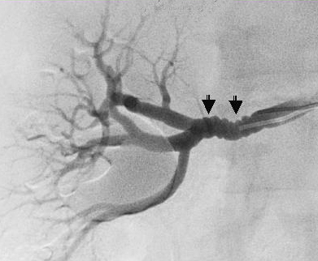
Fibromuscular dysplasia:
More in females, age 15-30 years
Uncommon cause of RAS(15-25% of cases).
unknown etiology.
There is hypertrophy of the
media(medial fibroplasia)
May be associated with dis-
ease in other arteries as
carotid artery dissections.
.irregular narrowing(beading )
in distal renal artery and extends
to intrarenal branches

Slide 27
c/p of RAS:
Hypertension
Renal failure( with bilateral disease)
Deterioration of KFT after using ACEI or ARBs
Acute pulmonary edema( characteristic of bilateral renovascular disease) FLASH PULMONARY EDEMA
Peripheral arterial disease. In legs in old patients with atherosclerotic RAS

Slide 28
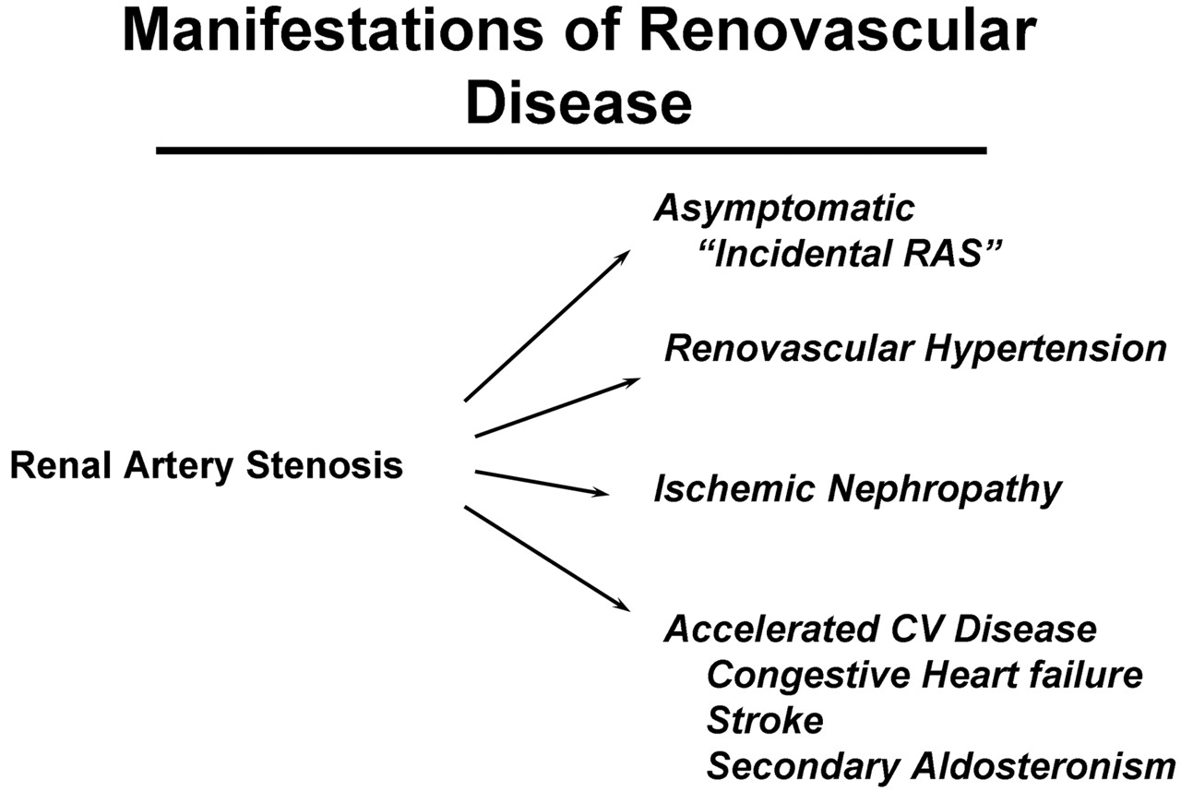

Slide 29
Screening for Renovascular Disease
Clinical syndrome most important in patient selection
When there is a suspicion of a Renal Artery Stenosis, investigative tests may be ordered for confirmatory diagnosis, which may include:
Urine Examination-
Hematuria
Proteinuria
Blood Examination-
Hyperkalemia (high serum potassium)

Slide 30
Approach:
Various diagnostic modalities:
Non invasive sonography:
Invasive techniques
  Serologic markers (PRA)
  Duplex ultrasound - in experienced hands can predict with great accuracy the presence or absence of significant RAS
  Captopril renal scan - 10-25% false negative
  MR angiography - rare false negatives / common false positives. Equipment/experience dependent
  Contrast angiography

Slide 31
Assessment of Renin Release
The baseline plasma renin activity (PRA) is elevated in 50-80% of patients with RVHT.
Measuring the rise in the PRA 1 hour after administering 25-50 mg of captopril can increase the predictive value of the test. Patients with RAS have an exaggerated increase in PRA( captopril renin test)
Although elevation of peripheral or renal vein PRA has been used to diagnose unilateral renal disease and predict surgical curability, an elevated plasma renin level does not establish the cause of hypertension, and levels that are within the reference range do not rule out renovascular disease.

Slide 32
Renal vein renin ratio
Renal vein renin measurements compare renin release from the 2 kidneys and are used to predict the potential success of surgical revascularization.

Slide 33
Angiography
The standard diagnostic study of RAS is renal arteriography. It is necessary whenever surgery or percutaneous transluminal angioplasty is anticipated.
MRA, CT angiography, and spiral angiography are newer studies that hold considerable promise for diagnosis and evaluation of RVHT

Slide 34
Complication of angiography
Bleeding at puncture site.
Thrombus formation.
Embolus formation ( plaque dislodged).
Dissection of vessel.
Puncture site infection(contamination)
Renal impairment due to ATN.
Contrast reaction: CIN is defined as increase of s.creatinine >0.5 mg/dl or >25% of base line s.cr within 48 hours of receiving the contrast.

Slide 35
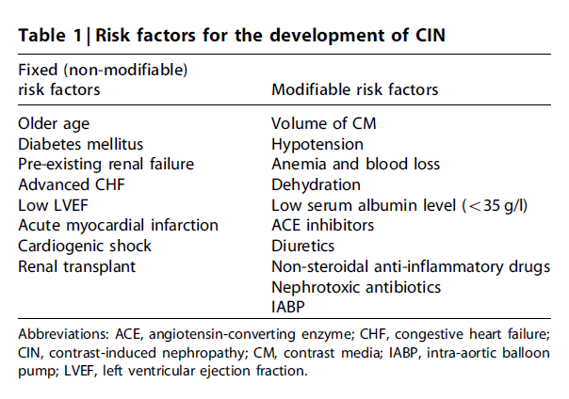

Slide 36
Treatment and management
Optimal blood pressure control plays an essential role in the therapeutic management of renovascular hypertension (RVHT);
Definitive therapy for the underlying cause by renal artery dilation and surgical revascularization yield excellent results & are generally considered the treatments of choice . to avoid the development of ischemic nephropathy
Pharmacologic Therapy :most effective therapy is with an (ACE) inhibitor

Slide 37
Percutaneous Transluminal Angioplasty(PTA)
cheaper
less invasive than surgical revascularization
can be performed at the time of angiography.
PTRA is most effective against midvessel stenosis.
Lesions involving segmental arteries or the ostia of renal arteries and lesions in patients with neurofibromatosis are especially refractory to balloon angioplasty
Primary renal artery stenting in patients with atherosclerotic RAS has a high rate of technical success and a low rate of complications

Slide 38
Surgical Revascularization
more than 90% of patients are cured or experience improvement of their hypertension with surgical revascularization
In patients with FMD, cure rate is high 80%, and morbidity is low
In patients with diffuse atherosclerosis, complication rate is high with surgical revascularization, and PTA thus medical therapy may be preferable

Slide 39
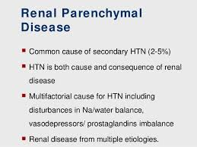

Slide 40
Thank you

