Slide 1

URINARY TRACT INFECTIONS
BY
Dr. Hayam Hebah
Associate professor of Internal Medicine
AL Maarefa College

Slide 2
objectives
Normal defense mechanisms.
Spectrum of presentation
Risk factors
Clinical picture
Investigations
Management
Renal tuberculosis

Slide 3
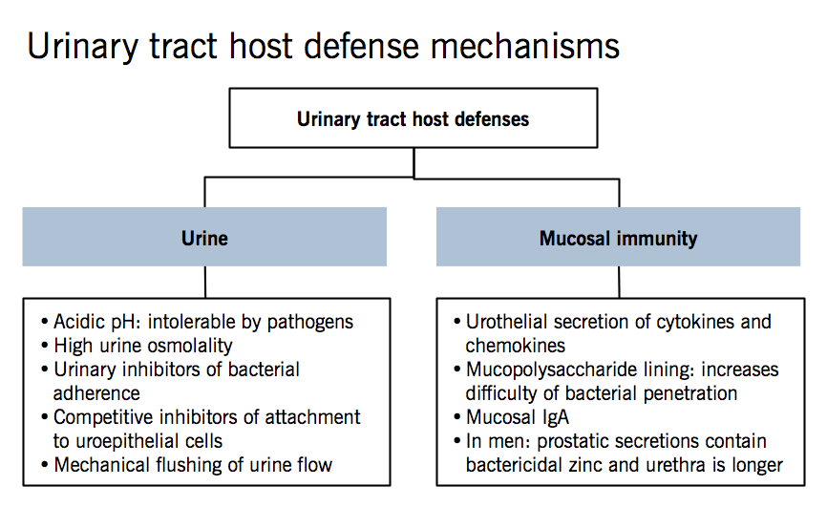

Slide 4
background
common in females : 3% at 20 y age
( ascent of organisms is easier, urethra is shorter and absent bactericidal prostatic secretion)
In males : in first year and > 60
Commonest organism is E. coli from the gastrointestinal tract(75%), but proteus, pseudomonas, streptococci and staphylococci may also be causative organisms.
Pyelonephritis can be an indication for hospitalisation and associated with systemic symptoms

Slide 5
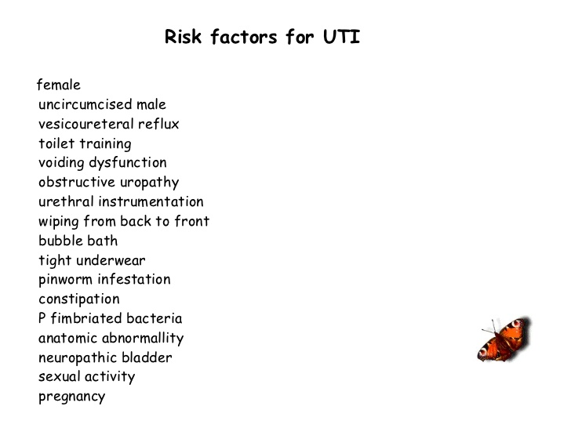

Slide 6
Spectrum of UTI presentations:
Asymptomatic bacteriuria
Symptomatic acute cystitis and urethritis
Acute pyelonephritis
Acute prostatitis
Septicemia( Gram –ve bacteria)

Slide 7
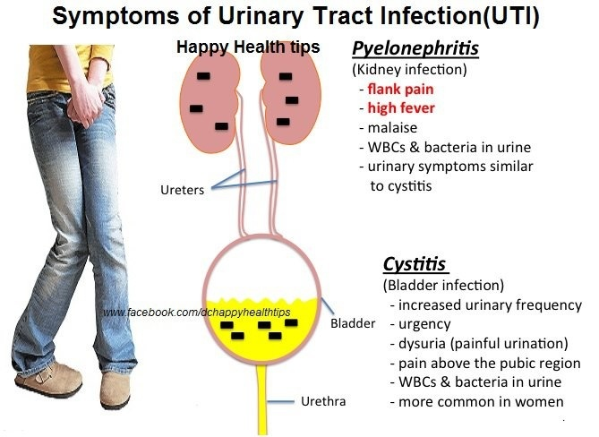

Slide 8
DD of LUTI:
STD( chlamydia or Reiter‘s syndrome.
Urethral syndrome ( s&s of urethritis and cystitis but no bacteria cultured )
chlamydia and certain anaerobes need special culture)
Intewrmittent or low count bacteriuria
Reaction to toiletries or disinfectants
Symptoms related to intercourse
Post menopausal atrophic vaginitis

Slide 9
DD of acute pyelonephritis
Pyelonephrosis( dt Upper UT obstruction)
Perinephric abscess
Acute appendicitis
Diverticulitis
Cholecystitis
Salpingitis
Ruptured ovarian cyst or ectopic pregnancy

Slide 10
Investigations:
All patients:
Urine analysis, nitrite, leucocyte esterase, microscopy for WBCS, organisms
Urine C&S
Infants ,children, anyone with fever:
CBC, urea, electrolytes, creat, blood C&S
Males , children, females with recurrent infections, pyelonephritis:
u/s or CT, PV for females, PR for males
Cystoscopy for hematuria or suspected bladder lesion.

Slide 11
Asymptomatic bacteriuria:
Only treated in infants, pregnant women and those with UT abnormalities.
Catheter related bacteriuria:
Ttt is avoided in asymptomatic patients and remove the catheter as soon as it is not needed.
Persistent or recurrent UTI:
If the causative organism persists on repeat culture despite ttt or if there is re-infection with any organism after an interval, then an underlying cause is present.
In females if infections are ≥3 times/year , investigate.

Slide 12
Acute pyelonephritis:
Triad of: loin pain, fever and renal tenderness.
Almost always ascending infection .
Rarely bacteremia may give rise to renal or perinephric abscesses ( mostly staphylococci).
PF: cysts or renal scarring.
Rarely associated with renal papillary necrosis.
Can lead to AKI .

Slide 13
MANAGEMENT OF UTI
Cystitis:
First choice: trimethoprim 200 mg bid.
Second choice: amoxicillin 250 mg tid
nitrofurantoin 50 mg qid.
cefalexin 250 mg qid
ciprofloxacin 100 mg bid
In pregnancy: co amoxiclav 250/125 mq tid
cefalexin 250 mg qid
amoxicillin 250 mg tid
3 d
(7-10 in males).
7d.

Slide 14
Prophylactic therapy ( continuous)
First choice: trimethoprim 100 mg at night
Second choice: nitrofurantoin 50 mg at night
co –amoxiclav 250/125 mg at night
Pyelonephritis:
First choice: co- amoxiclav 500/125 tid 14 d
ciprofloxacin 500 mg bid 7 d
Second choice: gentamicin for 14 d
( dose adjusted according to s. creat and drug serum level)
cefuroxime 150-1500 mg tid for 14 d
(hospital admission if no response within 24 hours)

Slide 15


Slide 16
Renal tuberculosis
Hematogenous route
Secondary infection
Starts in cortex
Sterile pyuria
Cystoscopy for bladder involvement.
CXR and imaging of UT are mandatory .
TTT by antituberculous chemotherapy
Surgery in cases of UT obstruction .

Slide 17
Causes of sterial pyuria:
Contamination of poorly collected urine specimens
Analgesic nephropathy
Staghorn calculi
Polycystic kidney
Bladder tumors
Tuberculosis
Appendicitis

Slide 18
Thank you .

