Slide 1
DIALYSIS
Dr. Hayam Hebah
Associate professor of Internal Medicine
AL Maarefa College

Slide 2
OBJECTIVES
Describe the scientific principles underlying dialysis treatment, and compare hemodialysis with peritoneal dialysis.
Describe the goals for hemodialysis procedure and be aware of the complications of hemodialysis.
Recognize the value of the vascular access areas for hemodialysis.
Describe the advantages and disadvantages of hemodialysis.
Describe acute complications that occur during dialysis.

Slide 3
Stages of CKD:
GFR (ml/min/1.73 m²) | description | stage
≥ 90 | Kidney Damage with Normal or ↑ GFR | 1
60-89 | Kidney Damage with Mild ↓ GFR | 2
30-59 | Moderate ↓ GFR | 3
15-29 | Severe ↓ GFR | 4
< 15 or Dialysis | Kidney Failure | 5

Slide 4
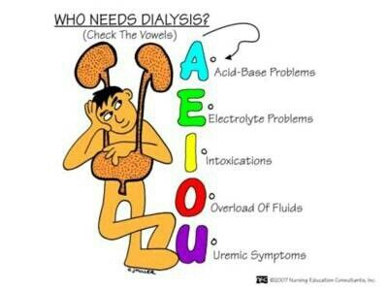

Slide 5
Indications of dialysis(when to initiate):
Failing nutritional status.
uremic syndrome:
Symptoms: nausea-vomiting-loss of appetite-fatigue-weakness-altered mental status-confusion-coma.
Signs: pericardial friction rub or pericardial effusion with or without tamponade ( uremic pericarditis).
3-Foot or wrist drop( uremic motor neuropathy)
4-Uremic encephalopathy( tremor-myoclonus-seizures)
5-Prolongation of bleeding time.

Slide 6
6-When eGFR <8ml/min but evaluation should start early at eGFR 10-12 ml/min especially in diabetic patients or with heart failure
7-Volume overload and /or hypertension.
8-Anemia refractory to erythropoietin and iron ttt.

Slide 7
Urgent indications:
Pulmonary edema
Hyperkalemia >7 mEq/L refractory to pharmacologic ttt.
Metabolic acidosis refractory to bicarbonate ttt.
Neurologic dysfunction: neuropathy, encephalopathy, seizures, psychiatric disturbance.
Pleuritis or pericarditis.
Bleeding diathesis with prolonged BT.

Slide 8
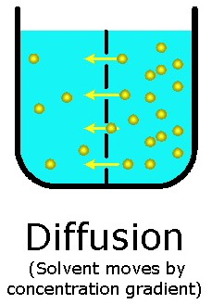
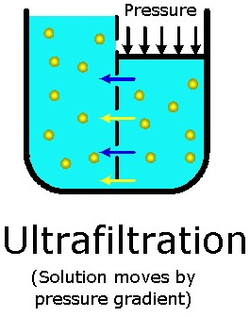
Physiologic principles of dialysis:

Slide 9
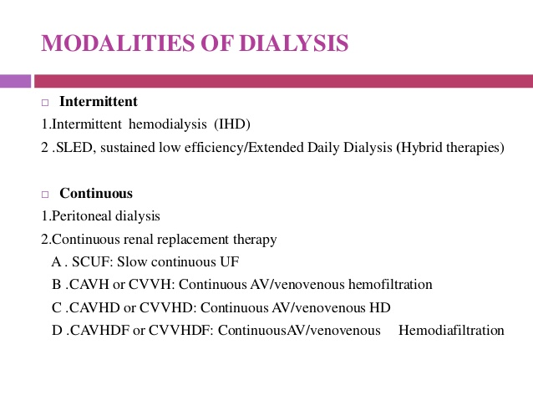

Slide 10
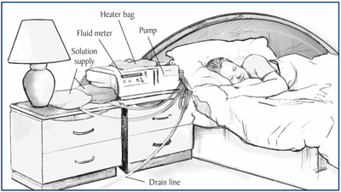
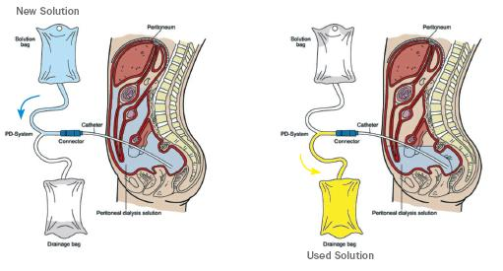
Forms of peritoneal dialysis
Manual
automated

Slide 11
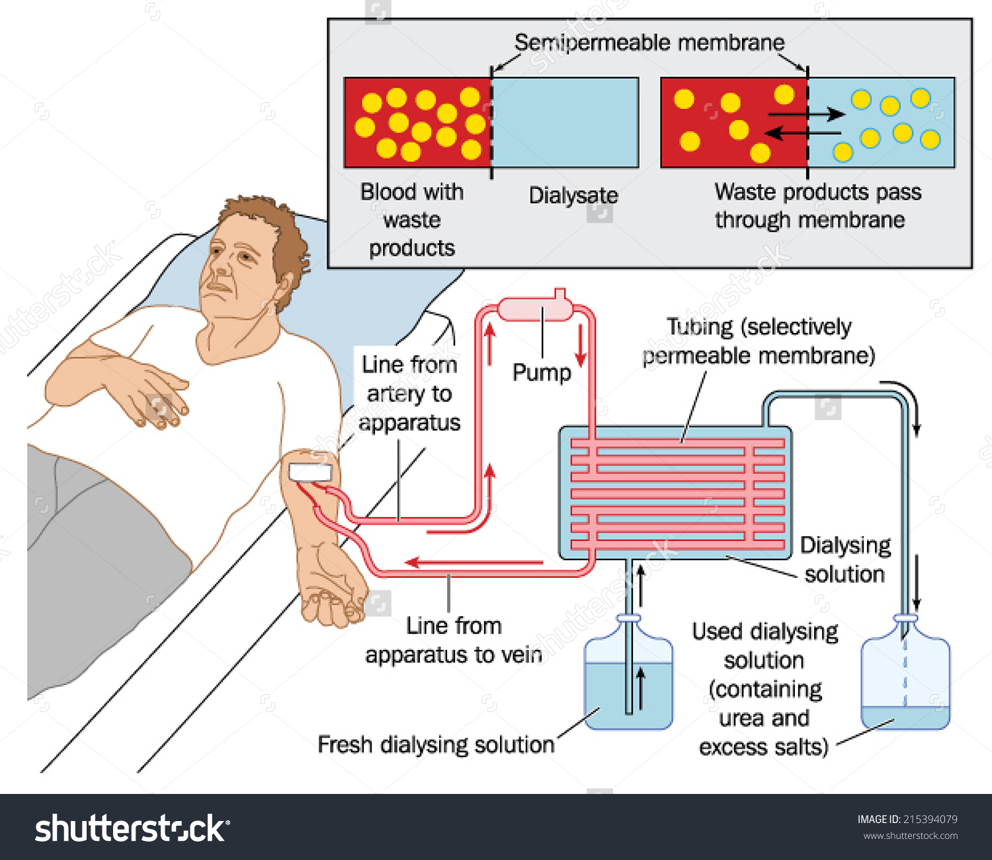
Hemodialysis:

Slide 12
Modalities of dialysis in ESRD:
HEMODIALYSIS
PERITONEAL DIALYSIS
Advantages:
Short ttt
3-6 TIMES/WEEK
Day or night
Efficient removal
Better control and quality of life
Reduce LVH.
disadvantages
Needs specialised team and equipement
Needs heparinisation
Needs vascular access and tendency to cardiac instability.
Advantages:
most exchanges done at night.
SIMPLE.
Manual or automated
No heparinisation
Disadvantages:
Long ttt.
needs delivery of large volumes.
exposure to high amounts of glucose.
Risk of peritonitis and breathing problems.

Slide 13
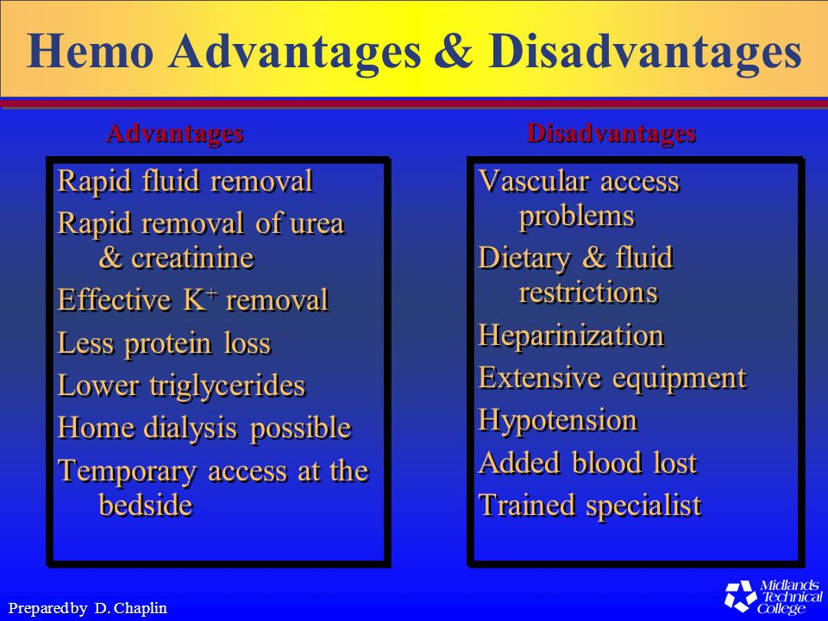

Slide 14
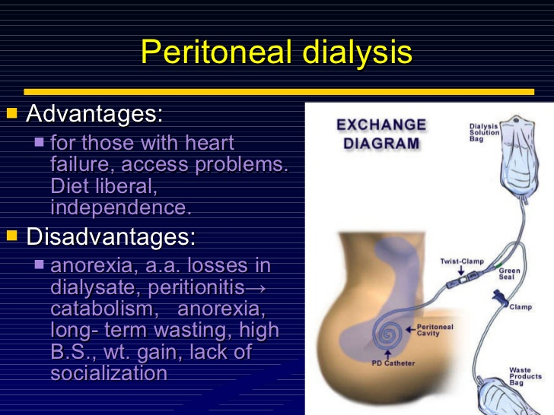

Slide 15
Patients in whom peritoneal dialysis is advised:
Infants or very young children
Patients with severe cardiovascular disease.
Patients with difficult vascular access( DM)
Patients who desire freedom to travel.
Patients with no available partener to assist in hemodialysis.
*Contraindications: peritoneal adhesions, fibrosis, malignancy , inadequate ultrafiltration ,frequent episodes of peritonitis

Slide 16
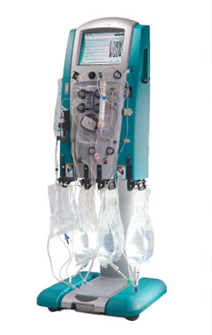
Dialysis:
In ARF
IN CRF
Intermittent hemodialysis
CRRT(continuous renal replacement therapies):
-CVVHD
-CVVHF
- CVVHDF
-SCUF
Peritoneal dialysis
HEMODIALYSIS.
In centre hemodialysis
Home hemodialysis
PERITONEAL DIALYSIS.
Manual
Automated CAPD

Slide 17
Dialysis requirements:
Blood circuit: inflow blood line( prepump segment)- roller pump segment- inflow arterial blood line( postpump segment)-outflow venous blood line
Dialysis fluid circuit: water purification system-
The dialyzer:
Dialysis water and dialysate
AV fistulas and grafts
Venous catheters.

Slide 18
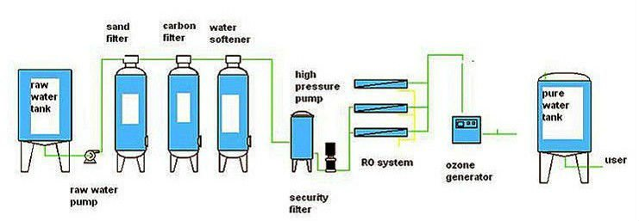
WATER TREATMENT UNITS FOR HEMODIALYSIS

Slide 19
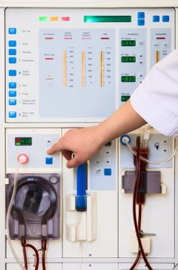
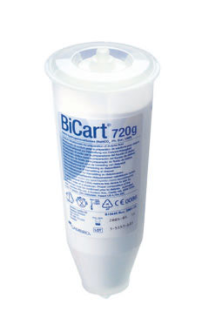
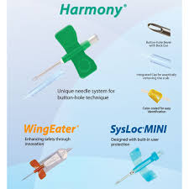
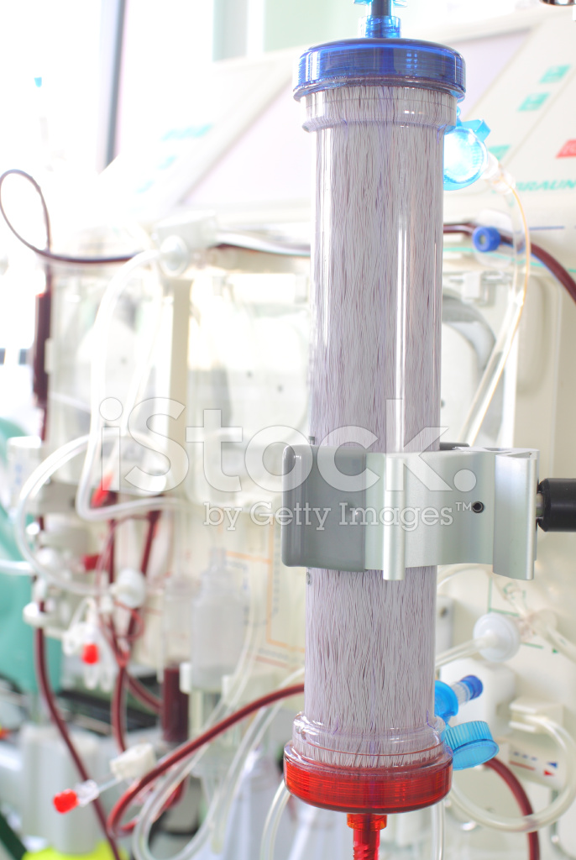
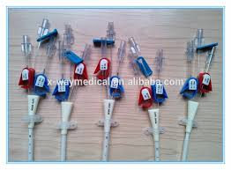
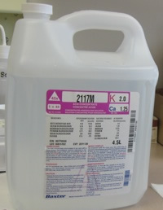
EQUIPEMENT OF HEMODIALYSIS:

Slide 20
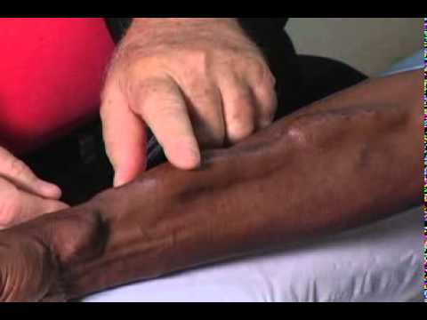
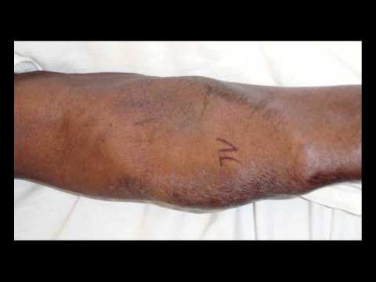
VASCULAR ACCESS
AV FISTULA
AV GRAFT

Slide 21
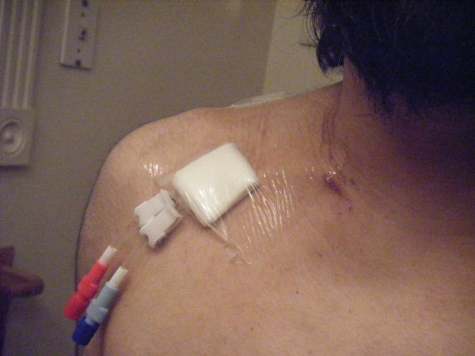
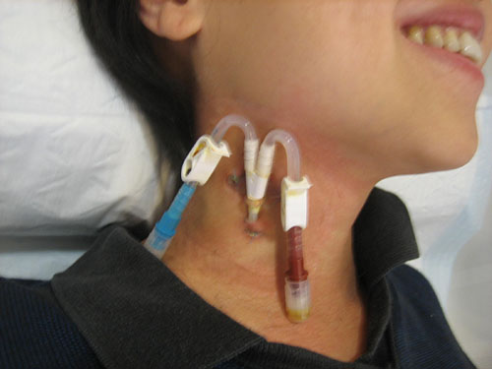
DIALYSIS CATHETERS
SUBCLAVIAN CATHETER
INTERNAL JUGULAR CATHETER

Slide 22
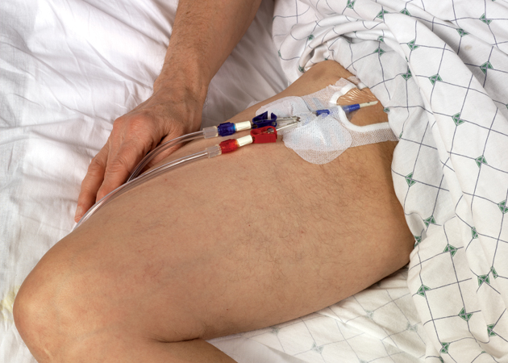
FEMORAL CATHETER

Slide 23
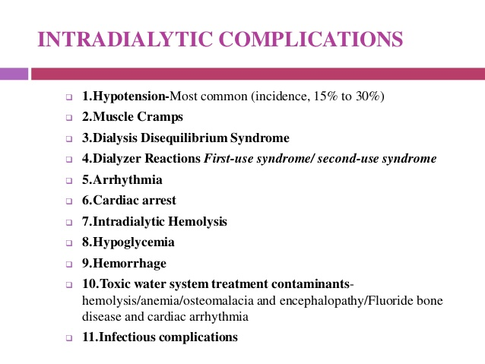

Slide 24
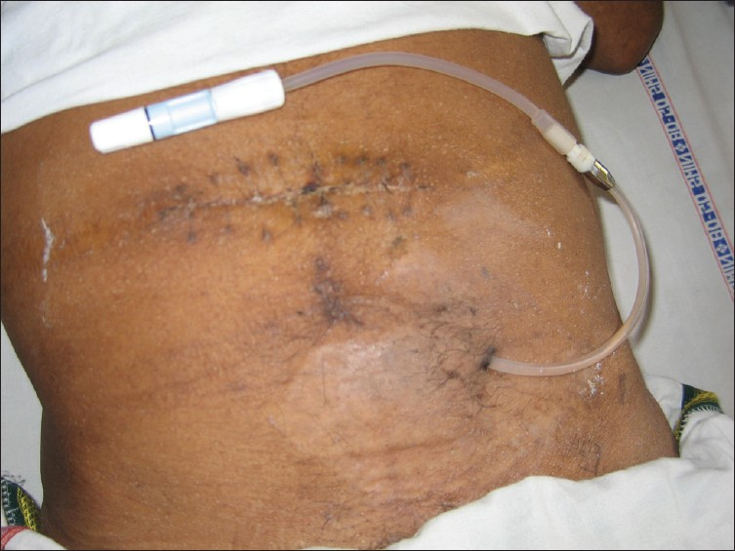
PERITONEAL DIALYSIS CATHETERS

Slide 25
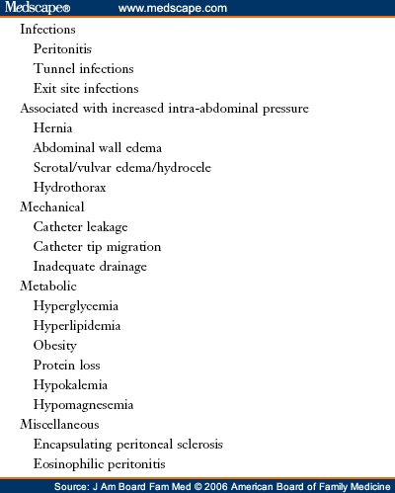
COMPLICATIONS OF PERITONEAL DIALYSIS:

Slide 26
Thank you

