Slide 1
HEART FAILURE
By Dr. Zahoor

Slide 2
HEART FAILURE
What is Heart Failure ?
It a condition when heart is not able to pump the blood to support physiological circulation
Cause may be structural or functional

Slide 3
HEART FAILURE
Main causes
Ischemic Heart Disease – 35-40%
Cardiomyopathy (dilated) 30-34%
Hypertension 15-20%
Other causes
Valvular Heart Disease
Congenital Heart Disease
Prognosis
50% of patient with heart failure are dead in 5 years

Slide 4
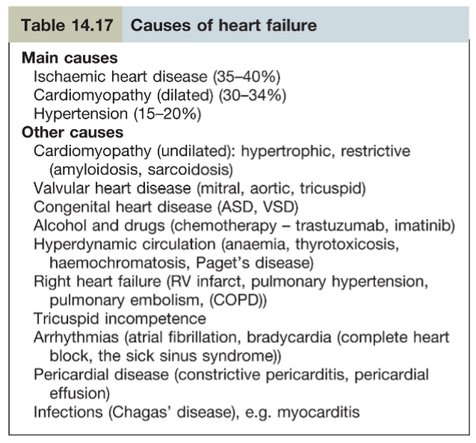
CAUSES OF HEART FAILURE

Slide 5
HEART FAILURE
Pathophysiology
When heart fails, changes occur in heart and peripheral vascular system, they are
- Ventricular dilatation
- Increased ANP secretion
- Salt and Water retention
- Sympathetic stimulation
- Peripheral Vasoconstriction
These changes are compensatory and maintain COP and peripheral perfusion

Slide 6
HEART FAILURE
Pathophysiology (cont)
When there is heart failure, amount of blood ejected per beat decreases, there is more end-diastolic volume
Heart rate increases, therefore, any reduction of stroke volume is compensated by increased heart rate to maintain COP
COP = Stroke Volume × Heart Rate

Slide 7
HEART FAILURE
Pathophysiology (cont)
When there is severe cardiac dysfunction, increased venous pressure on left side of the heart leads to back pressure in lungs and causes dyspnoea (due to accumulation of alveolar fluid)
There is hepatic enlargement, Ascites and dependent edema, due to right ventricle failure
In severe heart failure, COP is reduced at rest

Slide 8
HEART FAILURE
Pathophysiology (cont)
Outflow Resistance (after load)
Normally ventricle contract against load or resistance which is formed by
1. Pulmonary and Systemic Resistance
2. Blood Vessel wall
3. Volume of blood that is ejected
Increase in after load – decreases cardiac output, it will increase end diastolic volume and causes dilatation of ventricle

Slide 9
HEART FAILURE
Pathophysiology (cont)
Decrease cardiac output leads to diminished renal perfusion, activating Renin – Angiotensin – Aldosterone system and increases salt and water retention

Slide 10
HEART FAILURE
Pathophysiology (cont)
MYOCARDIAL REMODELING IN HEART FAILURE
There is alteration in ventricular size, shape, and function in clinical conditions e.g. hypertension, Cardiomyopathy, valvular heart disease and MI

Slide 11
HEART FAILURE
Pathophysiology (cont)
Natriuretic Peptides – ANP, BNP
ANP – Atrial Natriuretic Peptide is released from atrial myocyte in response to stretch
ANP is increased in CCF - causes diuresis, natriuresis, vasodilatation, and suppression of Renin – Angiotensin System
BNP – Brain Natriuretic Peptide
It is called BNP because it was first discovered in brain, but it is predominantly secreted by ventricles and has similar action of ANP

Slide 12
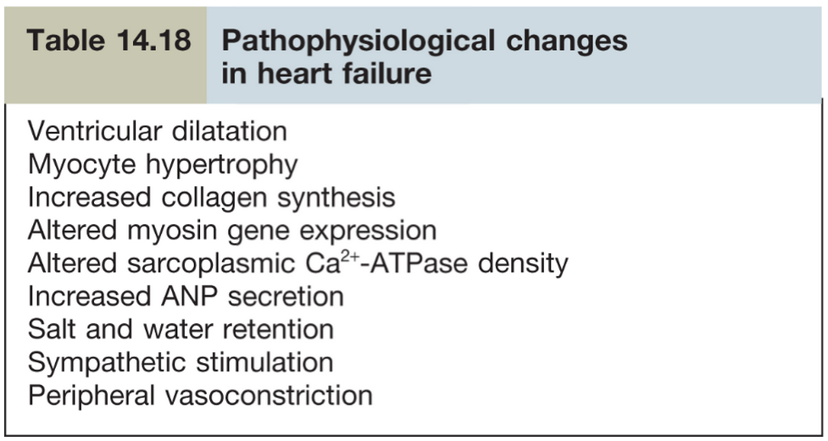
HEART FAILURE Summary of pathophysiology changes

Slide 13
TYPES OF HEART FAILURE
Left sided heart failure
Right sided heart failure
Biventricular heart failure
1.Left sided heart failure
There is reduction in LV output and increase in left atrial pressure, pulmonary venous pressure which causes pulmonary edema and presents with dyspnoea

Slide 14
TYPES OF HEART FAILURE
2. Right sided heart failure
It occurs in chronic lung disease, pulmonary valve stenosis. There is reduction of RV output and back pressure on right atrium ( Increased JVP, Liver enlargement, peripheral edema ).
3. Biventricular failure
It affects both ventricle and occurs in dilated Cardiomyopathy, ischemic heart disease, or due to left ventricular failure which leads to increase LA pressure, pulmonary hypertension and RV failure.

Slide 15
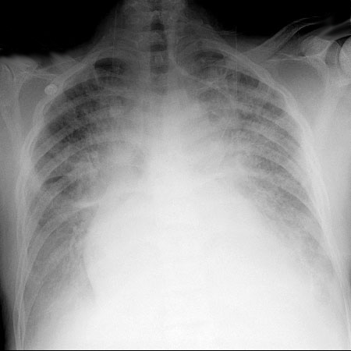
Severe CHF with Pulmonary edema

Slide 16
HEART FAILURE
Clinical Syndrome of Heart Failure
Heart failure can present as
Acute heart failure
Chronic heart failure
We will discuss each one

Slide 17
HEART FAILURE
Chronic Heart Failure
Left ventricular systolic dysfunction (LVSD)
  It is commonly caused by ischemic heart disease but also occurs with valvular heart disease and hypertension
Right ventricular systolic dysfunction (RVSD)
  It may be secondary to LVSD, Pulmonary Hypertension, Right Ventricular Infarction

Slide 18
HEART FAILURE
Chronic Heart Failure
Diastolic Heart Failure
It is a syndrome, where left ventricle relaxation is abnormal. There is stiffness in ventricular wall and decrease LV Compliance, leading to decrease diastolic ventricular filling with reduced cardiac output
Ejection fraction of left ventricle is about 45-50% (Normal 60%)
Cause- Hypertension in elderly ,
Hypertrophic Cardiomyopathy (Restrictive)

Slide 19
HEART FAILURE
Chronic Heart Failure
Symptoms and Signs of Chronic Heart Failure:
Symptoms:
  Exertional Dyspnoea
  Orthopnoea
  Proximal Nocturnal Dyspnoea
  Fatigue

Slide 20
HEART FAILURE
Chronic Heart Failure
Symptoms and Signs of Chronic Heart Failure:
Signs:
  Cardiomegaly
  3rd and 4th Heart sound
  Elevated JVP
  Tachycardia
  Hypotension
  Bibasal crackles
  Pleural Effusion
  Ankle edema
  Ascitis
  Tender hepatomegaly

Slide 21
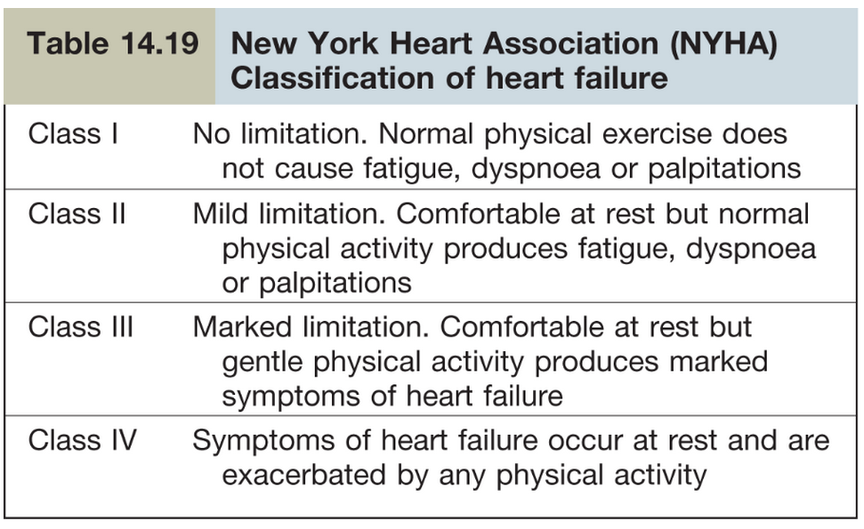
HEART FAILURE
Classification of Heart Failure

Slide 22
HEART FAILURE
Chronic Heart Failure
Diagnosis of Heart failure
  Symptoms and signs of Heart failure eg. Breathlessness, ↑JVP, Ankle Edema, Liver enlargement
  X-ray chest – look for cardiomegaly, pulmonary congestion and pulmonary edema
  ECG – for ischemia, hypertensive changes, arrhythmia
  Echocardiography – cardiac chambers, systolic and diastolic functions, valvular heart disease, cardiomyopathy

Slide 23
HEART FAILURE
Chronic Heart Failure
Diagnosis of Heart failure
Other Investigations
  Blood test
  FBC, Liver Biochemistry, U&E, Cardiac enzymes
  Nuclear cardiography
  Radionucleotide angiography (RNA) for ventricular ejection fraction
  SPECT - Single Photon Emission Computed Tomography can demonstrate myocardial ischemia and dysfunction of myocardium
  CMR (Cardiac MRI) for myocardial dysfunction

Slide 24
HEART FAILURE
Chronic Heart Failure (cont)
Investigations
  Cardiac Catheterization
    For IHD, revascularization
    Pressures in heart chambers
  Cardiac Biopsy
    Cardiomyopathies e.g. Amyloid
    Follow up in transplanted patients to assess rejections
  Ambulatory 24 hour ECG monitoring (HOLTER) in patients with history of Arrhythmias

Slide 25
HEART FAILURE
Chronic Heart Failure
Treatment of heart failure ( Drugs we will see )
Prevention
  Avoid smoking
  Avoid alcohol
  Treat hypertension
  Treat Diabetes Mellitus
  Treat Hypercholesterolaemia

Slide 26
HEART FAILURE (cont)
Chronic Heart Failure
Prevention (cont)
General Lifestyle
  Control of obesity
  Dietary modifications –avoid large meal
  Restrict salt intake
  Low level exercise – walking 20-30 minutes five times per week when tolerated

Slide 27
HEART FAILURE
Chronic Heart Failure
PREVENTION
General Lifestyle (cont)
  Driving
    Person can drive
    Symptomatic heart failure if present, person should not drive large lorries and buses
  Multidisciplinary team approach Many health care personal are required
    Nurse (specialist in heart failure)
    Dietician
    Pharmacist
    Occupational therapist
    Physiotherapist

Slide 28
HEART FAILURE
Chronic Heart Failure
Treatment of Chronic heart failure
Drug Treatment
  Diuretics – causes renal excretion of salt and water
    Loop diuretics e.g. furosemide (lasix)
    Thiazide diuretics e.g. Hydrochlorothiazide
  ACE inhibitors – e.g. Captopril, Enalapril
    they are useful, they slow down the development of heart failure and improve survival
    Side effect – cough, hypotension, hyperkalemia, renal dysfunction
    Contraindications – renal artery stenosis, pregnancy

Slide 29
HEART FAILURE
Chronic Heart Failure
Treatment of Chronic heart failure
Drug Treatment (cont)
  Angiotensin II receptor antagonist (ARA) e.g. Valsartan
    They are second line therapy, used if patient is not tolerant to ACE inhibitors
    They do not affect bradykinin metabolism therefore do not cause cough
  Beta Blockers – e.g. Tenormin, Concor
    They reduce cardiovascular morbidity and mortality
    They decrease oxygen demand
    In heart failure start with low dose and gradually increase dose

Slide 30
HEART FAILURE
Chronic Heart Failure
Treatment of Chronic heart failure
Drug Treatment (cont)
  Aldosterone antagonist – e.g. Spironolactone
    Improves survival in heart failure
  Cardiac glycoside – e.g. Digoxin
    Indicated in AF with heart failure
  Vasodilators & Nitrates – Hydralazine & Nitrates reduce after load and preload
    They are used in patients who can not tolerate ACEI and ARA
  Prophylactic anticoagulant- in HF , as there is four fold increased risk of stroke

Slide 31
HEART FAILURE
Chronic Heart Failure (CHF)
Treatment of Chronic heart failure
Non Pharmacological Treatment
Biventricular pacemaker & Implantable cardioverter defibrillator
  Indicated in patients with SA node and AV node conduction blocks

Slide 32
HEART FAILURE
CHF - Non Pharmacological Treatment (cont)
Cardiac Transplantation
- Indicated in younger patient with severe heart failure, whose life expectancy is less than 6 months
- After heart transplant expected 1 year survival over 90% and 5 year survival 75%
- Quality of life is improved

Slide 33
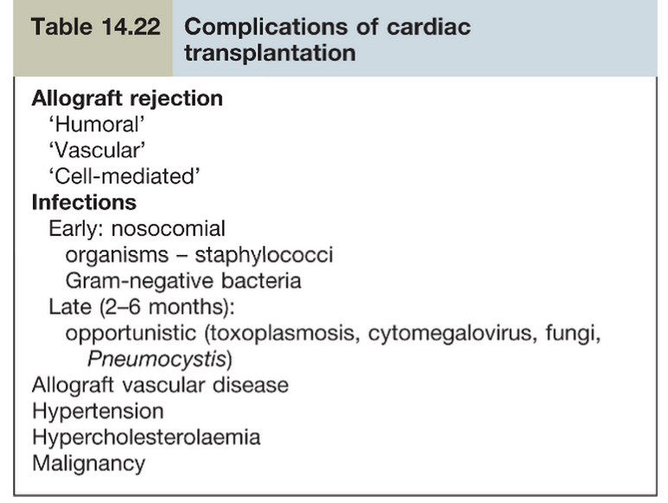

Slide 34
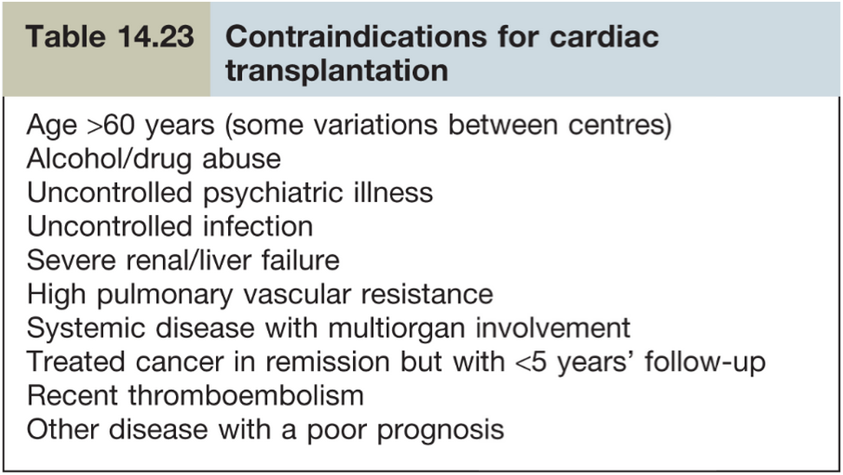

Slide 35
ACUTE HEART FAILURE (AHF)

Slide 36
ACUTE HEART FAILURE (AHF)
AHF occurs with rapid onset of symptoms and signs of heart failure
This causes severe dyspnoea, pulmonary edema and peripheral edema
AHF has poor prognosis with 60 days mortality of 10%
Poor prognostic indicators
Pulmonary capillary wedge pressure (PCWP) more than 16 mmHg
Decreased serum Na⁺
Increase left ventricle end-diastolic dimension on Echo
Decreased O₂ consumption

Slide 37
ACUTE HEART FAILURE (AHF)
Aetiology of AHF
Ischaemic Heart Disease – acute coronary syndrome can cause papillary muscle rupture or VSD (Ventricular Septal Defect)
People with Valvular heart disease can present with AHF due to endocarditis or prosthetic valve thrombosis
People with Hypertension can present with pulmonary edema
Acute and Chronic Kidney Disease can cause fluid overload and pulmonary edema
Atrial fibrillation (AF) is associated with AHF and may require cardio version

Slide 38
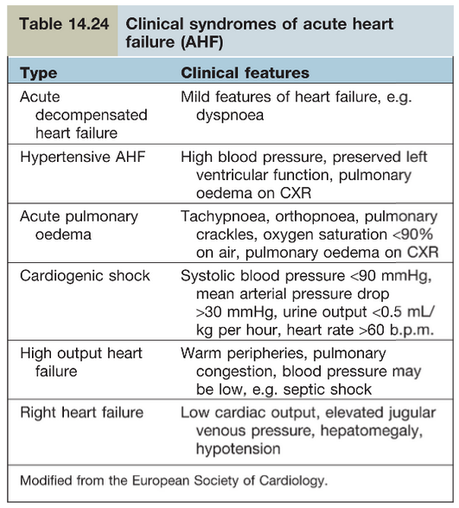
ACUTE HEART FAILURE (AHF)
Clinical Syndromes of AHF

Slide 39
ACUTE HEART FAILURE (AHF)
Diagnosis
12 lead ECG – for acute coronary syndrome, left ventricular hypertrophy, AF
X-ray chest – for cardiomegly, pulmonary edema
Blood investigations – cardiac enzymes
Blood BNP – more than 100 PG/m indicates heart failure
Echocardiography – to confirm heart failure

Slide 40
ACUTE HEART FAILURE (AHF)
Treatment of AHF
Goals of Treatment in AHF
To relieve symptoms
Reduction in stay in hospitals
Reduction in mortality from AHF
Monitor
Heart rate, BP, temperature and cardiac monitoring
All patient require low molecular weight heparin as prophylactic coagulation e.g. ENOXAPARIN 1mg/kg S.C × 2 daily
Atrial blood gases
Central venous canulation for 1/V medication

Slide 41
ACUTE HEART FAILURE (AHF)
Treatment of AHF (cont)
Initial therapy
O₂
Diuretic e.g. lasix
Vasodilator – GTN infusion
Inotropic support e.g. Dobutamine
If blood pressure is low, use nor-epinephrine

Slide 42
Case History – A fit woman with shortness of breath and flu like symptoms
A 23 year old woman, who is long distance runner and extremely fit and well, has been brought to A & E department. Since yesterday she has been increasingly short of breath. She had been unwell with a flu like illness and fever over the last week, she also had mild chest discomfort.
On examination she appears unwell and short of breath. Her respiratory rate is 34/min, BP 88/50 mmHg, and pulse 140/min. Her temperature 38.5ºC and SpO₂ 89%. Her JVP is raised and on auscultation, there is 3rd heart sound. There are wide spread fine inspiratory crackles.

Slide 43
Questions:
1. What is the most likely cause of her symptoms?
a. Heart failure
b. Pulmonary embolus
c. Chest infection
d. Status asthmaticus
Which of the following explain the underlying cause?
a. Myocardial infarction
b. Congenital heart disease
c. Myocarditis
d. Pericardial effusion

Slide 44
Answers:
Answer to Question 1:
a. Heart failure
Answer to Question 2:
c. Myocarditis

Slide 45
Thank you

