Slide 1
ISCHAEMIC
HEART DISEASE
By Dr. Zahoor

Slide 2
ISCHAEMIC HEART DISEASE (IHD)
Why myocardial ischaemia occurs?
Myocardial Ischaemia occurs when there is less supply of oxygen to the heart
Less supply of oxygen may be due to decreased blood flow because of coronary artery disease

Slide 3
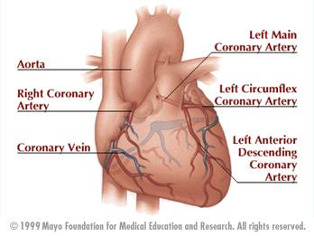
Diagram of coronary circulation

Slide 4
ISCHAEMIC HEART DISEASE (IHD)
Coronary artery disease may be due to
- Atheroma
- Thrombosis
- Embolus
- Spasm
- Coronary ostial stenosis

Slide 5
ISCHAEMIC HEART DISEASE (IHD)
Coronary Artery Disease (cont)
Decrease in oxygenated blood flow to coronary artery due to
- Anaemia
- Carboxyhaemoglubinaemia
- Hypotension
Increased demand of oxygen due to
- increase cardiac output e.g. Throtoxicosis
- myocardial hypertrophy e.g. Hypertension,
Aortic Stenosis

Slide 6
ISCHAEMIC HEART DISEASE (IHD)
Myocardial Ischemia occurs most commonly due to obstructive coronary artery disease (CAD) in the form of coronary Atherosclerosis
CAD is the largest cause of death in UK and many parts of the world
In 2009 in UK, 1:5 male and 1:8 female death were from coronary artery disease
Sudden death can occur

Slide 7
ISCHAEMIC HEART DISEASE (IHD)
We will study the process of Atherosclerosis
Coronary Atherosclerosis is characterized by accumulation of lipid, macrophages and smooth muscle cells in the intimal plaques in large and medium size coronary arteries
Process of Atherosclerosis
- Endothelial injury
- Accumulation of lipoprotein (LDL)
- LDL are taken by macrophages
- Formation of foam cells – macrophages which have
taken LDL
- Proliferation of smooth muscle cell

Slide 8
ISCHAEMIC HEART DISEASE (IHD)
Formation of Plaque
- Proliferation of smooth muscle cells with collagen formation, lipid deposition, macrophages, inflammatory cells, endothelial cell proliferation all make fibro lipid plaque
- Plaque may be
stable
unstable (can rupture)
- Plaque can obstruct the blood vessel
- Plaque can undergo thrombosis

Slide 9
ISCHAEMIC HEART DISEASE (IHD)
Coronary artery disease (CAD) gives rise to
1. Stable angina
2. Acute coronary syndrome
- Unstable angina
- Non ST elevation myocardial infarction
(NSTEMI)
- ST elevation myocardial infarction (STEMI)

Slide 10
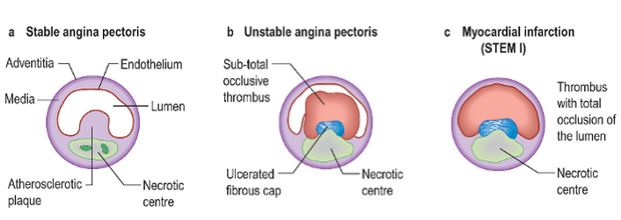
Mechanism for development of thrombosis on plaque

Slide 11
ISCHAEMIC HEART DISEASE (IHD)
Risk Factors
Fixed IHD risk factors (that can not be changed)
Age – CAD increases with age
Male sex – higher incidence than premenopausal women
Positive family history

Slide 12
ISCHAEMIC HEART DISEASE (IHD)
Risk Factors (Potentially changeable risk factors)
Hyperlipidaemia
Hypertension
Diabetes mellitus
Cigarette smoking
Diet and obesity
Lack of exercise
It is recommended that normal adult should do a minimum of 30mins of moderate activity e.g. Brisk walking, cycling on 5 days of the week

Slide 13
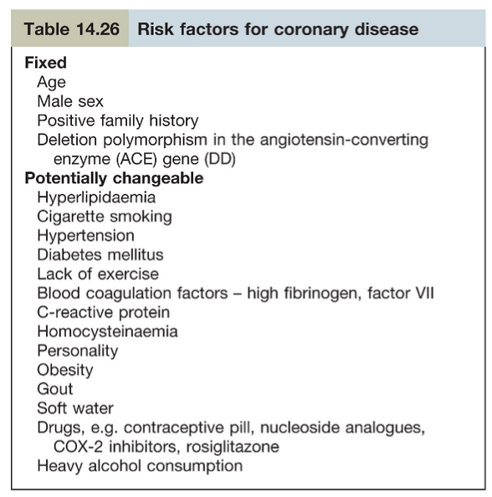
ISCHAEMIC HEART DISEASE (IHD)
Risk factors for Coronary Artery Disease

Slide 14
ISCHAEMIC HEART DISEASE (IHD)
Primary and Secondary Prevention
Primary Prevention
- It is prevention of atherosclerotic disease process
Secondary Prevention
- It is treatment of atherosclerosis that is treatment of disease or its complication

Slide 15
ISCHAEMIC HEART DISEASE (IHD)
Important Point
Blood Pressure should be maintained below 140/90 mmHg (in Diabetes, BP 130/80 mmHg)
Serum cholesterol should be below 4.0 mmol/L
HDL should be more than 1 mmol/L
LDL should be less than 2 mmol/L

Slide 16
Stable Angina

Slide 17
ISCHAEMIC HEART DISEASE (IHD)
Stable Angina
The most common symptom associated with angina is central chest pain on exertion
Pain of angina pectoris and myocardial infarction is due to myocardial hypoxia
Pain in angina is retrosternal, heavy, tight or gripping, with radiation to left arm, neck, jaw , epigastrium.
Pain last for 2-10 minute, may be mild or severe

Slide 18
ISCHAEMIC HEART DISEASE (IHD)
Pain is provoked by physical exertion, after meal, cold, windy weather, excitement
Pain is relieved by rest or sublingual nitrates ( GTN )

Slide 19
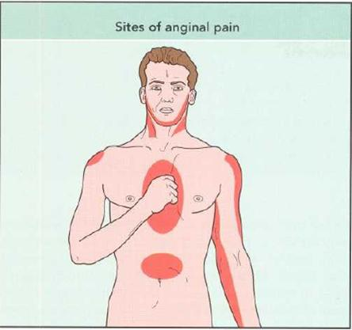
Anginal Pain - Radiation

Slide 20
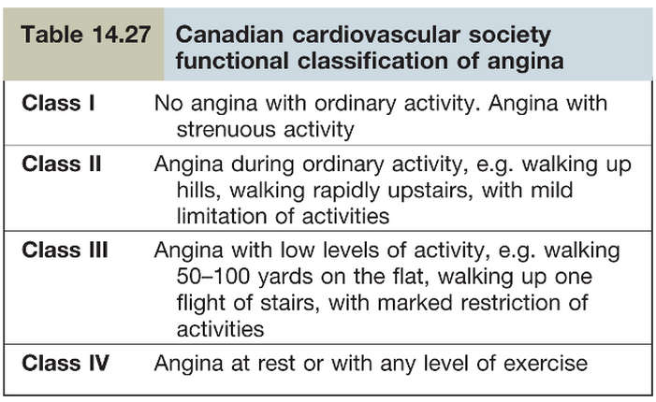
ISCHAEMIC HEART DISEASE (IHD)
Diagnosis of angina is largely based on clinical history

Slide 21
TYPES OF ANGINA
Stable angina – pain related to exertion
Unstable angina – pain occurs at rest, it is part of acute coronary syndrome and we will discuss later with acute coronary syndrome
Refractory angina – when anginal pain is not controlled by medical therapy, patient is having severe coronary disease

Slide 22
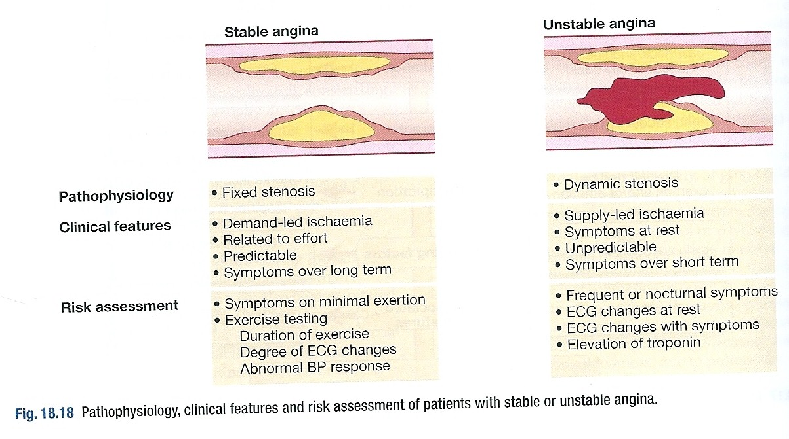

Slide 23
TYPES OF ANGINA (cont)
Variant (Prinzmetal’s) angina
- Angina usually at rest
- It is due to coronary artery spasm
- More in women
- There is ST elevation on ECG during pain
5. Cardiac syndrome X
- Patient has history of angina, positive exercise test but on angiography coronary arteries are normal. Prognosis is good.

Slide 24
STABLE ANGINA
Examination
No abnormal finding in angina
Look for
- Anaemia
- Throtoxicosis
- Hyperlipidaemia (Xanthelasma, Tendon
Xanthoma)
- Check blood pressure for hypertension
- Examine CVS, exclude aortic stenosis as
possible cause of angina

Slide 25
STABLE ANGINA (cont)
Investigations
ECG – 12 lead ECG is normal between attacks
During attack, transient ST-depression, T-wave inversion may appear
Cardiac enzymes – Troponin T and Troponin I normal
Exercise (Stress) ECG – ST- depression of 1mm is taken as positive test
CT – coronary angiography

Slide 26
STABLE ANGINA (cont)
Investigations (cont)
Functional imaging – SPECT
Stress Echocardiography
Stress Magnetic resonance imaging (MRI)
Cardiac catheterization
Note – SPECT – Single Photon Emission Computed Tomography – it is scan of heart, non invasive nuclear imaging test after radioactive tracer injection given IV

Slide 27
STABLE ANGINA (cont)
Management of Stable Angina
Inform the patient about the nature of disease and reassure that prognosis is good
Annual mortality < 2%
Treat underlying problem e.g. anemia or hyperthyroidism

Slide 28
STABLE ANGINA (cont)
Management of Stable Angina (cont)
Manage DM, hypertension if present
Look for risk factors e.g. smoking, obesity, hypercholesterolaemia, advice and treat
Regular exercise should be encouraged

Slide 29
STABLE ANGINA (cont)
Pharmacological therapy
Vasodilator – GTN (Glyceryl Trinitrate 0.3-1mg sublingual)
Isosorbide mononitrate – 10-60mg orally twice daily
Beta Blocker
Atenolol (Tenormin) 25-100mg daily
Bisoprolol (Concor) 2.5-10mg/day
Beta blocker decrease heart rate, decrease BP, and decrease myocardial O₂ demand

Slide 30
STABLE ANGINA (cont)
Pharmacological therapy (cont)
3. Calcium channel blocker
-Verapamil – 80-120mg three times per day
- Diltiazem – 60-120mg three times per day
- Amlodipine (mainly vasodilator) – 5-10mg per day
Verapamil and Diltiazem decrease force of cardiac contraction and inhibit cardiac conductive tissue, therefore, they are contraindicated in severe bradycardia, left ventricular failure, second or third degree heart block
Side effect – Verapamil - Constipation

Slide 31
STABLE ANGINA (cont)
Pharmacological therapy (cont)
Secondary Prevention
Aspirin 75mg daily – it is anti platelet, side effect is GI bleeding
ACE inhibitors – used if hypertension, heart failure.
Statins (Lipitor ) used to reduce total cholesterol to 4mmol/L and LDL to blow 2mmol/L

Slide 32
STABLE ANGINA (cont)
Revascularization
PCI – Percutaneous Coronary Intervention
It is process to dilate coronary artery stenosis, using inflatable balloon and metallic stent introduced via femoral, radial, or brachial artery

Slide 33
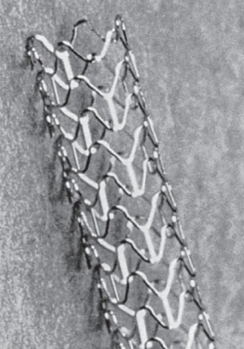
Intra Coronary Stent

Slide 34
STABLE ANGINA (cont)
Revascularization (cont)
Complication – bleeding, hematoma, pseudo aneurysm
Serious Complication
– Acute MI 2%
– Stroke 0.4%
– Death 1%
When metallic Drug – eluting stent are used, patients are advised to take Aspirin, Plavix for 1 year

Slide 35
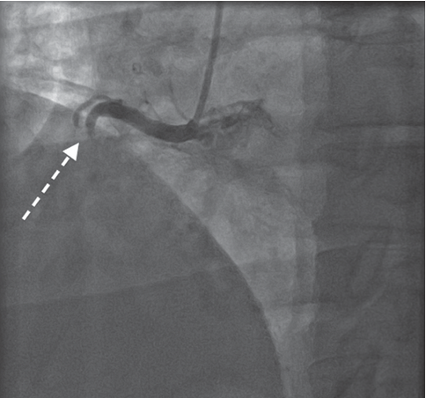
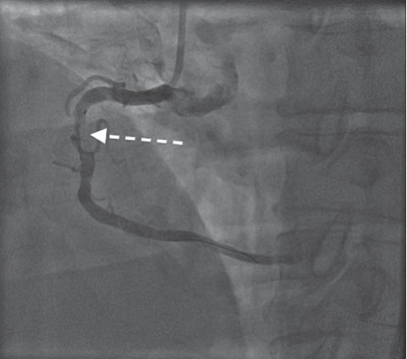
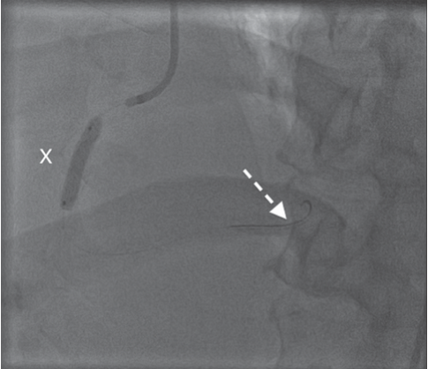
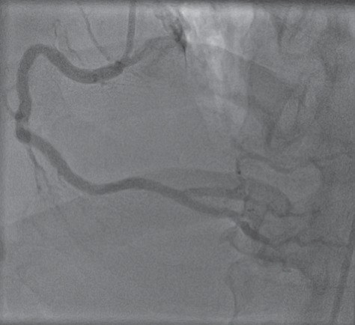
Percutaneous Transluminal Coronary Angioplasty PTCA
A. Right coronary artery (RCA) occluded
B. Soft wire passed
C. Balloon is inflated to dilate stenosis
D. RCA reopened

Slide 36
STABLE ANGINA (cont)
Coronary Artery Bypass Grafting (CABG)
Autologus veins or arteries are anastomosed
Saphanous vein or internal memory artery are used
Operative mortality < 1%

Slide 37
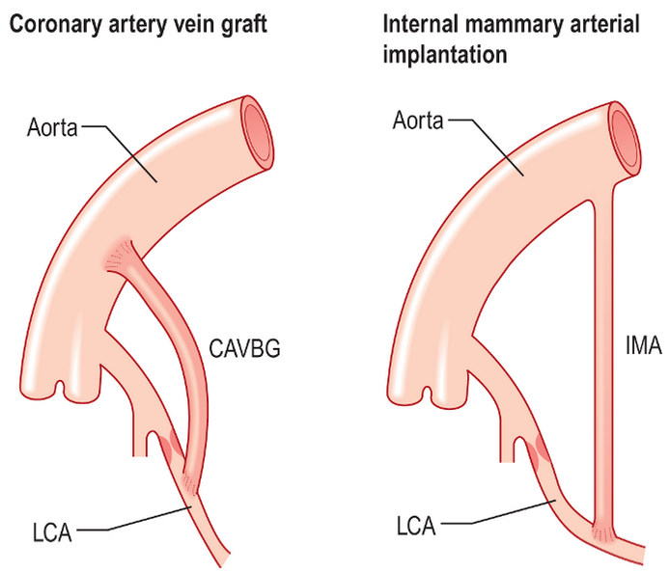
Relief of Coronary Obstruction By Surgical Techniques

Slide 38
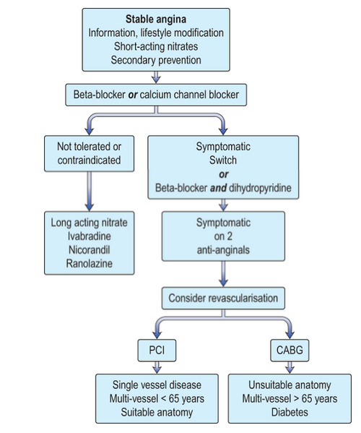
Algorithm for Management of Patient’s with Stable Angina

Slide 39
CASE HISTORY – A patient with hypertension and chest pain
A 50 year old smoker with hypertension develops central crushing chest pain radiating to his jaw. He has vomited and now feels short of breath. ECG was done which is shown.

Slide 40
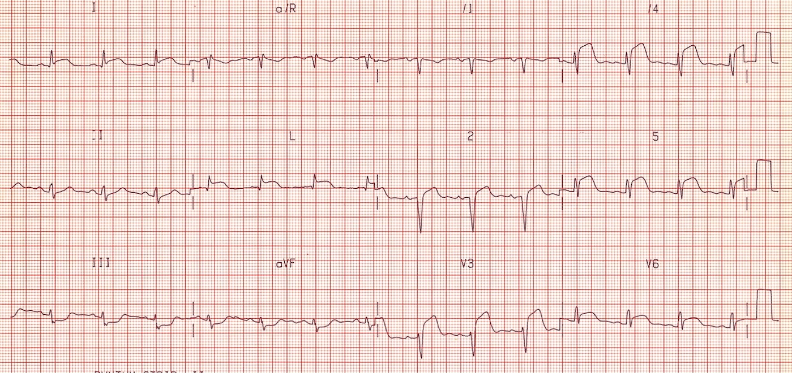

Slide 41
Questions:
What is the diagnosis?
a. Posterior MI
b. Inferior MI
c. Antrolateral MI
d. Pericarditis
Patient is given Morphine, anti-emetic and aspirin. He is taken immediately to the cardiac cath lab, where he undergoes coronary angiography and stenting to one of the vessels. Which coronary artery is stented?
a. Right
b. Circumflex
c. Diagonal
d. Left anterior descending (LAD)

Slide 42
Answers:
Answer to Question 1 :
c. Antrolateral MI
Answer to Question 2:
d. Left anterior descending (LAD)

Slide 43
Thank you

