Slide 1
Acute and Chronic Renal Failure
By
Dr. Hayam Hebah
Associate professor of Internal Medicine
AL Maarefa College

Slide 2
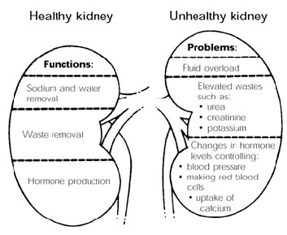

Slide 3
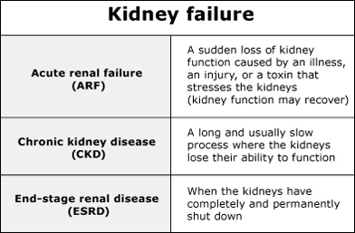

Slide 4
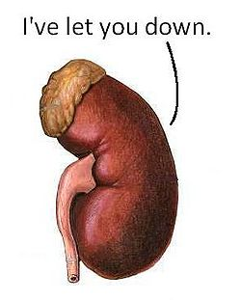
ACUTE RENAL FAILURE

Slide 5
AKI:
It is sudden and usually reversible loss of kidney function which develops over days or weeks and usually accompanied by reduction of urine volume.
Rise of serum creatinine may be :
---acute injury
------acute on chronic kidney disease.
Lowering of Creatinine clearance:

Slide 6
Creatinine clearance:
1- Cr Cl: U(mg/ml)x V (ml/min) /P(mg/ml).
2-Estimated creatinine clearance rate (eC_{Cr}) using Cockcroft-Gault formula.
3-Estimated GFR (eGFR) using Modification of Diet in Renal Disease (MDRD) formula
for creatinine in µmol/L

Slide 7
For creatinine in mg/dl
A more elaborate version of the MDRD equation also includes serum albumin and blood urea nitrogen (BUN) levels

Slide 8
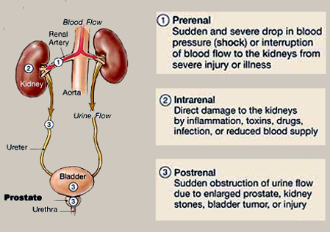
Causes of AKI:

Slide 9
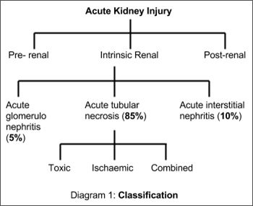

Slide 10
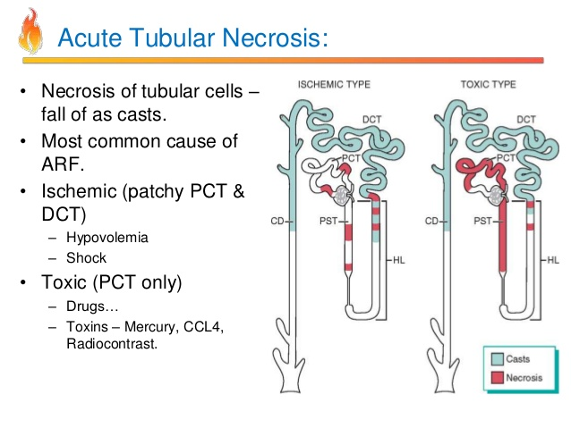

Slide 11
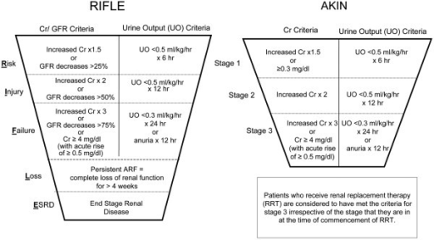

Slide 12
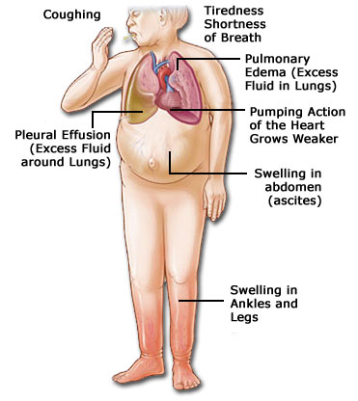
Symptoms of ARF:
c/p in volume
overloaded
patient .

Slide 13
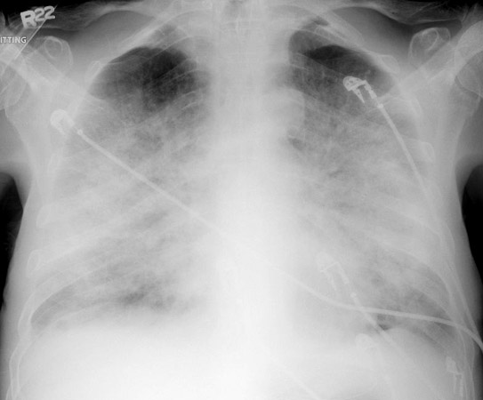
Pulmonary edema x-ray

Slide 14
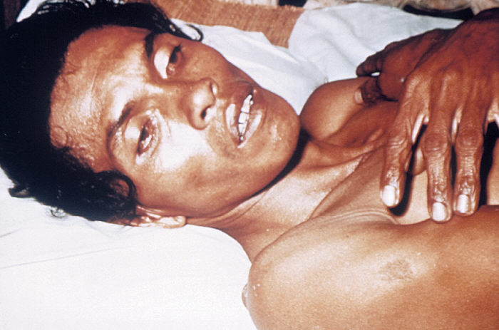
2-c/p of
Dehydrated
man with
-Sunken eyes ,
-Dry mouth,
-Loss of skin
turgor ,
-oliguria

Slide 15
C/P OF THE CAUSE :
e.g:----- picture of infective endocarditis or myocardial infarction
----- picture of fever and loin pain in obstructive uropathy.

Slide 16
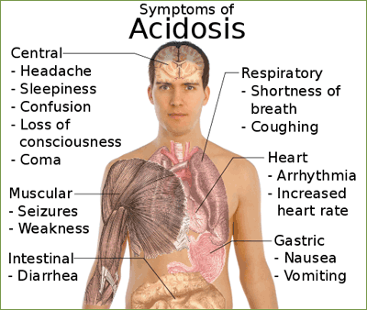

Slide 17
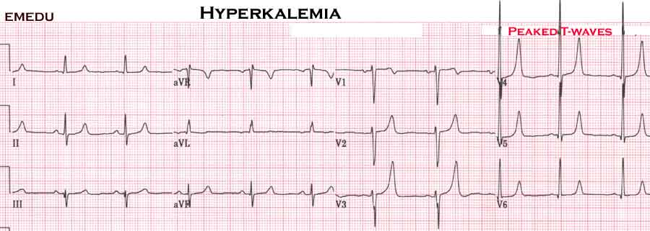
Hyperkalemia symptoms:
Weakness
Lethargy
Muscle cramps
Paresthesias
Dysrhythmias

Slide 18
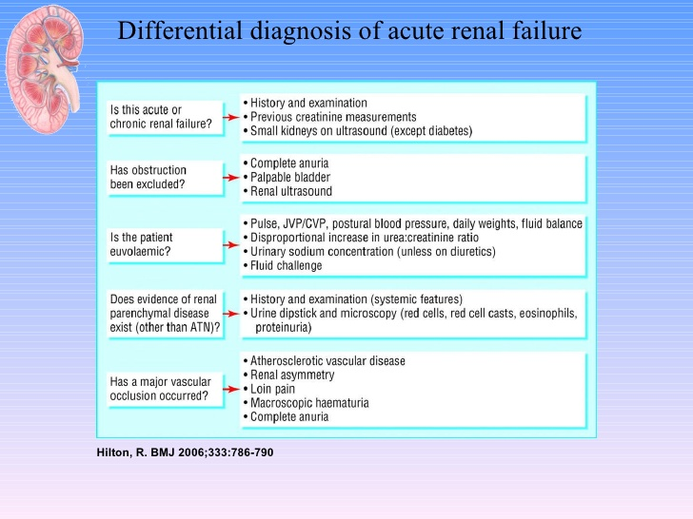

Slide 19
Investigations of patients with AKI:
Confirmation of AKI: urea and creatinine.
Complications:- electrolytes : k, calcium and phosphate - anemia: CBC -ECG
Cause of renal failure: urine analysis, urine C&S, CRP, Abdominal u/s , renal biopsy. CPK
Serology : HIV & hepatitis serology if urgent dialysis is indicated

Slide 20
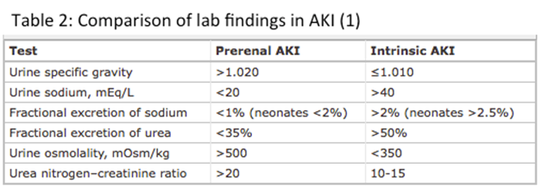

Slide 21
MANAGEMENT OF AKI:
1-Hemodynamic status :
correct hypovolemia and optimize systemic hemodynamics with inotropes if necessary.
2-Hyperkalemia :
Calcium gluconate (carbonate) for counteracting effect on the heart
Sodium Bicarbonate
Insulin/glucose
Kayexalate ( oral cation exchange resin)
Lasix
Albuterol(beta agonist)
Hemodialysis
.

Slide 22
3- Acidosis: sodium bicarbonate if PH<7
4-Cardiopulmonary complications:( pulmonary edema): -dialysis
- massive diuresis
5-electrolytes disturbance
6-fluid management : match intake to output (with 500ml for insensible losses).
7-discontinue nephrotoxic drugs and reduce dose of medications according to renal function level.
8- Ensure adequate nutritional support

Slide 23
Treatment of any intercurrent infections.
-PPI for reduction of upper GIT bleeding risk.
Treatment of the primary cause e.g steroids and immunosuppressives in cases of crescentic GN.
Surgical relieve of obstructions
Dialysis may be needed :
- hemodialysis
-CRRT.
- Peritoneal dialysis.

Slide 25
Chronic
Renal
Failure

Slide 26
Stages of CKD:
GFR (ml/min/1.73 m²) | description | stage
≥ 90 | Kidney Damage with Normal or ↑ GFR | 1
60-89 | Kidney Damage with Mild ↓ GFR | 2
30-59 | Moderate ↓ GFR | 3
15-29 | Severe ↓ GFR | 4
< 15 or Dialysis | Kidney Failure | 5

Slide 27
Common causes of ESRD:
Diabetes mellitus 20-40%
Interstitial diseases 20-30%
Hypertension 5-20%
Glomerular diseases 10-20%
systemic inflammatory diseases (SLE, Vasculitis) 5-10%
Congenital and inherited 5%
Unknown 5-20%

Slide 28
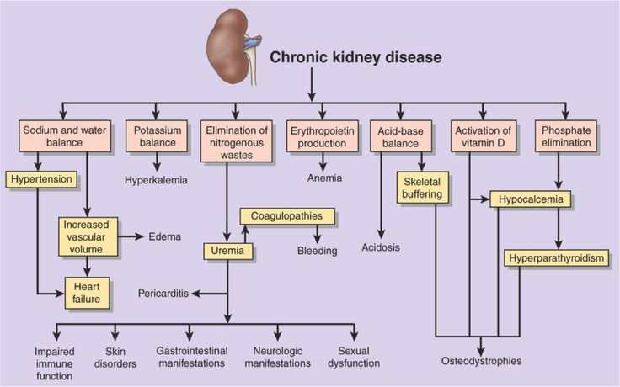
Clinical picture and complications

Slide 29
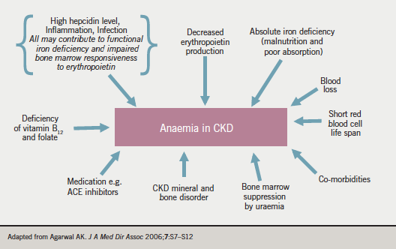

Slide 30
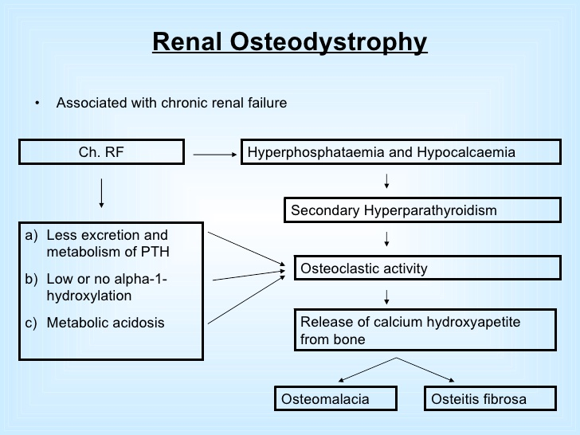

Slide 31
Investigations in CKD:
Urea and creatinine
Urine analysis and urine quantification
K and PH
Calcium, phosphorus ,PTH and 25(OH)D
Albumin
CBC,IRON PROFILE
U/S
Hepatitis and HIV

Slide 32
Management:
Treatment of the underlying condition if possible:
Aggressive blood pressure control to target values <130/80 better by ACEI or ARBs especially in diabetic kidney disease and proteinuria.
Treatment of hyperlipidemia to target levels per current guidelines
Aggressive glycemic control per the American Diabetes Association (ADA) recommendations (target hemoglobin A1c [HbA1C] < 7%)
Avoidance of nephrotoxins, including intravenous (IV) radiocontrast media, (NSAIDs), and aminoglycosides

Slide 33
management of protein intake
Vitamin D supplementation: synthetic vitamin D analogue, is for the prevention and treatment of secondary hyperparathyroidism associated with CKD stage 5.
Anemia: When the hemoglobin level is below 10 g/dL, treat with an erythropoiesis-stimulating agent (ESA) . Also ttt of iron deficiency by oral or intravenous iron.
The goal is a hemoglobin level of 10-12 g/dL

Slide 34
Hyperphosphatemia: Treat with dietary phosphate binders (eg, calcium acetate, sevelamer carbonate, lanthanum carbonate)and dietary phosphate restriction
Hypocalcemia: Treat with calcium supplements with or without calcitriol
Hyperparathyroidism: Treat with calcitriol, vitamin D analogues, or calcimimetics
Volume overload: Treat with loop diuretics or ultrafiltration
Metabolic acidosis: Treat with oral alkali supplementation
Uremic manifestations: Treat with long-term renal replacement therapy (hemodialysis, peritoneal dialysis, or renal transplantation)
Cardiovascular complications: Treat as appropriate
Growth failure in children: Treat with growth hormone

Slide 35
Dialysis
ABSOLUTE Indications of DIALYSIS:
HYPERKALEMIA >7mEq/l
ACIDOSIS: ph <7.1 and bicarbonate <12
FLUID OVERLOAD AND PULMONARY EDEMA
SEVERE UREMIA WITH PERICARDITIS
UREMIC ENCEPHALOPATHY, seizures ,coma.
OTHER INDICATIONS:

Slide 36
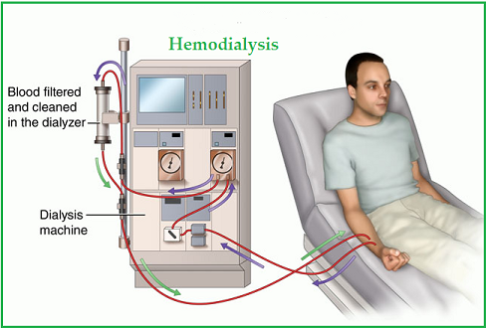
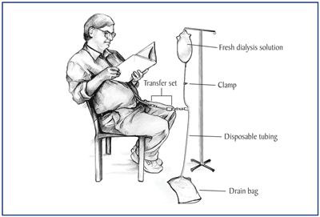
Hemodialysis
Peritoneal dialysis

Slide 37
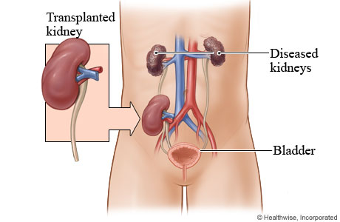
Renal transplantation:

Slide 38


