Slide 1
HEADACHE SYNDROMES
Dr. M. A. Sofi
MD; FRCP (London); FRCPEdin; FRCSEdin

Slide 2

HEADACHE SYNDROMES
Introduction to headache
IH Classification
Primary Headaches
Secondary Headaches
Differential diagnosis
History key questions
Examination
Investigations
Red flags

Slide 3
INTERNATIONAL HEADACHE CLASSIFICATION
PRIMARY HEADACHES
Over 90% of headaches seen in primary care are primary headaches. The primary headaches consists of four categories, of which the first two are the most common.
The four categories are:
TENSION-TYPE HEADACHE (TTH)
MIGRAINE
CLUSTER HEADACHES
OTHER PRIMARY HEADACHE

Slide 4
INTERNATIONAL HEADACHE CLASSIFICATION
SECONDARY HEADACHES
Headaches associated with Head & Neck Trauma
Cranial & Cervical Vascular anomalies
Subarachnoid hemorrhage
Intracranial vascular malformations
Intracranial nonvascular disorders
CNS Infections
Intracranial noninfectious inflammatory disorders
Substance abuse disorders
Psychiatric disorders

Slide 5
TENSION-TYPE HEADACHES
Tension-type headache (TTH) is a significant cause of sickness absence and impaired ability at work.
TTH is a very common form of headache and is divided into:[
Episodic TTH. This occurs on fewer than 15 days each month. It can evolve into the chronic variety.
Chronic TTH. This occurs on more than 15 days each month and has all the features of the episodic TH
TTH is the most common type of chronic recurring head pain.
It is more common in women than in men (ratio 1.4:1).
It is most common in young adults.
Lifetime prevalence of episodic TTH has not been clearly measured. Figures of 30% to 78% are widely quoted.
First onset over the age of 50 years is unusual.

Slide 6
TENSION-TYPE HEADACHE
Tension-type headache
Symptoms of tension type headaches (TTH) include:
Pressure or tightness around both sides of the head or neck
Mild to moderate pain that is steady and does not throb
Pain is not worsened by activity
Pain can increase or decrease in severity over the course of the headache
There may be tenderness in the muscles of the head, neck, or shoulders
They are not aggravated by physical activity
Chronic no longer respond to analgesia, occurs ≥15 days month. Disabling!
Management : reassurance & symptomatic Rx,
Caution: Medication overuse

Slide 7
MIGRAINE HEADACHES:
Migraine:
Migraine is classified as either episodic or chronic. The three main types of migraine
Migraine without aura
Migraine with aura
Migraine aura without headache
Account for the vast majority of migrainous headaches encountered in clinical practice.
Chronic migraine is a disabling neurological condition that affects 2% of the general population.
Patients with chronic migraine have headaches on at least 15 days a month, with at least eight days a month on which their headaches and associated symptoms meet diagnostic criteria for migraine.

Slide 8
MIGRAINE HEADACHES:
Chronic migraine associated with analgesic overuse
Childhood periodic syndromes that may not be precursors to or associated with migraine
Migrainous disorder not fulfilling above criteria
Migraine variants include the following:
Childhood periodic syndromes
Late-life migrainous accompaniments
Basilar-type migraine
Hemiplegic migraine
Status migrainosus
Ophthalmoplegic migraine
Retinal migraine

Slide 9
MIGRINE HEADACHES
Migraine:
Migraine affects about 6% of men and 18% of women.
In children it is more common in boys than in girls.
The first attack is often in childhood and over 80% have had their first attack by the age of 30.
If the onset is at age over 50, other pathology should be sought.
Usually severity decreases with advancing years.
There is a family history in many.

Slide 10
MIGRINE HEADACHES
Migraine is characterized by:
Paroxysmal headaches that tend to be severe and often unilateral, although in 30-40% it is bilateral.
There may be a premonitory phase in 20-60% of those with migraine.
There may also be an aura.
There may be photophobia, phonophobia and vomiting with marked headache but the course is highly variable.
The resolution phase occurs as the headache gradually fades.
The person may feel tired, irritable, depressed and have difficulty concentrating

Slide 11
MIGRAINE: SIGNS & SYMPTOMS
Typical symptoms include :
Throbbing or pulsatile headache, with moderate to severe pain that intensifies with movement or physical activity
Unilateral and localized pain in the fronto-temporal and ocular area, but the pain may be felt anywhere around the head or neck
Pain builds up over a period of 1-2 hours, progressing posteriorly and becoming diffuse
Headache lasts 4-72 hours
Nausea (80%) and vomiting (50%), including anorexia and food intolerance, and light-headedness
Sensitivity to light and sound (Phophobia)

Slide 12
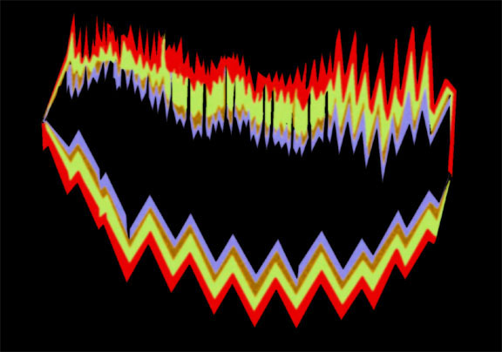
MIGRAINE: SIGNS & SYMPTOMS
Migraine aura includes:
May precede or accompany the headache or may occur in isolation
Usually develops over 5-20 minutes and lasts less than 60 minutes
Most commonly visual but can be sensory, motor, or any combination
Visual symptoms may be positive or negative
Common positive visual phenomenon is the scintillating scotoma, an arc or band of absent vision with a shimmering or glittering zigzag border

Slide 13
MIGRAINE: SIGNS & SYMPTOMS
Physical findings during a migraine headache may include the following:
Cranial/cervical muscle tenderness
Horner syndrome (i.e., relative miosis with 1-2 mm of ptosis on the same side as the headache)
Conjunctival injection
Tachycardia or bradycardia
Hypertension or hypotension
Hemisensory or hemiparetic neurologic deficits (ie, complicated migraine)
Adie-type pupil (i.e., poor light reactivity, with near dissociation from light)

Slide 14
MIGRAINE: DIAGNOSIS
Diagnosis
The diagnosis of migraine is based on patient history. IHS diagnostic criteria are at least 5 headache attacks that lasted 4-72 hours (untreated or unsuccessfully treated) and that the headache must have had at least 2 of the following characteristics :
Unilateral location
Pulsating quality
Moderate or severe pain intensity
Aggravation by or causing avoidance of routine physical activity (e.g., walking or climbing stairs)
In addition, during the headache the patient must have had at least 1 of the following:
Nausea and/or vomiting
Photophobia and phonophobia

Slide 15
MIGRAINE: TESTING & IMAGING
Selection of laboratory and/or imaging studies to rule out conditions other than migraine headache is determined by the individual presentation
ESR and CRP levels may be appropriate to exclude temporal/giant cell arteritis).
Neuroimaging is not necessary in patients with a history of recurrent migraine headaches and a normal neurologic examination
Don't perform neuroimaging studies in patients that meet criteria for migraine.
Don't perform CT imaging for headache When MRI is available
Don't prescribe opioid or barbiturate-containing medications as first-line treatment for recurrent headache disorders.
Don't recommend prolonged or frequent use of over-the-counter pain medications for headache.

Slide 16
MIGRAINE: MANAGEMENT
Acute/abortive medications
Acute treatment aims to reverse, or at least stop the progression of, a headache. It is most effective when given within 15 minutes of pain onset and when pain is mild
Abortive medications include the following:
Selective serotonin receptor (5-hydroxytryptamine–1, or 5-HT1) agonists (triptans)
Ergot alkaloids (e.g., ergotamine, dihydroergotamine [DHE]
Analgesics
Nonsteroidal anti-inflammatory drugs (NSAIDs)
Combination products
Antiemetics

Slide 17
MIGRAINE: MANAGEMENT
Preventive/prophylactic medications
Migraine attacks is greater than 2 per month
Individual attacks is longer than 24 hours
Headaches cause disruptions in the patient's lifestyle, with significant disability that lasts 3 or more days
Abortive therapy fails
Use of abortive medications more than twice a week
Migraine variants such as hemiplegic migraine or rare headache attacks producing profound disruption or risk of permanent neurologic injury.

Slide 18
MIGRAINE: MANAGEMENT
Prophylactic medications include the following:
Antiepileptic drugs
Beta blockers
Tricyclic antidepressants
Calcium channel blockers
Selective serotonin reuptake inhibitors (SSRIs)
NSAIDs
Serotonin antagonists
Botulinum toxin
Other measures
Treatment of migraine may also include the following:
Reduction of migraine triggers (e.g., lack of sleep, fatigue, stress, certain foods)
Nonpharmacologic therapy (e.g., biofeedback, cognitive-behavioral therapy)
Integrative medicine (e.g., butterbur, riboflavin, magnesium, feverfew, coenzyme Q10)

Slide 19
CLUSTER HEADACHES:
Cluster headaches
Cluster headaches are characterized by attacks of severe unilateral pain in a trigeminal distribution. They are more common in:
  Men.
  People who smoke.
  Adults older than 20 years.
They occur in clusters followed by a remission period of months or years.
Often begin during sleep and may wake the patient, as the pain is severe. They are associated with ipsilateral watering of the eye, conjunctival redness, rhinorrhoea, nasal blockage and ptosis.
The attack may occur up to eight times per day but is usually short in duration (between 15 minutes and three hours).

Slide 20
Cluster headache: Diagnostic criteria
A. At least five attacks fulfilling criteria B through D
B. Severe or very severe unilateral orbital, supraorbital and/or temporal pain lasting 15 to 180 minutes when untreated; during part (but less than half) of the time-course of cluster headache, attacks may be less severe and/or of shorter or longer duration
C. Either or both of the following:
1. At least one of the following symptoms or signs ipsilateral to the headache:
a)Conjunctival injection or lacrimation | f) Sensation of fullness in the ear
b)Nasal congestion and/or rhinorrhea | g) Miosis and/or ptosis
c)Eyelid edema | e)Forehead and facial flushing
d)Forehead and facial sweating | f) Sensation of fullness in the ear
e) Forehead and facial flushing
2. A sense of restlessness or agitation
D. Attacks have a frequency between one every other day and eight per day for more than half of the time when the disorder is active
E. Not better accounted for by another ICHD-3 diagnosis

Slide 21
CLUSTER HEADACHES: TREATMENT
Abortive agents
Oxygen (8 L/min for 10 minutes or 100% by mask) may abort the headache.
(5-HT₁) receptor agonists, such as triptans or ergot alkaloids + metoclopramide, are often the first line of Rx.
The triptan that has received the most study in the setting of CH is sumatriptan.
Subcutaneous injections can be effective, in large part because of the rapidity of onset.
Prophylactic agents
Calcium channel blockers may be the most effective agents for CH prophylaxis.
They can be combined with ergotamine or lithium.
Lithium has been suggested as an option because of the cyclical nature of CH, which is similar to that of bipolar disorders.
It effectively prevents CH (particularly in its more chronic forms)

Slide 22
OTHER PRIMARY HEADACHES
Other primary headaches
Primary stabbing headache (also called ice-pick headache): This consists of a single stab or series of stabs in the distribution of the first trigeminal nerve with no other accompanying signs or symptoms.
Primary cough headache (also called Valsalva headache):
A headache precipitated by coughing or straining in the absence of any other headache disorder.
Typically affects adults over the age of 40 and is more frequent in men

Slide 23
OTHER PRIMARY HEADACHES
Other primary headaches
Primary exertional headache: This is a pulsating headache brought on by exercise and lasting 5 minutes to 48 hours.
DIAGNOSIS —
At least two headache episodes
Brought on by and occurring only during or after strenuous physical exercise
Lasting <48 hours
Primary sexual headache (coital cephalgia): a headache precipitated by sexual activity, usually starting during intercourse and peaking at orgasm. It may have an explosive onset at orgasm, in which case SAH will need to be excluded at least on the first occurrence.

Slide 24
OTHER PRIMARY HREADACHES
Primary thunderclap headache A high-intensity headache of sudden onset reaching maximum intensity in under a minute and lasting from 1 hour to 10 days.
It resembles SAH, from which it cannot be distinguished on clinical grounds alone.
Primary thunderclap headache is not recurrent, generally, although it may recur in the first week after onset.
Thunderclap headache is frequently associated with serious vascular intracranial disorders, particularly SAH
It is mandatory to exclude :
ICH, CVT
Un-ruptured aneurysm
Arterial dissection (intracranial/ extra-cranial)
CNS angiitis: reversible benign
CNS angiopathy
Pituitary apoplexy.

Slide 25
OTHER PRIMARY HEADACHES
Other primary headaches
Hypnic headache: this is a dull headache that wakens the patient from sleep, occurs on at least half of all days and lasts at least 15 minutes after waking.
It affects those aged over 50 years only.
There are no other signs or symptoms but intracranial disorders must be excluded.
New daily persistent headache: Headache that is daily and unremitting virtually from onset.
It can resemble TTH but may build to become severe.
Nauseas, photophobia or phonophobia can also occur.
It is very difficult to treat.

Slide 26
OTHER PRIMARY HEADACHES
Hemicrania continua: Persistent unilateral headache for three months or more, daily and continuous, of moderate intensity with exacerbations.
All of the following characteristics:
Unilateral pain without side-shift
Daily and continuous, without pain-free periods
Moderate intensity, but with exacerbations of severe pain
At least one of the following autonomic features occurs ipsilateral to the side of pain:
Conjunctival injection and/or lacrimation
Nasal congestion and/or rhinorrhea
Ptosis and/or miosis
These feature autonomic symptoms such as eye watering, ptosis and nasal congestion. The condition responds completely to indomethacin.

Slide 27
SECONDARY HEADACHES:
According to lifetime prevalence studies of headache, the order of frequency (most to least common) is:
  Primary and secondary tension-type headaches (most common - quoted figures run close to 100% lifetime prevalence).
  Headache from systemic infection (63%).
  Migraine (16%).
  Headache after head injury (4%).
  Exertional headache (1%).
  Vascular disorders (1%).
  Subarachnoid haemorrhage (<1%).
  Brain tumors (0.1%).

Slide 28
SECONDARY HEADACHES: HEAD & NECK TRAUMA
Head and neck trauma
A variety of types of headache may occur after head and neck trauma,
Tension-type headache being the most common.
Post-traumatic headache appears to be less frequent in more severe head injuries. The classified types are:
Acute and chronic post-traumatic headache.
Acute and chronic headache attributed to whiplash injury.
Headache attributed to traumatic intracranial haematoma.
Headache attributed to other head and/or neck trauma.
Post-craniotomy headache.

Slide 29
SECONDARY HEADACHES: Cranial or cervical vascular disorder
Diagnosis is usually suggested by rapid, acute onset, the presence of neurological symptoms and the rapid remission of symptoms. The classified types are:
Ischaemic stroke or TIA
Subarachnoid haemorrhage.
Un-ruptured vascular malformation.
Vasculitis - eg, temporal arteritis.
Carotid or vertebral artery dissection.
Intracranial venous thrombosis.
Other intracranial vascular disorders.
  Posterior reversible encephalopathy syndrome (PRESS)

Slide 30
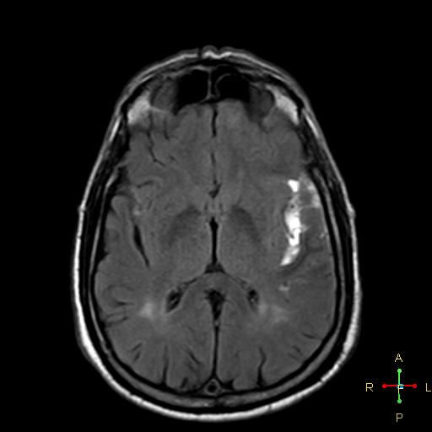
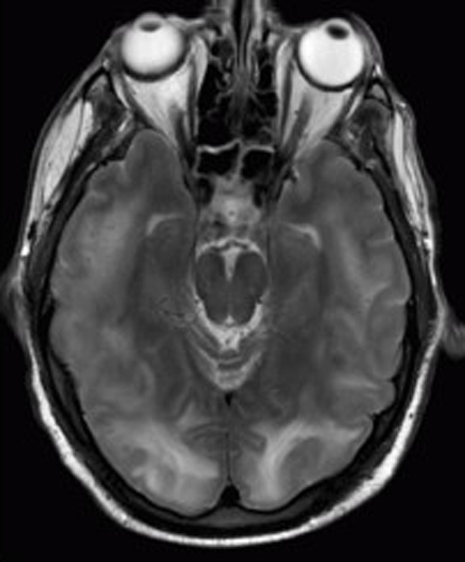
Subarachnoid hemorrhage
Multiple cortico-subcortical areas of hyperintense signal involving the occipital and parietal lobes bilaterally and pons in a patient with PRESS

Slide 31
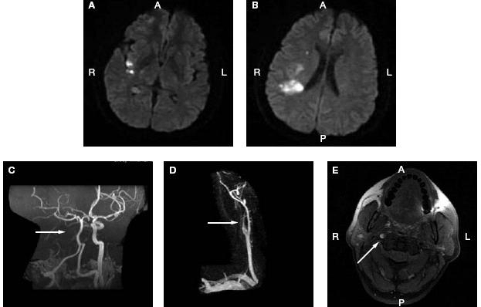
The patient developed neck pain followed by left hemiparesis. (A,B) Diffusion-weighted MRI showing scattered infarcts and dots within the right middle cerebral artery territory. (C) Magnetic resonance angiography image showing absence of the right carotid artery (arrow). (D) Magnified magnetic resonance angiography image showing a flameshaped tapering of the right internal carotid artery (arrow). E) Fat-saturated T1-weighted axial MRI image showing a crescent shaped region of blood within the wall of the right carotid artery

Slide 32
SECONDARY HEADACHES: Non-vascular intracranial disorder
Non-vascular intracranial disorder:
High cerebrospinal fluid (CSF) pressure.
Low CSF pressure.
Non-infectious inflammatory disease.
Intracranial neoplasm: overall prevalence of headache in patients with brain tumors was 60%, but headache was the sole symptom in only 2%.
Intrathecal injection.
Epileptic seizure
Chiari malformation type I
Syndrome of transient 'headache and neurological deficits with cerebrospinal fluid lymphocytosis‘.

Slide 33
SECONDARY HEADACHES: SUBSTANCE ABUSE OR ITS WITHDRAWAL
This category includes toxins and environmental pollutants, food allergies, caffeine and alcohol as well as therapeutic substances and drugs of misuse.
Acute substance use or exposure (including, for example, carbon monoxide poisoning).
Medication-overuse headache:
  Headache as an adverse event attributed to chronic medication.
Medication withdrawal including therapeutic medication
Exacerbation of chronic headache during planned medication withdrawal, withdrawal of drugs of dependence.

Slide 34
SECONDARY HEADACHES: INFECTION/ HOMEOSTASIS
Infection
Intracranial infection.
HIV/AIDS.
Chronic post-infection headache
Disorder of homeostasis
Hypoxia and/or hypercapnia (obstructive sleep apnoea).
Dialysis headache.
Arterial hypertension.
Hypothyroidism.
Fasting.
Cardiac cephalalgia.
Other disorder of homoeostasis

Slide 35
SECONDARY HEADACHES: Disorder of the cranium, neck, eyes, ears, nose, sinuses, teeth, mouth or other facial or cranial structures
Disorder of the neck.
Disorder of the eyes.
Disorder of the ears.
Sinusitis.
Disorder of the teeth, jaws or related structures.
Temporomandibular joint (TMJ) disorder.
Most disorders of the skull (congenital abnormalities, fractures, tumors, metastases) are usually not accompanied by headache.
Exceptions of importance are osteomyelitis, multiple myeloma and Paget's disease of bone.
Headache may also be caused by lesions of the mastoid, and by petrositis

Slide 36
HEADACHE DANGER SIGNS:
The vast majority of headaches are not life threatening. Seek medical attention immediately if headache:
Comes on suddenly, becomes severe within a few seconds or minutes, or that could be described as "the worst headache of your life"
Is severe and occurs with a fever or stiff neck
Occurs with a seizure, personality changes, confusion, or passing out
Begins quickly after strenuous exercise or minor injury
Is new and occurs with weakness, numbness, or difficulty seeing.
Persistent or frequent headaches, headaches that interfere with normal activities, or become more painful.

Slide 37

“Red flag” symptoms in headache
Symptom | Explanation
Sudden onset (Maximal immediately or within minutes) | Subarachnoid hemorrhge Cerebral venous thrombosis Pituitary apoplexy Meningitis
Focal neurological symptoms (other than for typically migraines) | Intracranial mass lesion Vascular Neoplastic Infection
Constitutional symptoms Weight loss Fever Menigism General malaise Rash | Meninencephalitis Neoplastic (Lymphoma or metastasis) Inflammatory (Vasculitic)
Raised intracranial pressure (Worse on wakening/lying down associated vomiting) | Intracranial mass lesion
New onset ˃ 40 years age | Temporal arteritis

Slide 38
THANK
YOU
FOR
YOUR
ATTENTION

