Slide 1
12. RHEUMATIC HEART DISEASES
Mitral stenosis (MS)
Mitral Regurgitation

Slide 2
Rheumatic heart disease
Rheumatic heart disease is the serious complication of rheumatic fever.
ARF follows 0.3% of cases of group A beta-hemolytic streptococcal pharyngitis in children.
39% of patients with ARF may develop varying degrees of pancarditis.
Chronic rheumatic heart disease remains the leading cause of mitral valve MS and valve replacement.

Slide 3
Rheumatic heart disease
ARF and RHD are thought to result from an autoimmune response
Exact pathogenesis remains unclear
Ch.RHD disease is estimated to occur in 5-30 million children and young adults.
90,000 individuals die from this disease each year.
The mortality rate from this disease remains 1-10%.

Slide 4
Pathophysiology
RF follows pharyngitis with group A beta-hemolytic Streptococcus
In 0.3-3% of cases, infection leads to rheumatic fever several weeks after the sore throat has resolved
Acute RHD often produces a pancarditis.
Endocarditis leads to as valve insufficiency.
Mitral valve is most commonly & severely affected (65-70% )
Aortic valve in (25%).
The tricuspid valve in only 10% always associated with mitral and aortic lesions.
The pulmonary valve is rarely affected

Slide 5
Pathophysiology
  Chronic manifestations occur in 9-39% of adults.
  Fusion of the valve apparatus resulting in stenosis/ combination of stenosis and insufficiency develops 2-10 years after an episode of acute rheumatic fever
  Recurrent episodes may cause progressive damage to the valves
  RHD is responsible for 99% of mitral valve stenosis in adults.
  Associated atrial fibrillation or left atrial thrombus formation from chronic mitral valve and atrial enlargement may be observed.

Slide 6
Epidemiology
Incidence of RF and RHD
Has not decreased in developing countries
Worldwide, there are:
15 million cases of RHD
282,000 new cases and
233,000 deaths from this disease each year.
Race
Has not been documented to influence disease incidence.
Mortality/Morbidity
RHD is the major cause of morbidity from rheumatic fever and the major cause of mitral insufficiency and stenosis in the United States and the world.

Slide 7
Epidemiology
Sex
Rheumatic fever occurs in equal numbers in males and females, but the prognosis is worse for females than for males
Age
Rheumatic fever is principally a disease of childhood, with a median age of 10 years, although it also occurs in adults (20% of cases).

Slide 8
Clinical presentation
A diagnosis of RHD is made after confirming antecedent RF.
Modified Jones criteria provide guidelines for the diagnosis
The Jones criteria require the presence of 2 major or 1 major and 2 minor criteria for the diagnosis .
Major criteria include:
Carditis
Polyarthritis
Chorea
Subcutaneous nodules
Erythema marginatum.
Minor criteria include:
Fever
Arthralgia,
Prolonged PR interval on ECG
Acute phase reactants ESR/C-reactive protein
leukocytosis.

Slide 9
Clinical presentation
Elevated or rising Streptococcal antibody titer
History of previous rheumatic fever or rheumatic heart disease
(These criteria are not absolute)
Diagnosis of RF can be made in a patient with Chorea alone if the patient has had documented group A streptococcal pharyngitis
Evidence of previous Group A Streptococcus pharyngitis is required to diagnose RF.
One of the following must be present:
Positive throat culture
Rapid streptococcal antigen test result

Slide 10
Clinical manifestations and diagnosis of acute rheumatic fever (Jones Criteria)
The 5 major manifestations are:
Migratory arthritis (predominantly involving the large joints)
Carditis and valvulitis (e.g., pancarditis)
Central nervous system involvement (e.g., Sydenham chorea)
Erythema marginatum
Subcutaneous nodules

Slide 11
Clinical manifestations and diagnosis of acute rheumatic fever (Jones Criteria)
The 4 minor manifestations are:
Arthralgia
Fever
Elevated acute phase reactants (erythrocyte sedimentation rate [ESR], C-reactive protein [CRP])
Prolonged PR interval

Slide 12
Clinical manifestations
Arthritis
The presenting feature is a flitting or migratory arthritis affecting large joints like the knees, ankles, wrists and elbows.
The joints are hot and red with decreased range of movement.
Typically, one joint is exquisitely painful and inflamed while another is improving.
  Usually one or two joints are affected at any time with each being only involved for between a few hours and a few days

Slide 13
Clinical manifestations
Chorea (also known as Sydenham's chorea and 'St Vitus' Dance'):
Occurs in 10-30% of patients.
Usually in children between 7 and 12 years with a female preponderance.
It causes rapid and purposeless movements particularly of the face and upper extremities
Paediatric autoimmune neuropsychiatric disorder associated with streptococcal infection (PANDAS) and Gilles de la Tourette's syndrome are other varieties of movement and neurological disorders described.
It may stop when the patient sleeps.

Slide 14
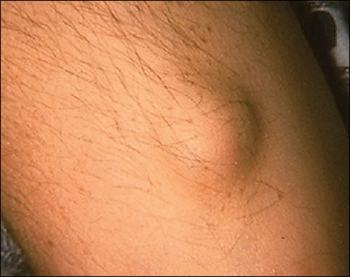
Clinical manifestations
Subcutaneous nodules:
Occur in 10% of patients.
They are infrequent and appear over the extensor surfaces of the elbows, knees, ankles, knuckles, scalp and spinous processes of the lumbar and thoracic vertebrae.
They are firm, painless lumps from a few millimetres to 2 cm in size.
They are normally in crops of three or four, appearing two or three weeks after onset of fever.
The histology resembles Aschoff bodies found in the heart and they are indicative of severe carditis
Subcutaneous nodule

Slide 15
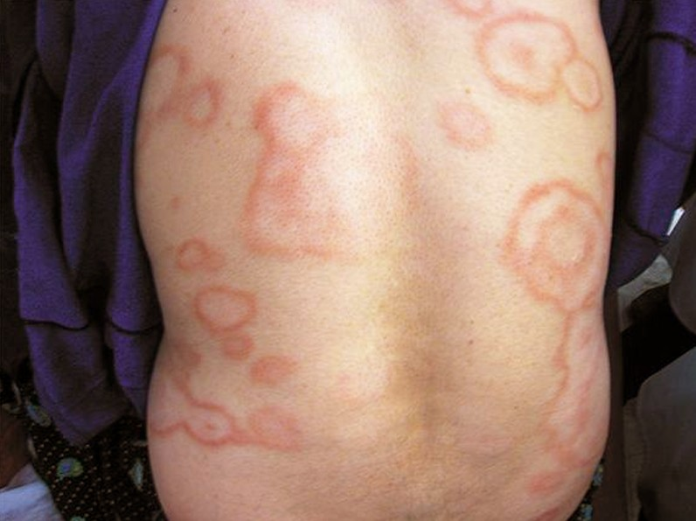
Clinical manifestations
Erythema marginatum (also known as erythema annulare):
It occurs in about 5-15% of patients.
The rash comprises pale-red macules or papules between 1 and 3 cm in diameter on the trunk and proximal limbs but never on the face.
The rash occurs early in the disease and remains long past the resolution of other symptoms.
It is exacerbated by heat and fades when the patient is cool.
Erythema marginatum

Slide 16
Differential diagnosis
Heart disease - consider:
Cardiomyopathy.
Kawasaki disease.
Infective endocarditis.
Rash (erythema marginatum) - consider:
Reactions.
Lyme disease.
Chorea - consider:
Drug reactions (especially in young people) to: metoclopramide, oral contraceptives, phenytoin, haloperidol or amitriptyline.
Huntington's chorea. This does not usually present until at least 30 (peak age 35-45).
Chorea gravidarum may occur in pregnancy.
Wilson's disease

Slide 17
Investigations
Throat swabs are usually performed but may fail to grow streptococci by the time symptoms of RF appear.
Clinical features begin when antibodies are at a peak.
Antistreptococcal antibodies are useful in patients with only chorea. Sensitivity can be improved by testing for several antibodies.
Check antibody titres two weeks apart for a rise.
The most common antibodies tested include antistreptolysin O (ASO) and anti-DNase B,

Slide 18
Investigations
  Antibodies rise during the first month after infection and then plateau for 3-6 months before returning to normal levels at 6-12/12
  ASO titer peaks two to three weeks after the onset of clinical disease and there is a sensitivity of 80-85%.
  Anti-DNase B has a slightly higher sensitivity at 90%.

Slide 19
Investigations
ECG may show a prolonged PR interval and possibly other features too. Tachycardia is usual, although some children develop bradycardia.
ST elevation suggests pericarditis.
CXR may show features of heart failure.
Doppler echocardiography is more sensitive than clinical assessment in the detection of carditis in acute RF and can contribute to earlier diagnosis.
The use of handheld echocardiography is being explored

Slide 20
Investigations
RF should still be considered as a likely diagnosis, even if criteria are not fully satisfied, when there is chorea or carditis without apparent cause and recent streptococcal infection, or when the patient has had previous RF and has symptoms of a recurrence.

Slide 21
Management
General
This is one of the very few conditions in which bed rest is enforced even if the patient feels well enough to be up and about.
Full activity should not be resumed until markers for inflammation and infection (acute-phase reactants) have returned to normal.
The main aims of management are to:
Eradicate the streptococcal infection if infection is still present (usually a pharyngitis).
Suppress inflammation arising from the autoimmune response.
Supportive treatment, particularly for cardiac complications such as congestive cardiac failure.

Slide 22
Management
Penicillin is given to eradicate any organisms still present.
Penicillin appears to be the drug of choice both in initial infection and to prevent recurrence.
WHO recommends that this should be given intramuscularly
For recurrent pharyngitis a second 10 days of penicillin may be given
Aspirin usually relieves arthritis within a few days. High doses are required and other NSAIDs like naproxen may be safer
Heart failure will require diuretics, angiotensin-converting enzyme (ACE) inhibitors and digoxin
Chorea is often self-limiting but is likely to need suppression with diazepam

Slide 23
Summary
Acute rheumatic fever is a nonsuppurative sequela of GA S pharyngitis that occurs two to four weeks following infection.
The diagnosis of ARF is established largely on clinical grounds.
The probability of ARF is high in the setting of GAS infection followed by two major manifestations or one major and two minor manifestations.
The 5 major manifestations are migratory arthritis (predominantly involving the large joints), carditis and valvulitis (eg, pancarditis), central nervous system involvement (eg, Sydenham chorea), erythema marginatum, and subcutaneous nodules.

Slide 24
Summary
The 4 minor manifestations are arthralgia, fever, elevated acute phase reactants, and prolonged PR interval.
Arthritis usually is the earliest symptomatic manifestation of ARF. The natural history consists of inflammation affecting several joint "migrates" from joint to joint.
Joint pain usually is more prominent than objective signs of inflammation and is almost always transient.
Rheumatic fever causes a pancarditis, affecting the pericardium, epicardium, myocardium, and endocardium

Slide 25
Summary
Sydenham chorea (also known as chorea minor or "St. Vitus dance") is a neurologic disorder consisting of abrupt, nonrhythmic involuntary movements, muscular weakness, and emotional disturbances
Erythema marginatum is an evanescent, pink or faintly red, non-pruritic rash involving the trunk and sometimes the limbs but not the face. The lesion extends centrifugally with return of the skin in the center to a normal appearance.

Slide 26
Summary
Subcutaneous nodules are firm, painless lesions ranging from a few millimeters to 2 cm in size. The nodules are usually located over a bony surface or prominence or near tendons (usually extensor surfaces) and are usually symmetric
Investigators have speculated that some cases of arthritis occurring after a streptococcal infection may not be caused by ARF. Evidence of carditis is not seen in these patients. This disorder has been called poststreptococcal reactive arthritis (PSRA).

Slide 27
Mitral stenosis (MS): Pathophysiology
Mitral stenosis (MS), resulting from thickening and immobility of the mitral valve leaflet, causes an obstruction in blood flow from the left atrium to left ventricle.
As a result, there is an increase in pressure within the left atrium, pulmonary vasculature, and right side of the heart, while the left ventricle is unaffected in isolated MS.
MS often coexists with mitral regurgitation and occasionally with aortic valve dysfunction, which may cause left ventricular dysfunction

Slide 28
Mitral stenosis (MS): Pathophysiology
ETIOLOGY
Rheumatic heart disease — In the great majority of cases, only 50 to 70 percent of patients report a history of RF.
Causes of MS include:
Degenerative calcification (can occur in the elderly).
Congenital mitral stenosis (Lutembacher's syndrome).
Inborn errors of metabolism (eg, Hurler-Scheie syndrome, Anderson-Fabry disease).
Systemic lupus erythematosus.
Rheumatoid arthritis.
Carcinoid syndrome.
Infective endocarditis with large vegetations.
Amyloid deposition in the mitral valve

Slide 29
Clinical presentation
Patients with mitral stenosis may feel asymptomatic for years and then present with a gradual decrease in activity.
Breathlessness: progressive breathlessness is the main symptom. This can include shortness of breath on exertion, orthopnoea and paroxysmal nocturnal dyspnoea. Pulmonary oedema can be triggered by the onset of atrial fibrillation.

Slide 30
Clinical presentation
Atrial fibrillation: palpitations due to atrial fibrillation may be the presenting feature.
Systemic emboli: are a rarer presentation. Stroke, renal failure and myocardial infarction can occur.
Haemoptysis: this may occur secondary to rupture of the bronchial veins due to raised left atrial pressure.
During pregnancy: the increase in blood volume may make a previously asymptomatic woman develop symptoms.

Slide 31
Clinical presentation
Signs
Malar flush on the cheeks.
Raised jugular venous pressure.
Laterally displaced apex beat.
Right ventricular heave.
Loud first heart sound with an opening snap in early diastole.
A mid-late diastolic murmur, best heard, with the patient in the left lateral position, with the bell of the stethoscope (see separate article Heart Auscultation).
Atrial fibrillation.
Signs of right ventricular failure including hepatomegaly, ascites and peripheral oedema.

Slide 32
Clinical presentation
Investigations
CXR:
left atrial enlargement
(Kerley A and B lines) if severe.
Mitral valve calcification
Prominent pulmonary vessels
ECG: may reveal atrial fibrillation, left atrial enlargement and right ventricular hypertrophy.
Echocardiography:
Main method to assess the severity and consequences of mitral stenosis, as well as the extent of anatomical lesions.
Echocardiography also evaluates pulmonary artery pressures, associated MR, concomitant valve disease, and left atrial size.

Slide 33
Management
Asymptomatic patients with clinically significant mitral stenosis, should be followed up yearly by means of clinical and echocardiographic examinations and at longer intervals (2 to 3 years) in cases of less severe stenosis.
PMC is the treatment of choice when treatment is indicated, except for patients with suboptimum valve morphology
Commissurotomy (valvulotomy) involves making one or more incisions at the edges of the commissure formed between the valves in order to relieve the constriction.

Slide 34
Management
Medical therapy
Diuretics or long-acting nitrates can be used to alleviate dyspnoea.
Beta-blockers or heart-rate regulating calcium-channel blockers can improve exercise tolerance.
Anticoagulant therapy is indicated in patients with either permanent or paroxysmal atrial fibrillation. In patients with sinus rhythm, anticoagulation is indicated when there has been prior embolism, or a thrombus is present in the left atrium.

Slide 35
Management
Surgery: PMC:
Symptomatic patients with severe MS or those with PHT should be considered for PMC.
Contra-indications to PMC include:
Mitral valve area >1.5 cm²
Left atrial thrombus
Mitral regurgitation
Bicommissural calcification
Severe concomitant aortic valve disease,
Severe combined tricuspid stenosis and regurgitation
When PMC is not successful and symptoms persist, surgery should be considered early

Slide 36
Management
Prognosis
Five-year survival rate with symptomatic mitral stenosis who refuse valvotomy is only 44%.
No symptoms or minimal symptoms, survival is greater than 80% at ten years.
When limiting symptoms occur, ten-year survival is less than 15%
When severe PHT develops, mean survival is less than three years.
Most patients with severe untreated mitral stenosis die as a result of progressive heart failure but others may die from systemic embolism or pulmonary embolism, or infection.

Slide 37
Mitral Regurgitation
Mitral regurgitation (MR) is defined as an abnormal reversal of blood flow from the left ventricle (LV) to the left atrium (LA).
The most common etiologies of MR include:
MV prolapse (MVP)
Rheumatic heart disease
Infective endocarditis
Annular calcification
cardiomyopathy
Ischemic heart disease

Slide 38
Mitral Regurgitation
Signs and symptoms
When associated with coronary artery disease (CAD) and acute myocardial infarction (MI), significant acute MR is accompanied by the following symptoms:
Dyspnea
Fatigue
Orthopnea
Pulmonary edema (often the initial manifestation)

Slide 39
Mitral Regurgitation
Chronic MR:
Some patients may remain asymptomatic for years
Patients may have normal exercise tolerance until systolic LV dysfunction develops, at which point they may experience symptoms of a reduced forward cardiac output
Patients may feel chest palpitations if AF develops as a result of chronic atrial dilatation
Patients with LV enlargement and more severe disease eventually progress to symptomatic congestive heart failure (CHF) with pulmonary congestion and edema

Slide 40
Mitral Regurgitation
Palpation may reveal:
Brisk carotid upstroke and hyperdynamic cardiac impulse
Prominent LV filling wave
Auscultation may reveal the following:
Diminished S₁ in acute MR and chronic severe MR with defective valve leaflets
Wide splitting of S₂ as a result of early closure of the aortic valve
S₃ as a result of LV dysfunction or increased blood flow across the MV
Accentuated P₂ if pulmonary hypertension is present
Characteristic murmur

Slide 41
Mitral Regurgitation
Diagnosis:
CXR:
Evidence of LV enlargement due to volume overload (particularly in chronic MR), though pulmonary congestion may not be observed until heart failure has developed
Evidence of LA enlargement in the anteroposterior view
Echocardiography:
Flail leaflet/ruptured papillary muscle
Very large color flow central jet or eccentric jet adhering, swirling, and reaching the posterior wall of the LA
Dense/triangular continuous-wave signal of regurgitant jet

Slide 42
Mitral Regurgitation
Management
Medical therapy includes the following:
Afterload-reducing agents and diuretics in MR with symptoms or LV dysfunction
Beta blockers and biventricular pacing for primary treatment of LV dysfunction in functional MR
In the presence of AF, beta blockers, calcium channel blockers, digitalis, or a combination
Anticoagulation for AF or have had MV replacement surgery
Prophylactic antibiotics

Slide 43
Mitral Regurgitation
Surgical:
Symptomatic chronic severe MR – Surgery is recommended for NYHA functional class II-IV symptoms without severe LV dysfunction
Surgical MV repair remains the criterion standard intervention for severe MR; however, percutaneous double-orifice repair is a viable alternative
Operative mortality includes:
Isolated mitral valve repair surgery carries a 2% mortality.
Mitral valve replacement surgery: 4% mortality for patients younger than 50 years; 17% mortality for patients older than 80 years.

Slide 44
Mitral Regurgitation
Prognosis
Outcomes for asymptomatic chronic severe degenerative MR are as follows:
Mortality ranges from 50-73% at 5 years
Mortality in patients with preserved LV function ranges from 27-45%.
Sudden death may be as common as 1-8% per year in patients with a flail leaflet.

