Slide 1
NEPHROTIC SYNDROME
BY
DR. Hayam Hebah
Associate professor of Internal Medicine
AL Maarefa college

Slide 2
Definition:
Nephrotic syndrome
hypercholesterolemia
Overt proteinuria: usually >3.5 g/24 hrs
Hypoalbuminemia(<3 g/L)
Edema and generalised fluid retention

Slide 3
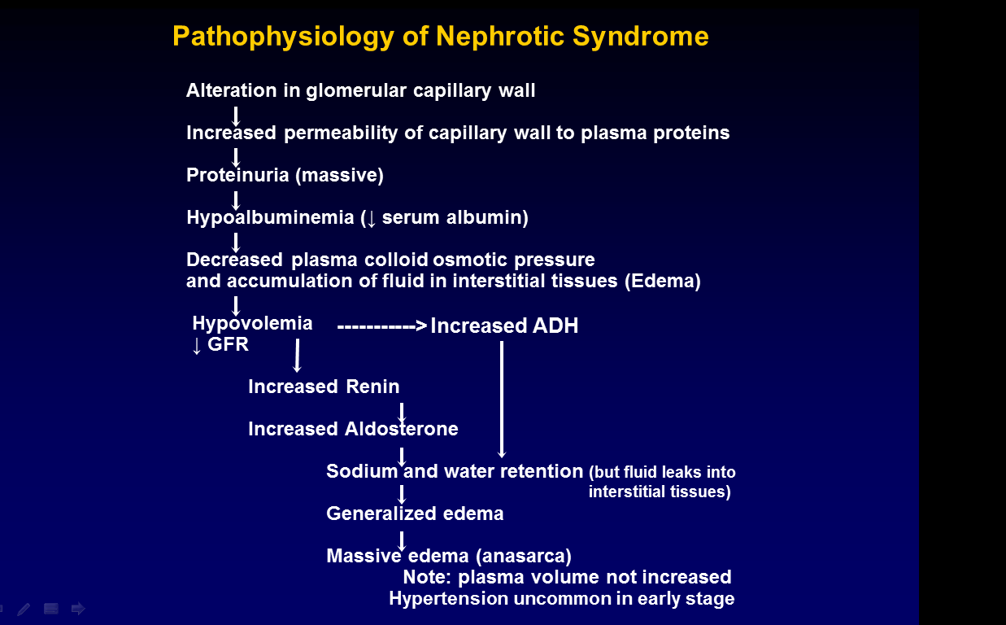

Slide 4
Metabolic complications of proteinuria
Intravascular volume depletion with hypotension, or intravascular expansion with hypertension may occur
Hypercoagulability( due to loss of coagulation inhibitors as antithrombin III, protein C&S and increase in liver synthesis of procoagulant factors.
Infection due to urinary loss of Igs and resulting hypogammaglobulins.
Hyperlipidemia and atherosclerosis
Hypocalcemia and bone abnormalities
Failure to thrive may be caused by anorexia, hypoproteinemia, increased protein catabolism, or frequent infectious complications. Edema of the gut may cause defective absorption, leading to chronic malnutrition

Slide 5
*Bone problems:
Hypocalcemia d.t low serum albumin
low bone density and abnormal bone histology caused by urinary losses of vitamin D–binding proteins, with consequent hypovitaminosis D and, as a result, reduced intestinal calcium absorption
Osteomalacia
Low bone mass may be found in relation to cumulative steroid dose
Hypovolemia Observed only when the patient's serum albumin <1.5 mg/dL..

Slide 6
Hypercoagulability
Venous thrombosis and pulmonary embolism are well-known complications
Hypercoagulability from urinary loss of anticoagulant proteins, such as antithrombin III and plasminogen, along with the simultaneous increase in clotting factors, especially factors I, VII, VIII, and X.
There is also an increased risk of arterial thrombotic events, including coronary and cerebrovascular ones .This risk was related to risk factors for arterial disease, such as hypertension, diabetes, smoking, and reduced GFR.

Slide 7
Causes of nephrotic syndrome:
Primary:-
Minimal change disease
Focal segmental glomerulosclerosis
Membranous nephropathy
Secondary:
Diabetic nephropathy
Lupus nephritis
Amyloidosis
Drugs
Malignancy
Congenital NS

Slide 8
Drugs causing NS:
minimal-change nephropathy with NSAID use.
membranous nephropathy with the administration of gold and penicillamine
focal glomerulosclerosis in association with intravenous bisphosphonates.
Lithium and interferon therapy also are implicated in focal glomerulosclerosis of the collapsing type.
anticancer agents

Slide 9
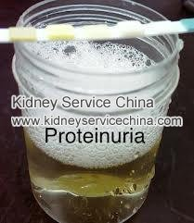
C/P of NS
Symptoms:
Signs
swelling of the face; this is followed by swelling of the entire body.
Foamy urine
A thrombotic complication, such as DVT or PE.
OF the cause of nephrotic syndrome
Edema start periorbital . Later ,increase in weight, the development of ascites, or pleural effusions.
Hematuria and hypertension manifest in a minority of patient
according to cause

Slide 10
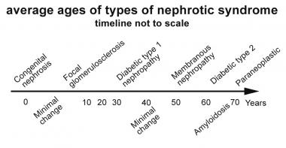
Epidemiology: -Age:

Slide 11
Sex:
-most cases of NS occur more in males except in SLE ,females are more liable.
Race:
Because diabetes is major cause of nephrotic syndrome, American Indians, Hispanics, and African Americans have a higher incidence of nephrotic syndrome than do white persons.
HIV nephropathy is seen with greater frequency in African Americans.
Focal glomerulosclerosis appears to be overrepresented in African-American children, as compared with white children.

Slide 12
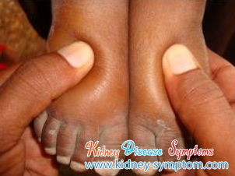
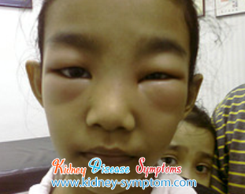
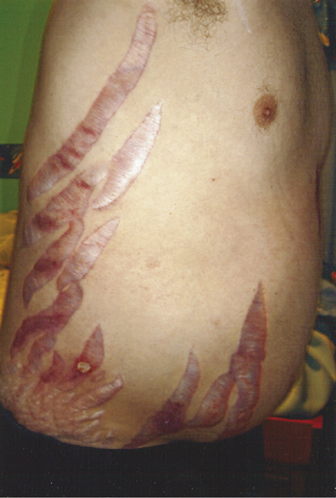
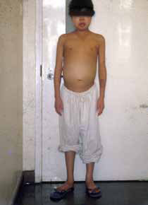

Slide 13
investigations
Urine analysis: first step ,detects proteinuria.
Microscopic hematuria may be seen in membranous nephropathy but not in MCD.
QUANTITATIVE PROTEINURIA
Blood examination for s. creatinine and electrolytes
Serum albumin.
Lipid profile.
Serologic studies: Phospholipase A2 receptor
Ultrasonography
Investigations for the cause in secondary forms

Slide 14
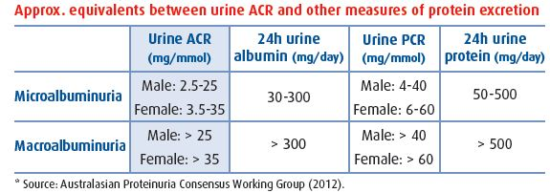
Urine quantification:
24 hours collection
Protein: creatinine ratio(PCR) in a spot sample of urine
Albumin : creatinine ratio(ACR)

Slide 15
RENAL BIOPSY:
For childhood nephrotic syndrome, a renal biopsy is indicated for the following:
Congenital nephrotic syndrome
Children older than 8 years at onset
Steroid resistance
Frequent relapses or steroid dependency
Significant nephritic manifestations
Adult nephrotic syndrome of unknown origin may require a renal biopsy for diagnosis. A renal biopsy is not indicated in a patient with longstanding diabetes

Slide 16
Management of NS:
3 steps:
1-measures to reduce proteinuria.
2- measures to treat complications of nephrotic syndrome
3-ttt of underlying cause

Slide 17
GENERAL MEASURES IN ACUTE STAGE
Diuretics will be needed; furosemide, spironolactone, and even metolazone may be used BUT TAKE CARE OF volume depletion may occur with diuretic use.
Anticoagulation has been advocated by some for use in preventing thromboembolic complications, but its use in primary prevention is of unproven value.
Hypolipidemic agents may be used ??
For proteinuria ,angiotensin-converting enzyme (ACE) inhibitors and/or angiotensin II receptor blockers(ARB).These may reduce proteinuria by reducing the systemic blood pressure, by reducing intraglomerular pressure, and also by direct action on podocytes.

Slide 18
Long-Term Monitoring
immunizations when the patient is free of relapses and has been off immunosuppression for 3 months. Pneumococcal and influenza vaccines are recommended but are not routinely used, because their efficacy is not established.
treatment of relapses of steroid-responsive nephrotic syndrome. The first 2 relapses are treated in the same manner as the initial presentation; frequent relapses are treated with a maintenance dose of prednisone at 0.1-0.5 mg/kg on alternate days for 3-6 months, with the drug then tapered.
Monitoring for steroid toxicity every 3 months in the outpatient clinic
monitoring of diuretic and angiotensin antagonist regimens.

Slide 19
Complications of NS and its management:
For edema---→ salt restriction, diuretics and in severe cases salt free albumin infusions.
For infections--→vaccination and antibiotics
Thrombotic complications-→ anticoagulation for patients with DVT and arterial thrombosis
Hyperlipidemia-→ food restriction and lipid lowering agents
Steroid toxicity--→ minimisation of dose of steroids and adding steroid sparing immunosuppressives
Hypovolemia and ARF--→judicious fluid control.
Vitamin D supplementation.
Proteins 0.8-1 g/kg/d

Slide 20
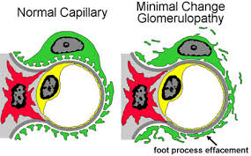
Minimal change nephropathy(MCD)

Slide 21
c/p of MCD:
Main cause of NS in children
¼ of cases in adults
Caused by reversible dysfunction of podocytes
Present with proteinuria SELECTIVE PROTEINURIA or NS
Remits with high dose of corticosteroids
Histologically: - N L/M
- No immune deposits by IF.
- Fusion of podocytes foot processes by EM.
Course may be associated with relapses and remission but rarely progress to ESRD

Slide 22
Treatment:
Corticosteroids give excellent response .
Immunosuppressive medications other than steroids are usually reserved for steroid-resistant patients with persistent edema, or for steroid-dependent patients with significant steroid-related adverse effects e.g: Cyclophosphamide.
Cyclosporine is indicated when relapses occur after cyclophosphamide treatment.

Slide 23
Prognosis of MCD
The prognosis usually is very good.
Most children respond to steroid therapy; still, about 50% of children have 1 or 2 relapses within 5 years .
Only 30% of children never have a relapse after the initial episode.
Adults have a burden of relapse similar to that of children. However, the long-term prognosis for kidney function in patients with this disease is excellent, with little risk of renal failure.

Slide 24
Focal segmental glomerulosclerosis
Can occur in all age groups. More in blacks
AFFECT SOME OF THE GLOMERULI(NOT ALL) SO FOCAL AND ONLY SEGMENTS OF GLOMERULI AFFECTED(SEGMENTAL)
Primary form present with severe NS
Secondary form with HIV, obesity, heroin addiction, vasculitis, HUS, cholesterol embolism.
Can respond to corticosteroids but mostly no response . Immunosupressives are used also.
Progression to CKD is common.
Recurs after transplantation.

Slide 25
Treatment:
predisone, cyclosporine, and cyclophosphamide have all been used in treatment.
Corticosteroids should be the first-line agent, with cyclophosphamide or cyclosporine as backup for steroid-resistant cases.
Mycophenolate and rituximab have also been used in treating focal glomerulosclerosis. However, data on the use of these latter 2 agents are not convincing

Slide 26
Prognosis of FSGS
Only 20% of patients undergo remission of proteinuria; an additional 10% improve but remain proteinuric. Many patients experience frequent relapses, become steroid-dependent, or become steroid-resistant
ESRD develops in 25-30% of patients with focal segmental glomerulosclerosis by 5 years and in 30-40% of these patients by 10 years

Slide 27
Membranous nephropathy
Commonest cause of NS in adults.
Caused by autoantibodies directed at antigens expressed on podocytes surface.
Ag is the M-type phospholipase A2 receptor1.
COURSE:- 1/3 spontaneous remission.
-1/3 remain in nephrotic state
-1/3 develop CKD
May respond to corticosteroids or immunosuppressants.

Slide 28
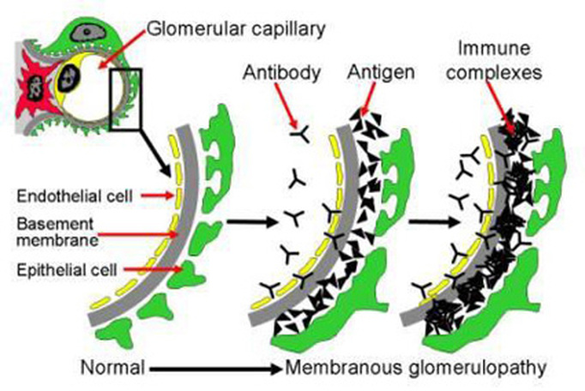

Slide 29
MN:
IDIOPATHIC
SECONDARY:
Infections: hepatitis B and C, Malaria
Autoimmune: SLE, rheumatoid arthritis, hashimoto thyroiditis.
Malignancies: solid organs as cancer breast, colon, lung.
Drugs: gold and penicillamine.
Miscellaneous: DM, SARCOIDOSIS.

Slide 30
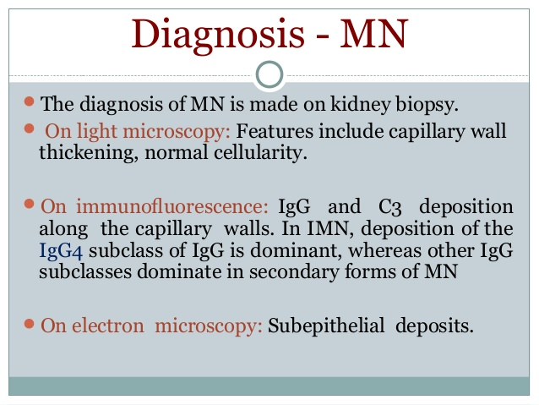

Slide 31
Treatment:
For idiopathic membranous nephropathy, prednisone along with chlorambucil or cyclophosphamide remains important for treatment. Other agents that have been used for the treatment are cyclosporine, synthetic corticotropin, and rituximab.
For secondary forms, treatment is of the cause.

Slide 32
Prognosis of MN:
Survival rates in these patients were the same as those expected for the general population.
The prognosis may worsen because of (1) an increased incidence of renal failure and the complications secondary to nephrotic syndrome, including thrombotic episodes and infection, or (2) treatment-related conditions, such as infectious complications of immunosuppressive treatments.

Slide 33
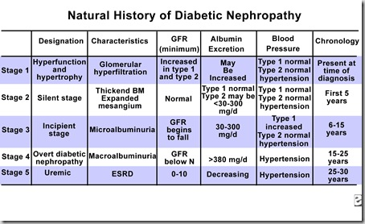
DIABETIC NEPHROPATHY

Slide 34
Management of diabetic nephropathy
Good glycemic control.
Antihypertensives to keep BP<130/80
Use ACEI or ARBs

Slide 35
Lupus nephritis:
Refer to SLE lecture

Slide 36
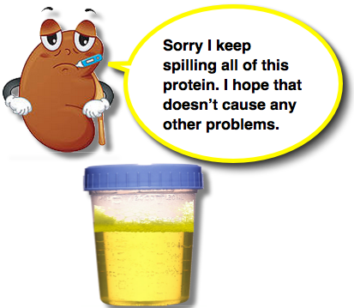

Slide 37
THANK YOU

