Slide 1
Iron Toxicity

Slide 2
Overview
Principle of the disease
Clinical features
Diagnosis
management

Slide 3
Overview
Iron, which is essential to the function of hemoglobin, myoglobin, many cytochromes, and many catalytic enzymes, can be extremely toxic when levels are elevated after an overdose or from accumulation in disease states.

Slide 4
The acute ingestion of iron is especially hazardous to children.
Serious iron ingestions in adults are usually associated with suicide attempts.
Early recognition is necessary to ensure appropriate therapy and prevention of fatalities.

Slide 5
Principle of the disease
Normally:
approximately 10% of ingested iron is absorbed from the intestine and subsequently bound to transferrin, using only 15 to 35% of the iron-binding capacity of transferrin.

Slide 6
Normal serum iron levels range from 50 to 150 μg/dL.
The total iron-binding capacity (TIBC), ranges from 300 to 400 μg/dL.
TIBC is a crude measure of the ability of serum proteins—including transferrin—to bind iron.

Slide 7
When iron levels rise after a significant iron overdose, transferrin becomes saturated so that excess iron circulates as free, unbound iron in the serum.
This unbound iron is directly toxic to target organs.

Slide 8
Iron preparations:
In assessment of the severity of an iron exposure, it is important to refer to the amount of elemental iron ingested because the toxicity of an iron compound depends on the amount of elemental iron it contains.

Slide 10
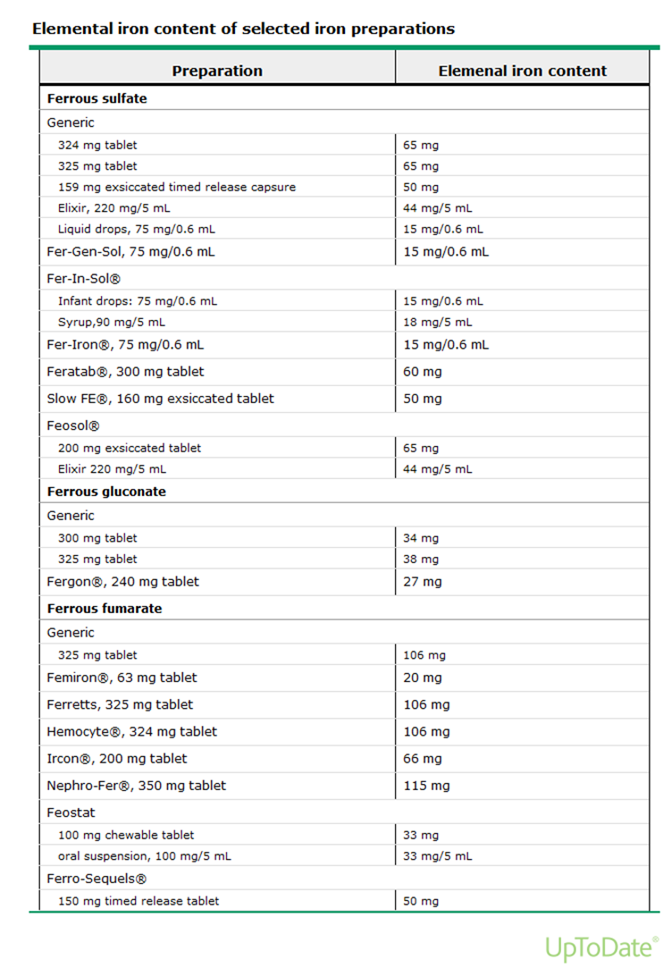

Slide 11
The total amount of elemental iron ingested can be approximated by multiplying the estimated number of tablets by the fraction of elemental iron contained in the tablet.

Slide 12
Ingestions of less than 20 mg/kg of elemental iron usually cause no symptoms.
Ingestion of 20 to 60 mg/kg results in mild to moderate symptoms.
Ingestion of more than 60 mg/kg may lead to sever symptoms.

Slide 13
the dose of elemental iron associated with 50% mortality is 200 to 250 mg/kg in adult but in children doses as small as 130 mg of elemental iron have been lethal.

Slide 15
Iron has two distinct toxic effects:
it causes direct caustic injury to the gastrointestinal mucosa
AND
it impairs cellular metabolism, primarily of the heart, liver, and central nervous system (CNS).

Slide 16
Clinical features
The clinical effects of acute iron poisoning occur in five stages.
Not every patient goes through every phase.

Slide 17
Phase 1:
reflects the corrosive effects of iron on the gut.
Vomiting occurs within 80 minutes of ingestion in more than 90% of symptomatic cases.
Diarrhea, which can be bloody, soon follows.

Slide 18
Phase 2:
represents an apparent (but not complete) recovery that lasts less than 24 hours but can extend up to 2 days.
Most patients recover after this point.

Slide 19
Phase 3:
characterized by the recurrence of gastrointestinal symptoms, severe lethargy or coma, anion gap metabolic acidosis, leukocytosis, coagulopathy, renal failure, and cardiovascular collapse.

Slide 20
Serum iron levels may have fallen to normal during this phase because of distribution of iron into the tissues.

Slide 21
Phase 4:
characterized by fulminant hepatic failure, occurs 2 to 5 days after ingestion.
rare, appears to be dose related, and is usually fatal.

Slide 22
Phase 5:
represents the consequences of healing of the injured gastrointestinal mucosa.
It is characterized by pyloric or proximal bowel scarring, which is sometimes associated with obstruction.

Slide 23
Diagnosis
History :
Amount and type !
VOMITING

Slide 24
LABs:
CBC
U&Es
LFTs
BGs
Glucose
Coagulation
Serum level

Slide 25
A serum iron level measured at its peak, 3 to 5 hours after ingestion, is the most useful laboratory test to evaluate the potential severity of an iron overdoes

Slide 26
Peak serum iron levels below 350 μg/dL are generally associated with minimal toxicity.
350 to 500 μg/dL, with moderate toxicity.
above 500 μg/dL, with potentially severe toxicity

Slide 27
Most tablets that contain a significant amount of elemental iron are radiopaque.
The presence of tablets on a radiograph correlates with the severity of the ingestion

Slide 29
Management
Supportive measures:
Airway
Breathing
circulation

Slide 30
Gastric decontamination:
Activated charcoal does not bind iron, and neither gastric lavage effectively removes large numbers of pills.
Whole-bowel irrigation is generally the preferred method of decontamination for significant iron ingestions.

Slide 31
Hemodialysis and hemoperfusion are not effective in the removal of iron because of its large volume of distribution.

Slide 32
Deferoxamine:
is the antidote of choice for serious iron overdose.
It is a chelating agent that, in acute iron intoxication, binds with ferric iron (Fe3+) in the blood to form water-soluble ferrioxamine that is then excreted by the kidneys.

Slide 33
Indications for deferoxamine include:
_ sever symptoms
_ high anion metabolic acidosis
_ serum level more than 500mcg/Dl
_ significant number of pills on abdominal radiography.

Slide 34
Dose and duration of treatment:
continuous infusion at 15 mg/kg/hr for up to 24 hours.
The maximum rate of administration is 35 mg/kg/hr.

Slide 35
Significant adverse effects of intravenous deferoxamine therapy include hypotension and the development of acute respiratory distress syndrome (ARDS)

Slide 36
Q?

