Slide 1
Emergency Airway Algorithm
Abdullah Alsakka
EM. Consultant
Head of Arab Board for Emergency Medicine
King Khalid University Hospital
Riyadh Saudi Arabia

Slide 2
Objectives
Introduction
Emergency Airway Algorithm
The Crash Airway Algorithm
The Difficult Airway Algorithm
The Failed Airway Algorithm
Conclusions
Evidence for the algorithm

Slide 3
Emergency Airway Algorithm
Key question 1: Is the crash airway?
Key question 2: Is the difficult airway?
Critical action: Perform RSI.*
Key question 3: Was intubated successful?
Key question 4: Can the patient oxygenation be maintained?
Key question 5: Have three attempts at orotrachial intubation made by an experienced operator

Slide 4
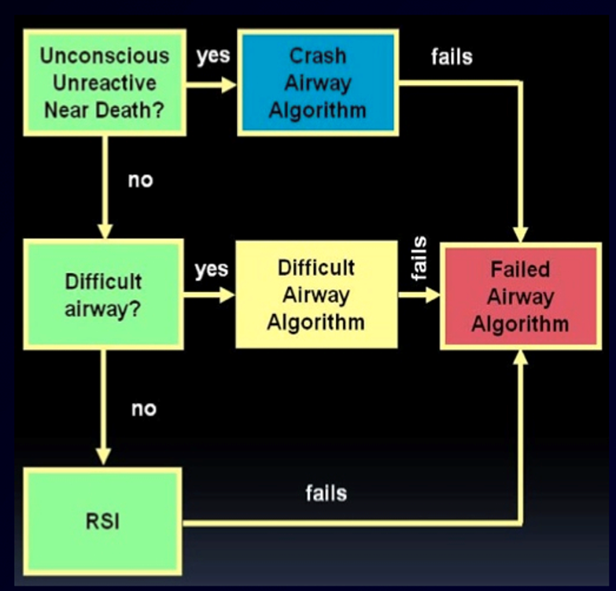

Slide 5
The Crash Airway Algorithm
Entering the crash airway algorithm indicate that one has unconscious, unresponsive patient with immediate need for airway management
Critical action: Intubate immediately
Key question 1: Was intubation successful?
Key question 2: Is bag mask oxygenation is adequate?
Critical action: Administer succinylcholine 2 mg/kg intravenous push
Critical action: Attempt intubation
Key question 3: Was intubation successful?
Key question 4: Is oxygenation is adequate?
Key question 5: Have been three attempt at intubation by an experienced operator?

Slide 6
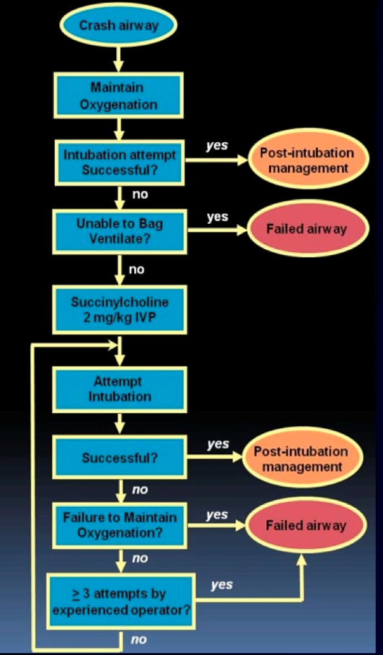

Slide 7
The Difficult Airway Algorithm
Critical action: Call for assistance
Key question 1: Is there adequate time?
Key question 2: Despite the presence of the difficult airway, is RSI indicated?
RSI is often both safe and effective in a patient with an identified difficult airway but identifying the difficult airway in advance permits care planning
Critical action: Perform wake intubation
Awake intubation is the cornerstone of difficult airway management
Critical action: Select an alternative approach

Slide 8
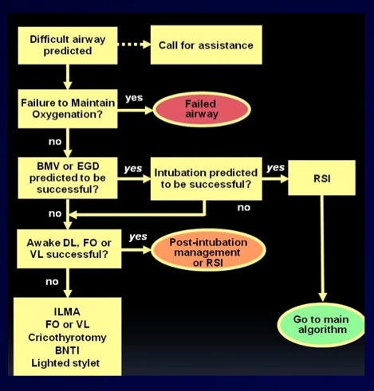

Slide 9
The Failed Airway Algorithm
Critical action: call for assistance
Key question 1: Is oxygenation adequate?
Can not intubate, can not oxygenate = cricothyrotomy in the vast majority of circumstance
Critical action
Key question 2: Does the advice used result in a definitive airway?

Slide 10
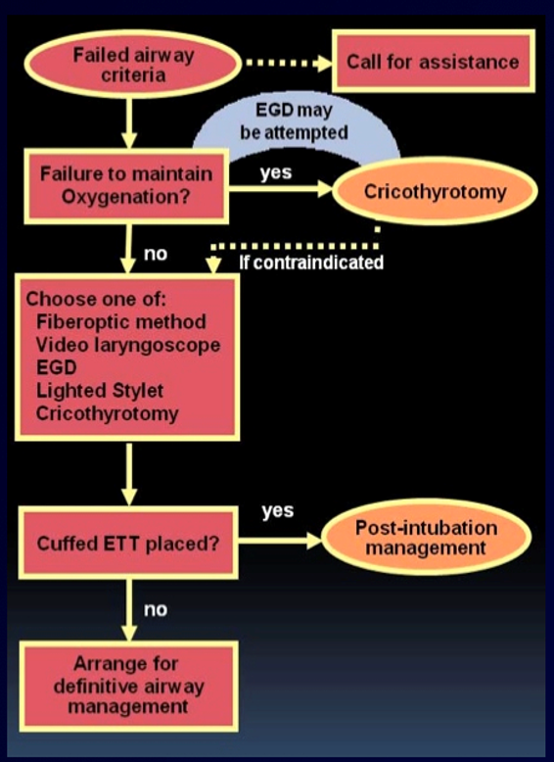

Slide 11
Conclusions
The algorithm are intended as guide line only
Understanding the fundamental concept of the difficult and failed airway
Identification of the difficult, recognition of the crash airway and the use of RSI as airway management method of choice for the most emergency intubations which will result in successful airway management with minimal morbidity.

Slide 12
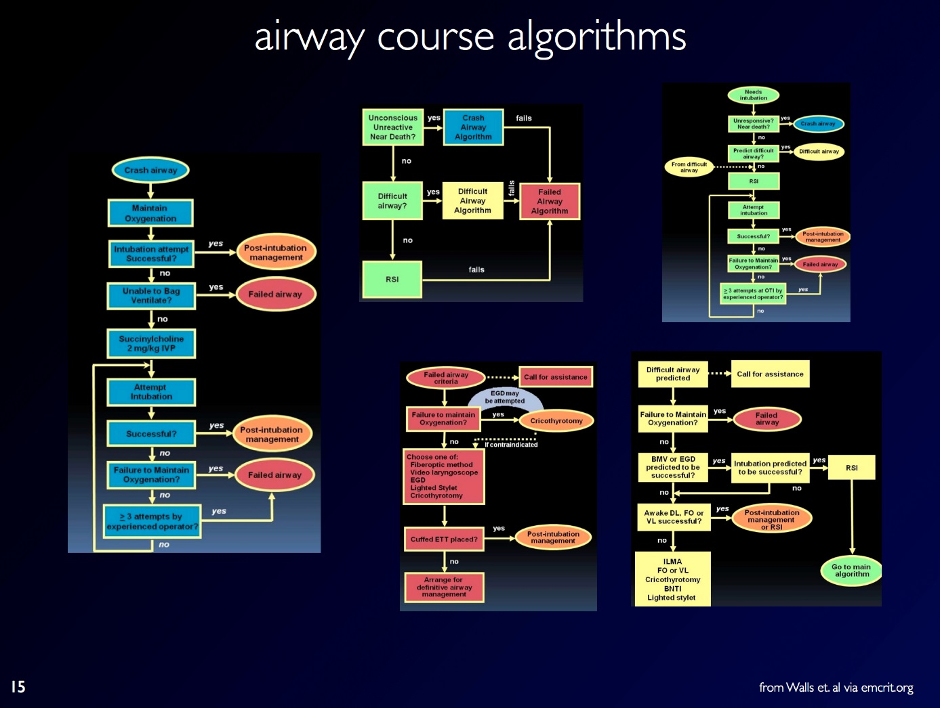

Slide 13
Evidence for Algorithms
There no systemized data supporting the algorithm
The algorithms are the result of careful review of the American society of anesthesiologists difficult airway algorithm and comprise knowledge and experience of the editors who functioned as an expert panel in this regard.
They are designed to help guide a consistent approach to both common and uncommon management situations

