Slide 1
Acetaminophen Toxicity

Slide 2
Overview
Principle pf the disease
Clinical features
Diagnosis
Management

Slide 3
Overview
Acetaminophen is one of the most commonly used antipyretic and analgesic agents throughout the world.
Acetaminophen is found as an isolated product or in combination medications for the treatment of cold symptoms, pain, and headache.

Slide 4
It’s a very common drug all over the world in both oral and IV route.
toxicity is a concern in all intentional ingestions as well as with repeated supratherapeutic dosing and drug abuse.

Slide 5
Principles of the disease
Acetaminophen is absorbed rapidly, with peak plasma concentrations generally occurring within 1 hour and complete absorption within 4 hours.
acetaminophen inhibits prostaglandin E2 (PGE2) synthesis, leading to antipyresis and analgesia

Slide 6
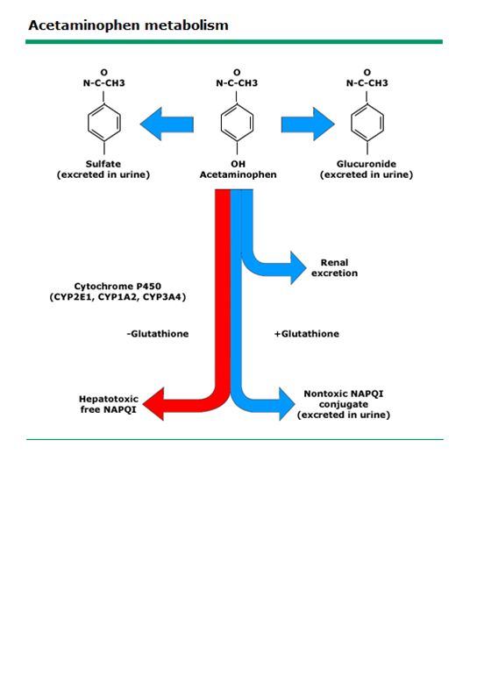

Slide 7
At therapeutic doses, 90 percent of acetaminophen is metabolized in the liver to sulfate and glucuronide conjugates then excreted in the urine.

Slide 8
One-half of the remaining acetaminophen is excreted unchanged in the urine and one-half is metabolized via the hepatic cytochrome P450 to N-acetyl-p-benzoquinoneimine (NAPQI), which is hepatotoxic.

Slide 9
With normal doses ,NAPQI is rapidly conjugated to hepatic glutathione, forming nontoxic cysteine and mercaptate compounds that are excreted in the urine.

Slide 10
With toxic doses the sulfate and glucuronide pathways become saturated, resulting in an increased fraction of acetaminophen being metabolized by cytochrome P450 enzymes.
Once glutathione stores are depleted, NAPQI begins to accumulate and hepatic injury ensues.

Slide 11
Clinical features
Early
1st 8 hours.
Nonspecific
Mild symptoms such as nausea ,vomiting or anorexia.

Slide 12
Liver injury
Between 8 and 36 hours.
RUQ pain
RUQ tenderness
Jaundice
Vomiting
High LFTs.

Slide 13
Liver failure
Metabolic acidosis
Coagulopathy
Hepatic encephalopathy

Slide 14
Death may occur from hemorrhage, adult respiratory distress syndrome, sepsis, multiorgan failure, or cerebral edema.

Slide 16
Diagnosis
Acetaminophen toxicity should be consider in any patient with drugs overdose

Slide 17
History
The amount
150mg/kg
The time since ingestions
4 hours
8 hours

Slide 18
Laboratory
CBC
U&Es
LFTs
VBG
Serum level
PT.PTT,INR

Slide 19
LFTs
AST is the first enzyme to raise.
Alanine transaminase (ALT), prothrombin time, and bilirubin typically begin to rise and peak shortly after AST values
With severe toxicity, AST, ALT, and the prothrombin time may all be elevated within 24 hours

Slide 20
Serum level
serum acetaminophen concentration 4 hours after ingestion or as soon as possible after 4 hours.

Slide 21
The serum acetaminophen concentration and the time of ingestion determine the need for antidotal therapy .

Slide 22
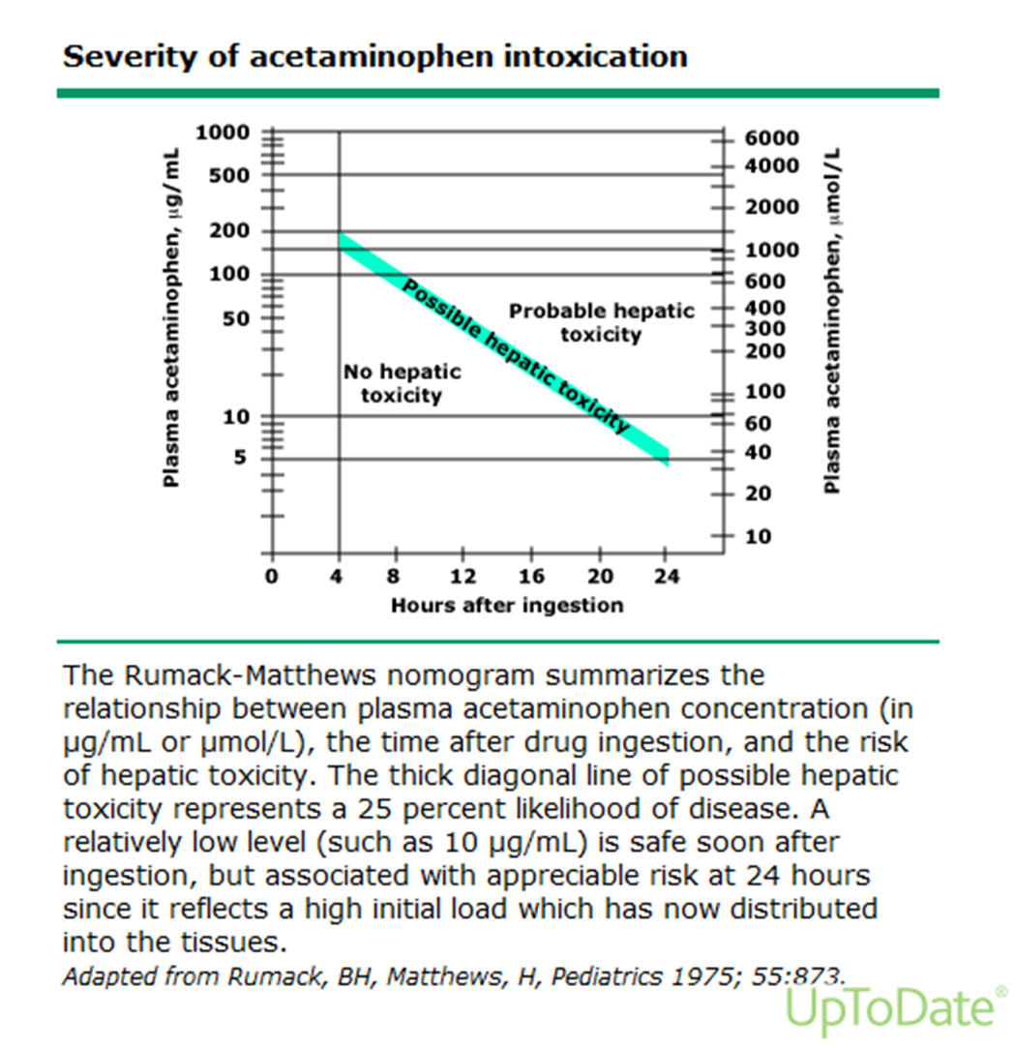

Slide 23
Measurement of serum acetaminophen concentration before 4 hours is typically not necessary.

Slide 24
there is little need to treat patients before 6 to 8 hours after ingestion
patients treated with NAC (N-Acetylcysteine) up to 6 hours after ingestion, even after very large doses, have no increased risk of hepatotoxicity regardless of their serum acetaminophen concentration.

Slide 25
the risk of hepatotoxicity does not significantly increase unless NAC is delayed for 8 hours or longer after ingestion

Slide 26
Management
The mainstays of management are to provide supportive care and to initiate NAC therapy when it is indicated

Slide 27
Gastric decontamination
Usually not needed

Slide 28
N-Acetylcysteine
When it is indicated, NAC should be administered as early as possible.
Delay of NAC administration for more than 8 hours after ingestion increases the risk of hepatotoxicity

Slide 29
The main role of early NAC administration is to
prevent hepatotoxicity by detoxifying NAPQI and decreasing NAPQI production

Slide 30
NAC can be administered by the oral (PO) or IV route, with advantages and disadvantages for each.
All formulations of NAC(PO and IV) are effective when they are started within 8 hours of ingestion.

Slide 31
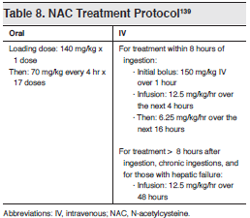

Slide 33
Supportive care
Supportive care includes management of coingestions and the nausea and vomiting, hepatic injury, and renal dysfunction related to acetaminophen poisoning.

Slide 34
Q?

