Slide 1
Abdominal Injury
Mohammed Aref Malabarey MD, FRCPC, DABEM
Consultant Physician
Assistant Professor of Emergency Medicine

Slide 2
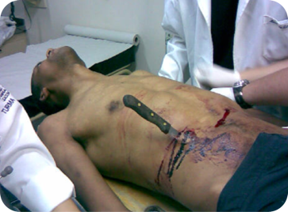
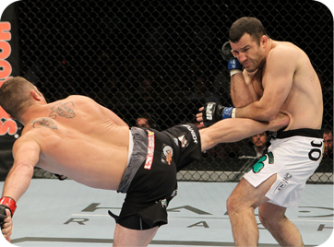
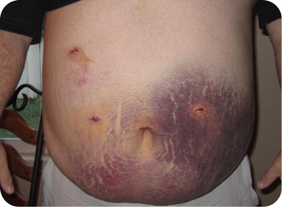
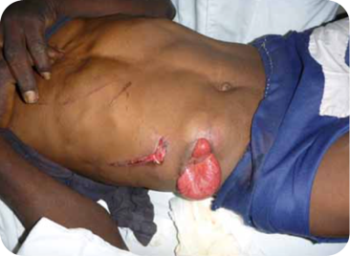

Slide 3
Relevant Anatomy
Anterior Abdomen:
Between the anterior axillary line from the anterior costal margins to the
groin creases
Low chest:
Begins at the nipple line or 4th intercostal space anteriorly and the inferior scapular tip or 7th intercostal space posteriorly
Flank:
Between the anterior and posterior axillary lines bilaterally and from the inferior scapular tip to the iliac crest
Back:
Between the posterior axillary lines, beginning at the inferior scapular tip and extending to the iliac crest

Slide 4
Penetrating Abdominal Trauma
  Stabbing 3x more common than firearm wounds
  GSW cause 90% of the deaths
  Most commonly injured organs: small intestine > colon > liver
Blunt Abdominal Trauma
  Greater mortality than PAT (more difficult to diagnose, commonly associated with trauma to multiple organs/systems)
  Most commonly injured organs: spleen > liver, intestine is the most likely hollow viscus.
  Most common causes: MVC (50 - 75% of cases) > blows to abdomen (15%) > falls (6 - 9%)

Slide 5
Mechanism of blunt injury ?
Rupture or burst injury of a hollow organ by sudden rises in intra-abdominal pressures
Crushing effect
Acceleration and deceleration forces → shear injury
Seat belt injuries
  “seat belt sign” = highly correlated with intraperitoneal injury

Slide 6
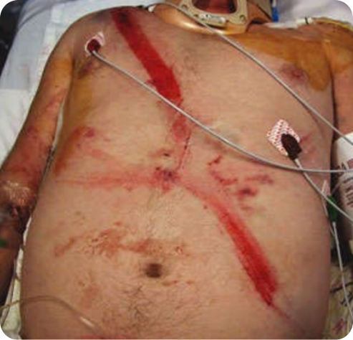
Seat Belt Sign
-Contusion or perforation of the intestine
-Tear of the mesentery
-Diaphragmatic rupture
-Injuries to the lumbar spine
-Abdominal aortic dissection (rare)

Slide 7
Physical Exam is generally unreliable
Distracting Injuries
Altered Mental Status
Spinal cord injuries

Slide 8
Signs of Intraperitoneal Injuries?
  Abdominal tenderness/ peritoneal signs, gastrointestinal hemorrhage
  Entrance and exit wounds to determine path of injury
  Abdominal distention —> Pneumoperitoneum, gastric dilatation, or Ileus
  Ecchymosis of flanks (Gray-Turner sign) or umbilicus (Cullen's sign) - retroperitoneal hemorrhage
  Abdominal contusions – eg lap belts

Slide 9
Investigations
Blood Tests —> Not very helpful!
Imaging: X-Rays, CT-Scan, Ultrasound

Slide 10
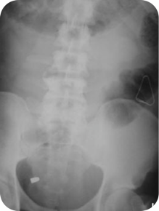
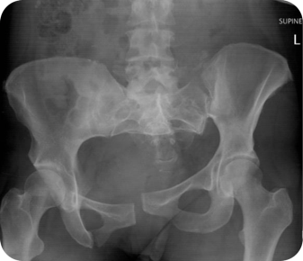
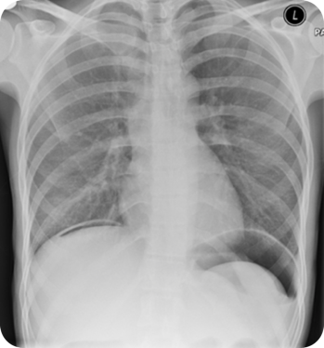
X-Rays

Slide 11
CT Scan
NEVER send an unstable patient to CT
  Accurate for solid visceral lesions and intraperitoneal hemorrhage
  Guide nonoperative management of solid organ damage
  IV not oral contrast
  Disadvantages : insensitive for injury of the pancreas, diaphragm, hollow viscus and mesentery

Slide 12
ULTRASOUND
The FAST Exam
    Perihepatic & hepato-renal space (Morrison’s pouch)
    Perisplenic
    Pelvis (Pouch of Douglas/rectovesical pouch)
    Pericardium (subxiphoid)
  sensitivity 60 to 95% for detecting 100 mL - 500 mL of fluid
Extended FAST (E-FAST):
  Add thoracic windows to look for pneumothorax.
  Sensitivity 59%, specificity up to 99% for PTX (c/w CXR 20%)

Slide 13
Advantages:
  Portable and rapid
  No radiation or contrast
  Less expensive
Disadvantages
  Not as good for solid parenchymal damage, retroperitoneum, or diaphragmatic defects.
  Limited by obesity, substantial bowel gas & subcutanous air
  Can’t distinguish blood from ascites.

Slide 14
Management?
Refer to approach to trauma lecture
BUT
WHEN TO TAKE THE PATIENT TO OR?

Slide 15
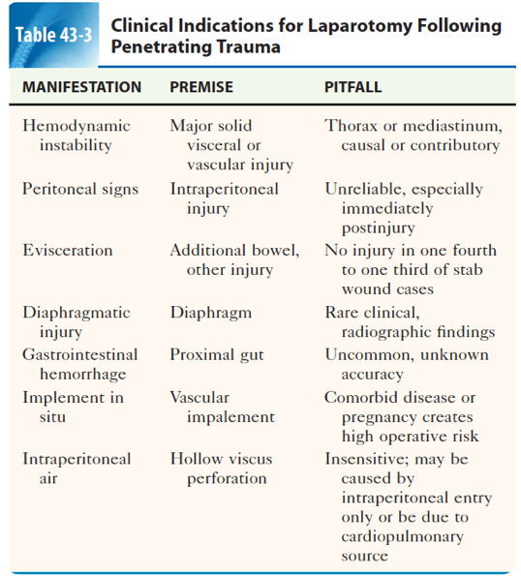

Slide 16
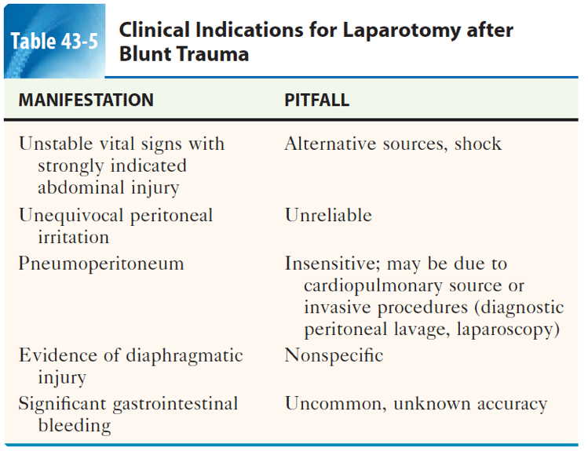

Slide 17
APPROACH

Slide 18
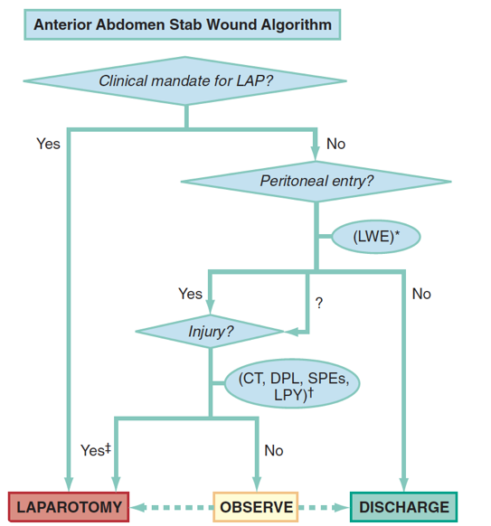

Slide 19
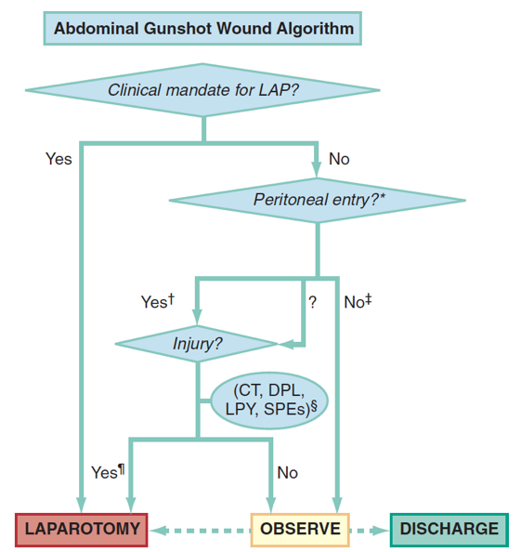

Slide 20
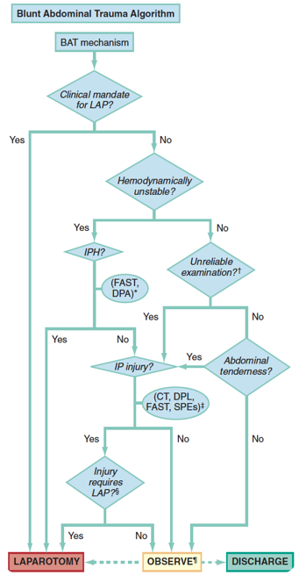

Slide 21
TAKE HOME MESSAGES
DO NOT forget your ABC’s
Watch out for clinical signs
Physical exam is unreliable
Don’t take unstable patients to CT
FAST is EXTREMELY important
Remember the indications for laparotomy

Slide 22

dr_aref@hotmail.com

